Slide 1
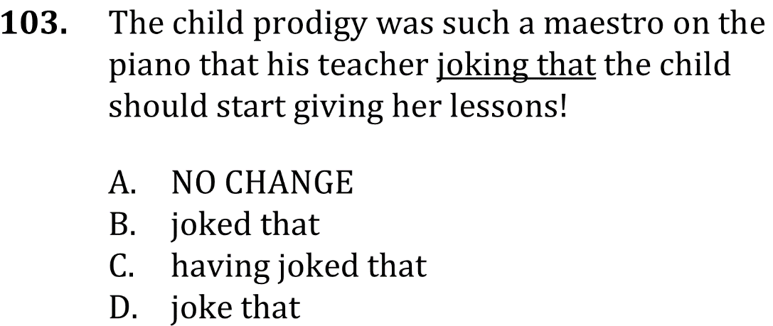
eliminate Fragments and correct Sentence Flow

Slide 2
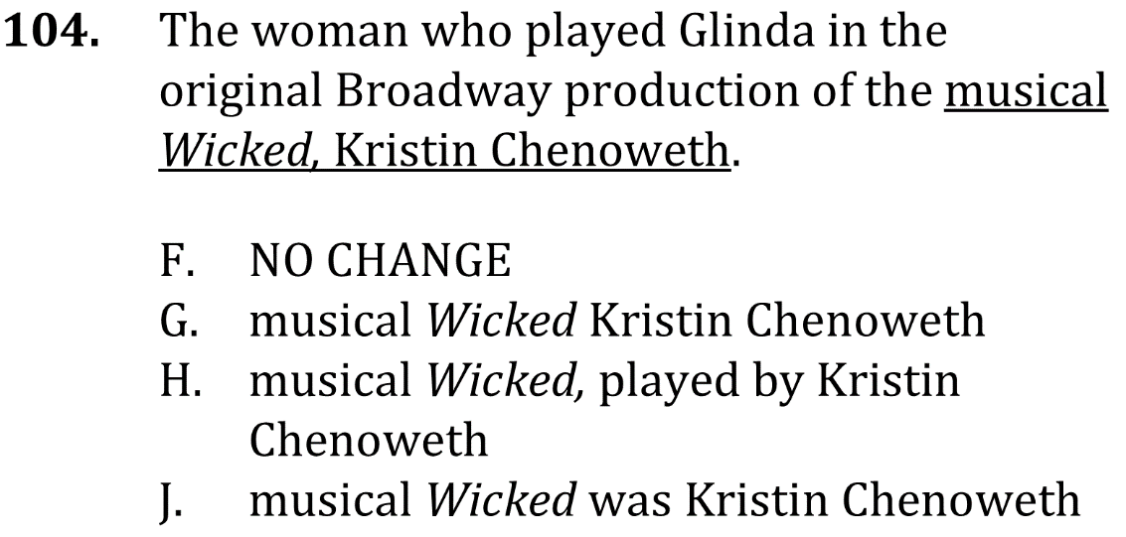
eliminate Fragments and correct Sentence Flow

Slide 3
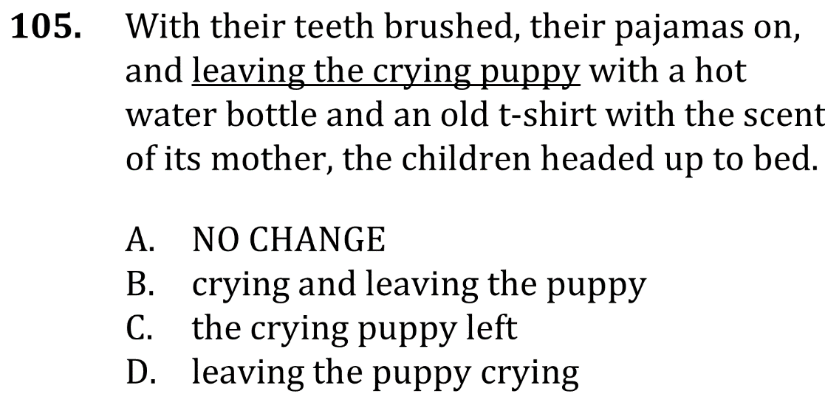
eliminate Fragments and correct Sentence Flow

Slide 4
eliminate Fragments and correct Sentence Flow

Slide 5
eliminate Fragments and correct Sentence Flow

Slide 6
eliminate Fragments and correct Sentence Flow

