Slide 1
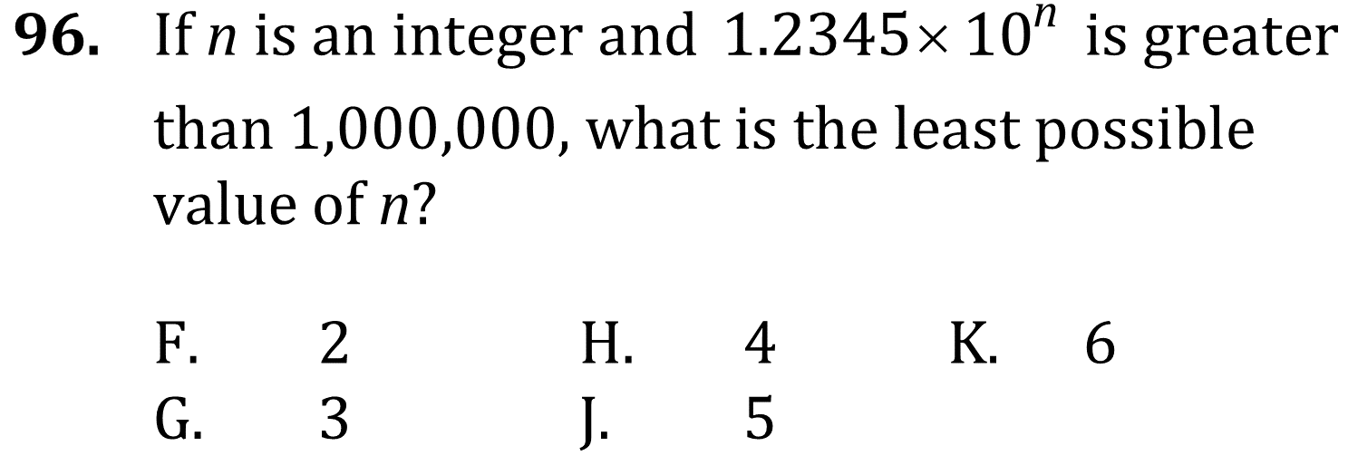
Scientific Notation

Slide 2
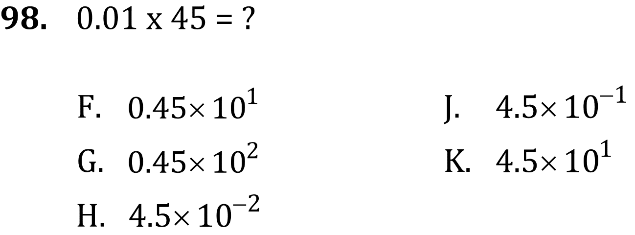
Scientific Notation

Slide 3
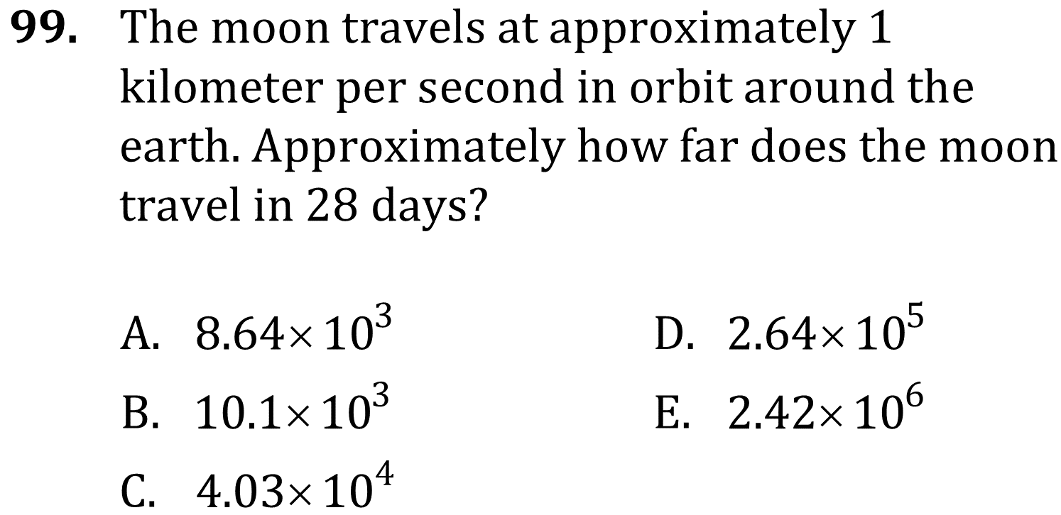
Scientific Notation

Slide 4
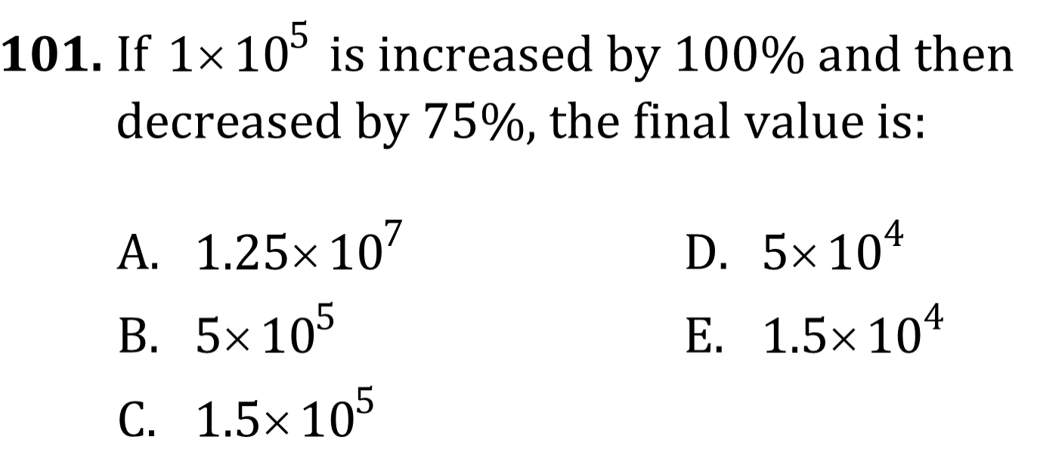
Scientific Notation

Slide 5
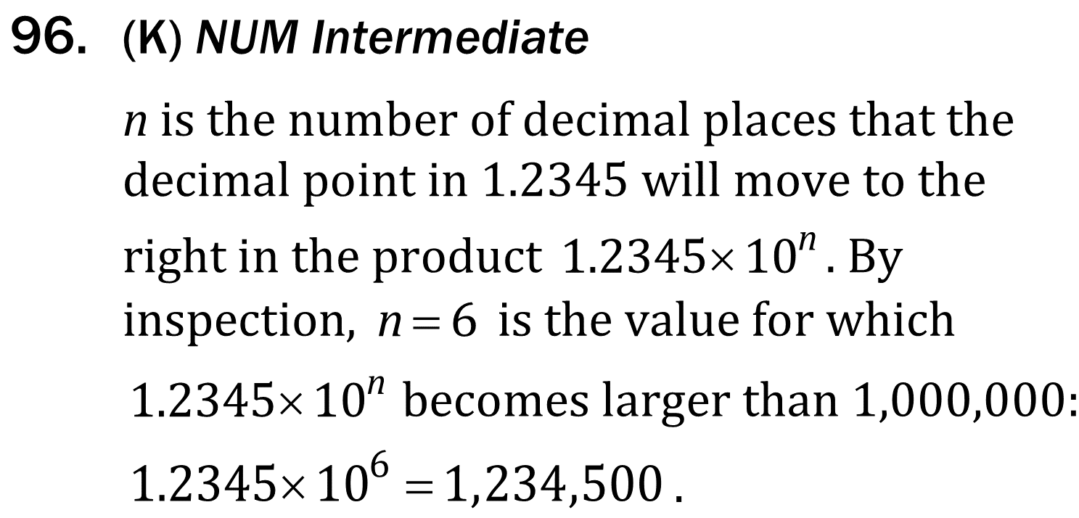
Scientific Notation

Slide 6
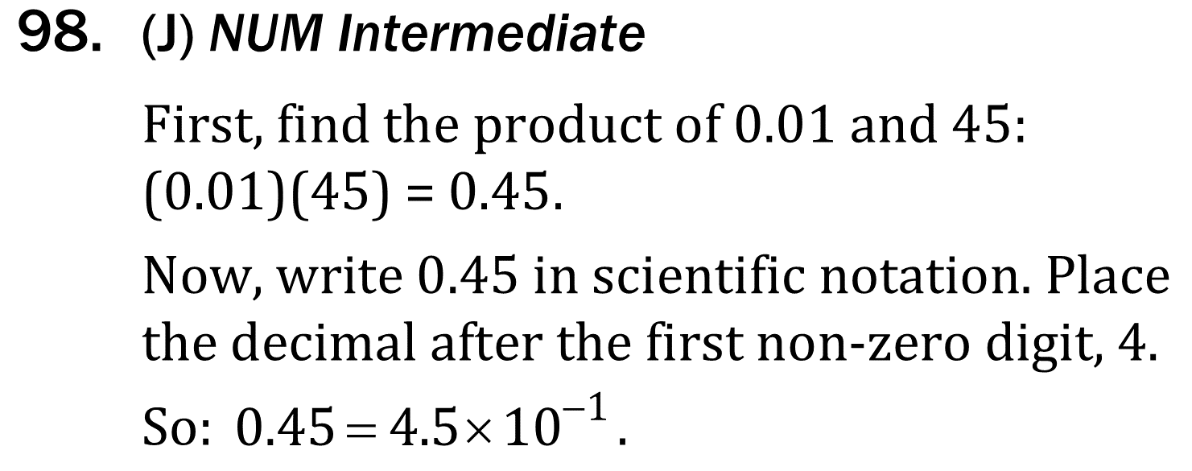
Scientific Notation

Slide 7
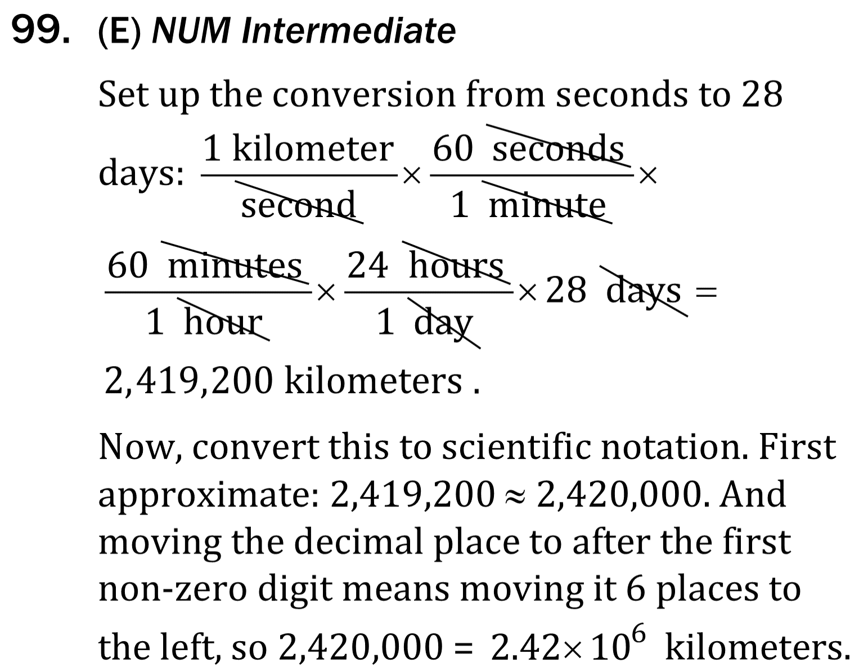
Scientific Notation

Slide 8
Scientific Notation

