Slide 1
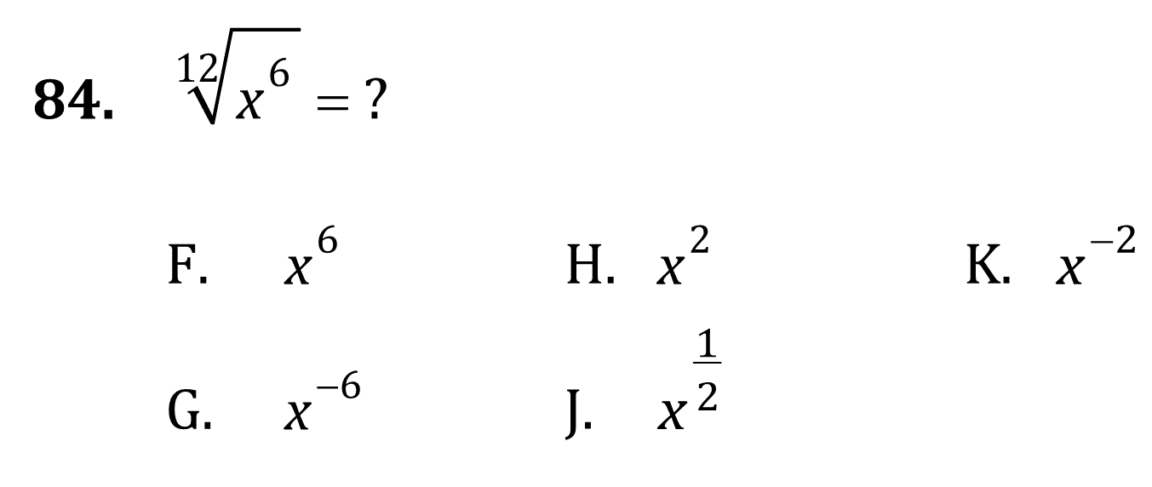

Exponents

Slide 2
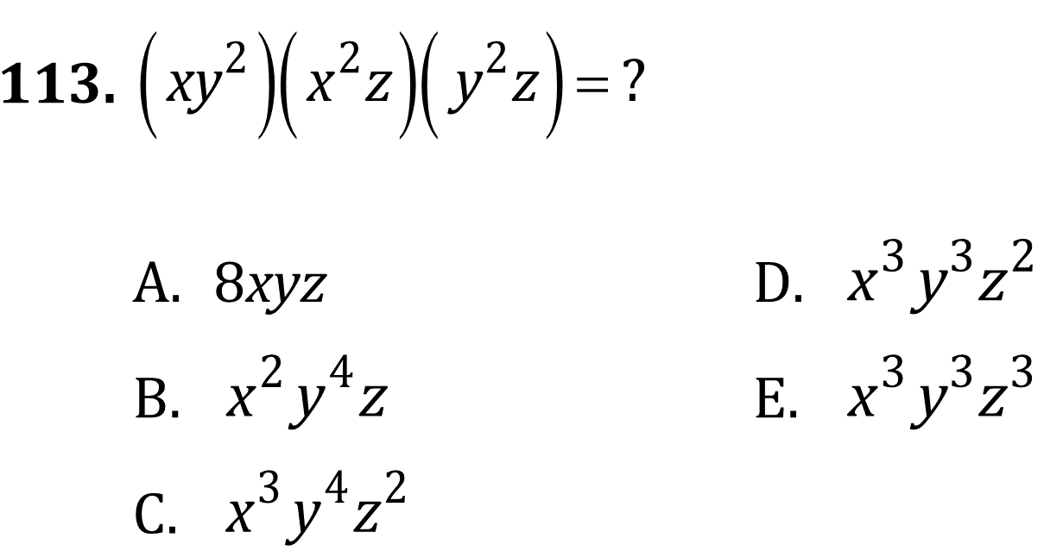
Exponents

Slide 3
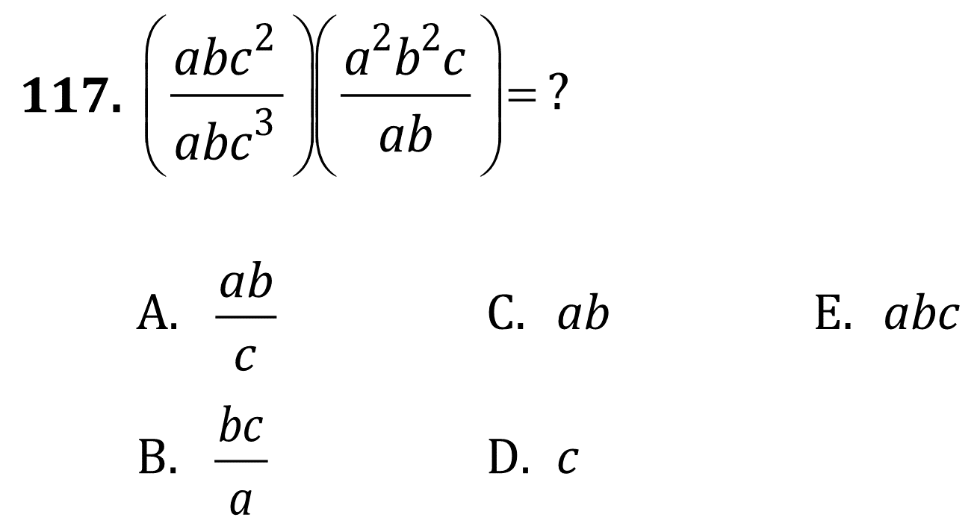
Exponents

Slide 4
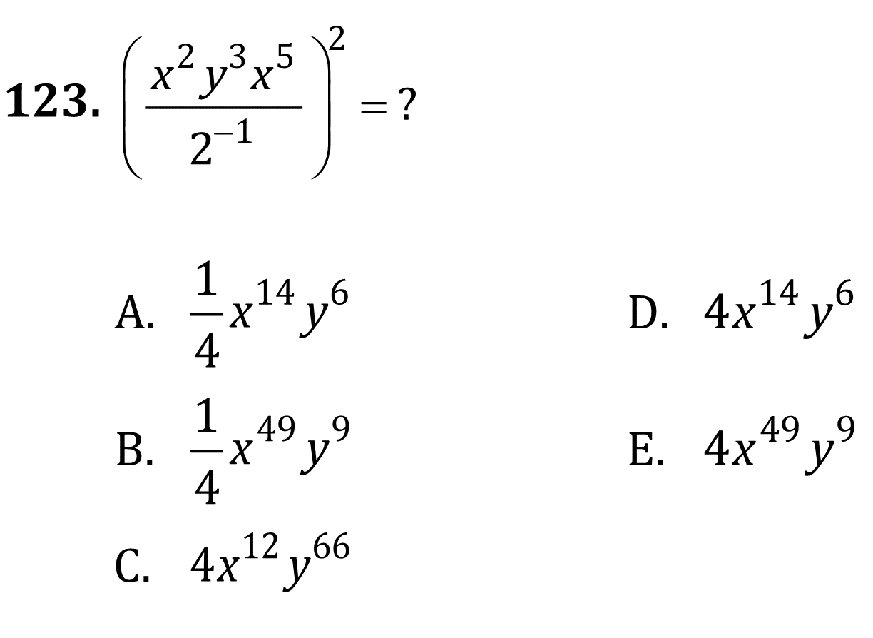
Exponents

Slide 5

Exponents

Slide 6

Exponents

Slide 7

Exponents

Slide 8
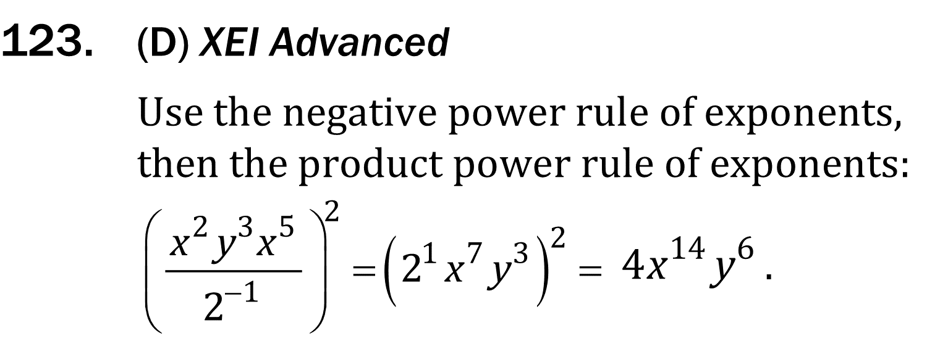
Exponents

