Slide 1
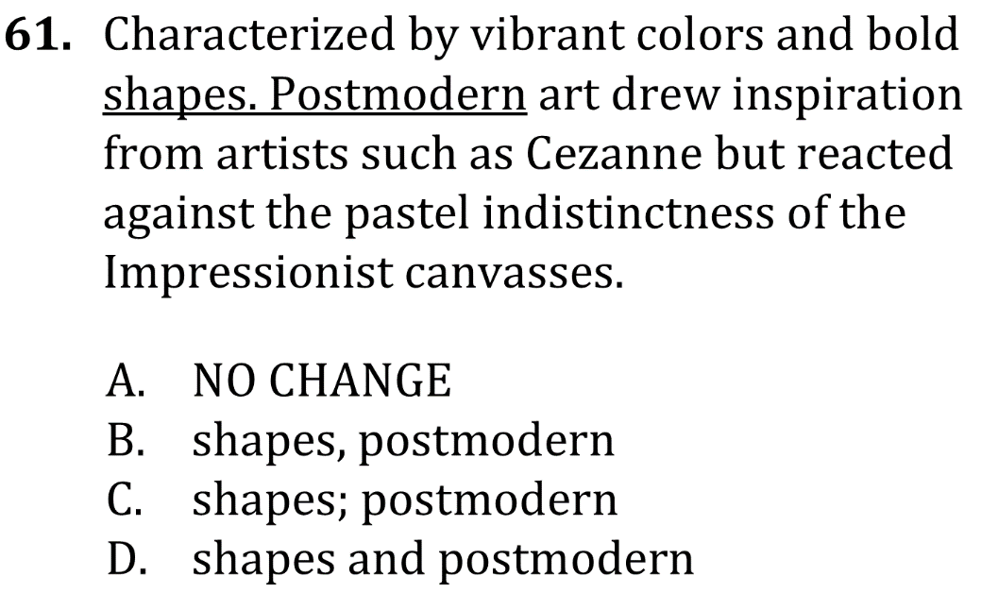

Eliminate Fragments

Slide 2
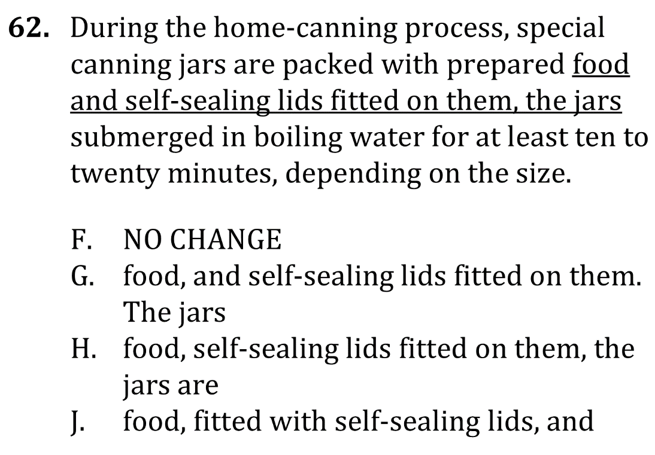
Eliminate Fragments

Slide 3

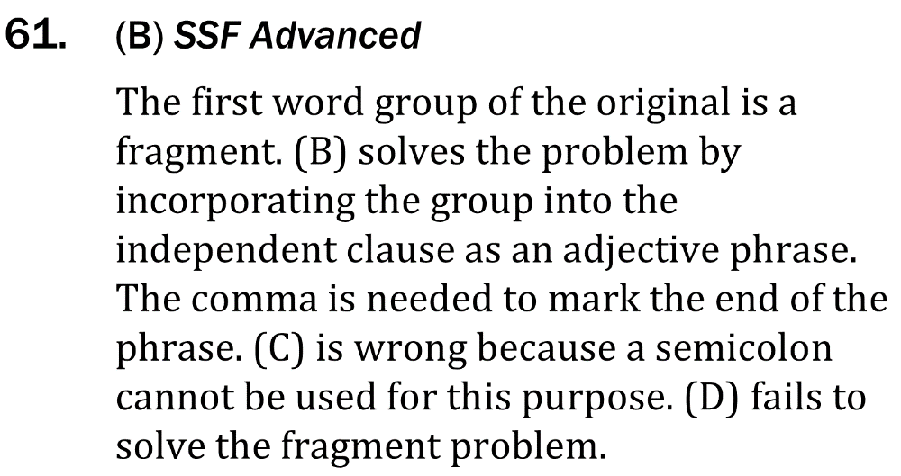
Eliminate Fragments

Slide 4

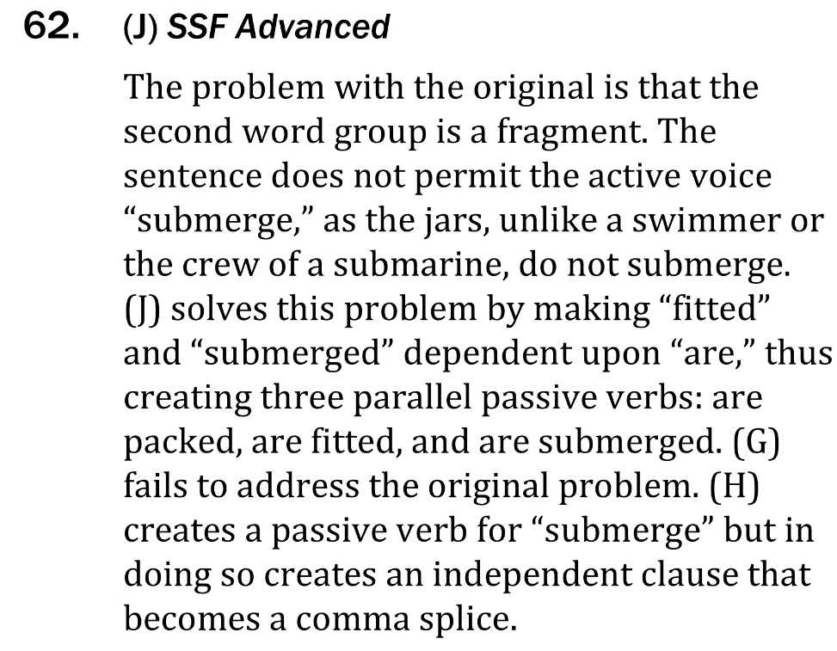
Eliminate Fragments

