Slide 1
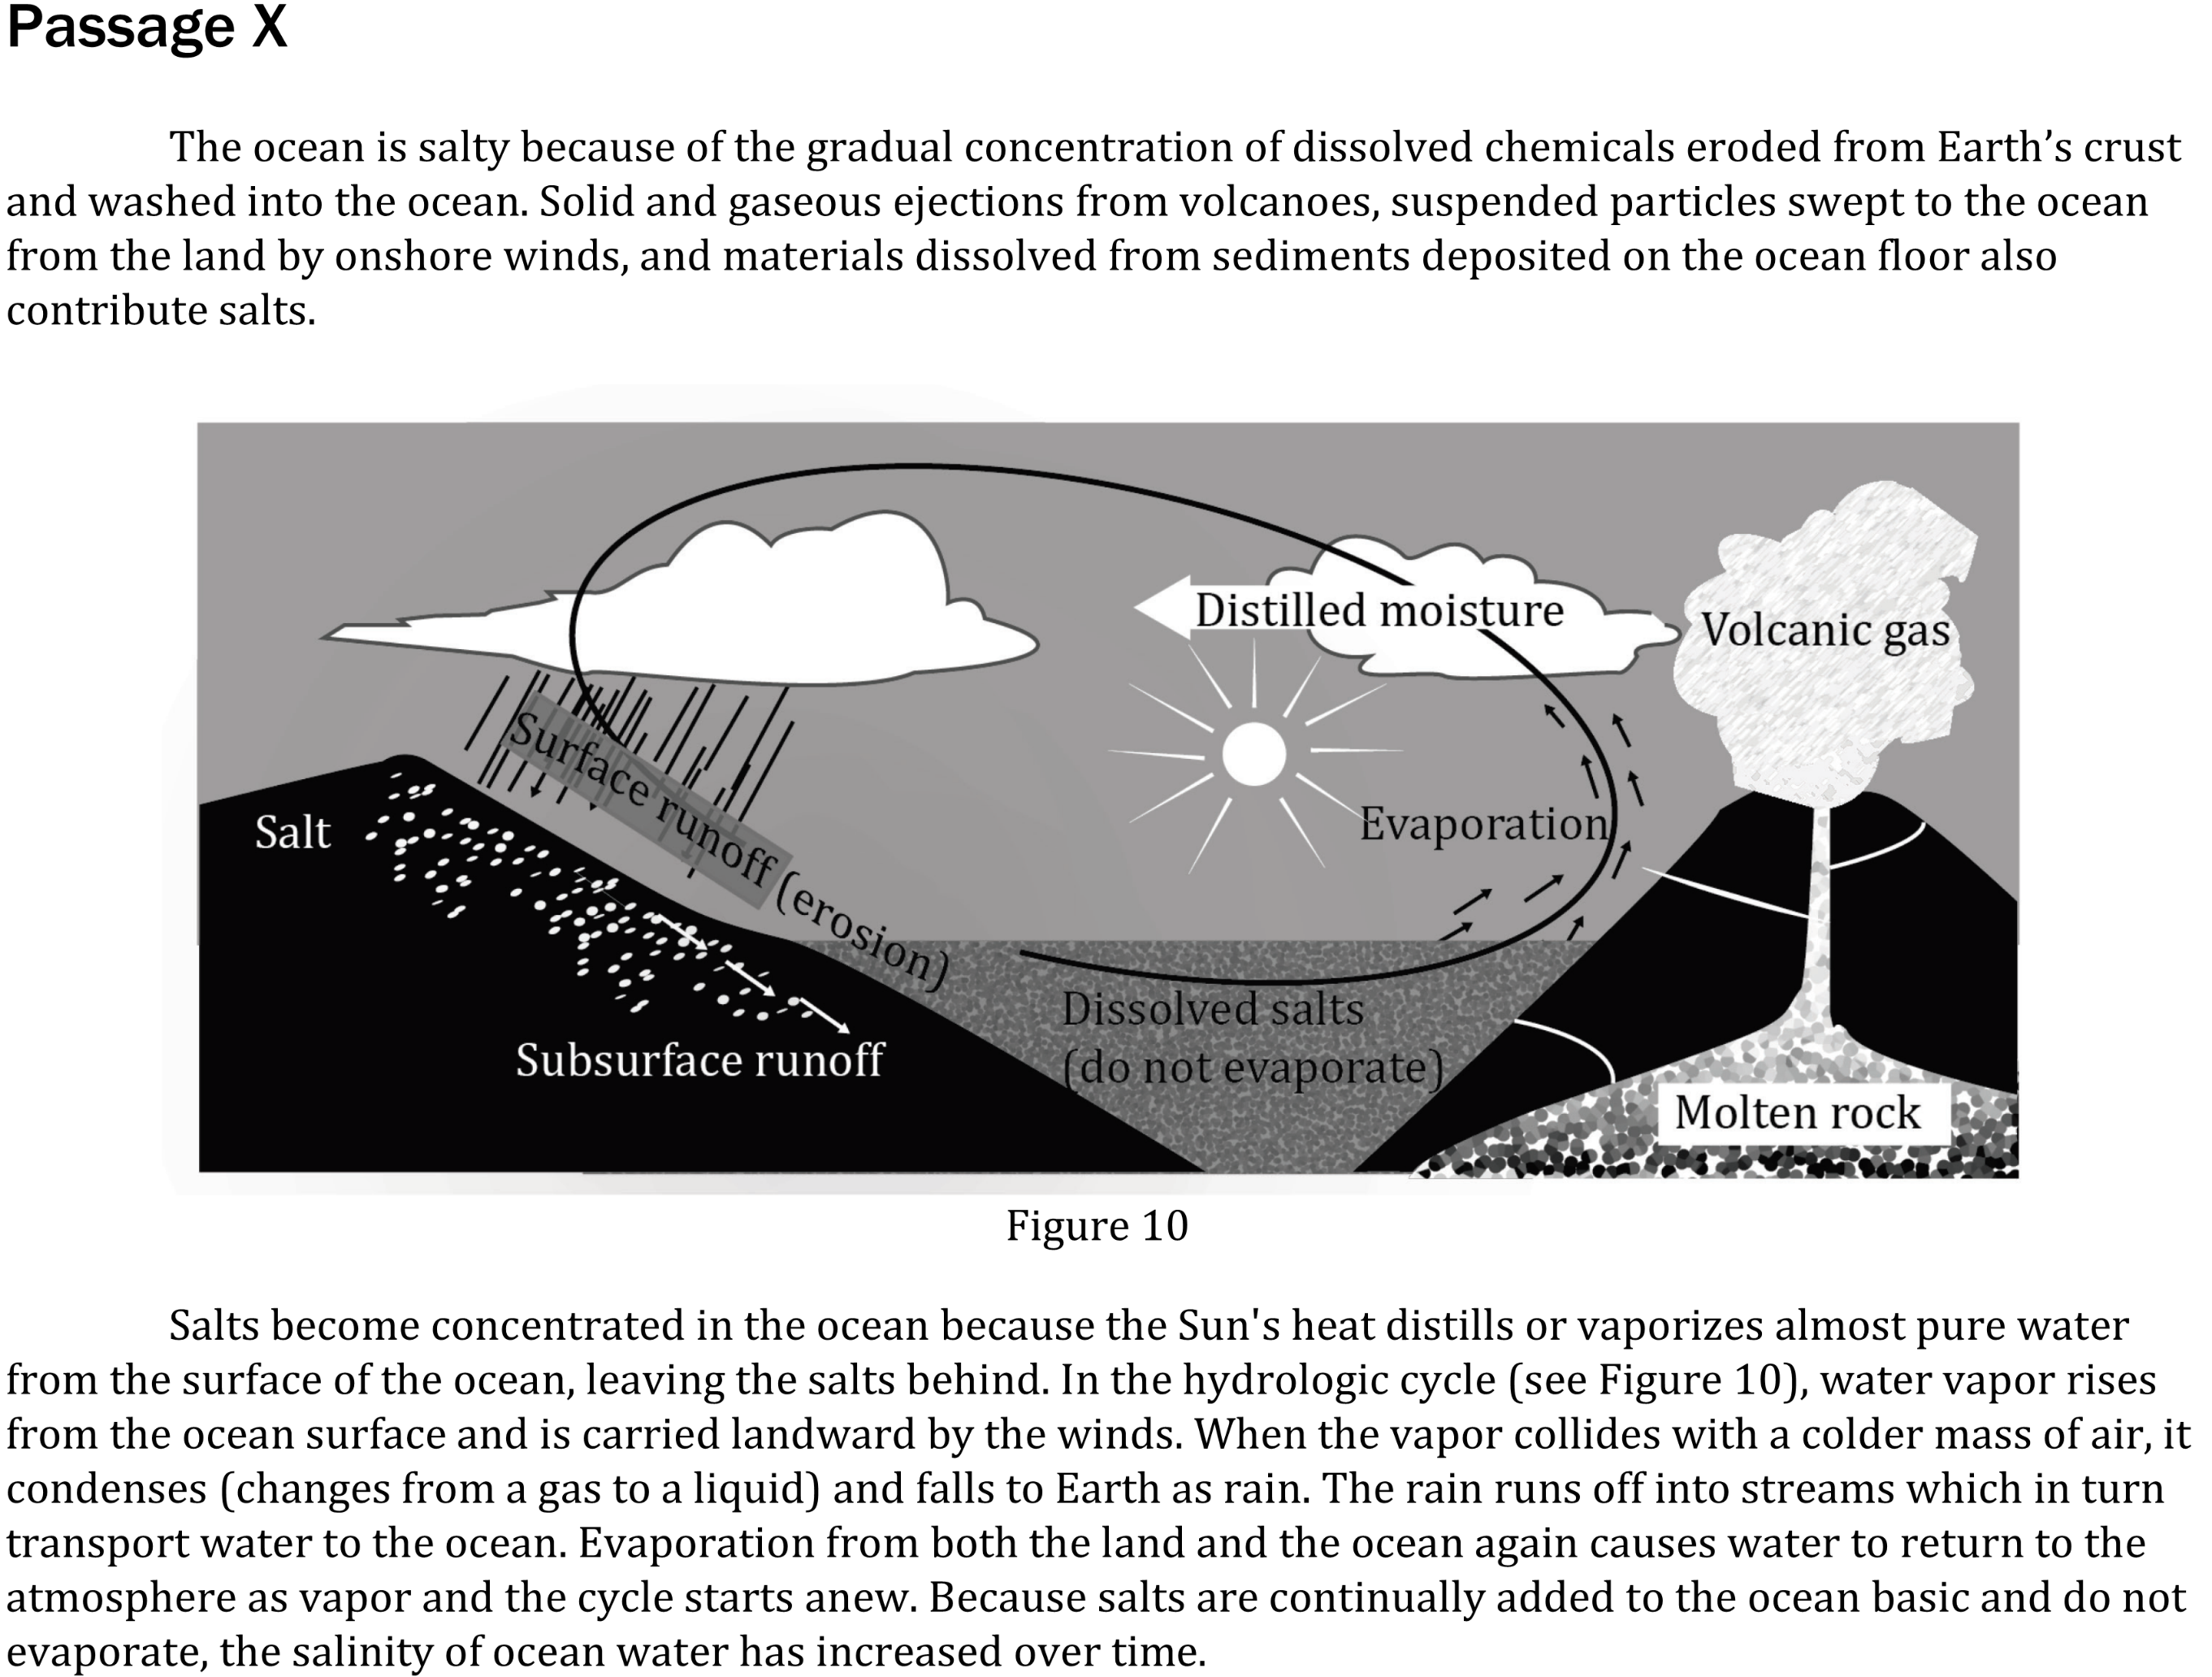

Notes:
Read and interpret data in more complex data presentations; Determine what would cause a specific result in an experiment. Level: Intermediate Skill Group: Scientific Investigation

Slide 2
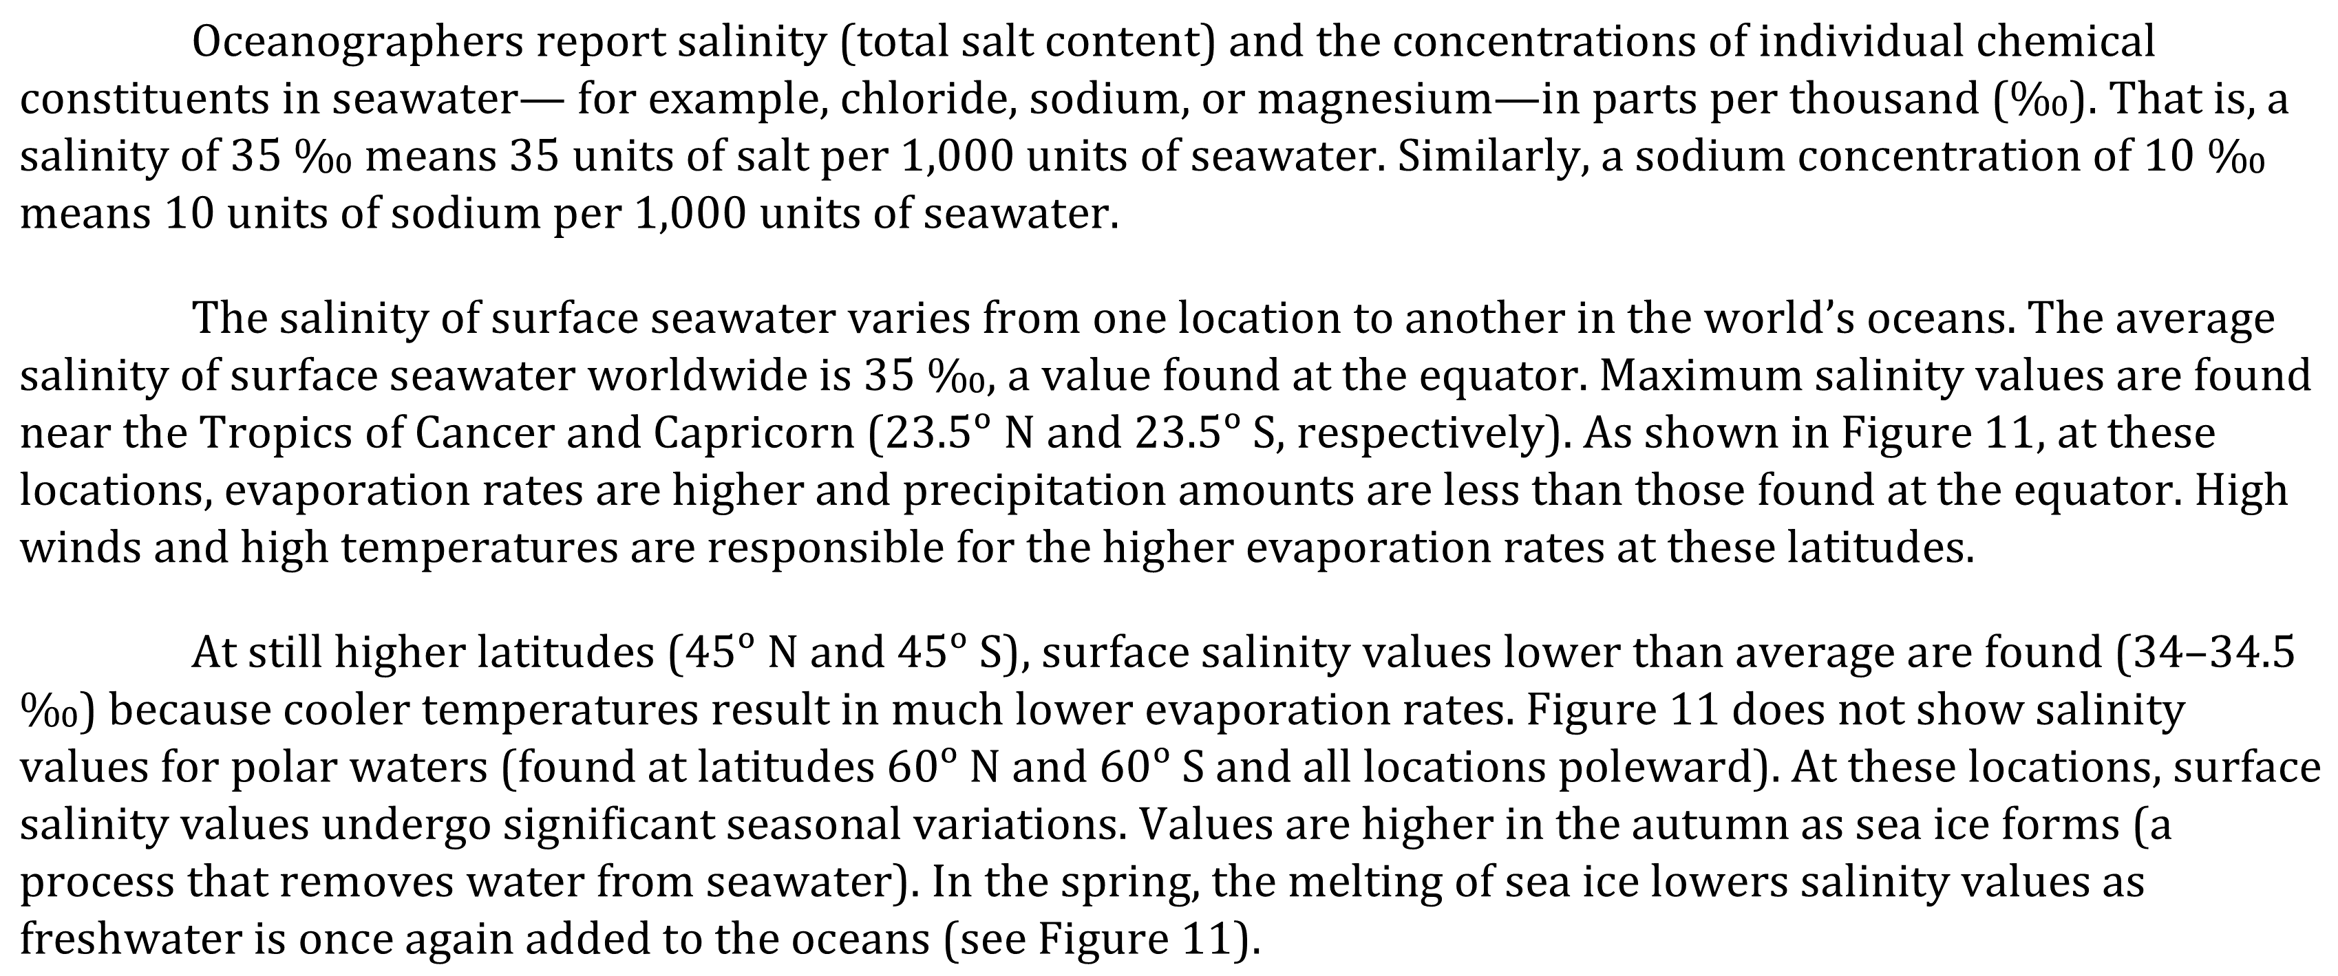
Notes:
Read and interpret data in more complex data presentations; Determine what would cause a specific result in an experiment. Level: Intermediate Skill Group: Scientific Investigation

Slide 3
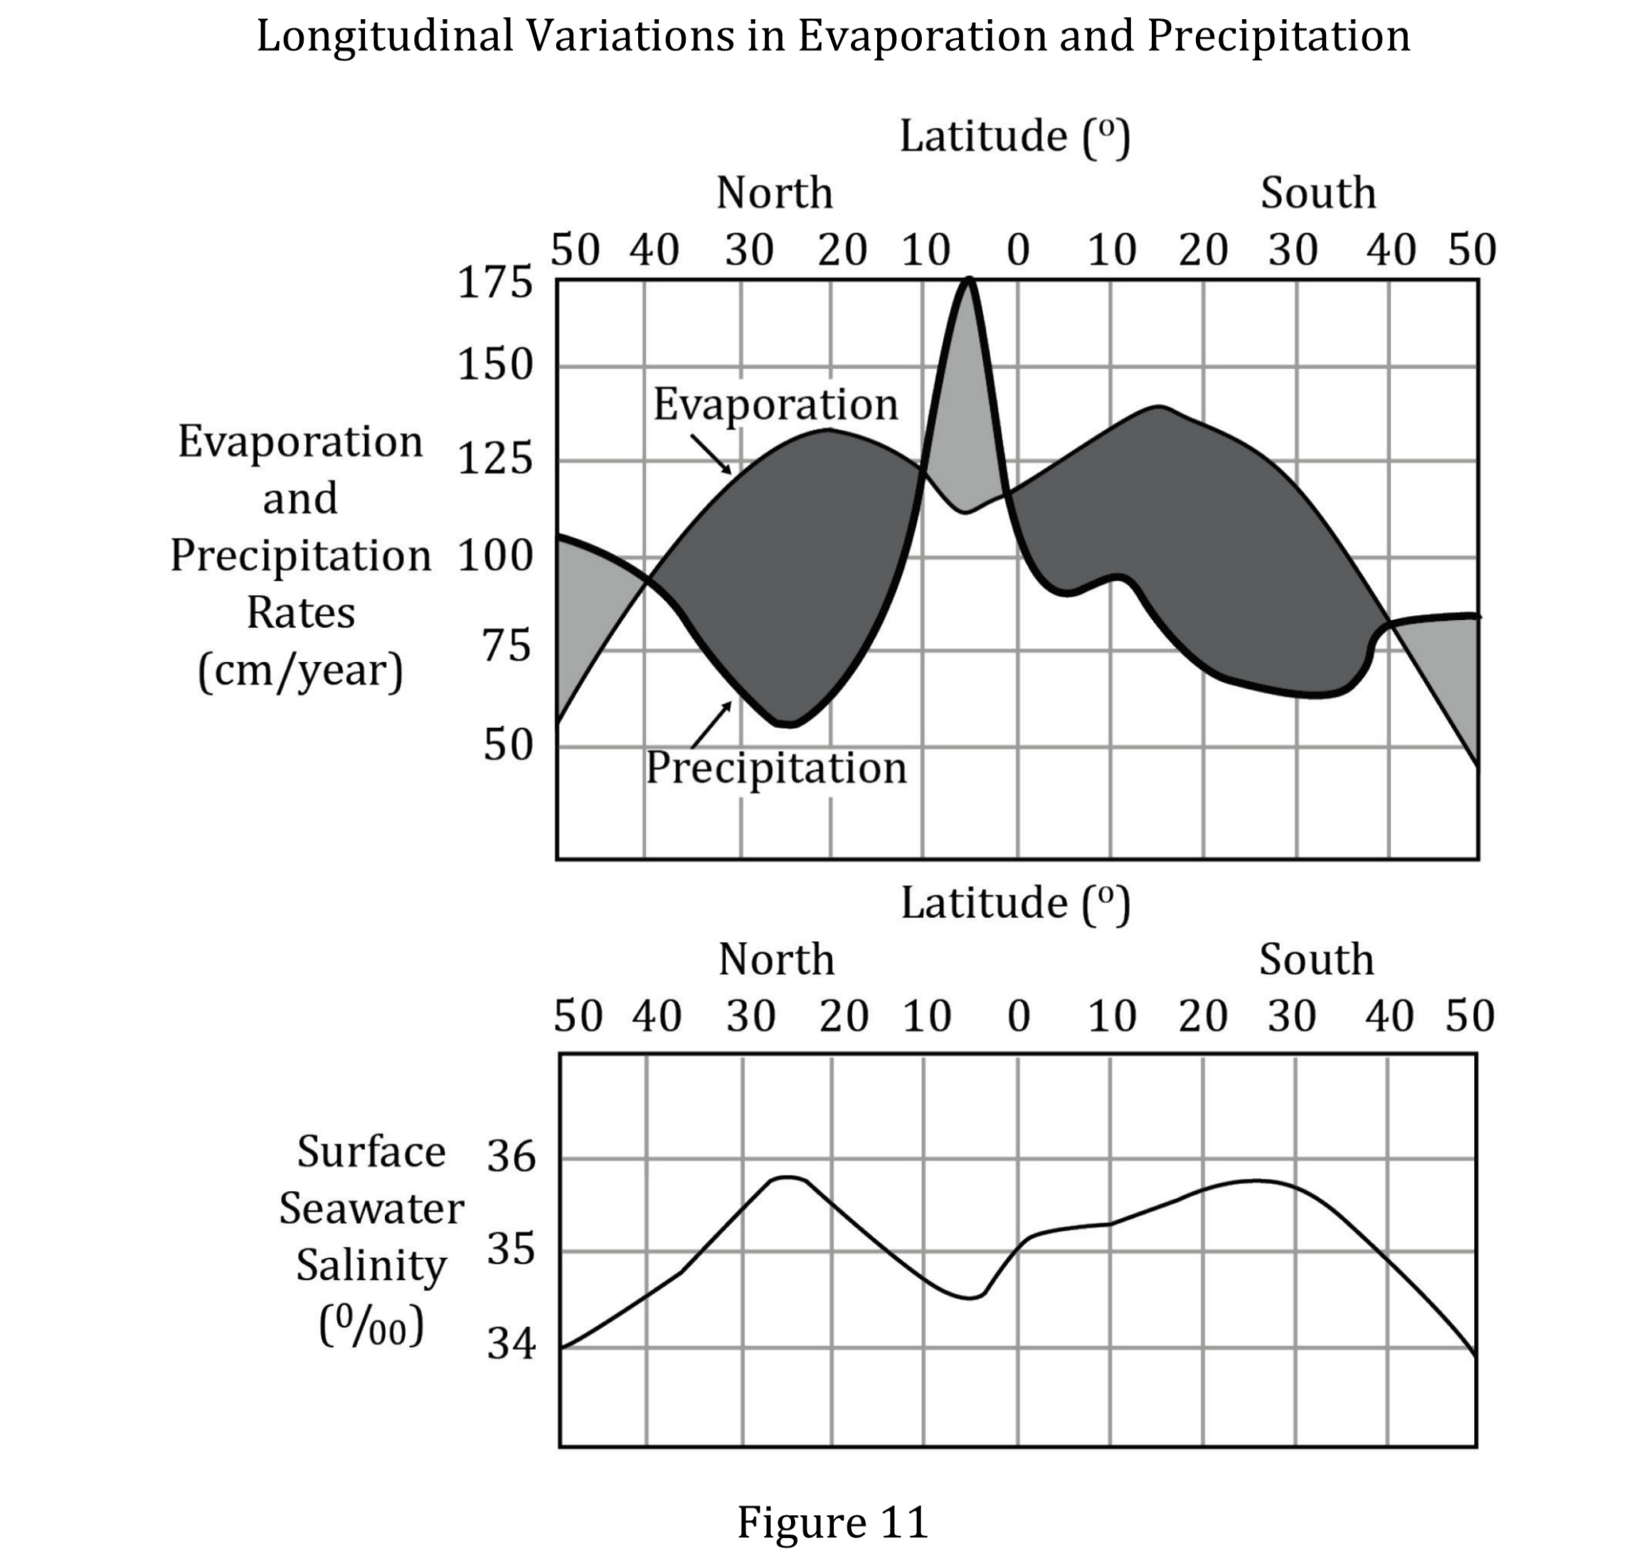
Notes:
Read and interpret data in more complex data presentations; Determine what would cause a specific result in an experiment. Level: Intermediate Skill Group: Scientific Investigation

Slide 4
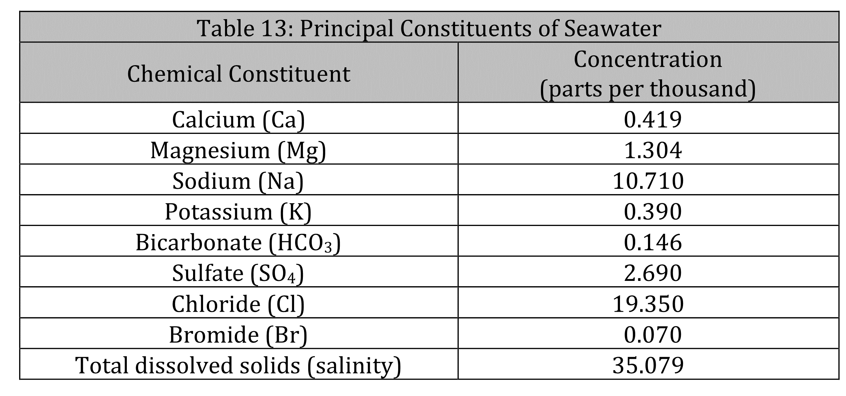
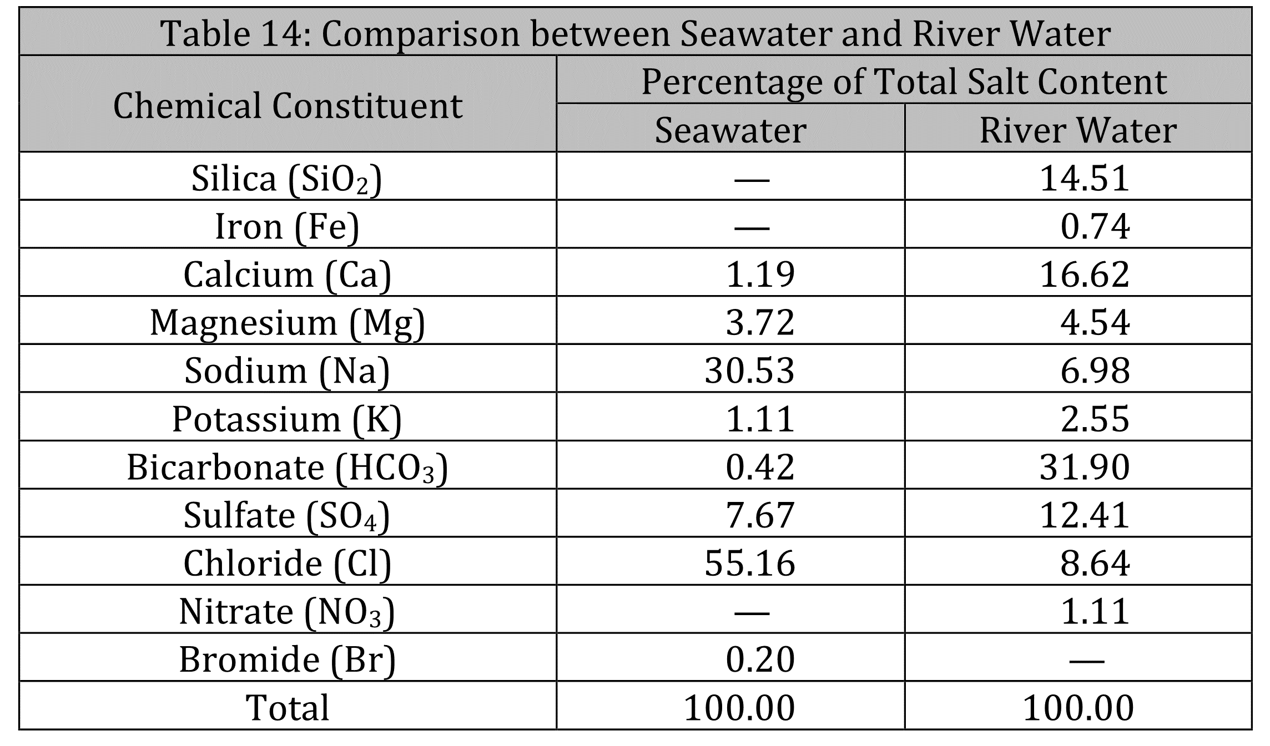
Notes:
Read and interpret data in more complex data presentations; Determine what would cause a specific result in an experiment. Level: Intermediate Skill Group: Scientific Investigation

Slide 5
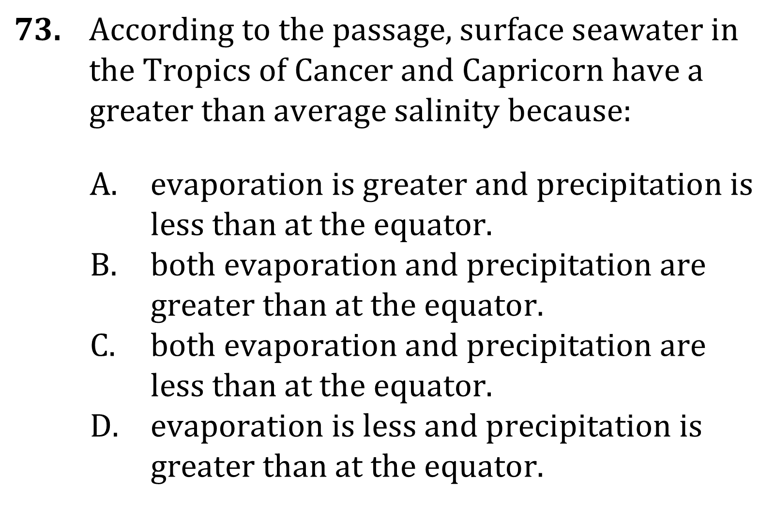
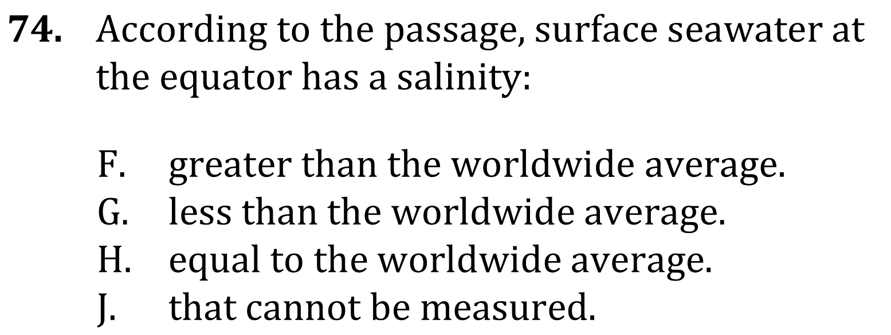
Notes:
Read and interpret data in more complex data presentations; Determine what would cause a specific result in an experiment. Level: Intermediate Skill Group: Scientific Investigation

Slide 6
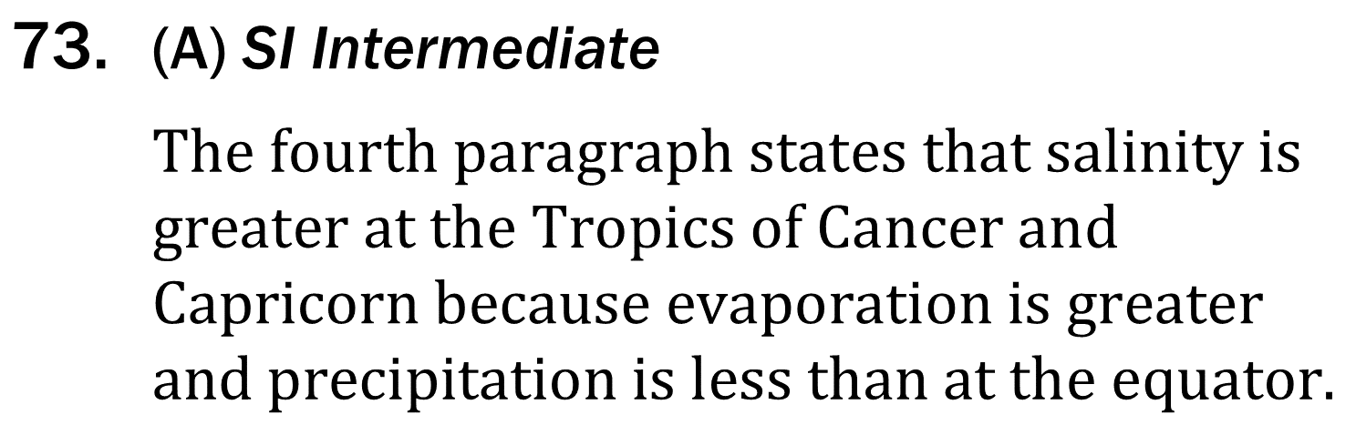
Notes:
Read and interpret data in more complex data presentations; Determine what would cause a specific result in an experiment. Level: Intermediate Skill Group: Scientific Investigation

Slide 7
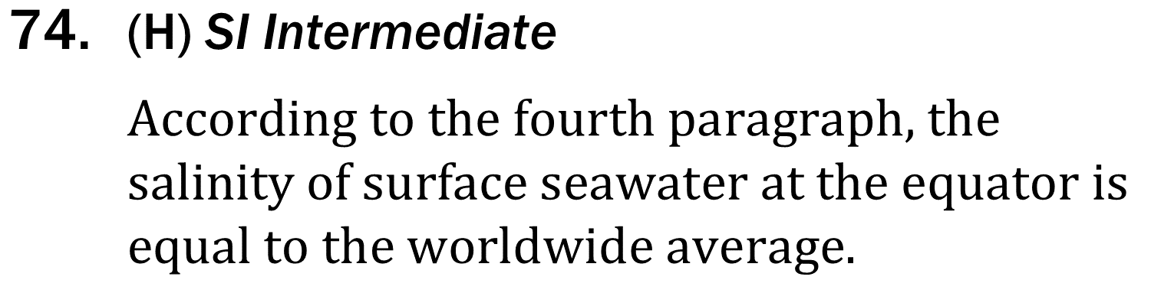
Notes:
Read and interpret data in more complex data presentations; Determine what would cause a specific result in an experiment. Level: Intermediate Skill Group: Scientific Investigation

