Slide 1
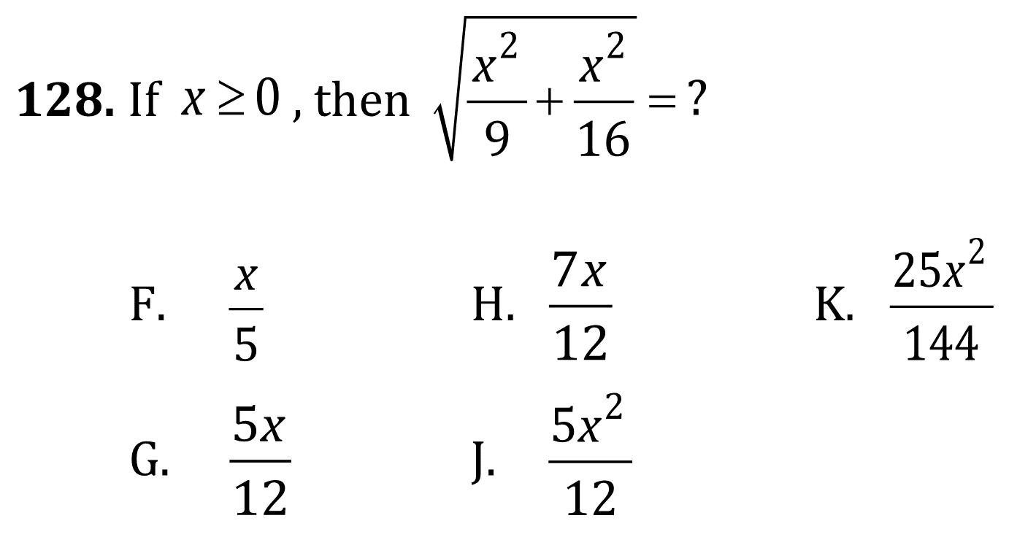
Radical Equations

Slide 2
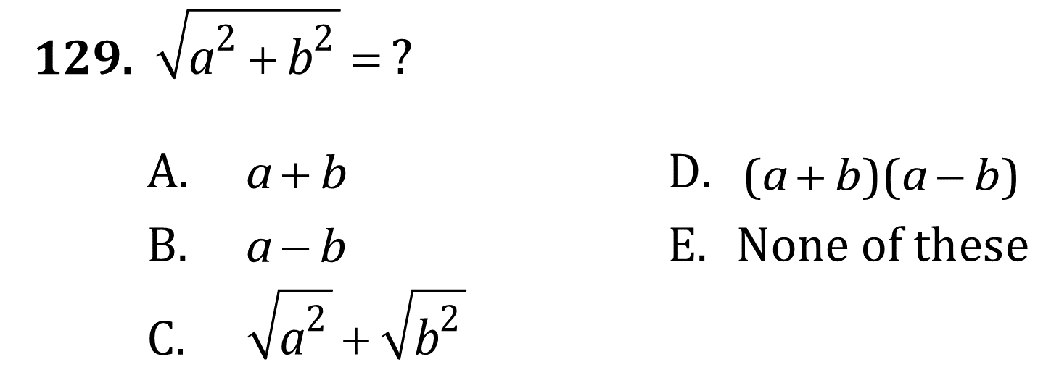
Radical Equations

Slide 3
Radical Equations

Slide 4
Radical Equations

Slide 5
Radical Equations

Slide 6
Radical Equations

