Slide 1
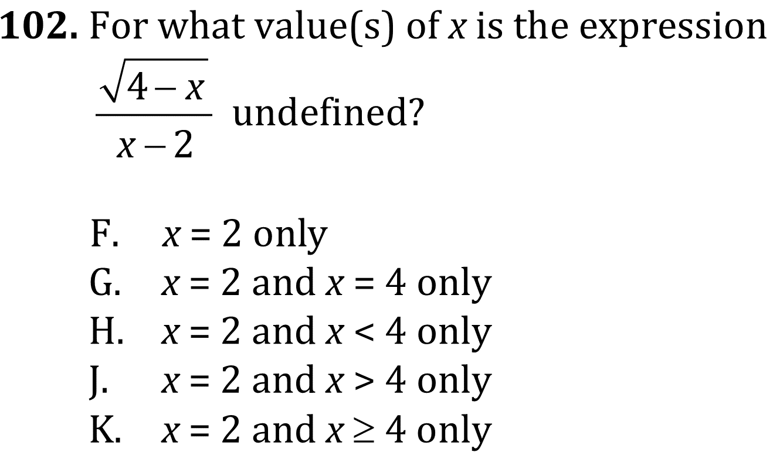

Domain and Rational Equations

Slide 2
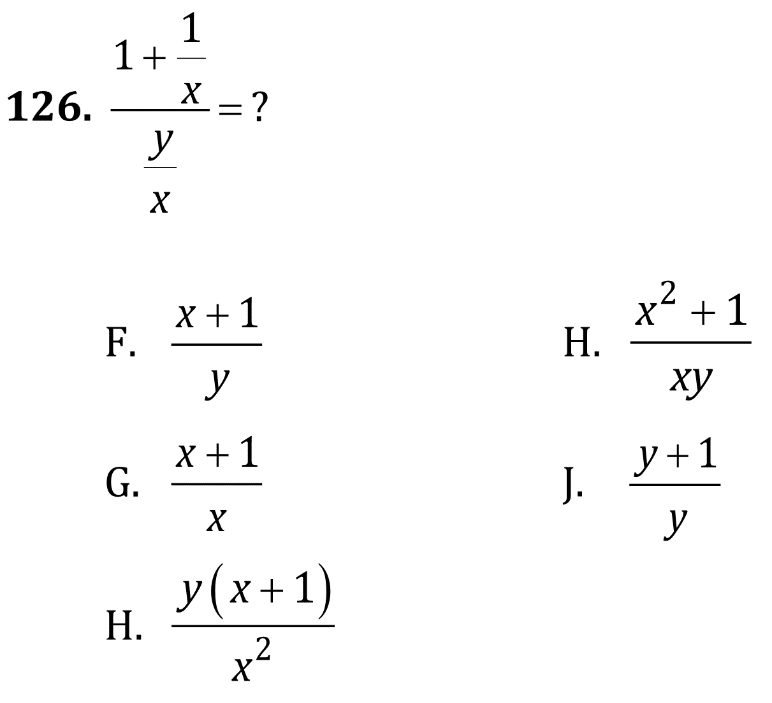
Domain and Rational Equations
Determine when expressions are undefined. (intermediate) Create expressions, equations, and inequalities for common algebra situations. (Advanced)
Level: Intermediate; Advanced Skill Group: Algebra

Slide 3
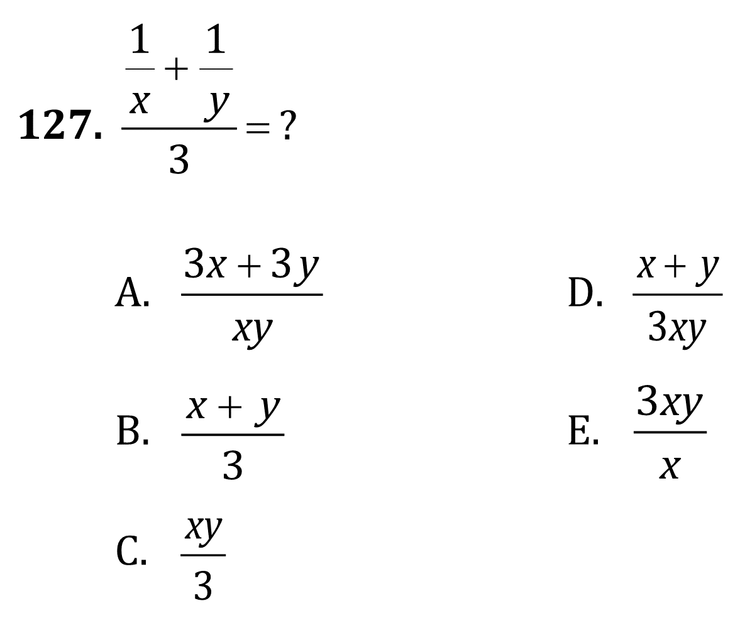
Domain and Rational Equations

Slide 4
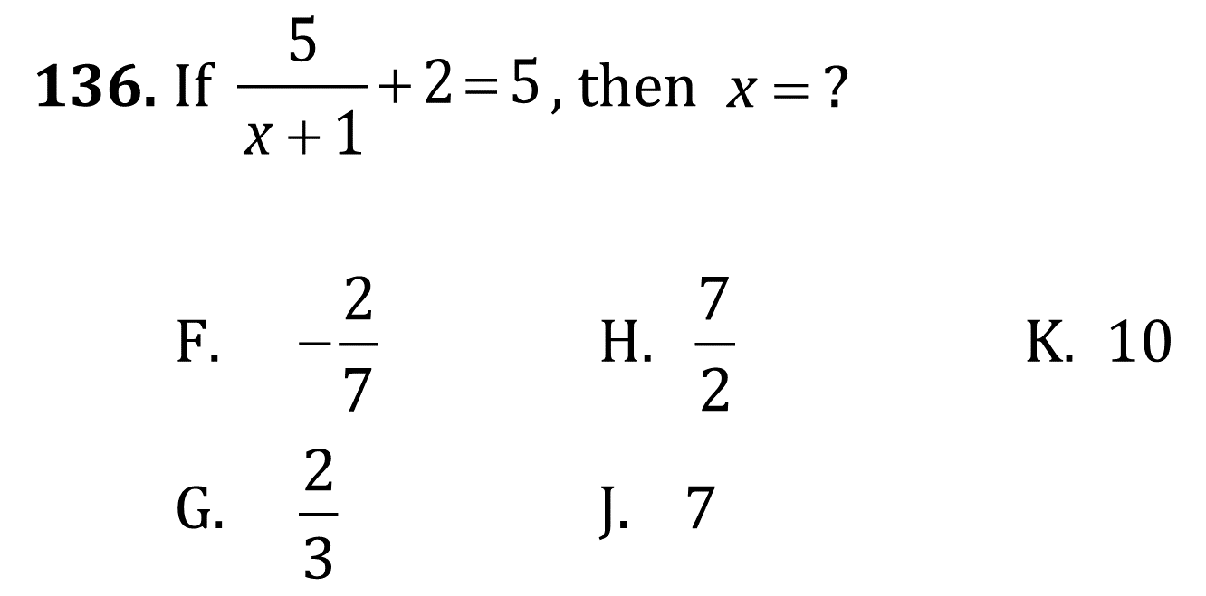
Domain and Rational Equations

Slide 5
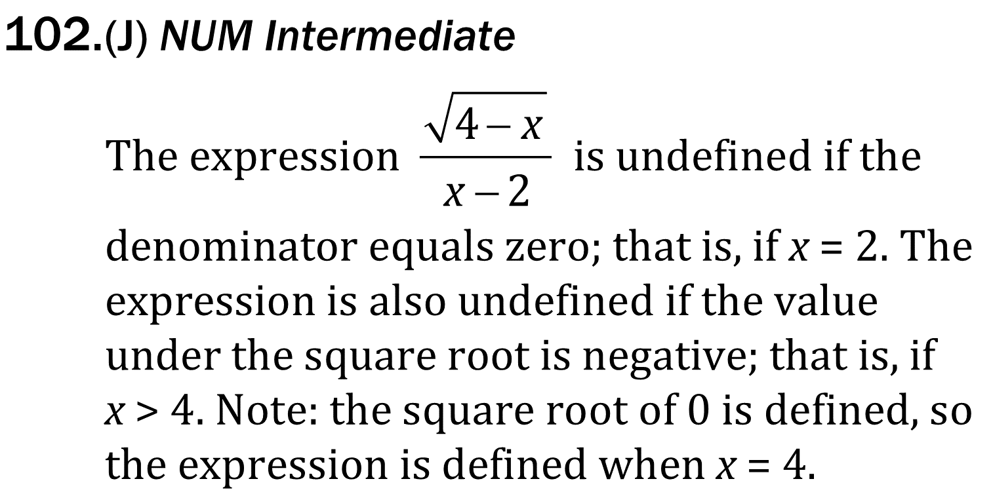
Domain and Rational Equations

Slide 6
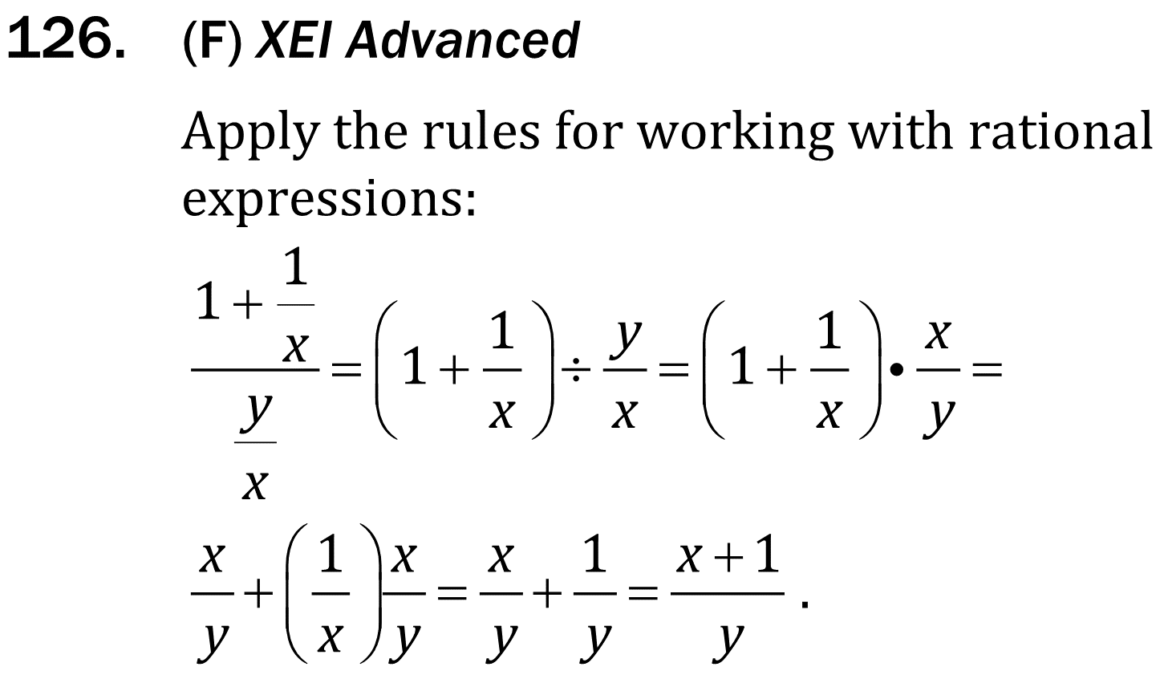
Domain and Rational Equations

Slide 7
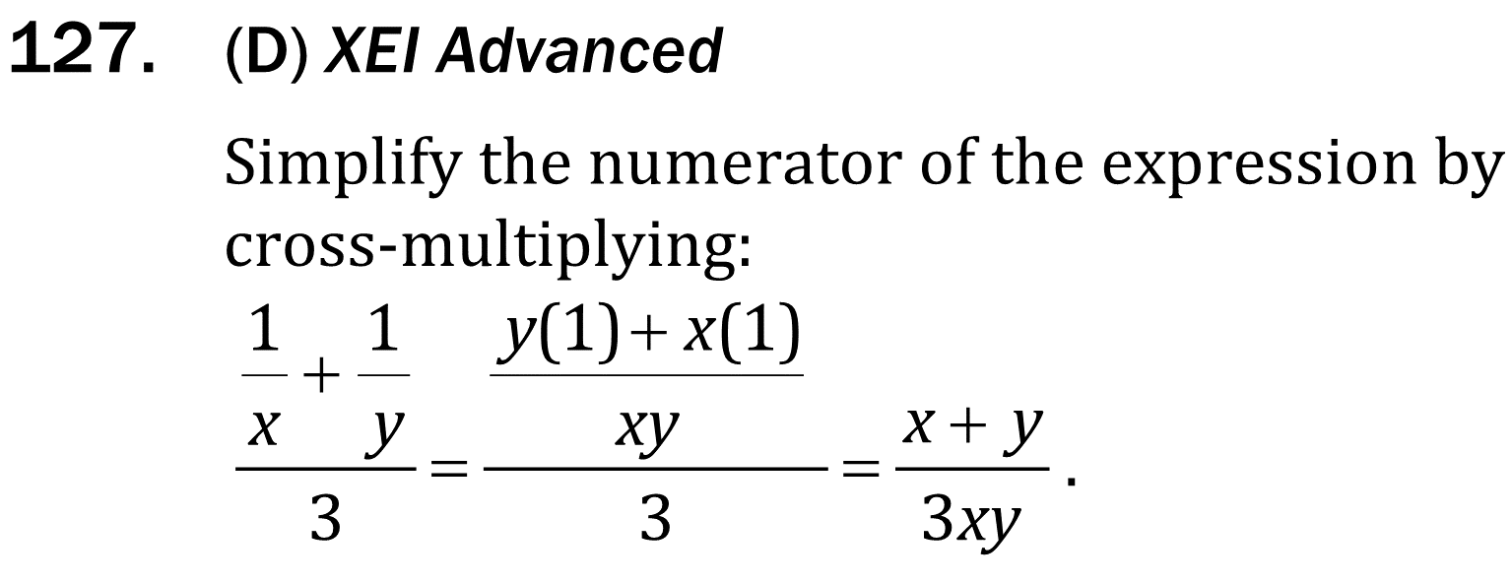
Domain and Rational Equations

Slide 8
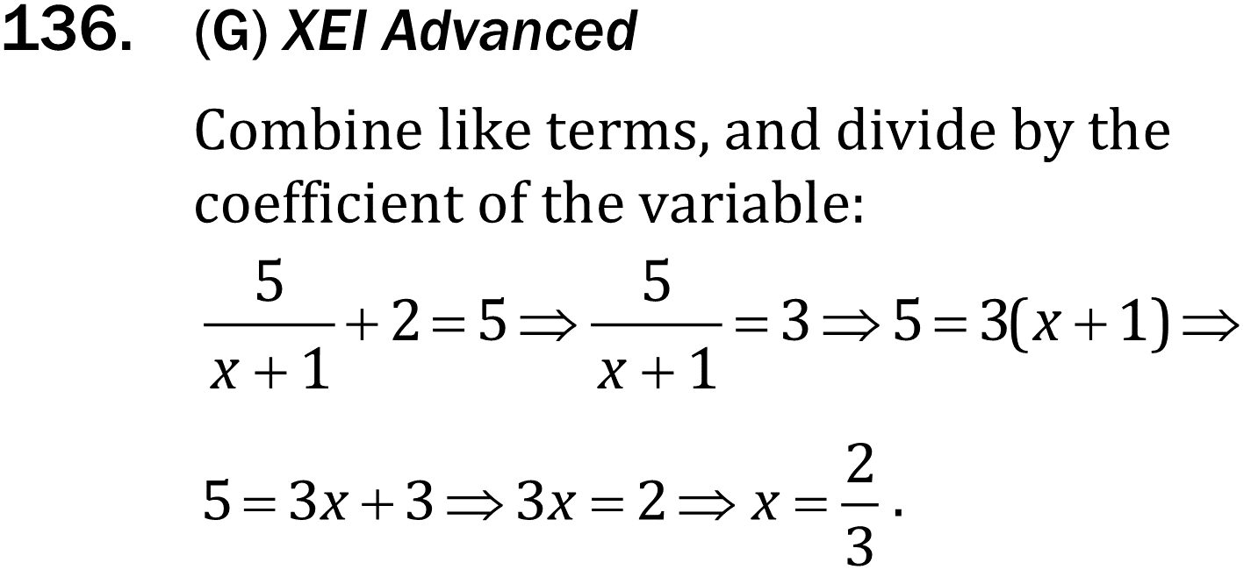
Domain and Rational Equations

