Slide 1
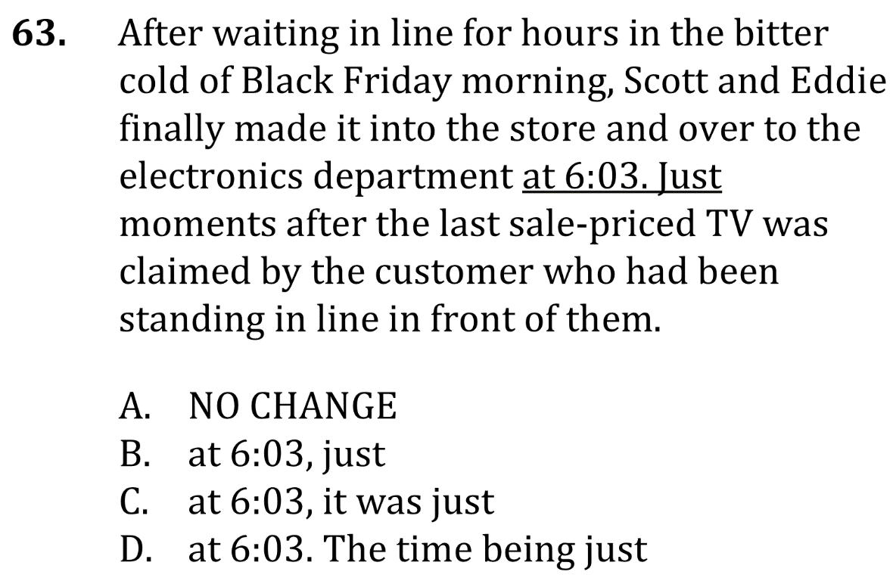
Eliminate fragments

Slide 2
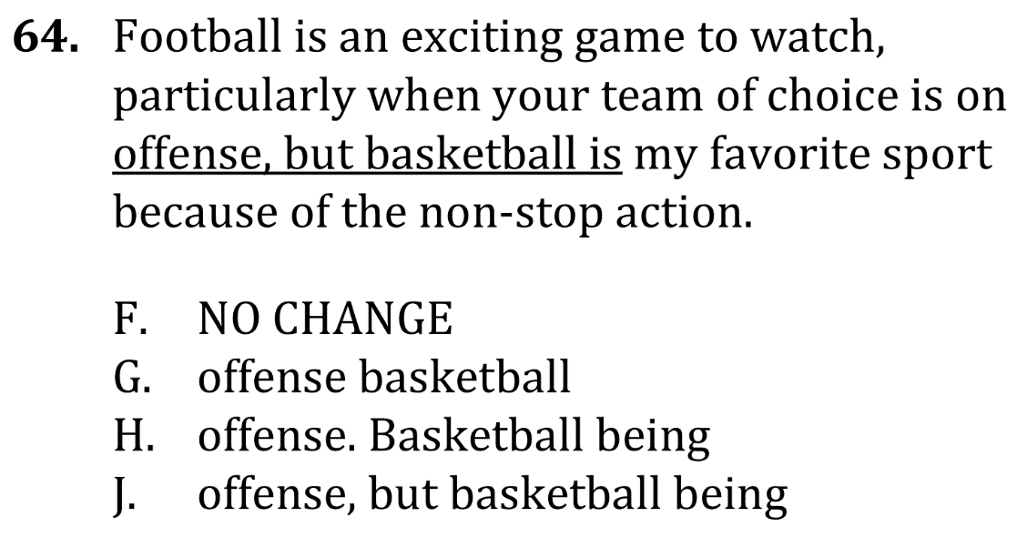
Eliminate fragments

Slide 3
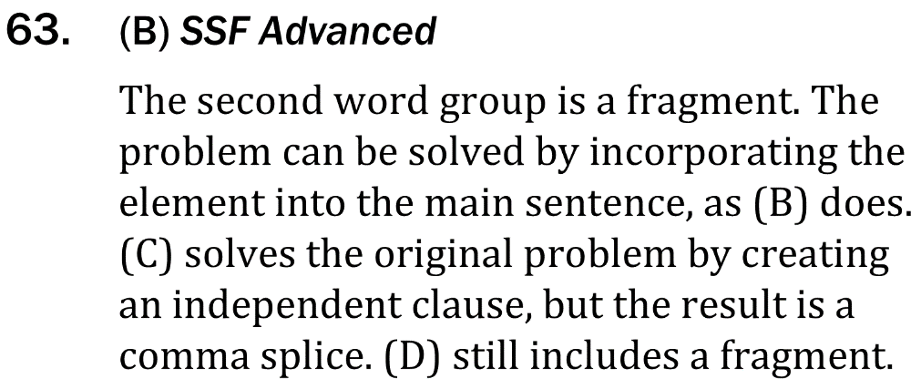
Eliminate fragments

Slide 4
Eliminate fragments

