Slide 1
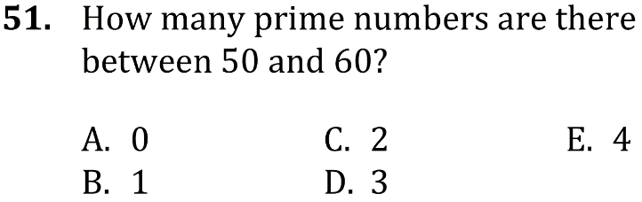

Prime numbers, Greatest Common Factor, & Least Common Multiple
Show familiarity with primes, greatest common factor, least common factor, least common multiple, and working with numerical factors. Level: Intermediate Skill Group Number and Quantity

Slide 2
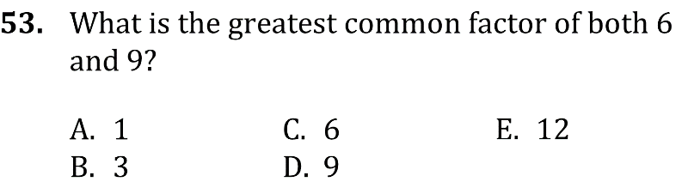
Prime numbers, Greatest Common Factor, & Least Common Multiple
Show familiarity with primes, greatest common factor, least common factor, least common multiple, and working with numerical factors. Level: Intermediate Skill Group Number and Quantity

Slide 3
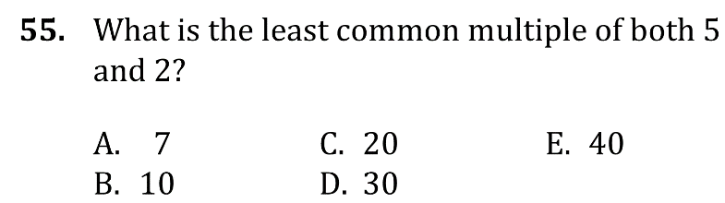
Prime numbers, Greatest Common Factor, & Least Common Multiple
Show familiarity with primes, greatest common factor, least common factor, least common multiple, and working with numerical factors. Level: Intermediate Skill Group Number and Quantity

Slide 4
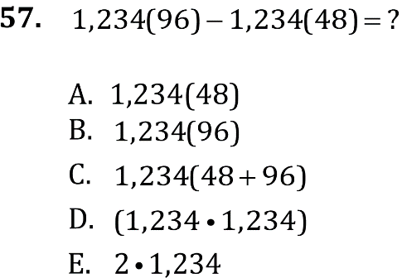
Prime numbers, Greatest Common Factor, & Least Common Multiple
Show familiarity with primes, greatest common factor, least common factor, least common multiple, and working with numerical factors. Level: Intermediate Skill Group Number and Quantity

Slide 5
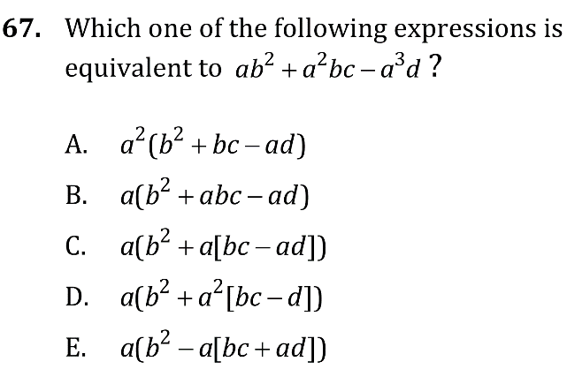
Prime numbers, Greatest Common Factor, & Least Common Multiple

Slide 6
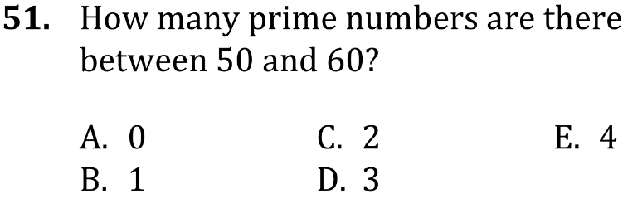
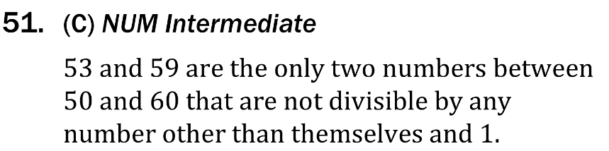
Prime numbers, Greatest Common Factor, & Least Common Multiple
Show familiarity with primes, greatest common factor, least common factor, least common multiple, and working with numerical factors. Level: Intermediate Skill Group Number and Quantity

Slide 7
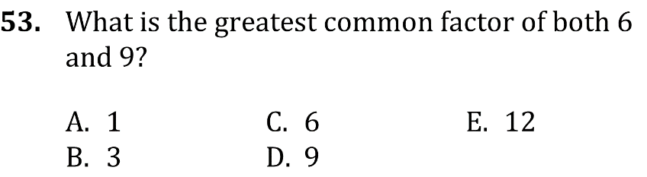
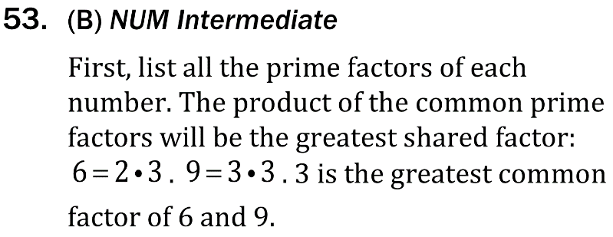
Prime numbers, Greatest Common Factor, & Least Common Multiple
Show familiarity with primes, greatest common factor, least common factor, least common multiple, and working with numerical factors. Level: Intermediate Skill Group Number and Quantity

Slide 8

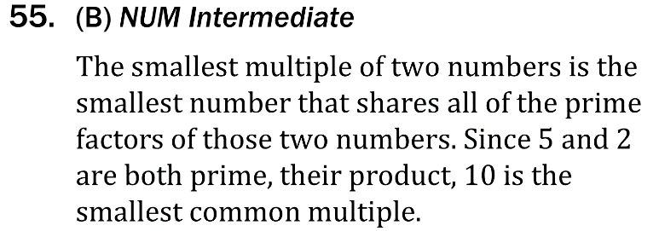
Prime numbers, Greatest Common Factor, & Least Common Multiple
Show familiarity with primes, greatest common factor, least common factor, least common multiple, and working with numerical factors. Level: Intermediate Skill Group Number and Quantity

Slide 9
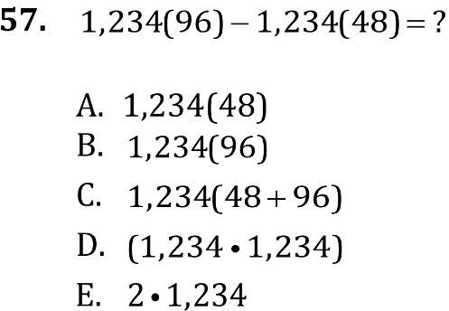
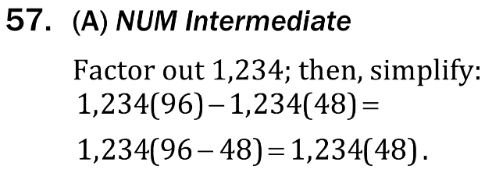
Prime numbers, Greatest Common Factor, & Least Common Multiple
Show familiarity with primes, greatest common factor, least common factor, least common multiple, and working with numerical factors. Level: Intermediate Skill Group Number and Quantity

Slide 10

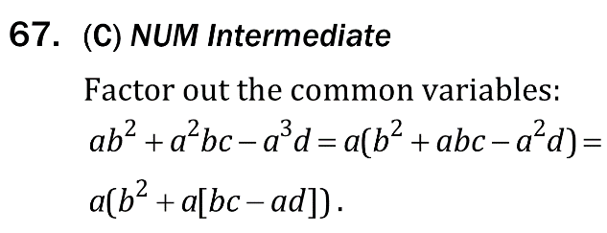
Prime numbers, Greatest Common Factor, & Least Common Multiple

