Slide 1
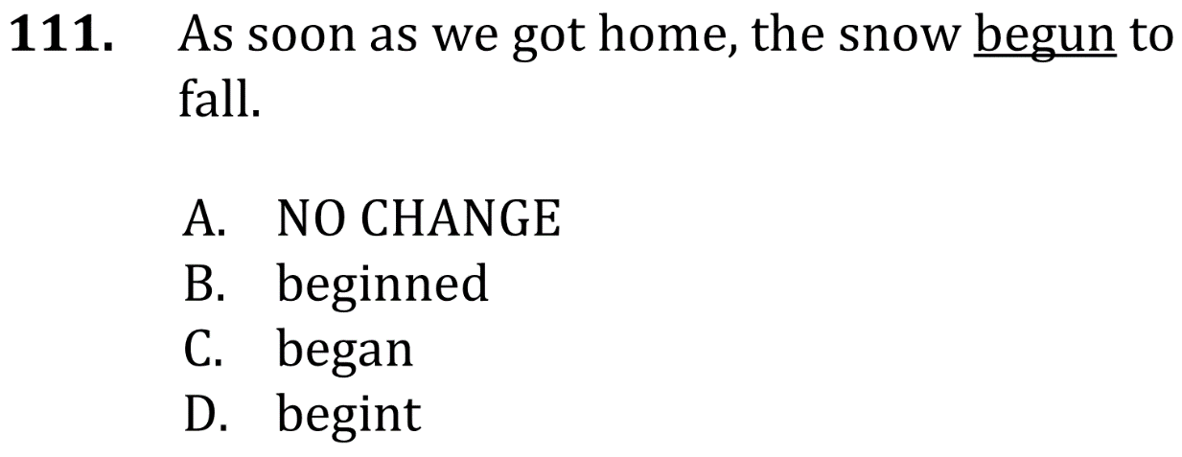

Use The Right Verb

Slide 2
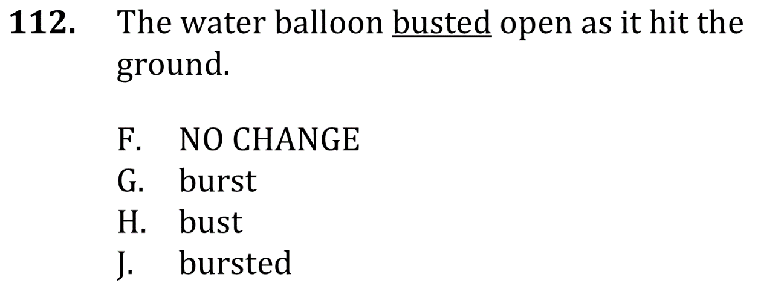
Use The Right Verb

Slide 3
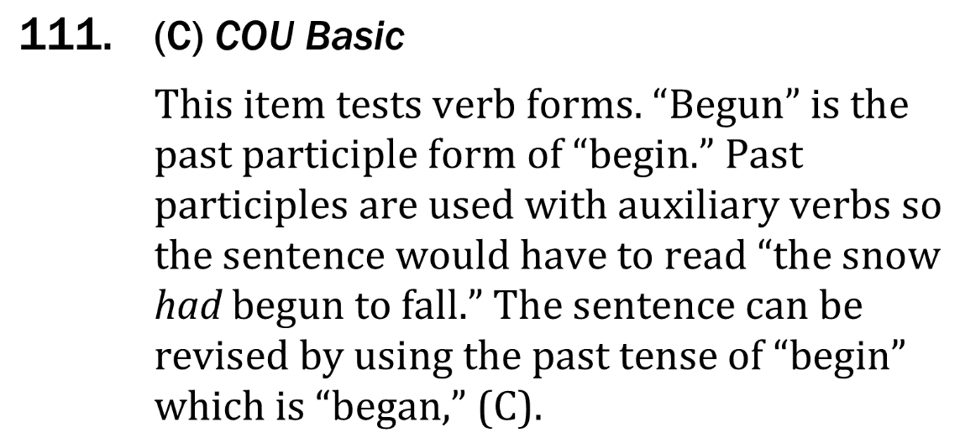
Use the right verb

Slide 4


Use the right verb

