Slide 1
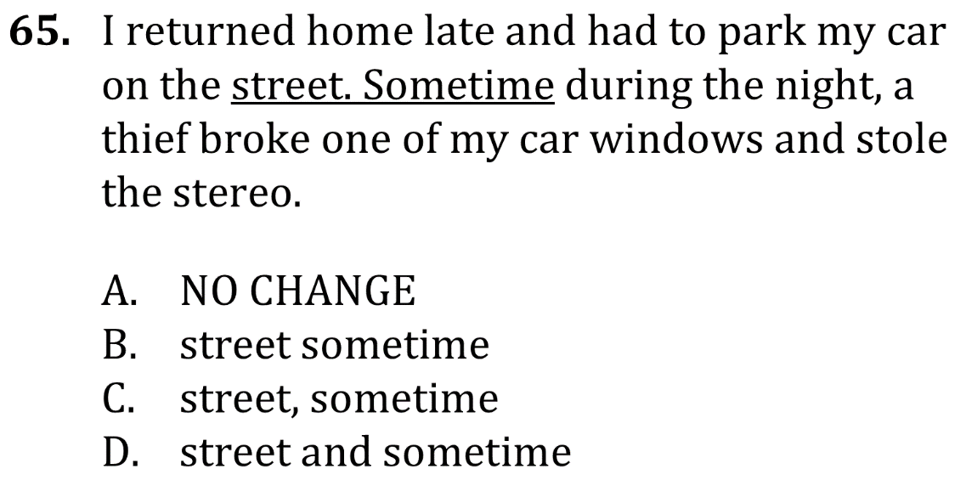
Eliminate fragments and run-ons

Slide 2
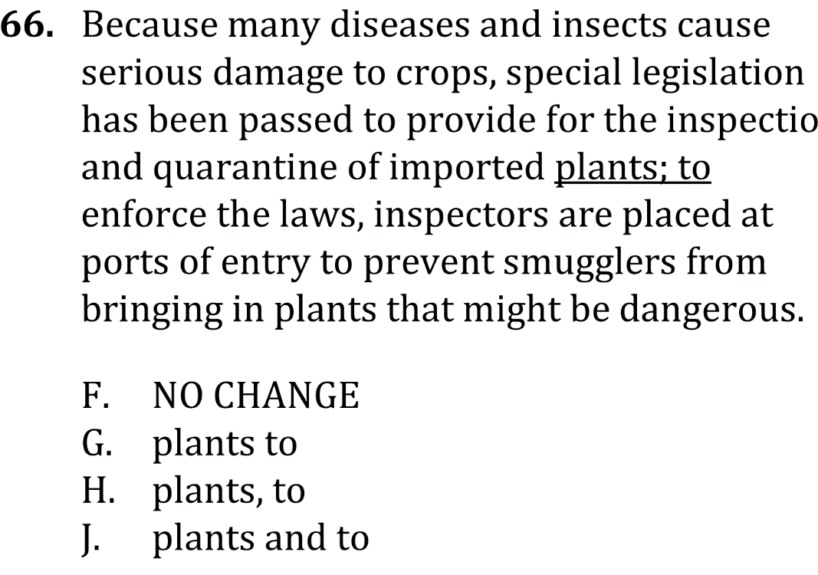
Eliminate fragments and run-ons

Slide 3
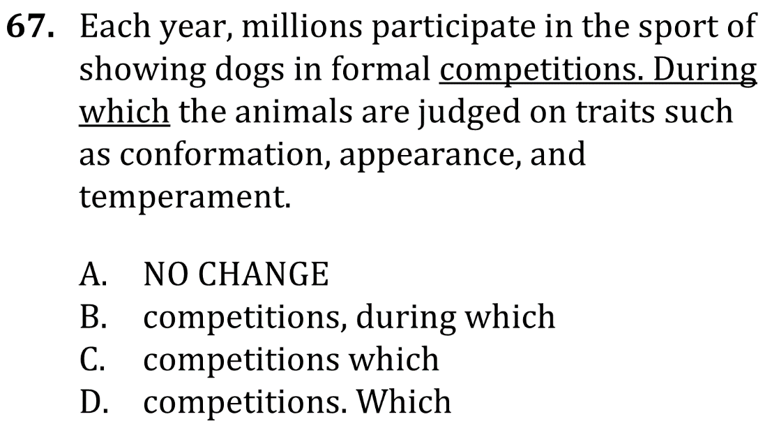
Eliminate fragments and run-ons

Slide 4
Eliminate fragments and run-ons

Slide 5
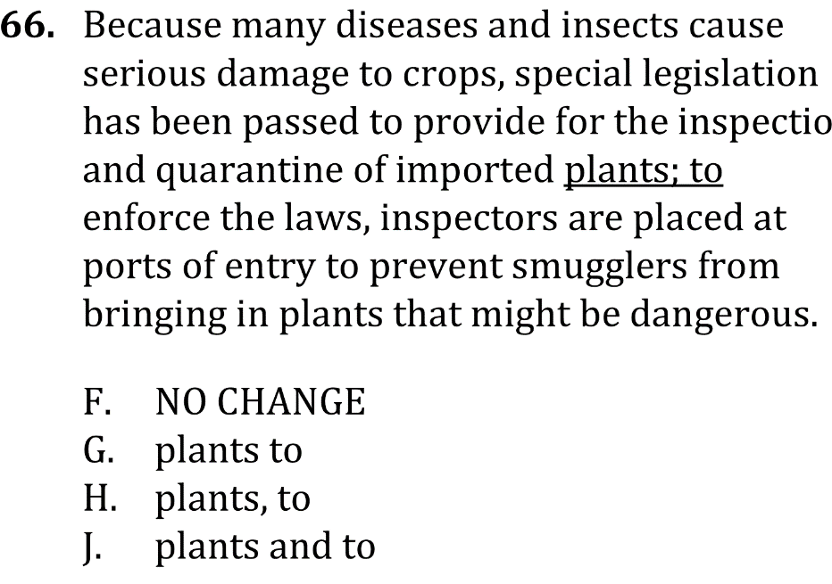
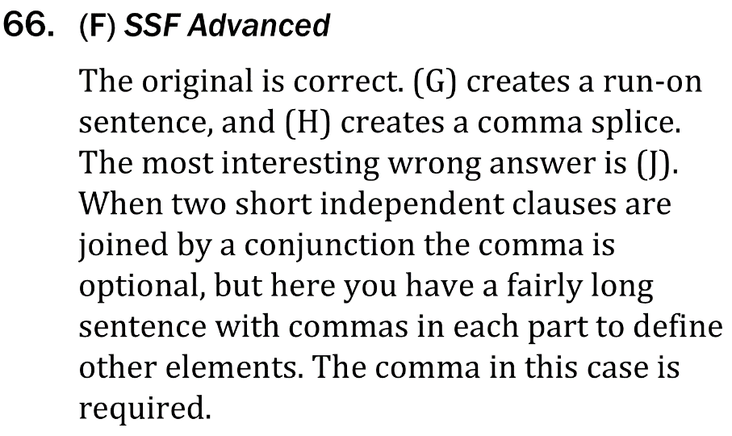
Eliminate fragments and run-ons

Slide 6
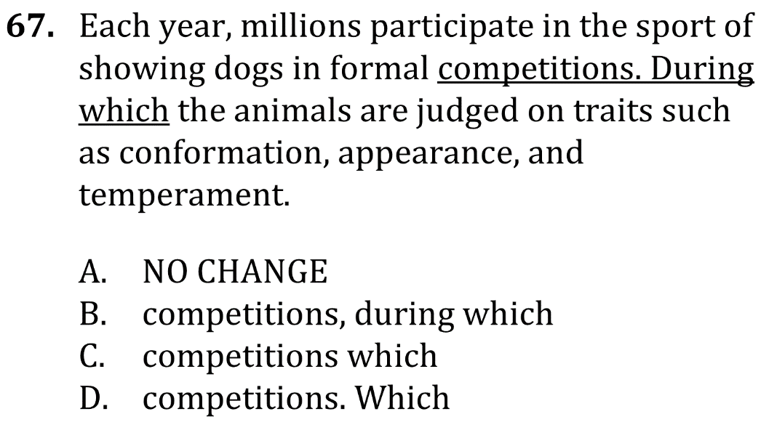
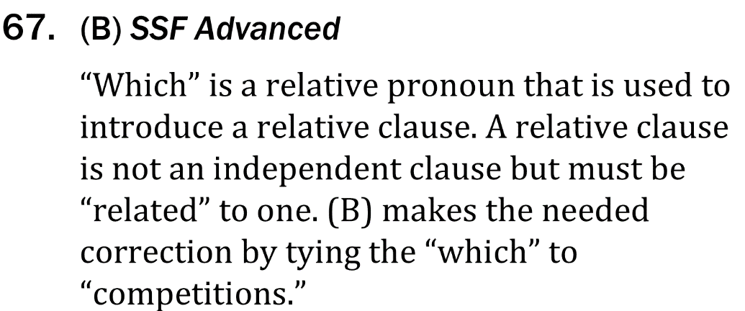
Eliminate fragments and run-ons

