Slide 1
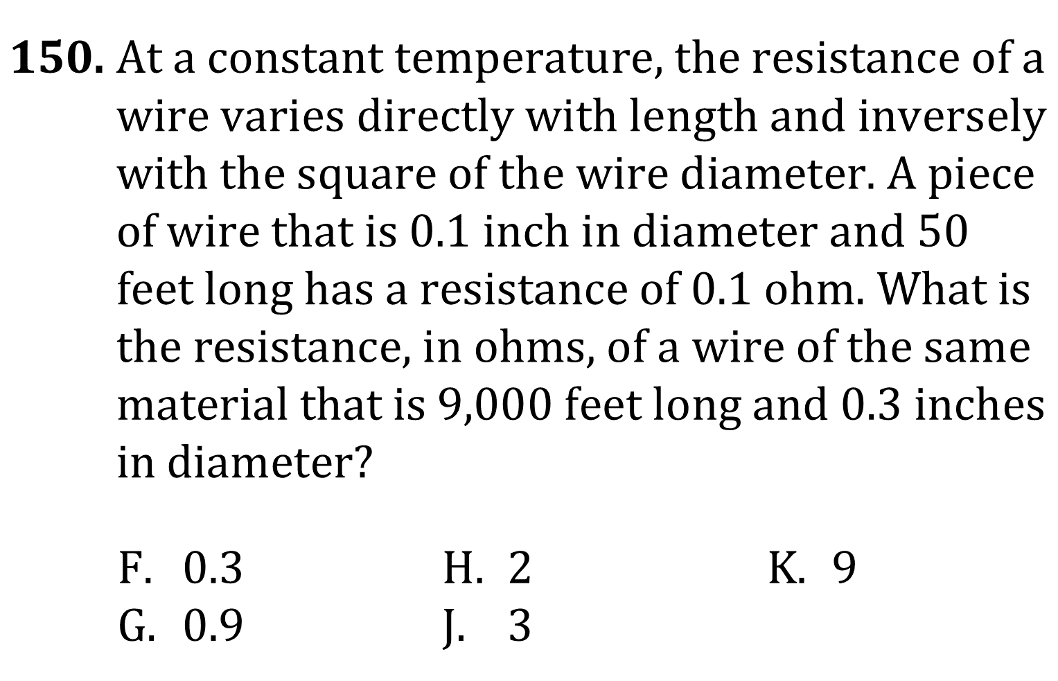
Solving Equations

Slide 2
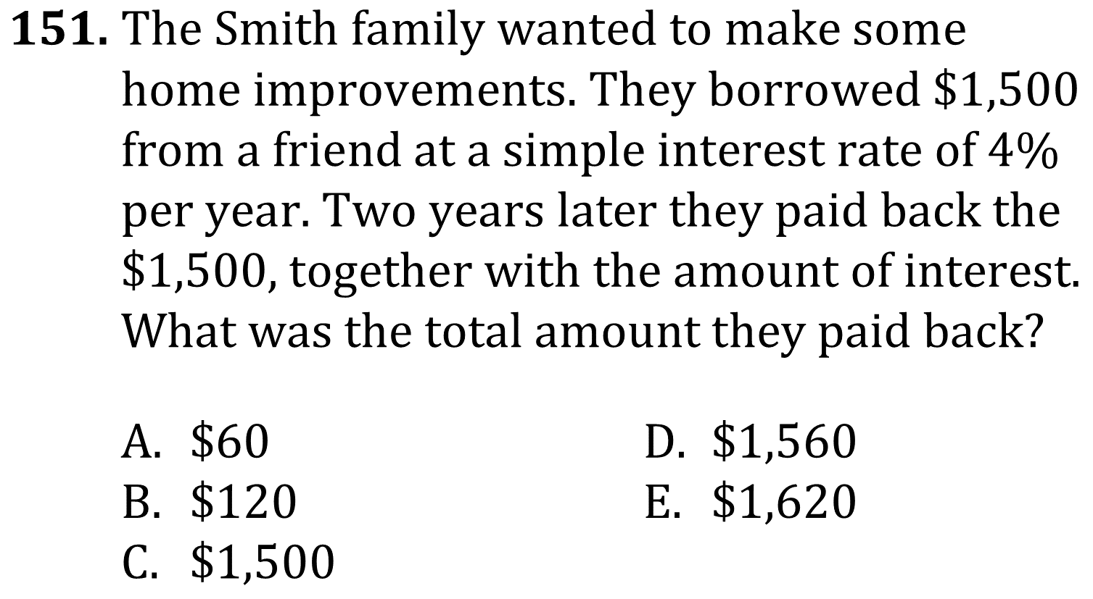
Solving Equations

Slide 3
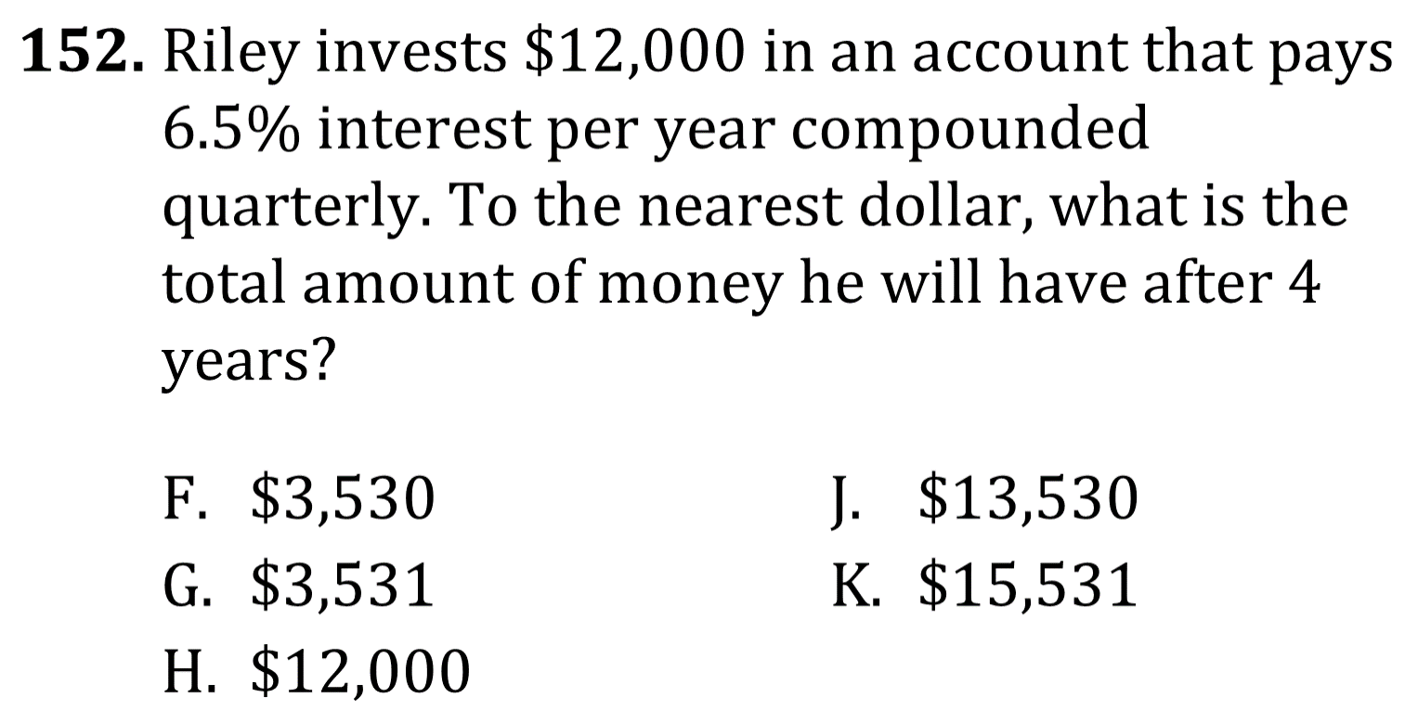
Solving Equations

Slide 4
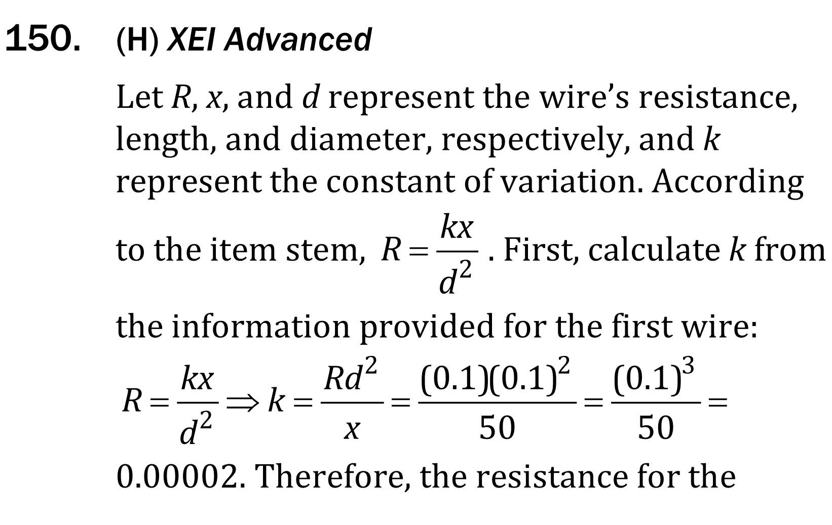
Solving Equations

Slide 5
Solving Equations

Slide 6
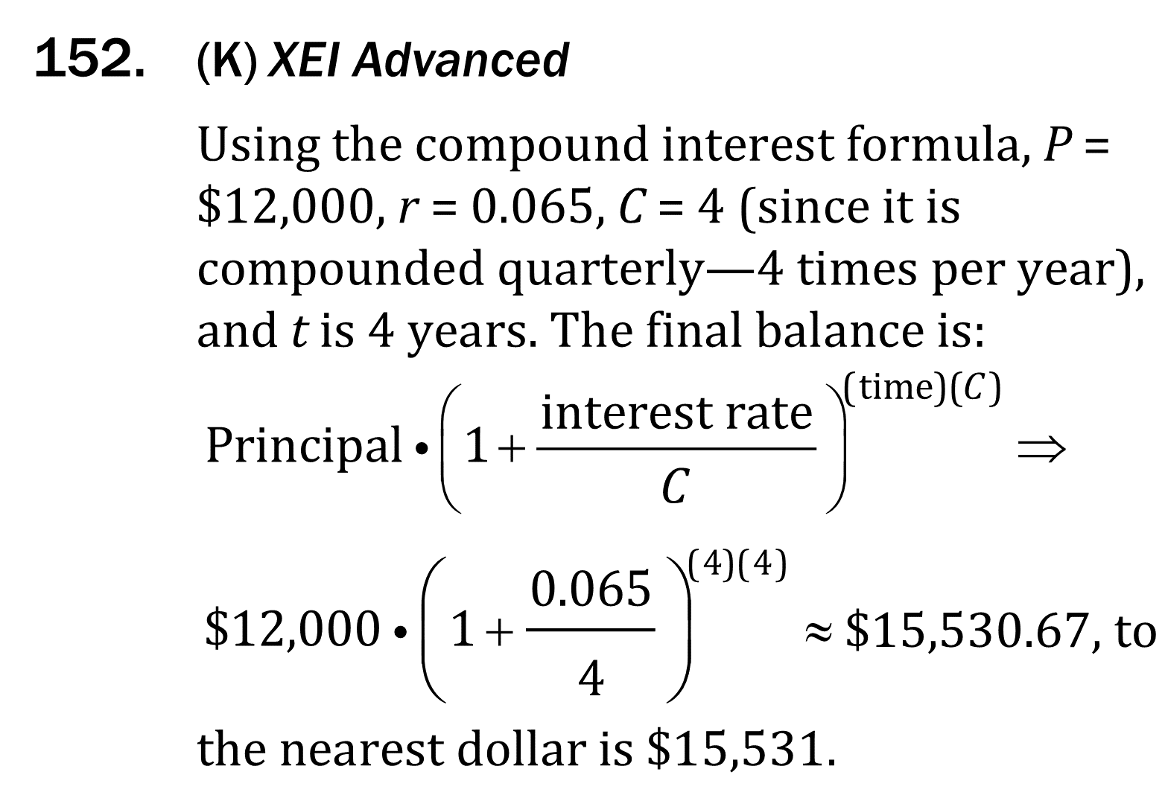
Solving Equations

