Slide 1
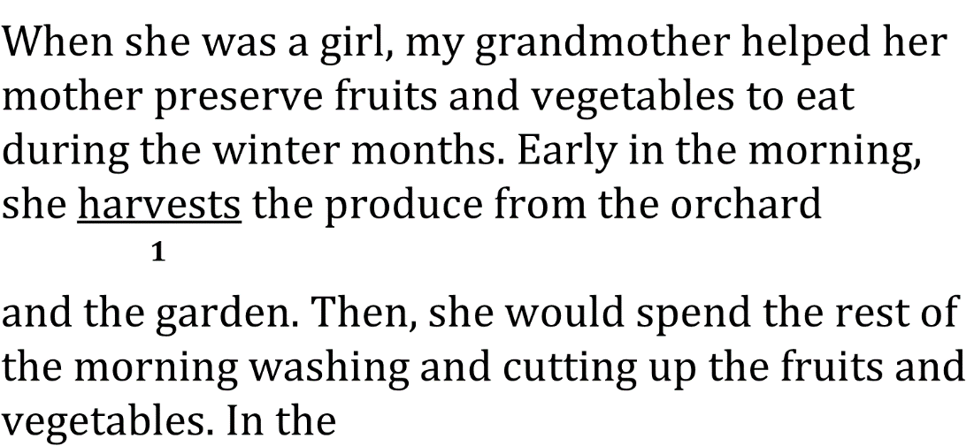





Use Correct Verb Tense and
Pronoun person

Slide 2

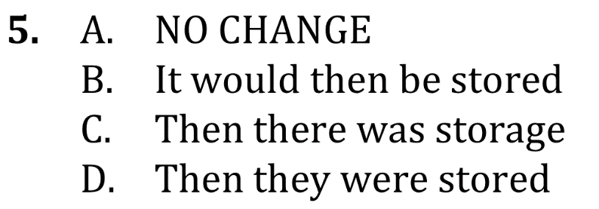

Use Correct Verb Tense and
Pronoun person

Slide 3


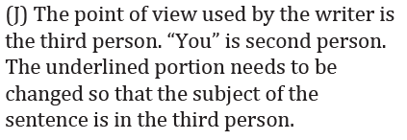
Use Correct Verb Tense and
Pronoun person

Slide 4
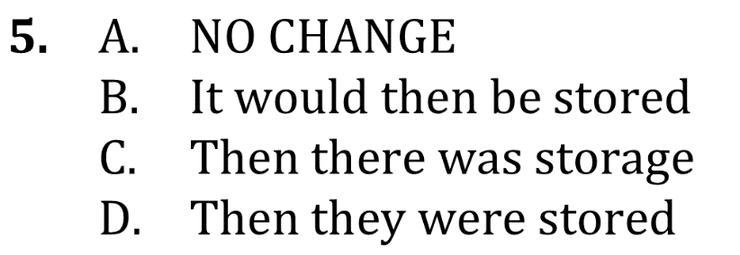

Use Correct Verb Tense and
Pronoun person

