Slide 1
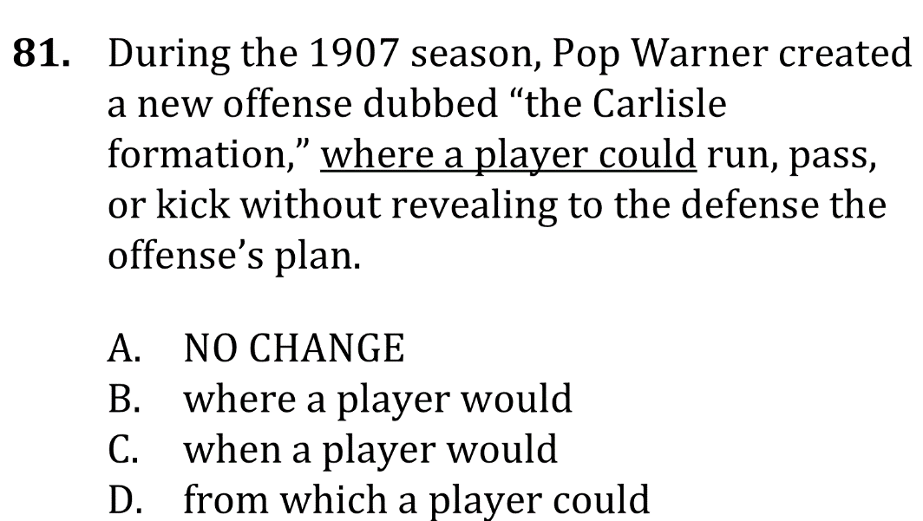
Maintain logical flow

Slide 2
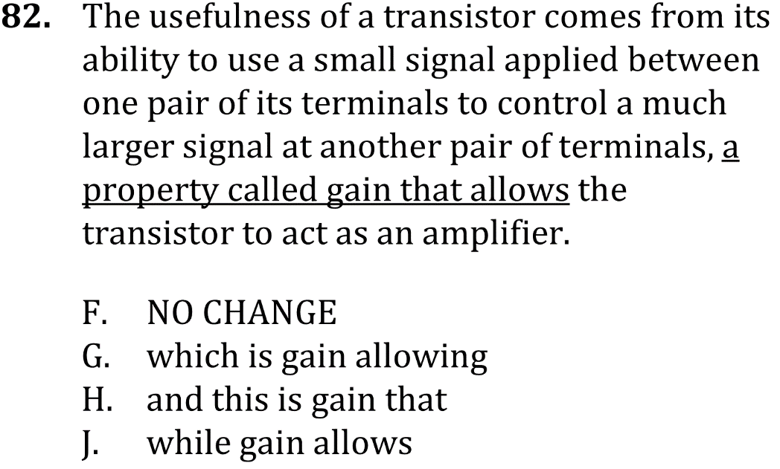
Maintain logical flow

Slide 3
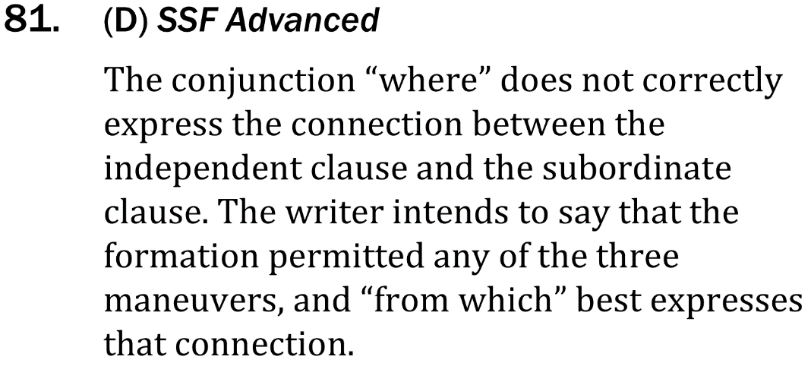
Maintain logical flow

Slide 4
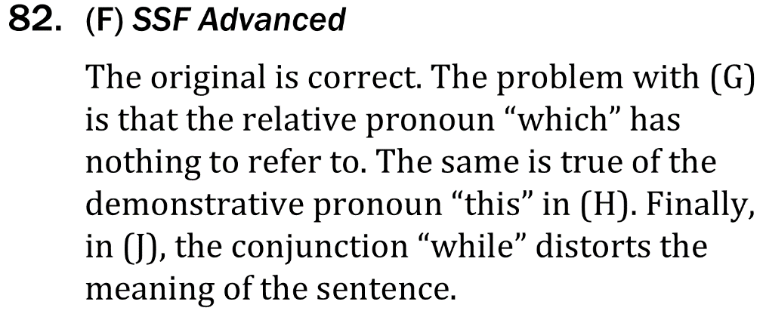
Maintain logical flow

