Slide 1
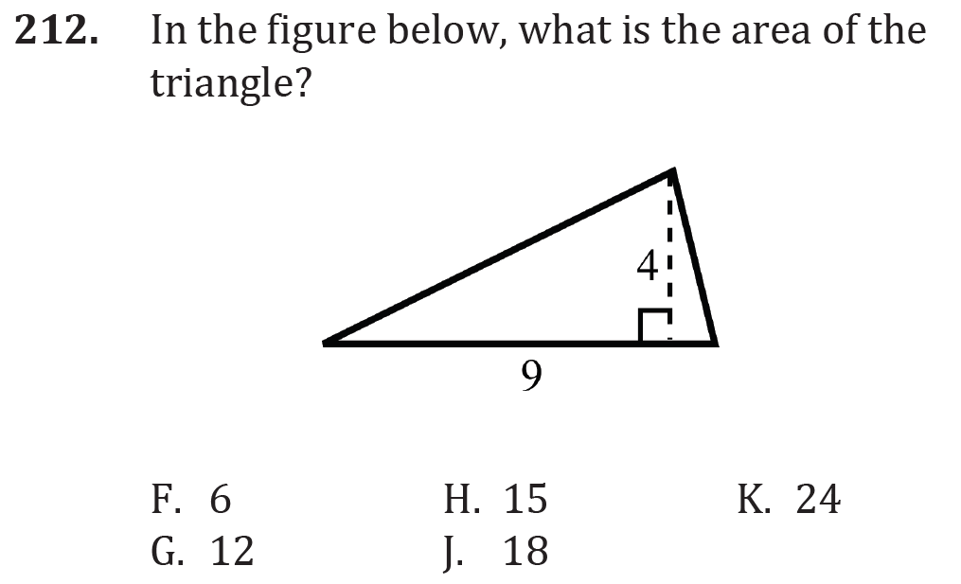

Perimeter and Area

Slide 2
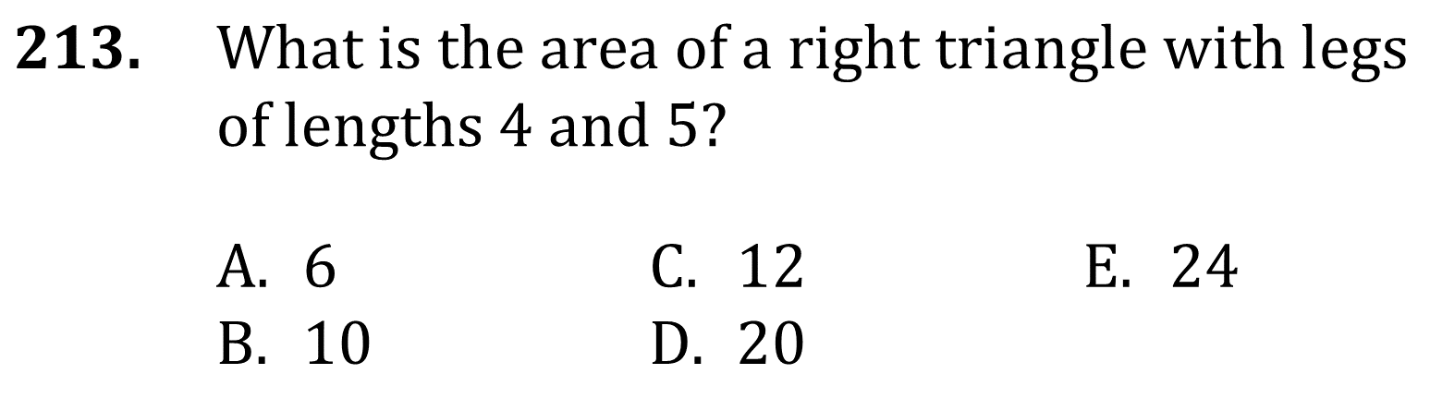
Perimeter and Area

Slide 3
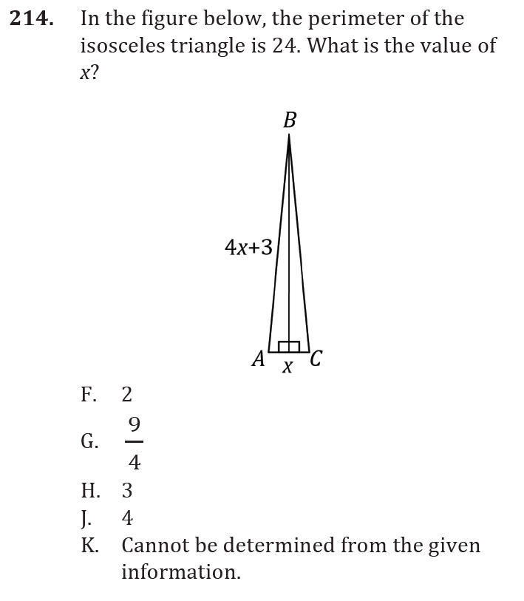
Perimeter and Area

Slide 4
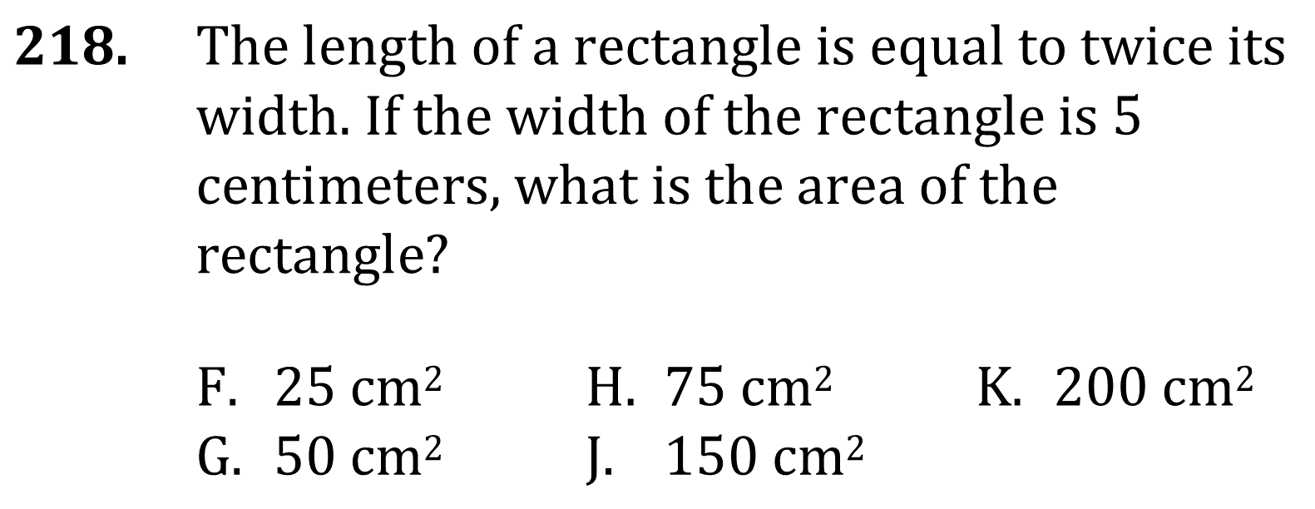
Perimeter and Area

Slide 5
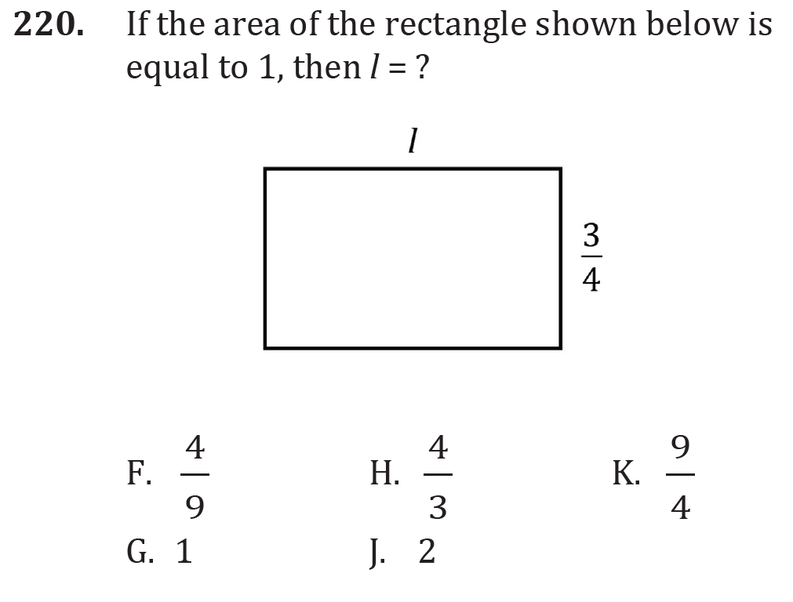
Perimeter and Area

Slide 6
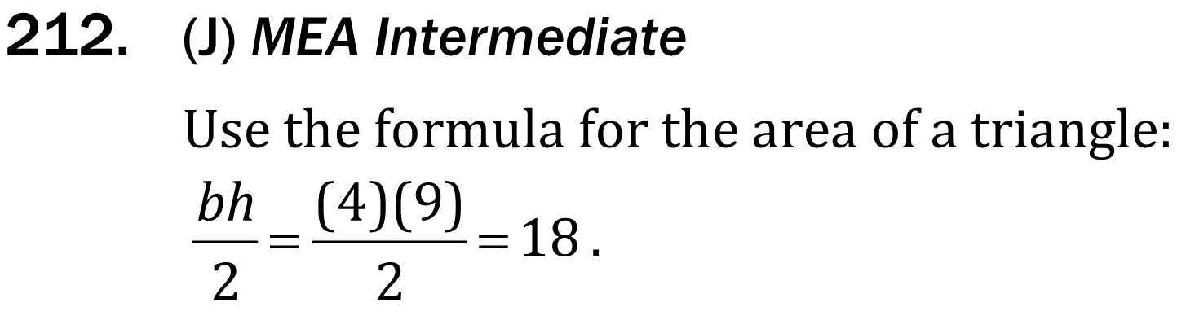
Perimeter and Area

Slide 7
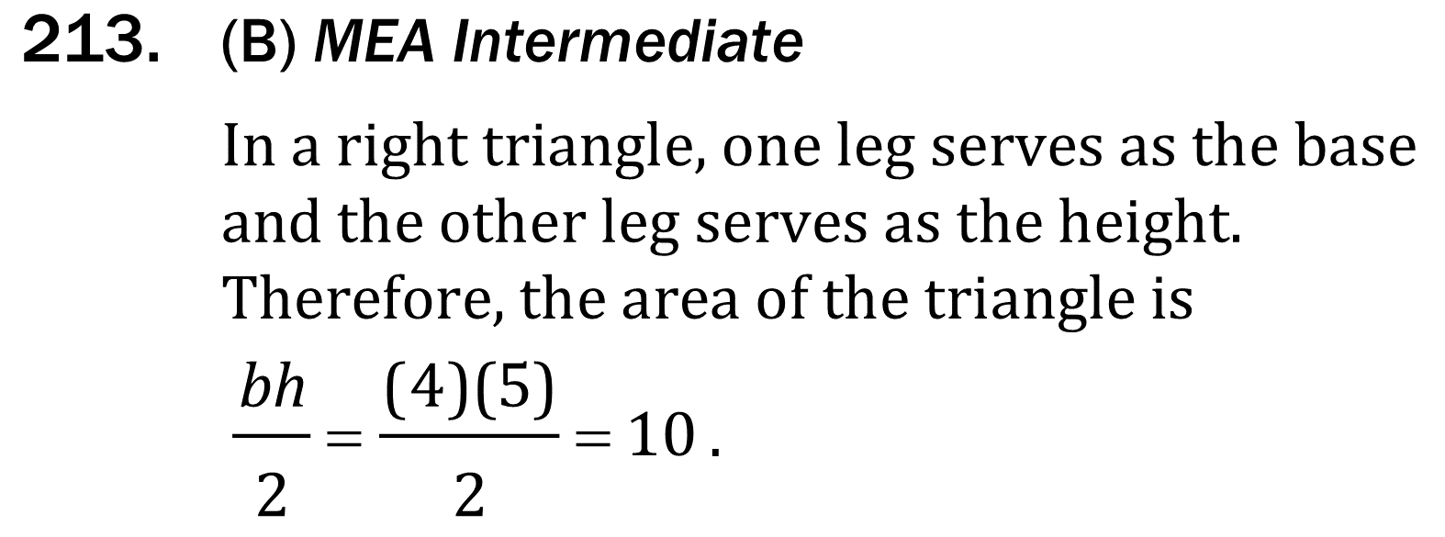
Perimeter and Area

Slide 8
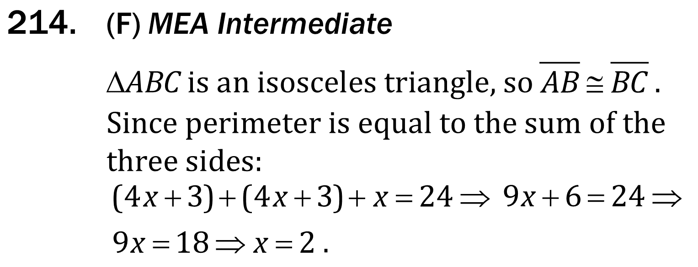
Perimeter and Area

Slide 9
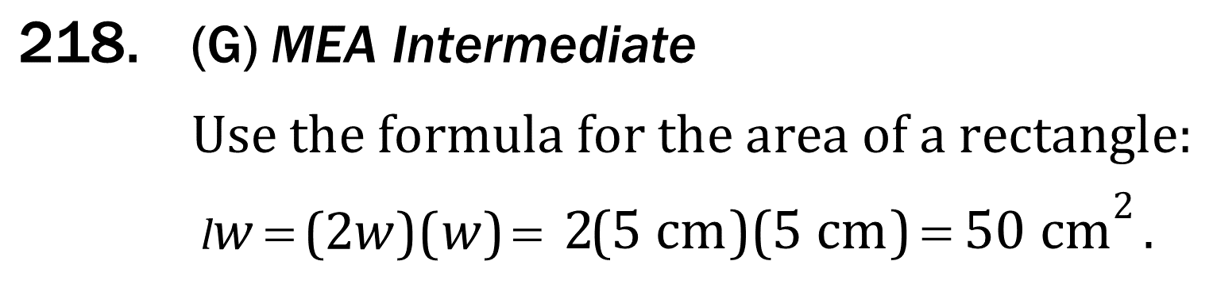
Perimeter and Area

Slide 10
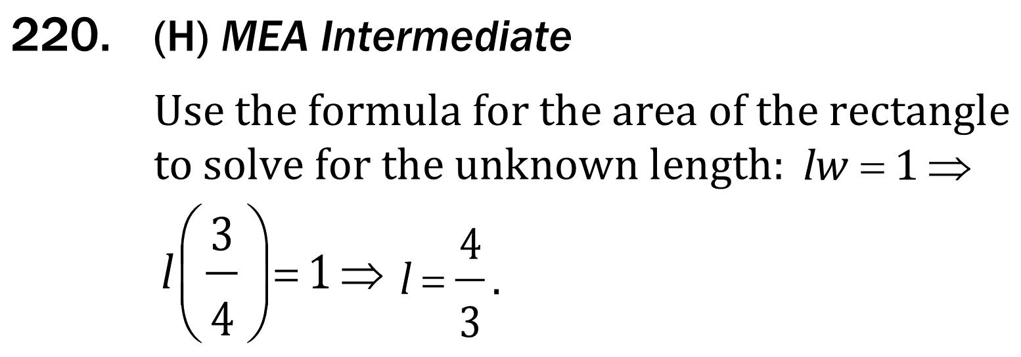
Perimeter and Area

