Slide 1
Circumference and Area

Slide 2
Circumference and Area

Slide 3
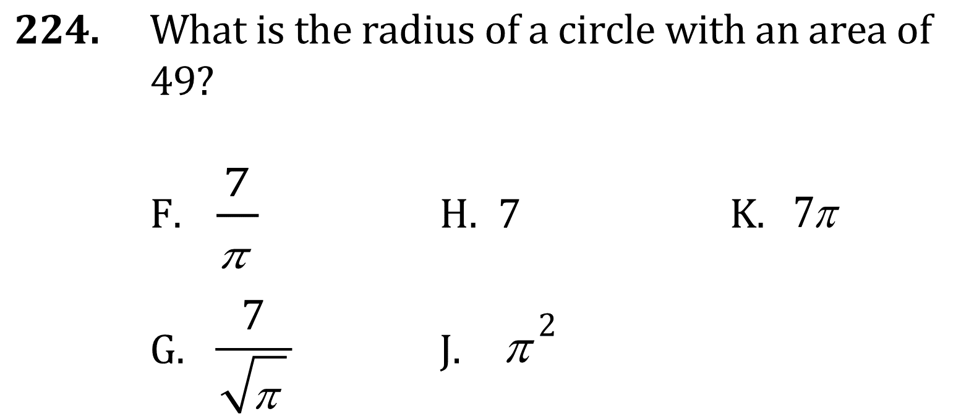
Circumference and Area

Slide 4
Circumference and Area

Slide 5
Circumference and Area

Slide 6
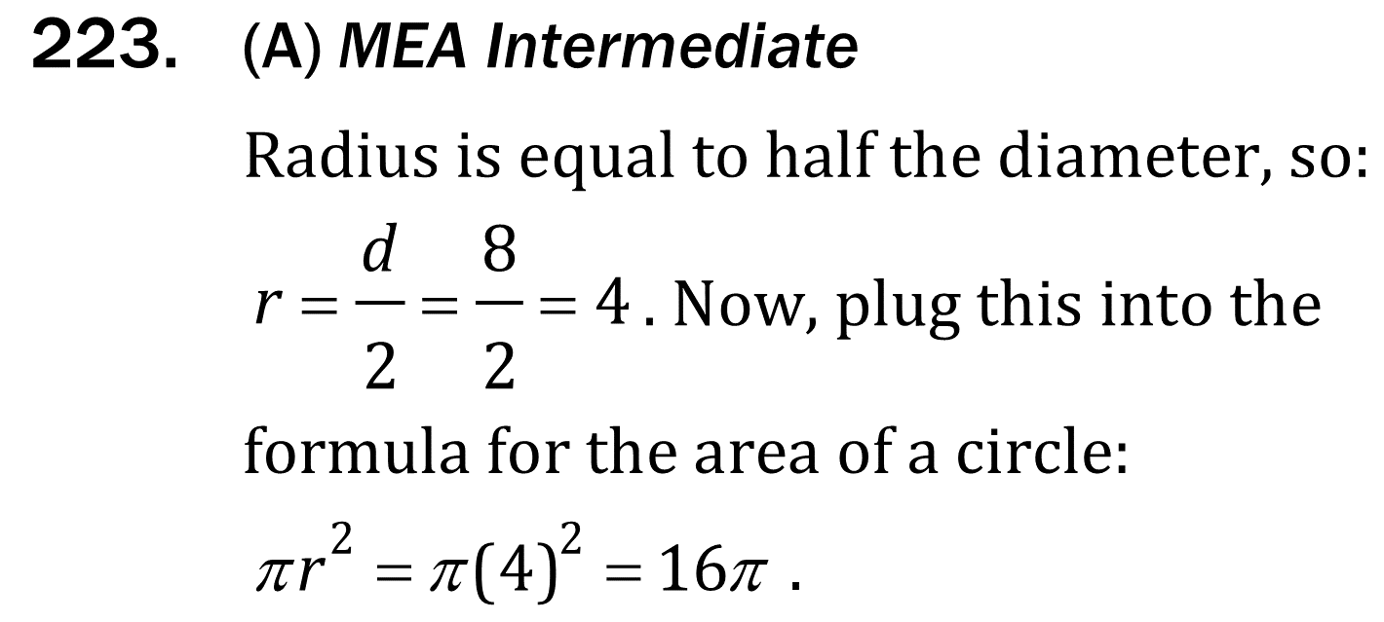
Circumference and Area

Slide 7
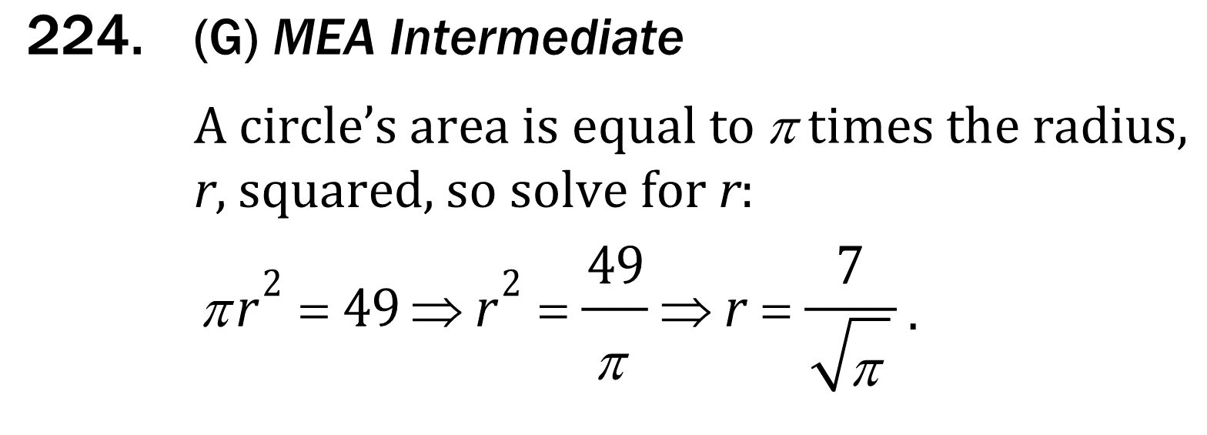
Circumference and Area

Slide 8
Circumference and Area

