Slide 1
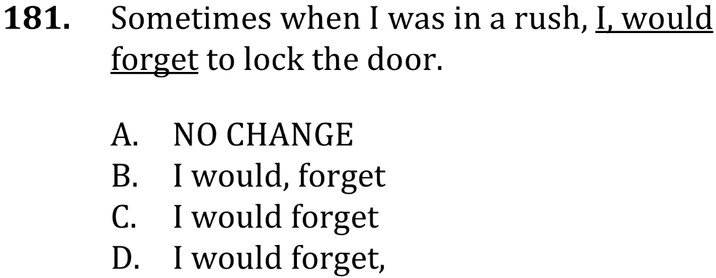

Delete unnecessary commas

Slide 2
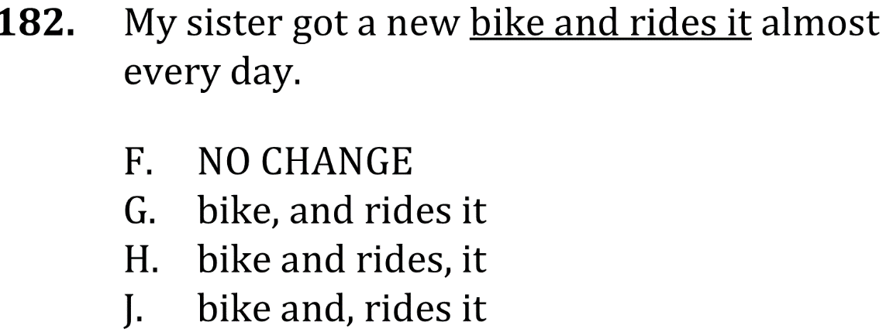
Delete unnecessary commas

Slide 3
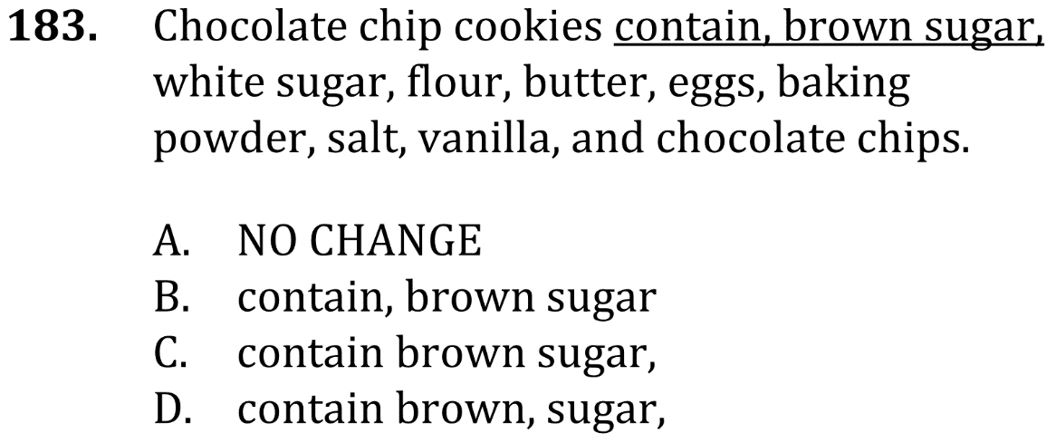
Delete unnecessary commas

Slide 4
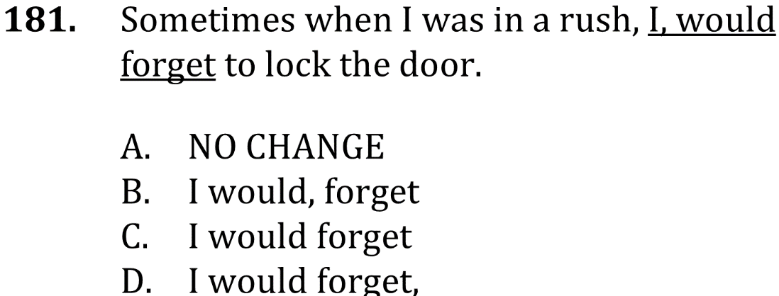

Delete unnecessary commas

Slide 5

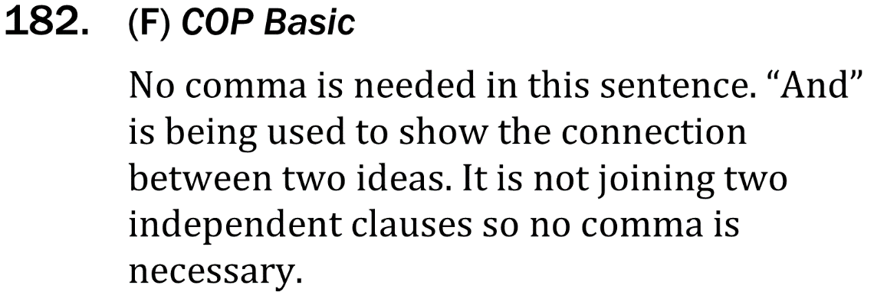
Delete unnecessary commas

Slide 6


Delete unnecessary commas

