Slide 1
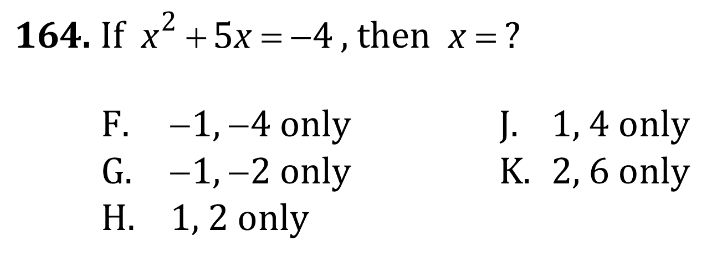
Quadratic Formula and Factoring

Slide 2
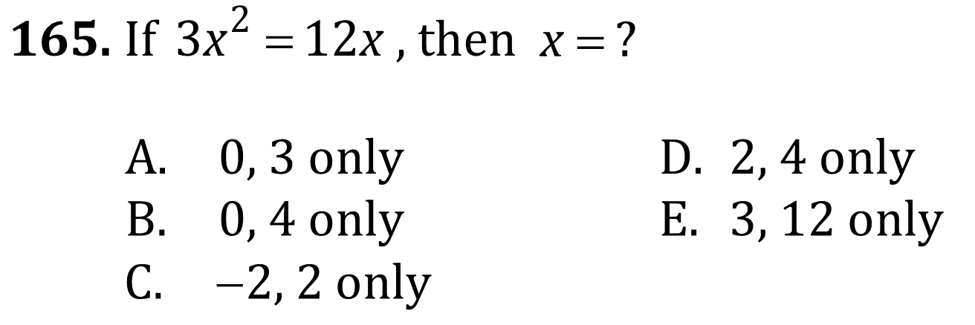
Quadratic Formula and Factoring

Slide 3
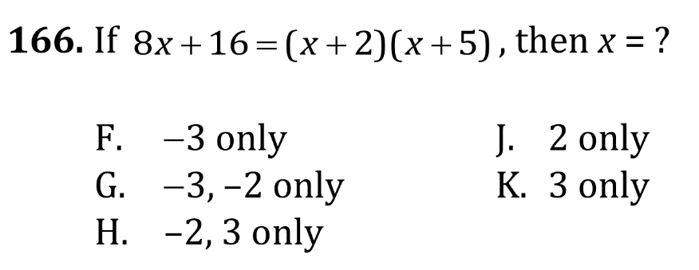
Quadratic Formula and Factoring

Slide 4
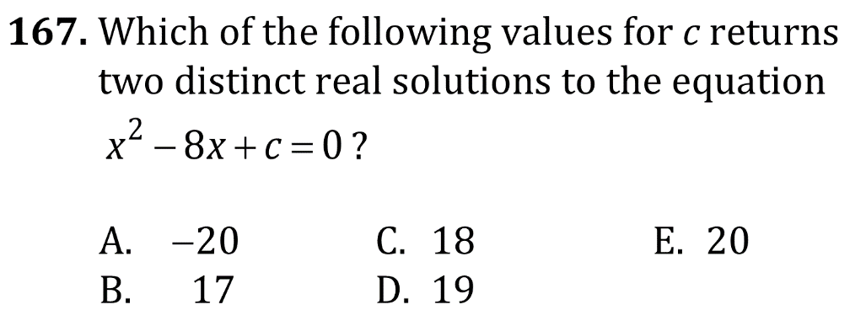
Quadratic Formula and Factoring

Slide 5
Quadratic Formula and Factoring

Slide 6
Quadratic Formula and Factoring

Slide 7
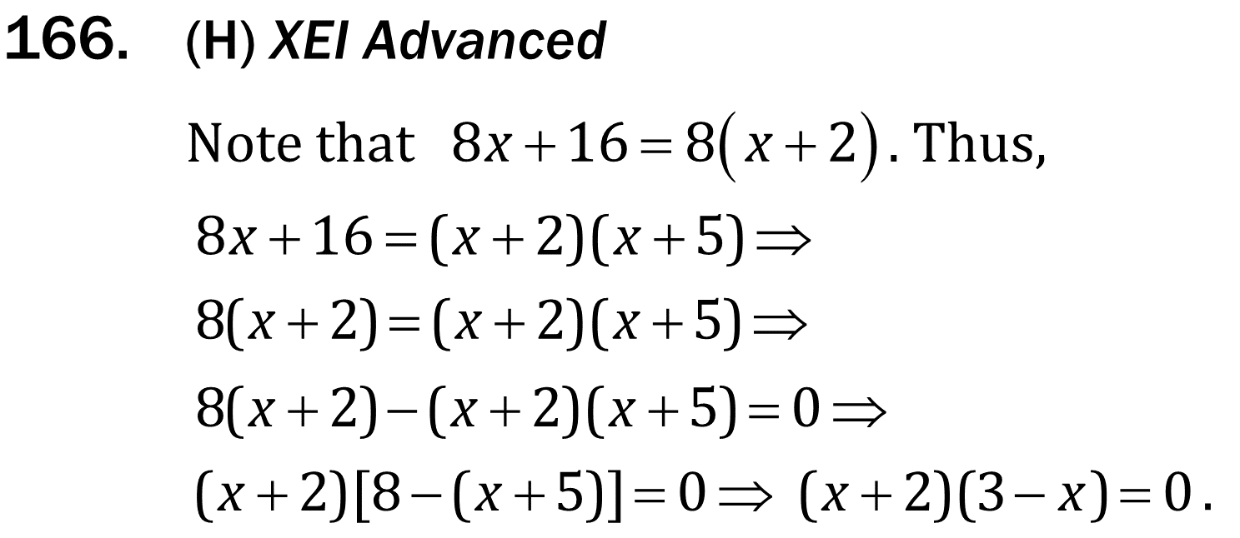
Quadratic Formula and Factoring

Slide 8
Quadratic Formula and Factoring

