Slide 1
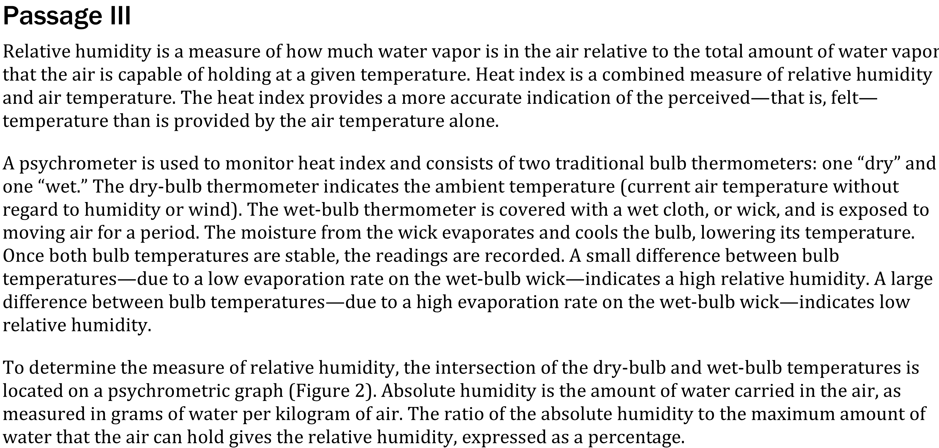
Notes:
Compare and contrast models. Level: Advanced Skill Group: Interpretation of Data

Slide 2
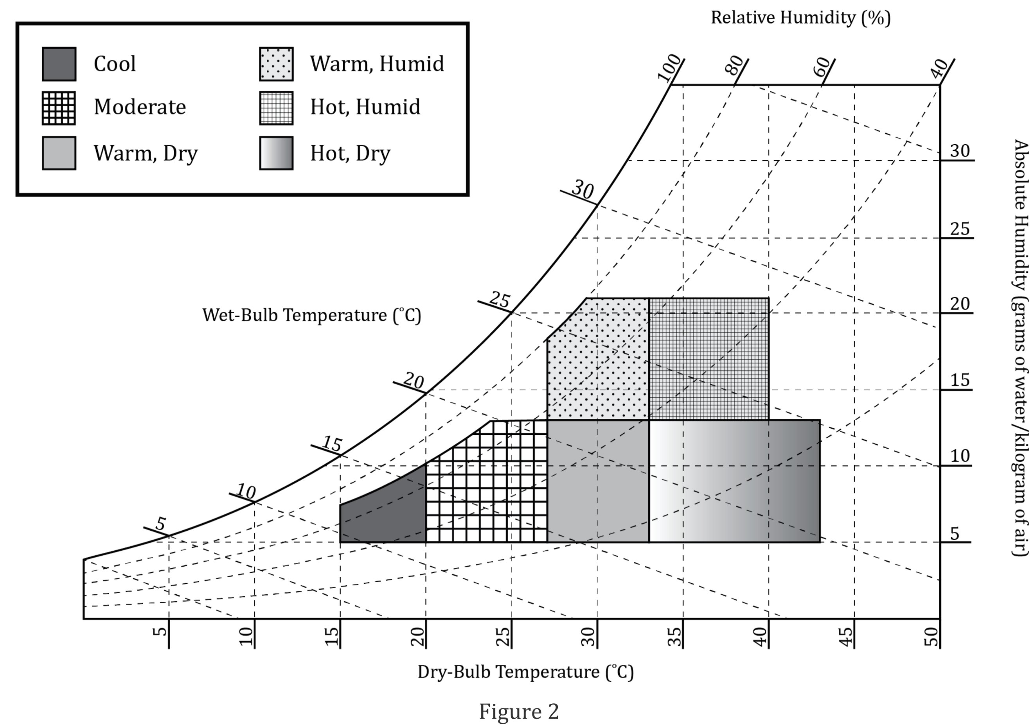
Notes:
Compare and contrast models. Level: Advanced Skill Group: Interpretation of Data

Slide 3
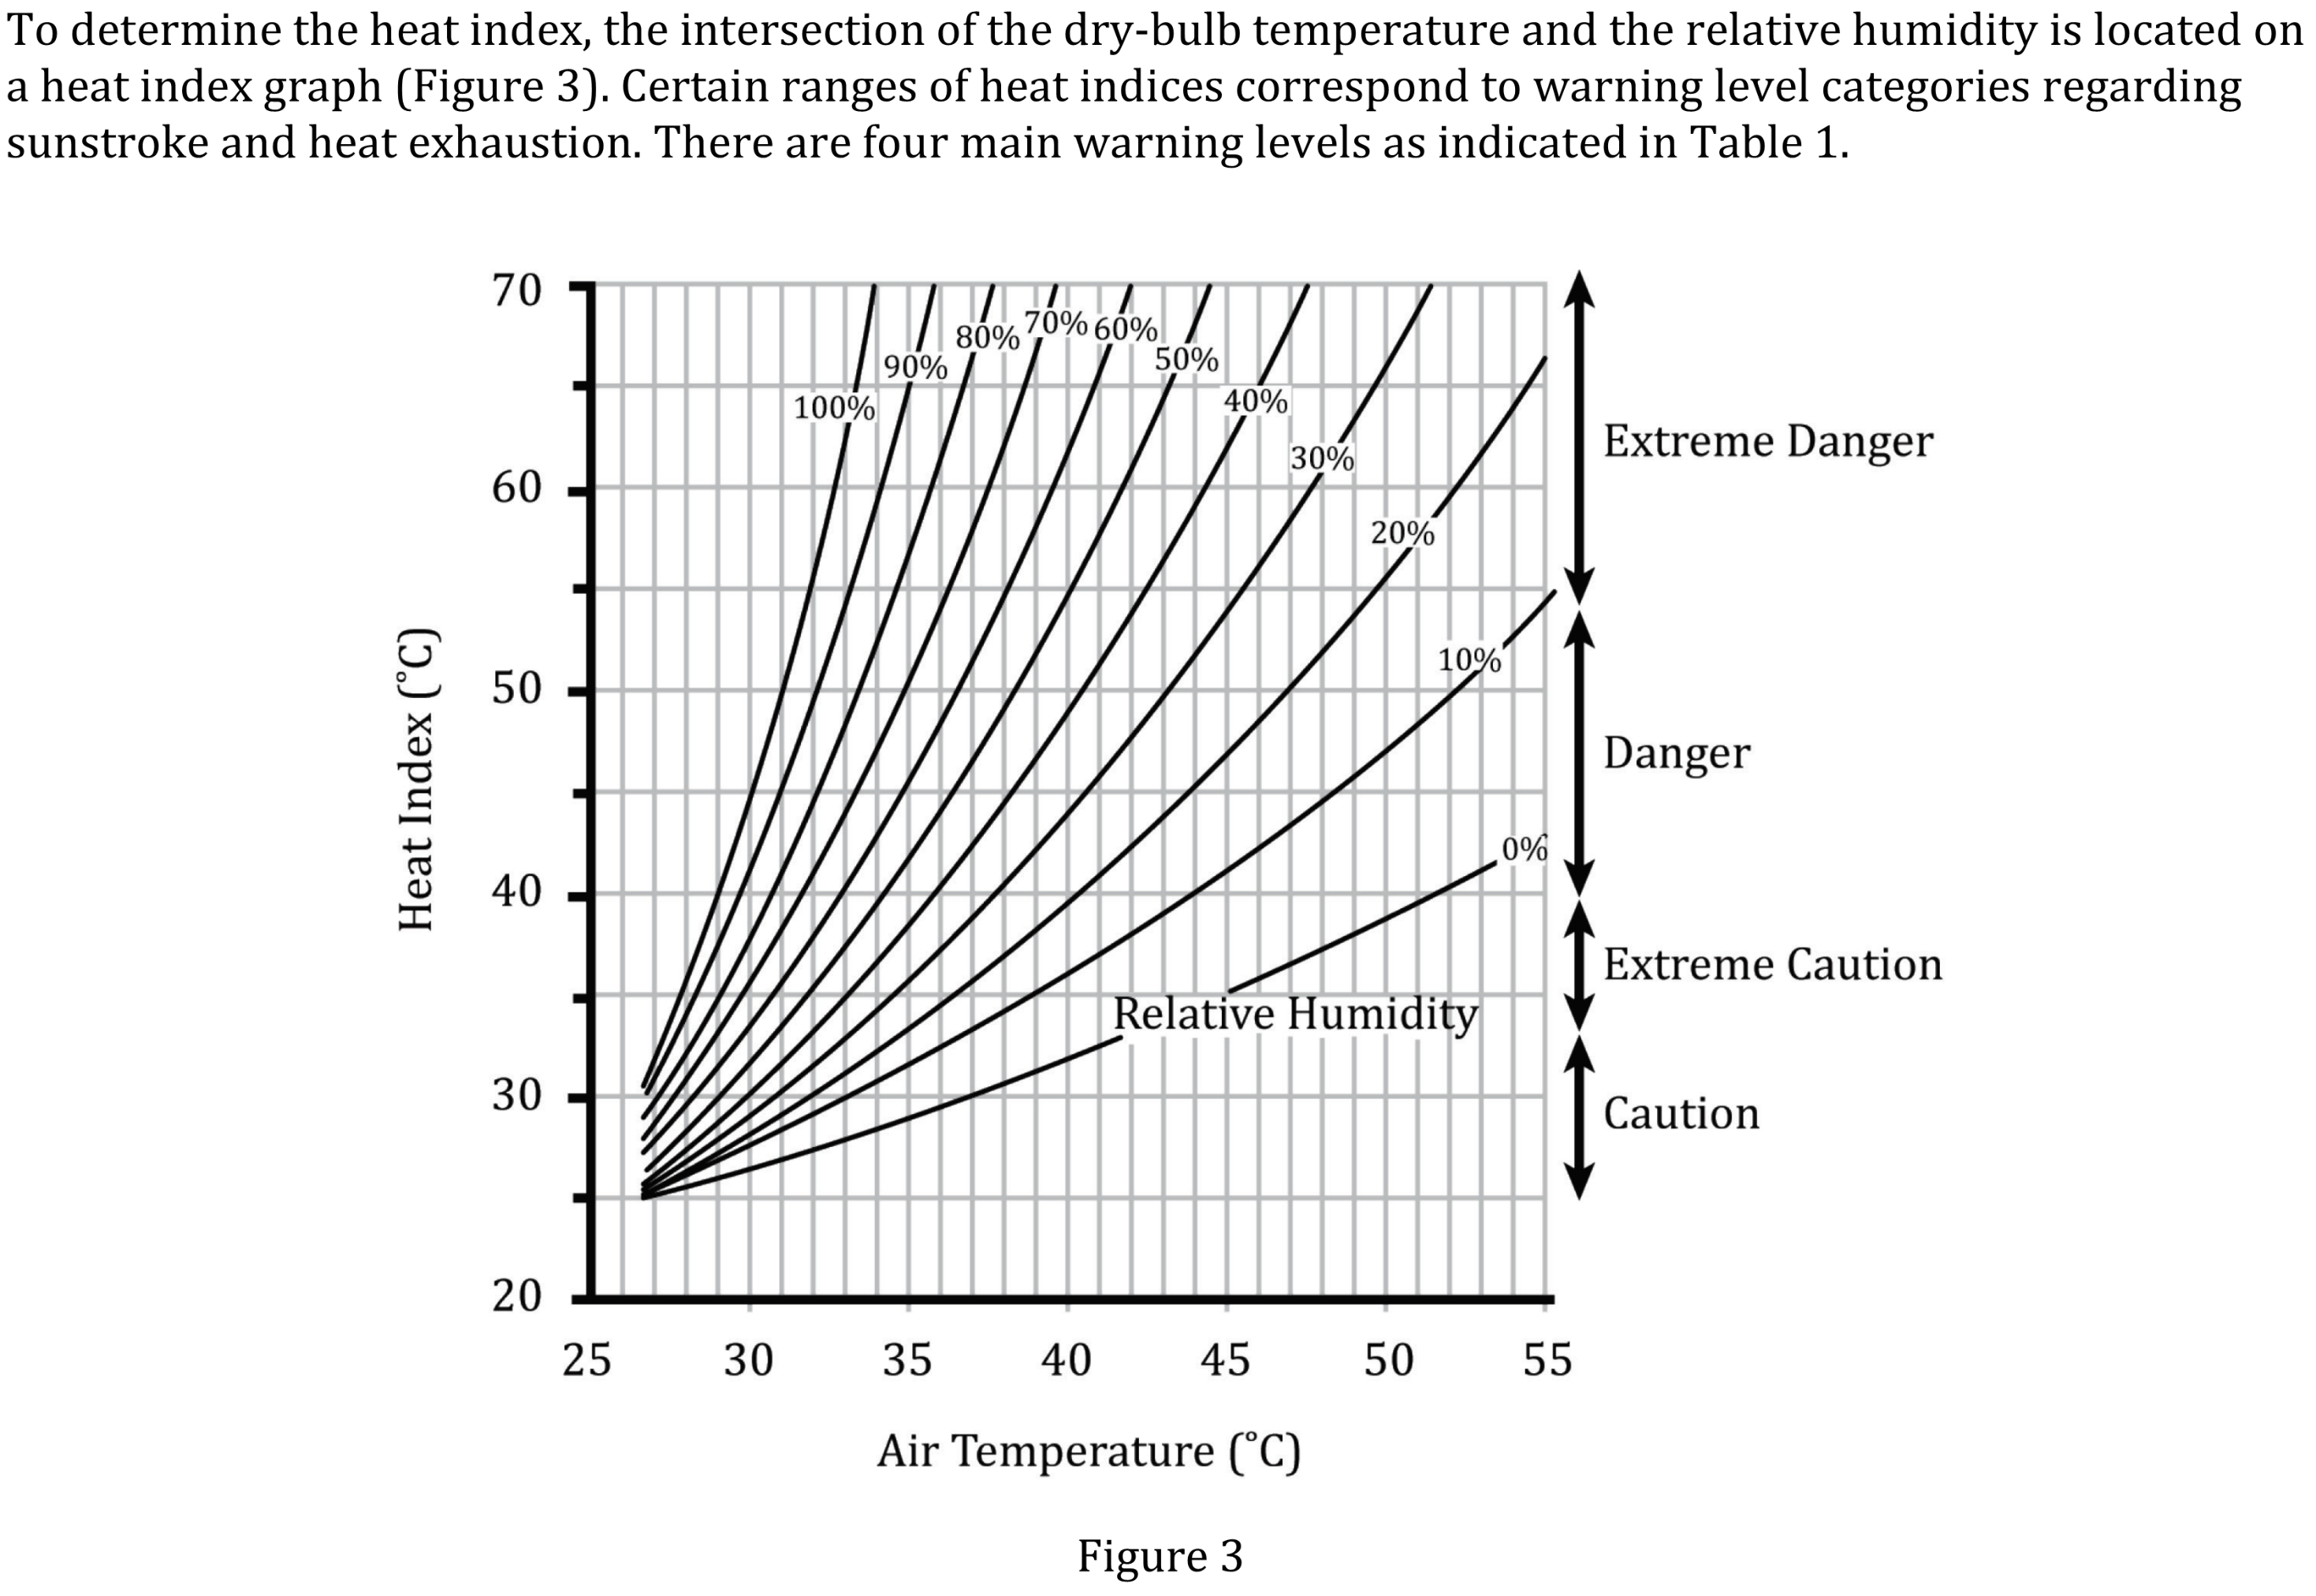
Notes:
Compare and contrast models. Level: Advanced Skill Group: Interpretation of Data

Slide 4
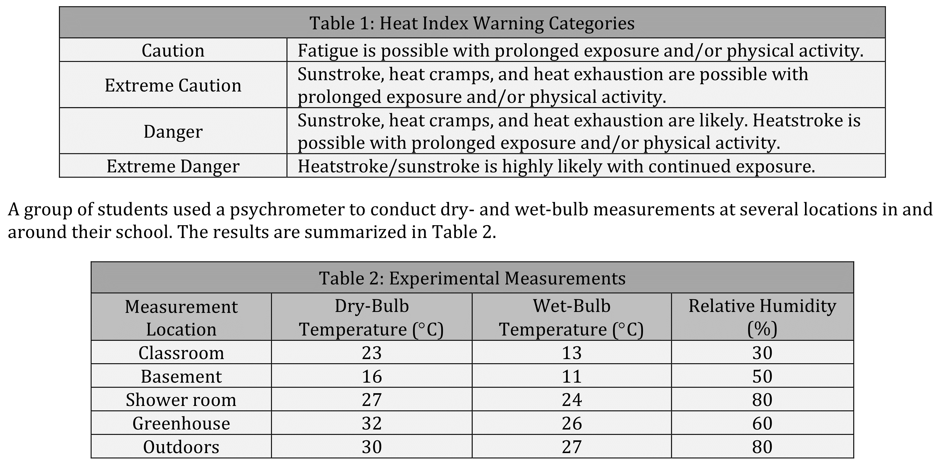
Notes:
Compare and contrast models. Level: Advanced Skill Group: Interpretation of Data

Slide 5
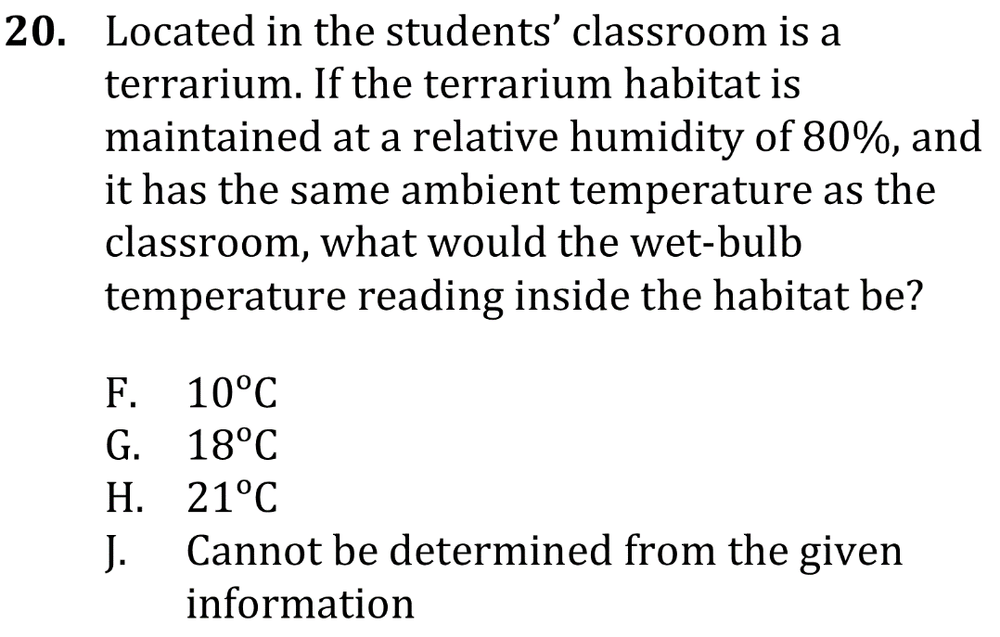
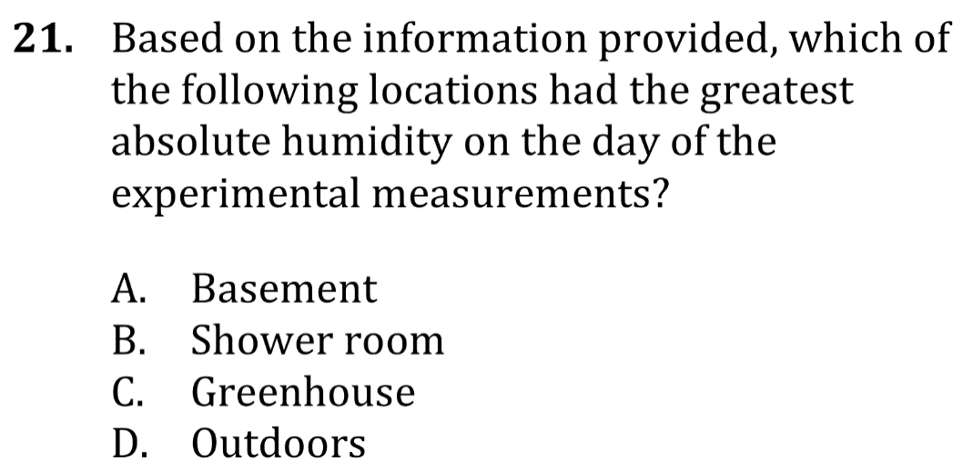
Notes:
Compare and contrast models. Level: Advanced Skill Group: Interpretation of Data

Slide 6
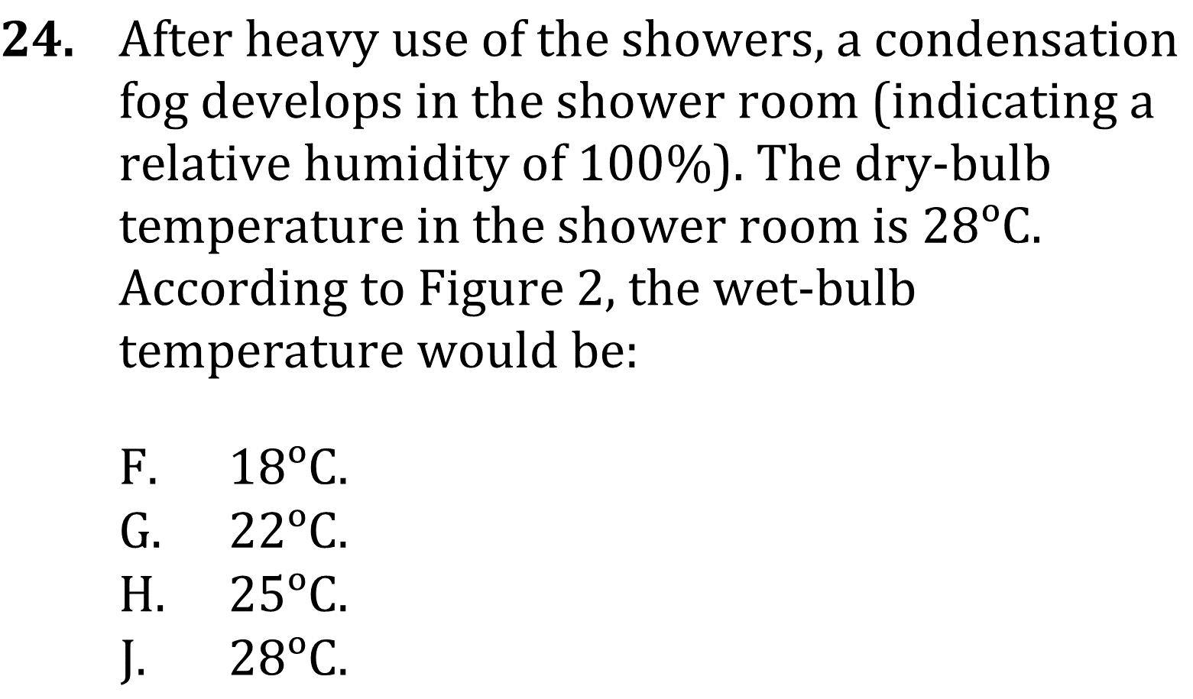
Notes:
Compare and contrast models. Level: Advanced Skill Group: Interpretation of Data

Slide 7
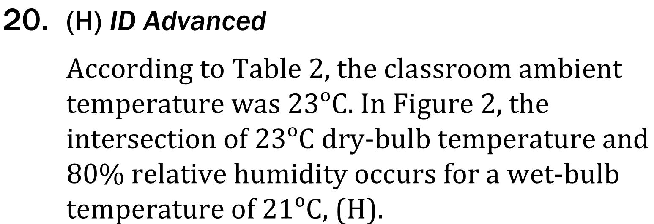
Notes:
Compare and contrast models. Level: Advanced Skill Group: Interpretation of Data

Slide 8
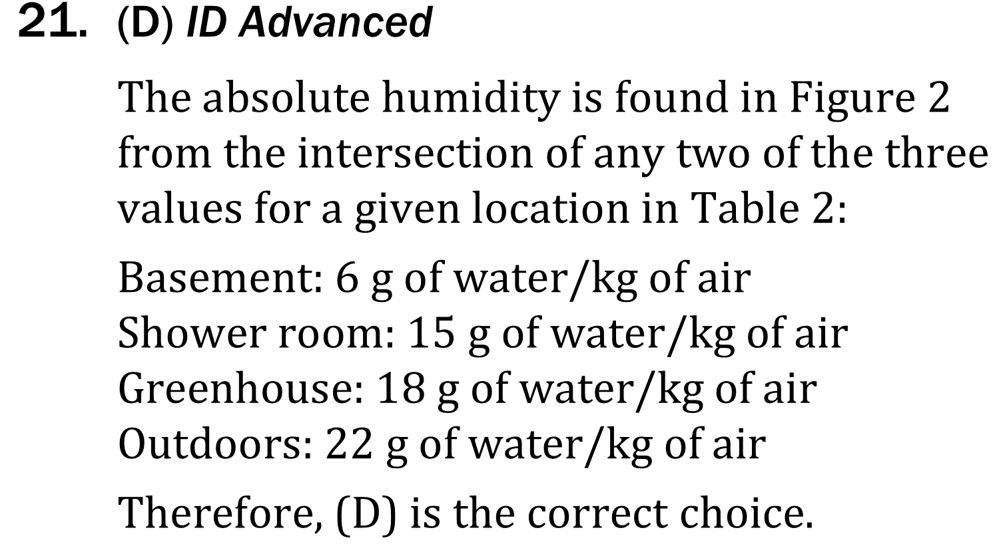
Notes:
Compare and contrast models. Level: Advanced Skill Group: Interpretation of Data

Slide 9
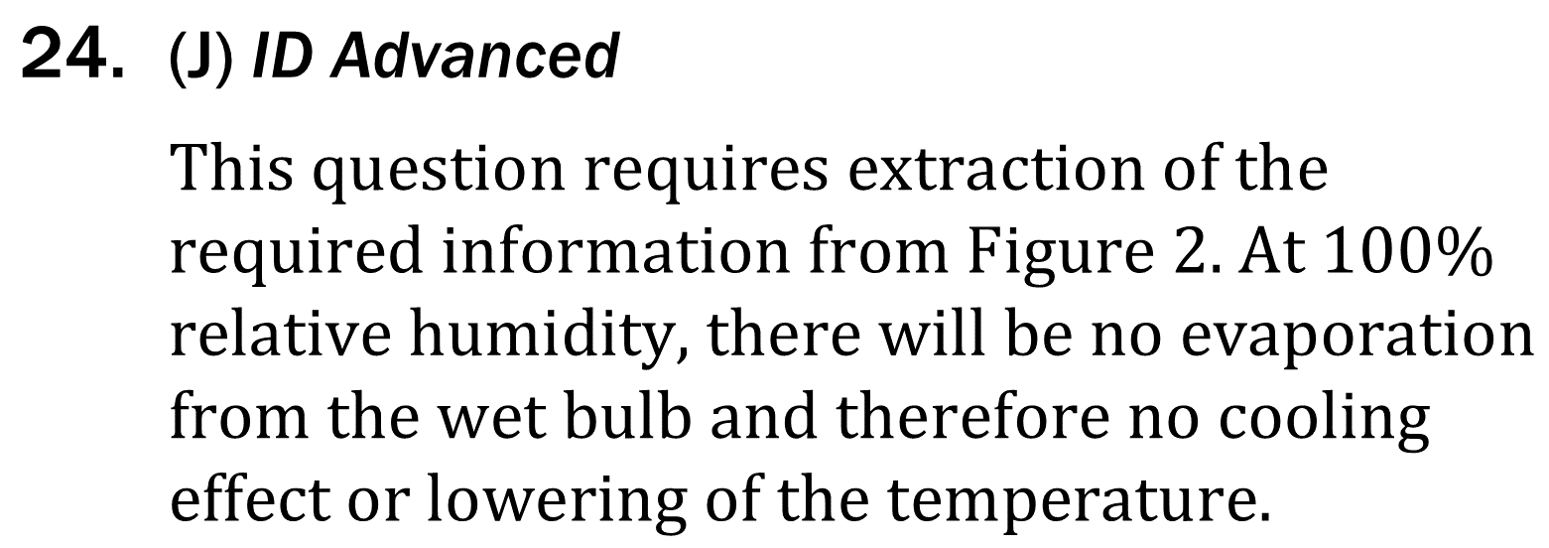
Notes:
Compare and contrast models. Level: Advanced Skill Group: Interpretation of Data

