Slide 1
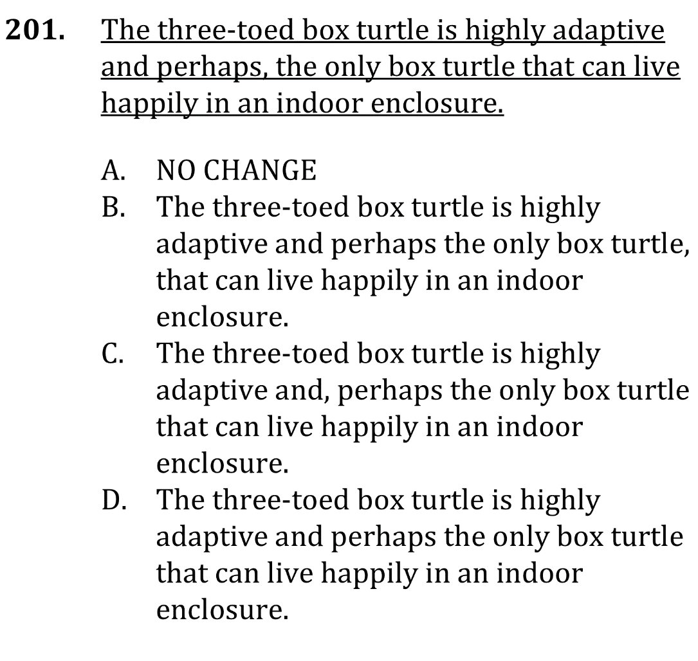

Use commas correctly

Slide 2
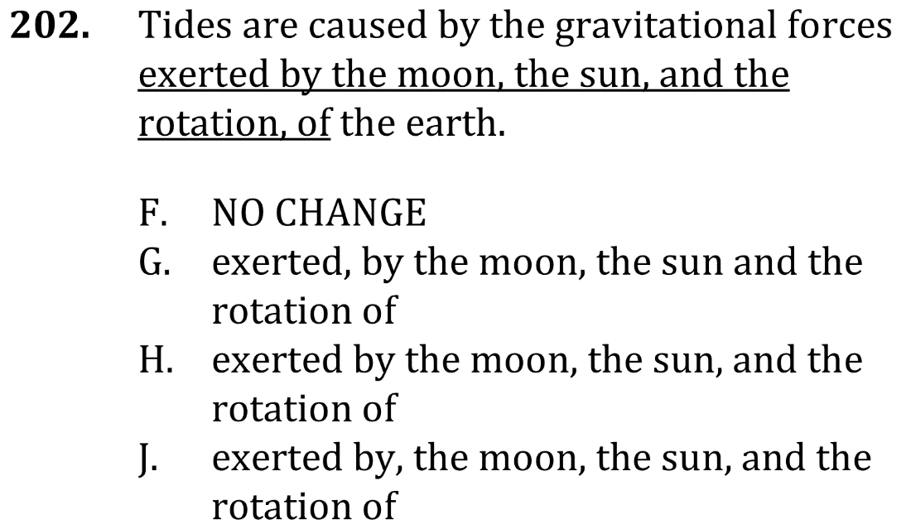
Use commas correctly

Slide 3


Use commas correctly

Slide 4


Use commas correctly

