Slide 1
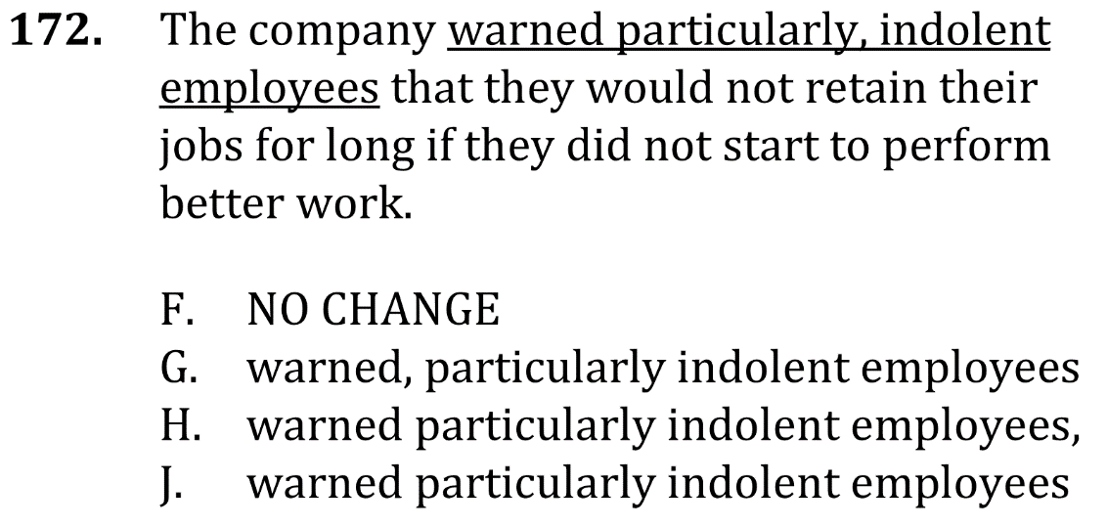
Eliminate unnecessary commas

Slide 2
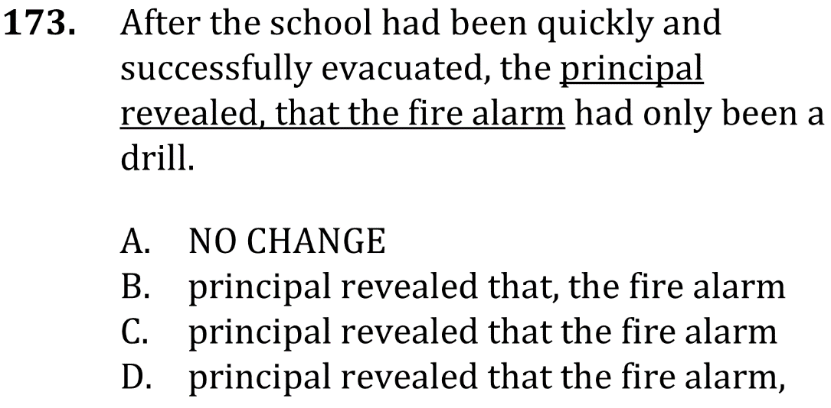
Delete unnecessary commas

Slide 3
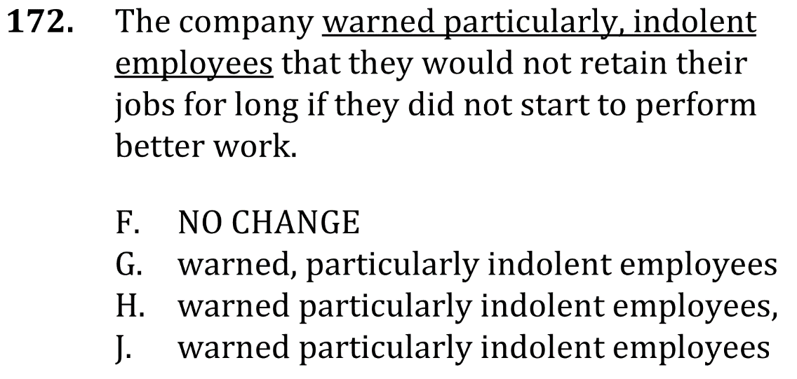
Delete unnecessary commas

Slide 4
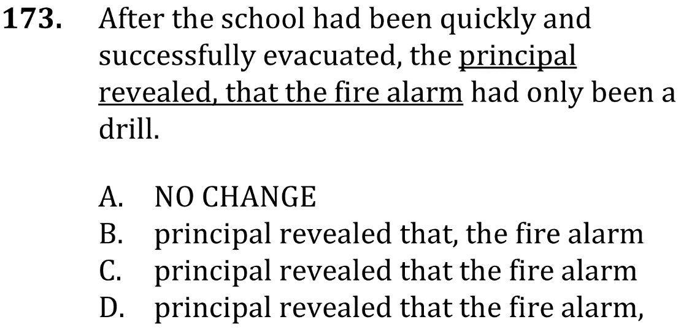
Delete unnecessary commas

