Slide 1
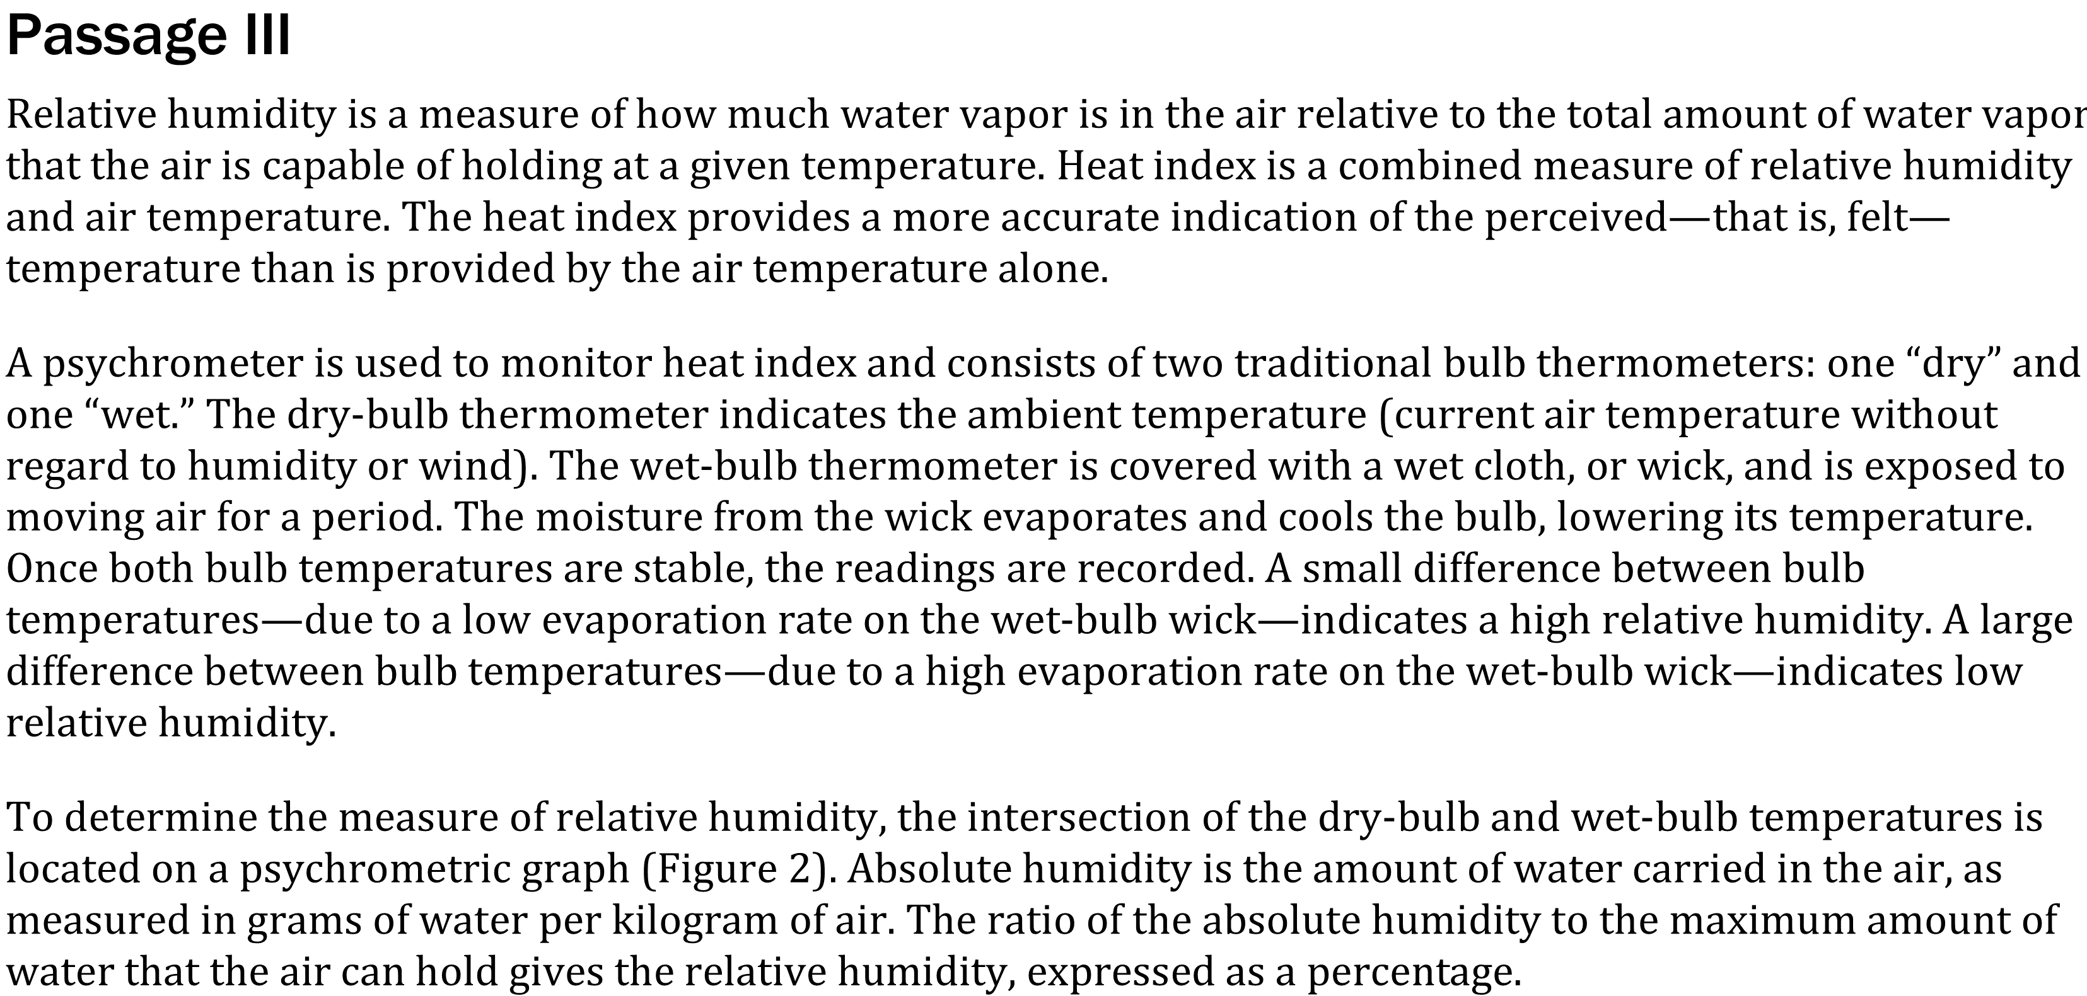

Notes:
Read and interpret data in more complex data presentations. Level: Advanced Skill Group: Scientific Investigation

Slide 2
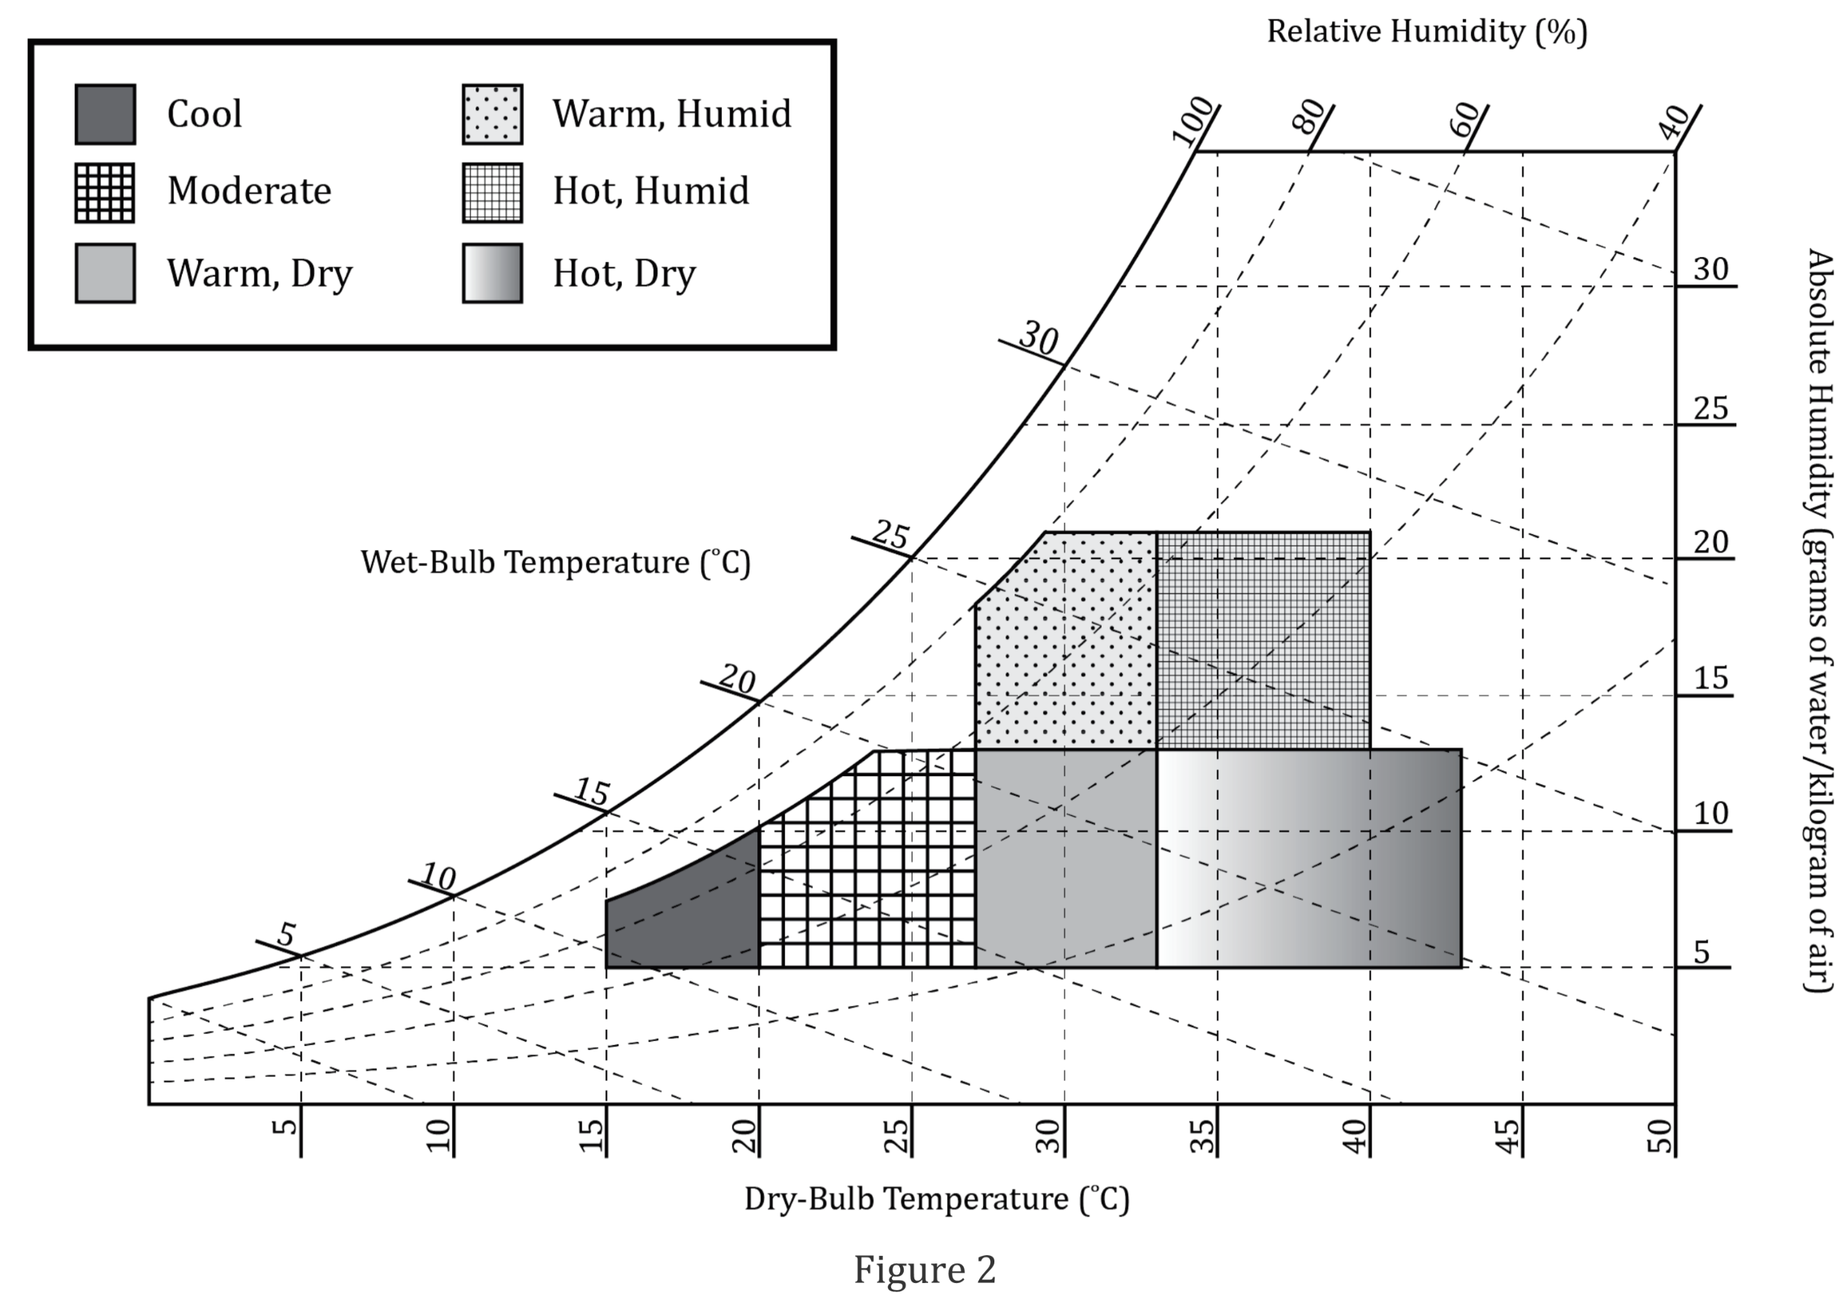
Notes:
Read and interpret data in more complex data presentations. Level: Advanced Skill Group: Scientific Investigation

Slide 3
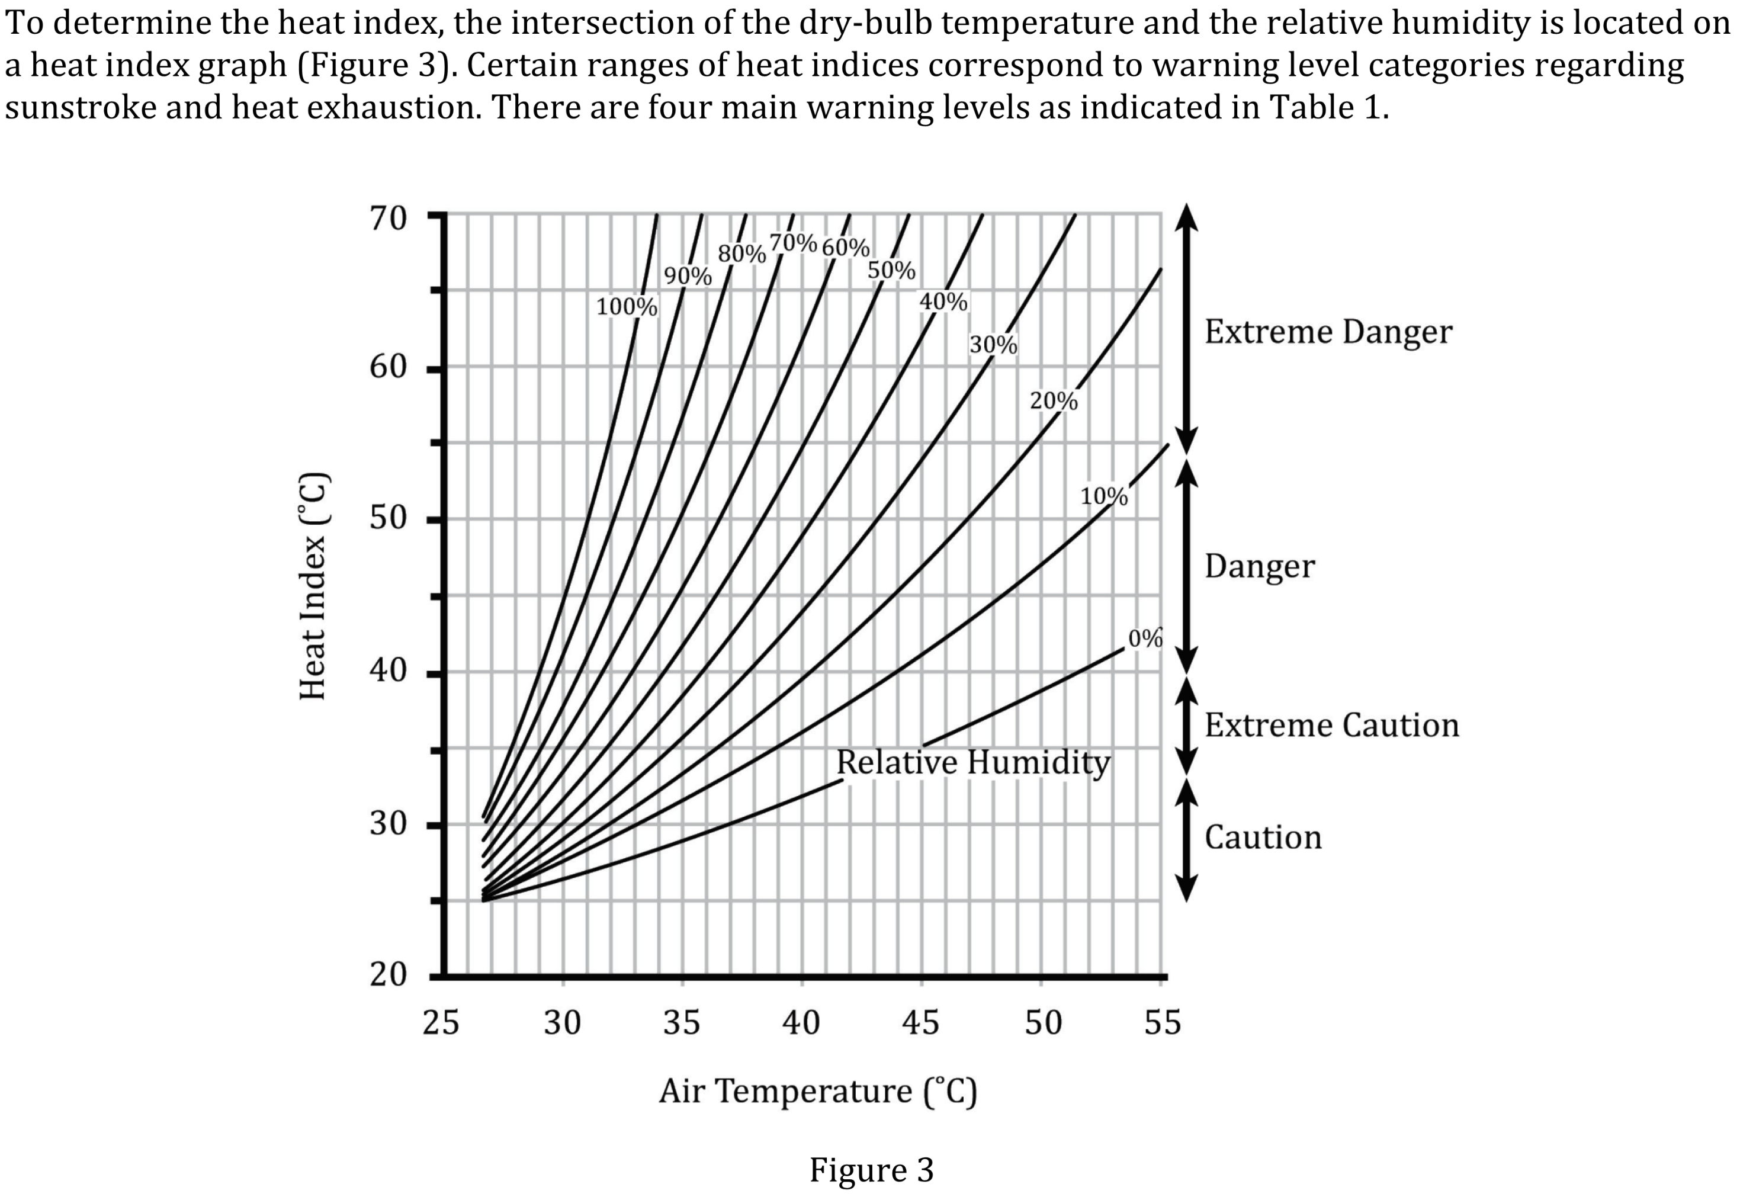
Notes:
Read and interpret data in more complex data presentations. Level: Advanced Skill Group: Scientific Investigation

Slide 4
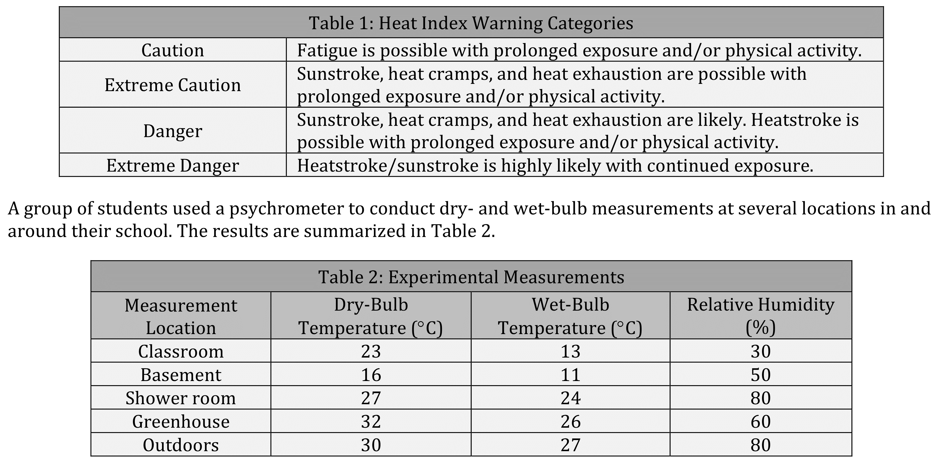
Notes:
Read and interpret data in more complex data presentations. Level: Advanced Skill Group: Scientific Investigation

Slide 5
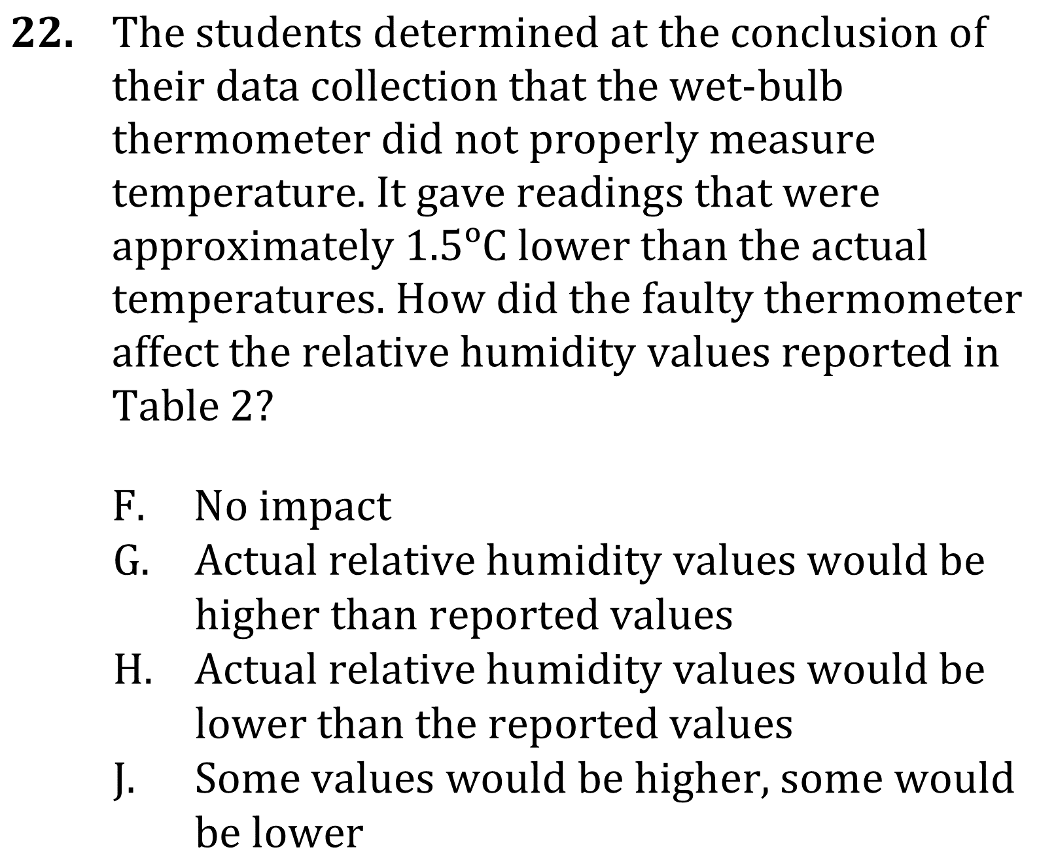
Notes:
Read and interpret data in more complex data presentations. Level: Advanced Skill Group: Scientific Investigation

Slide 6
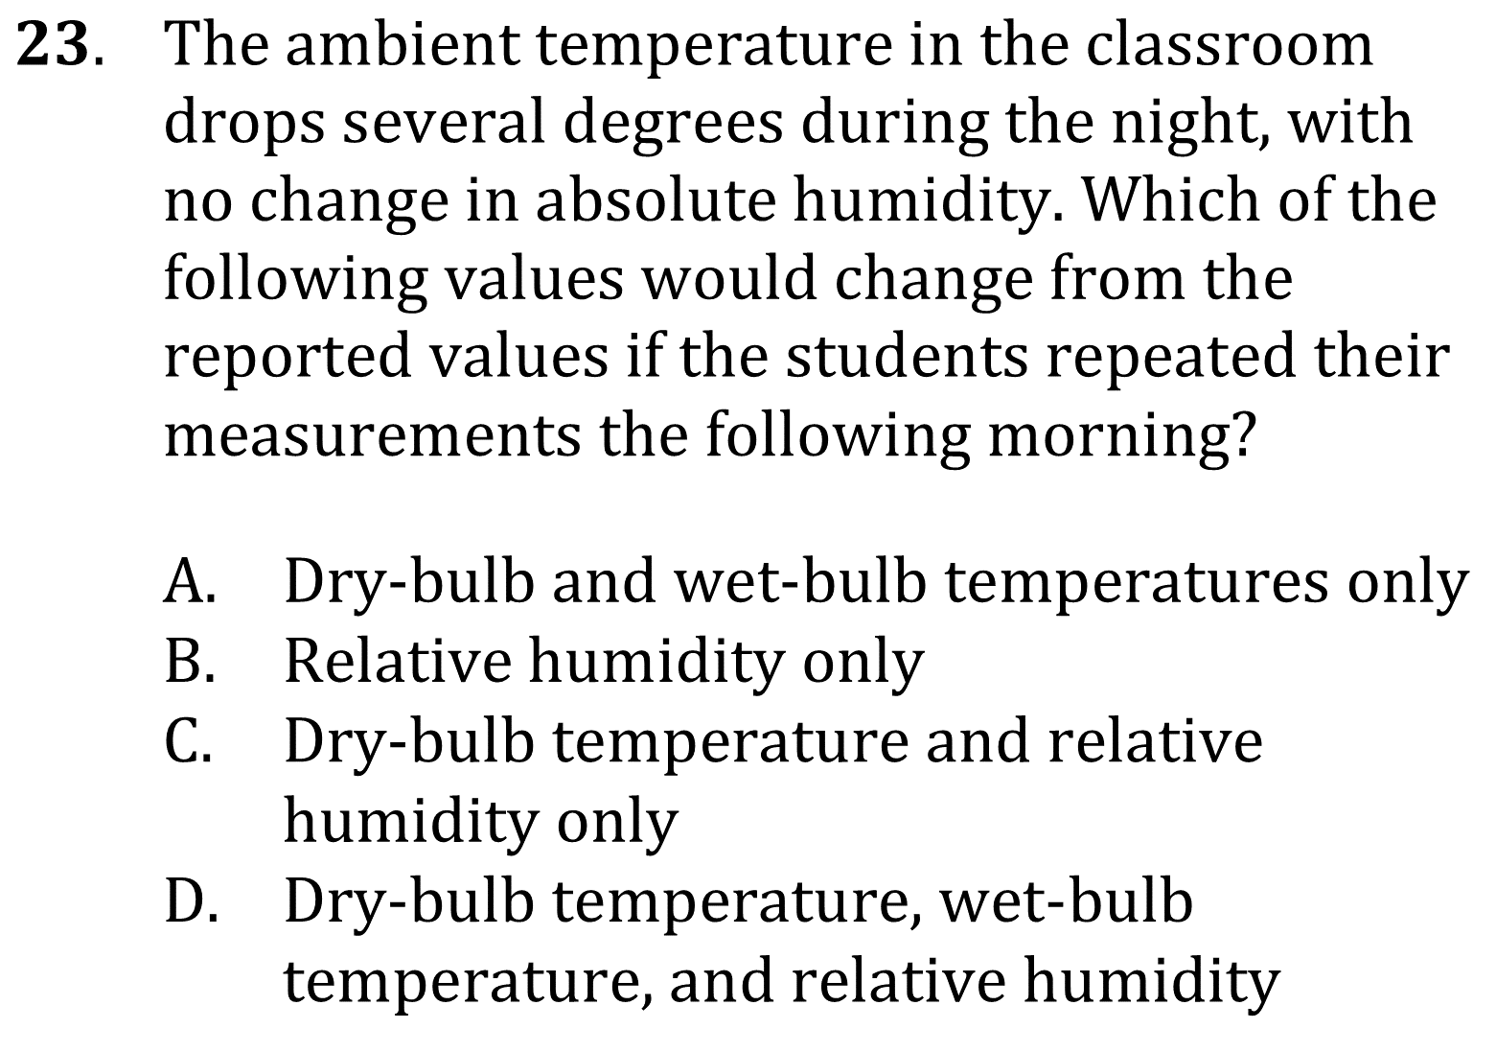
Notes:
Read and interpret data in more complex data presentations. Level: Advanced Skill Group: Scientific Investigation

Slide 7
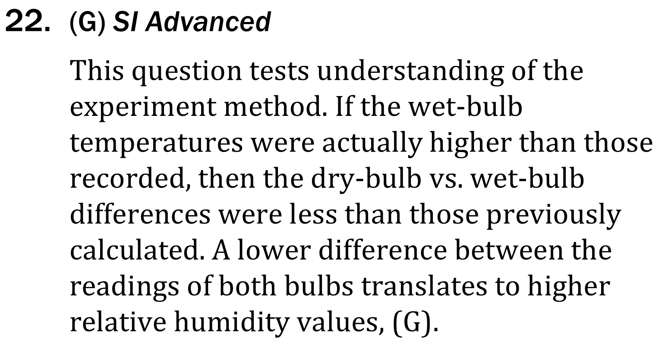
Notes:
Read and interpret data in more complex data presentations. Level: Advanced Skill Group: Scientific Investigation

Slide 8
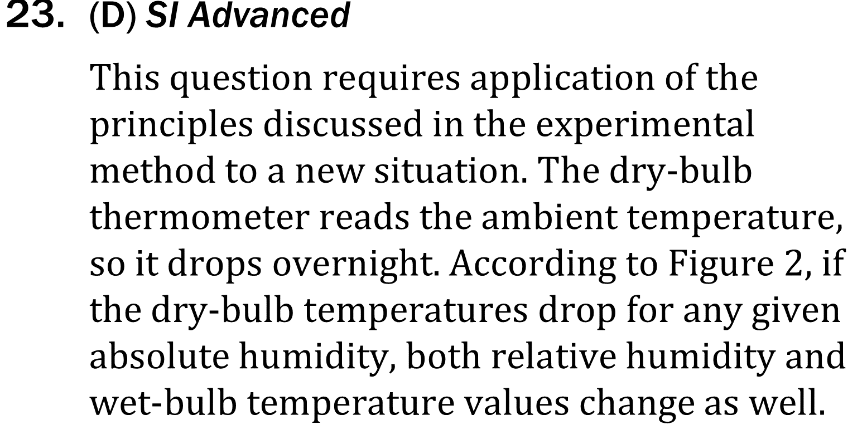
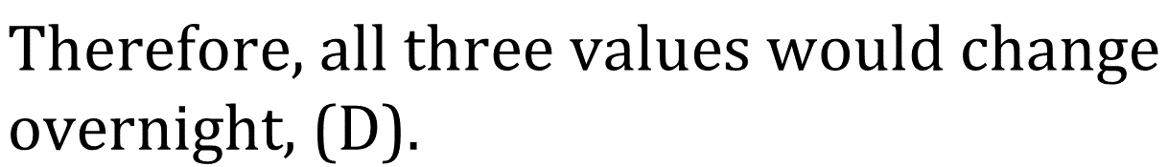
Notes:
Read and interpret data in more complex data presentations. Level: Advanced Skill Group: Scientific Investigation

