Slide 1
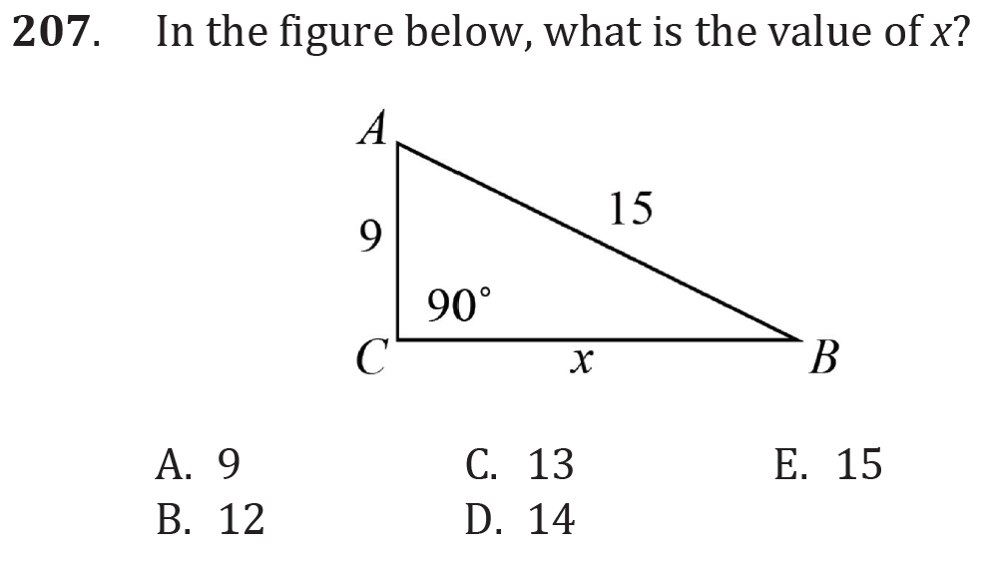
Pythagorean Theorem

Slide 2
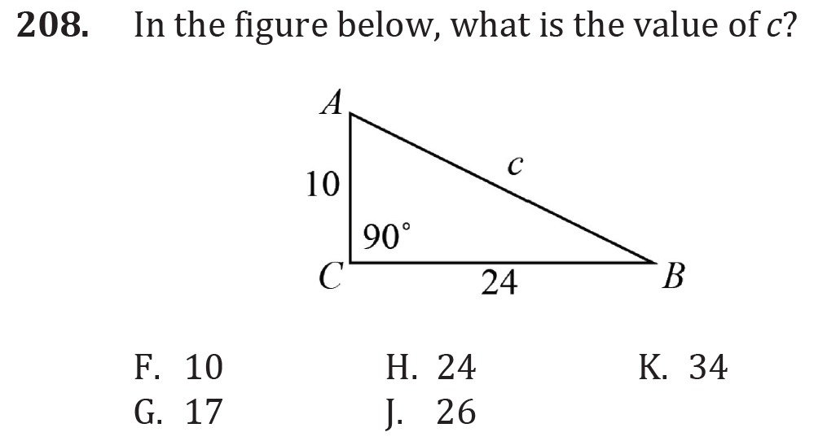
Pythagorean Theorem

Slide 3
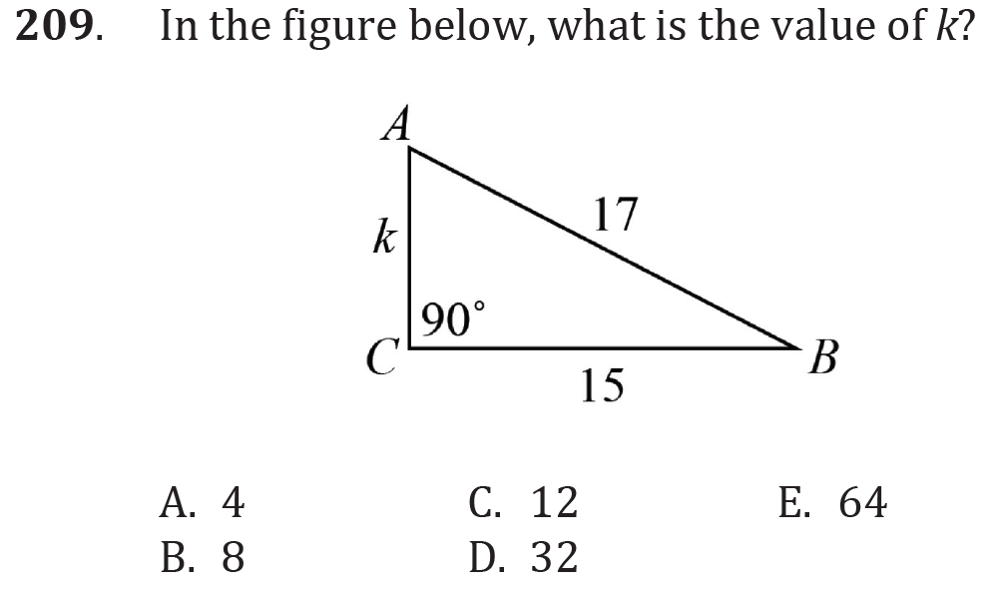
Pythagorean Theorem

Slide 4
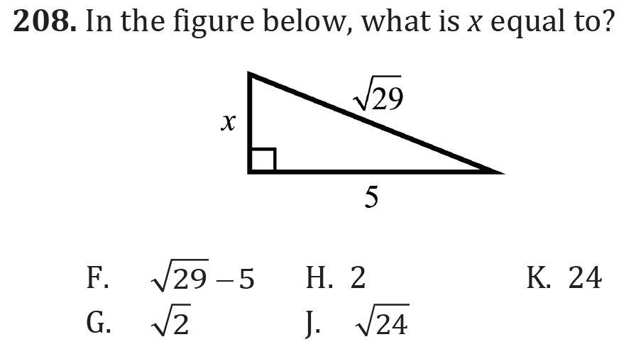
Pythagorean Theorem

Slide 5
Pythagorean Theorem

Slide 6
Pythagorean Theorem

Slide 7
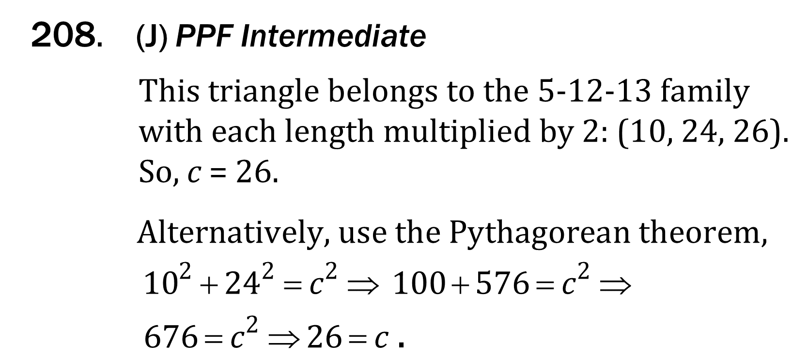
Pythagorean Theorem

Slide 8
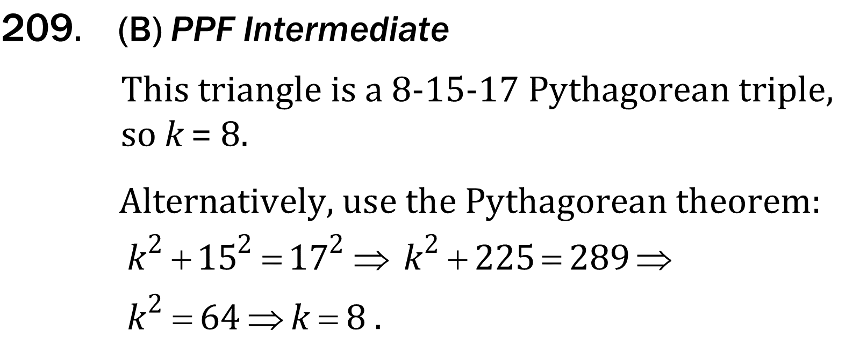
Pythagorean Theorem

Slide 9
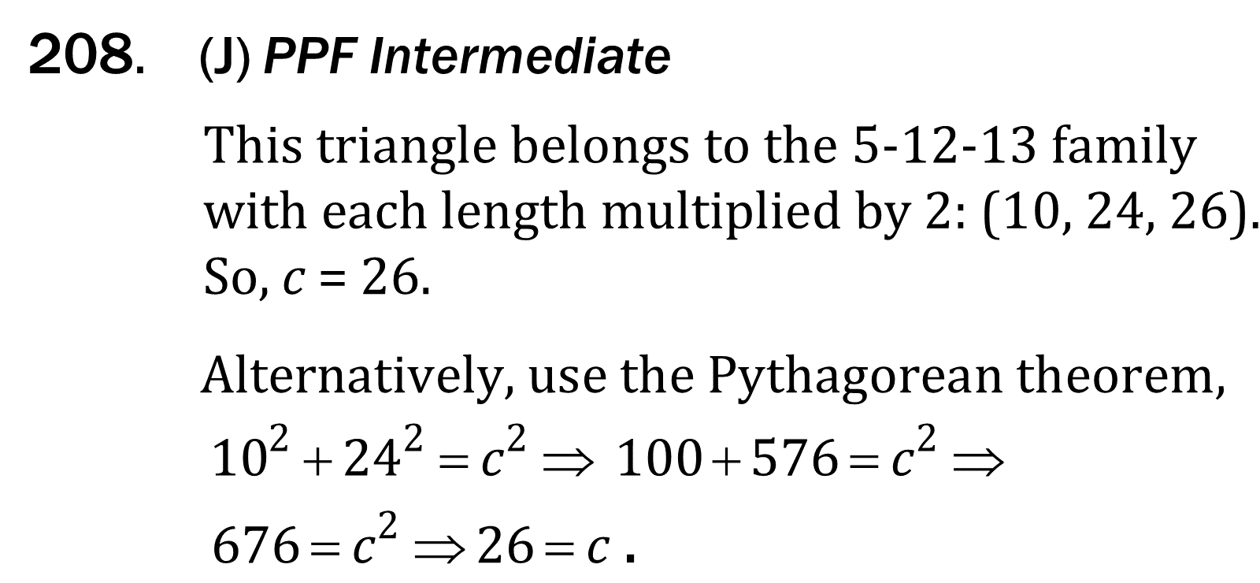
Pythagorean Theorem

Slide 10
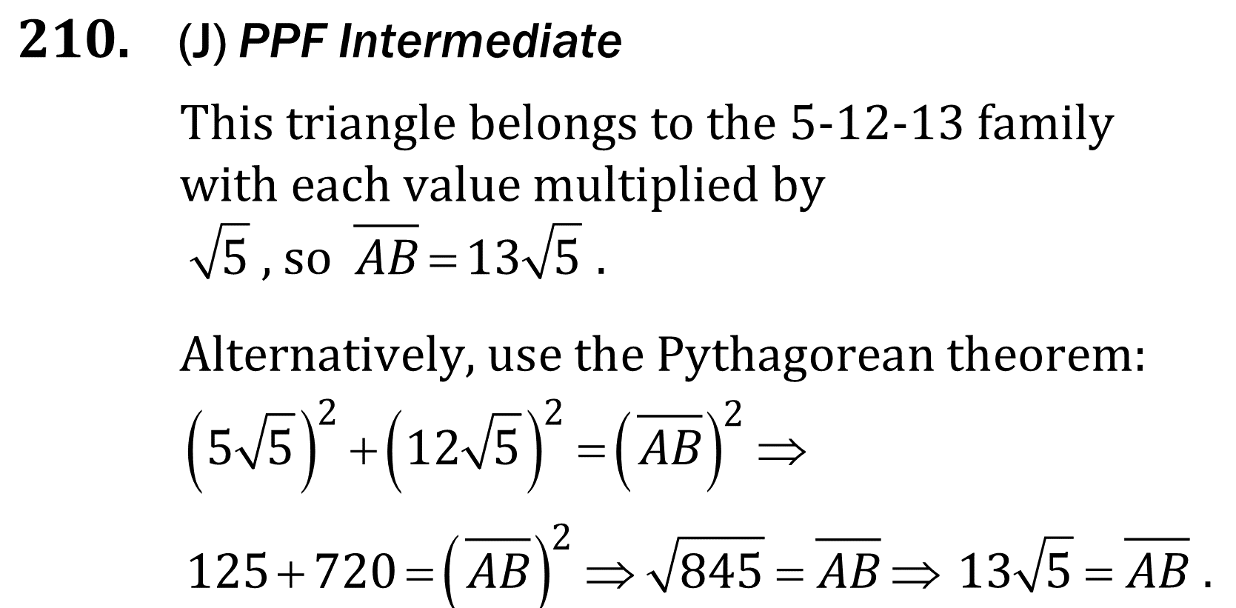
Pythagorean Theorem

