Slide 1
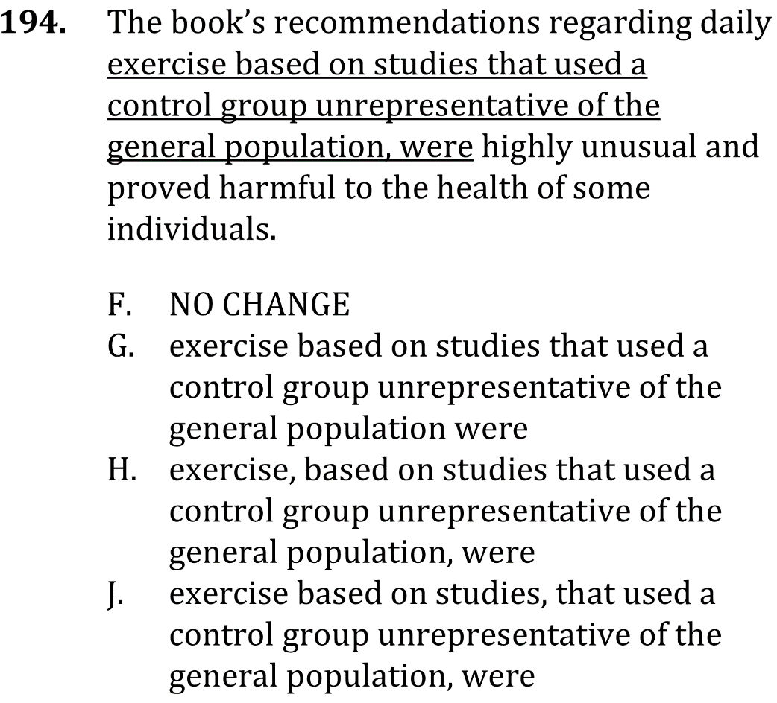

commas and parenthetical phrases

Slide 2
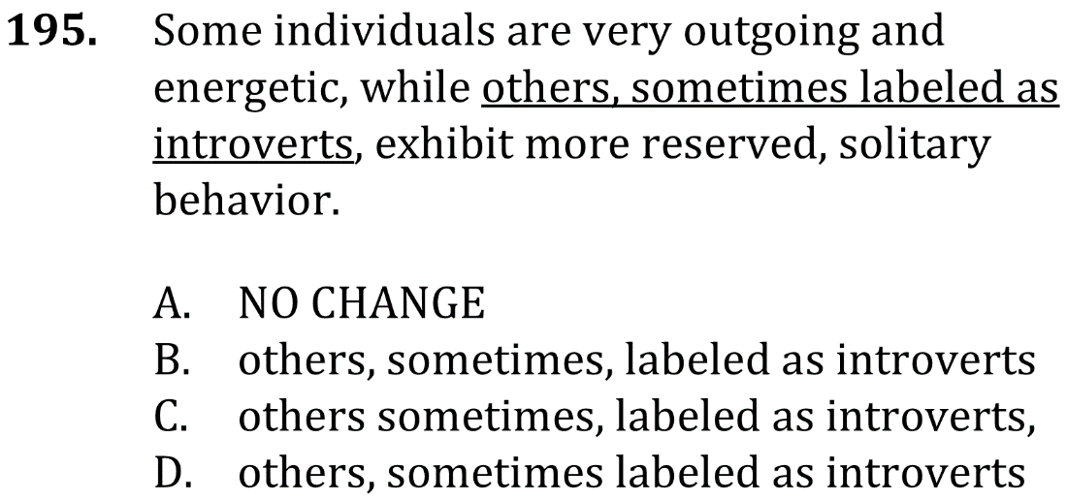
commas and parenthetical phrases

Slide 3

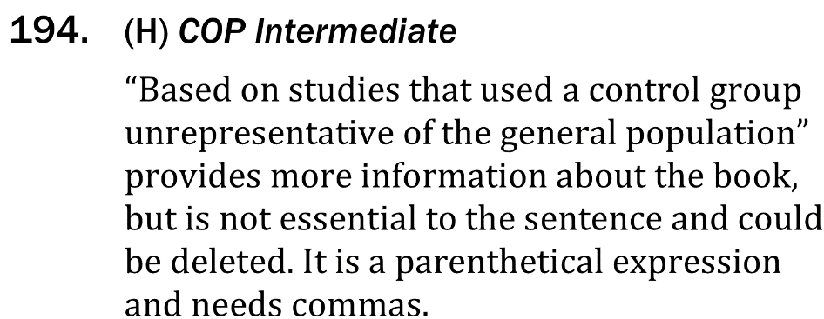
commas and parenthetical phrases

Slide 4


commas and parenthetical phrases

