Slide 1
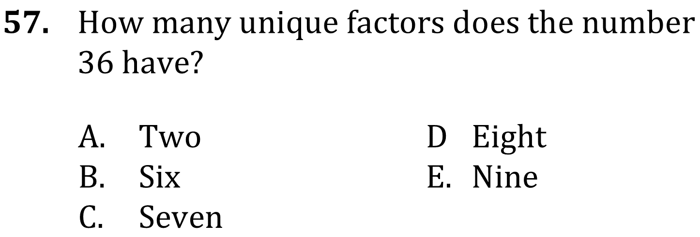
Factors, prime numbers, & odds/evens

Slide 2
Factors, prime numbers, & odds/evens

Slide 3
Factors, prime numbers, & odds/evens

Slide 4
Factors, prime numbers, & odds/evens

Slide 5
Factors, prime numbers, & odds/evens

Slide 6
Factors, prime numbers, & odds/evens

Slide 7
Factors, prime numbers, & odds/evens

Slide 8
Factors, prime numbers, & odds/evens

