Slide 1
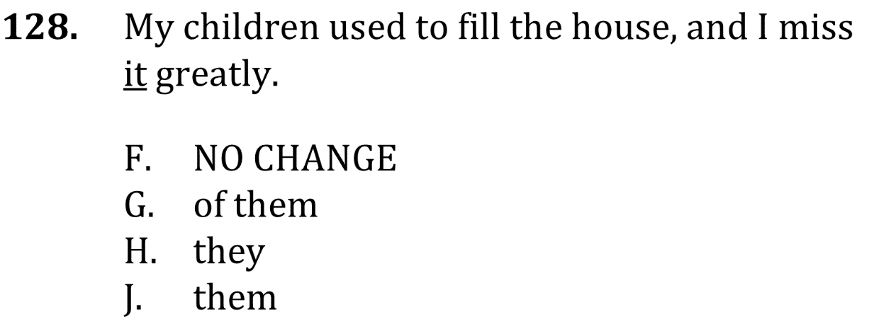
Use the right pronoun

Slide 2
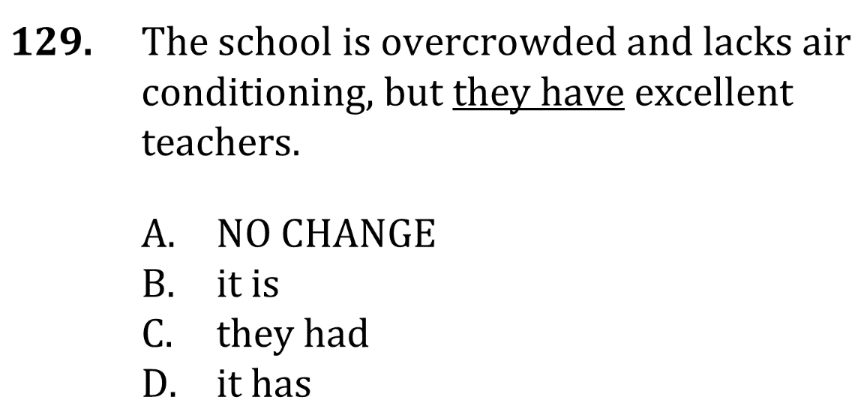
Use the right pronoun

Slide 3
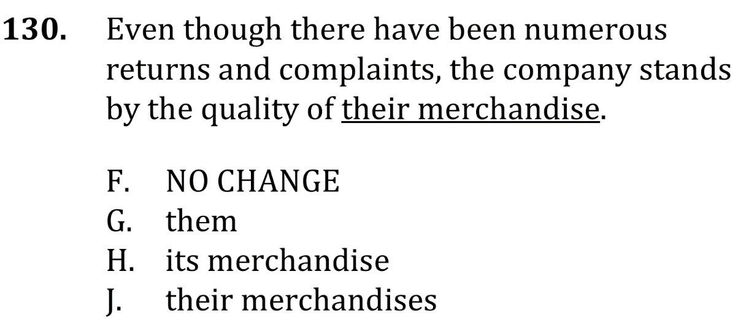
Use the right pronoun

Slide 4
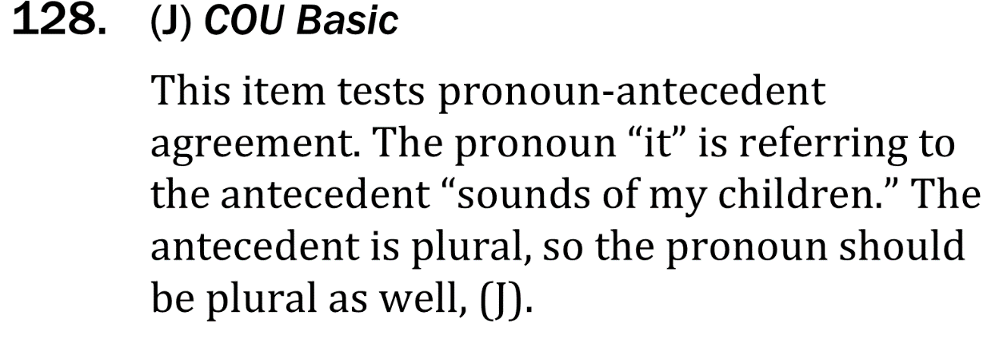
Use the right pronoun

Slide 5
Use the right pronoun

Slide 6
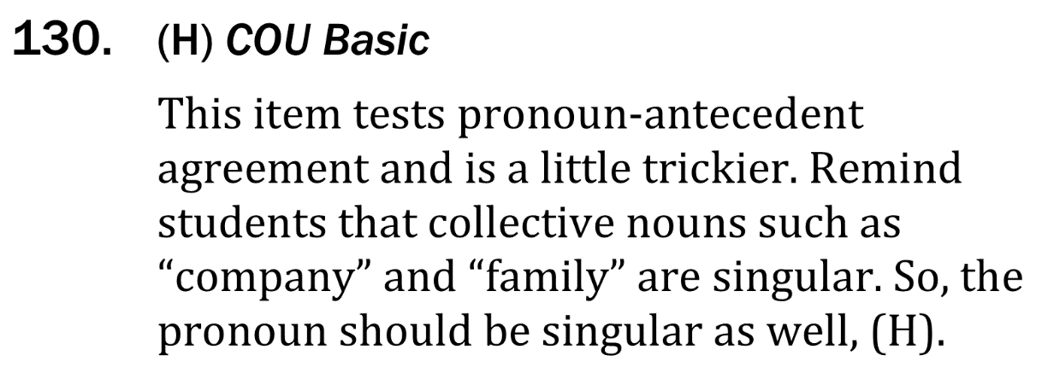
Use the right pronoun

