Slide 1
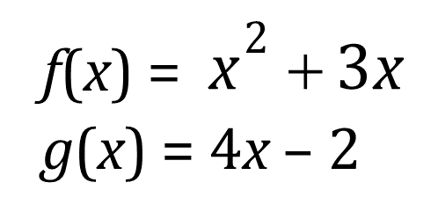


Composition of Functions

Slide 2

Composition of Functions

Slide 3
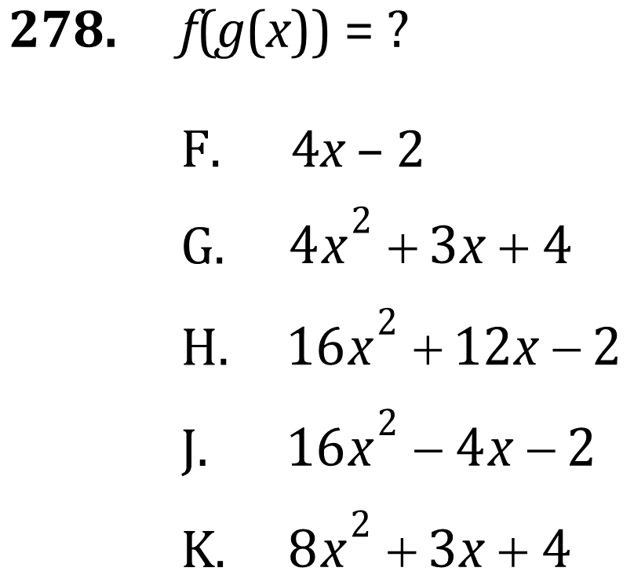
Composition of Functions

Slide 4
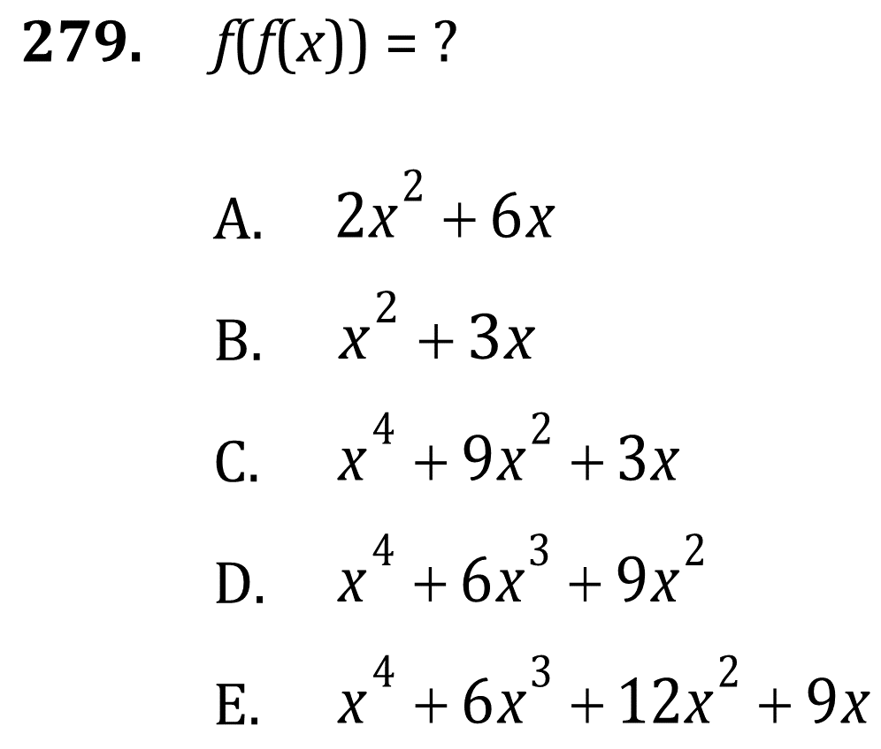
Composition of Functions

Slide 5

Composition of Functions

Slide 6
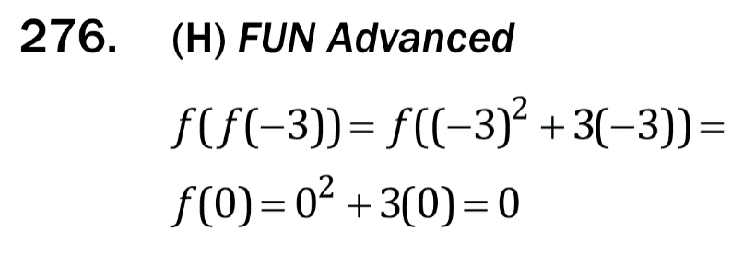
Composition of Functions

Slide 7
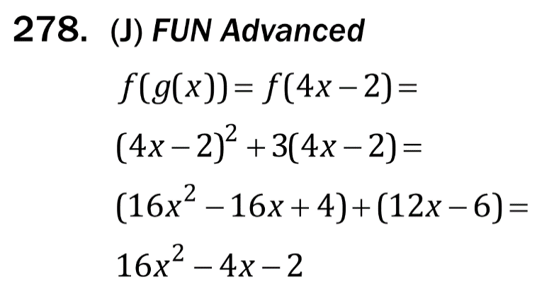
Composition of Functions

Slide 8
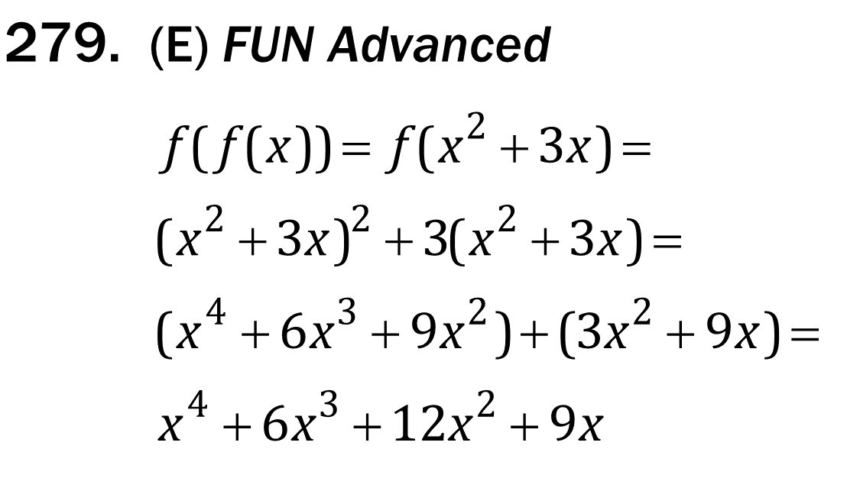
Composition of Functions

