Slide 1
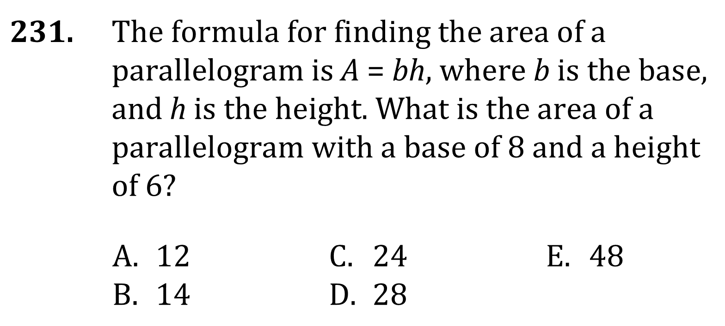
Area and Perimeter

Slide 2
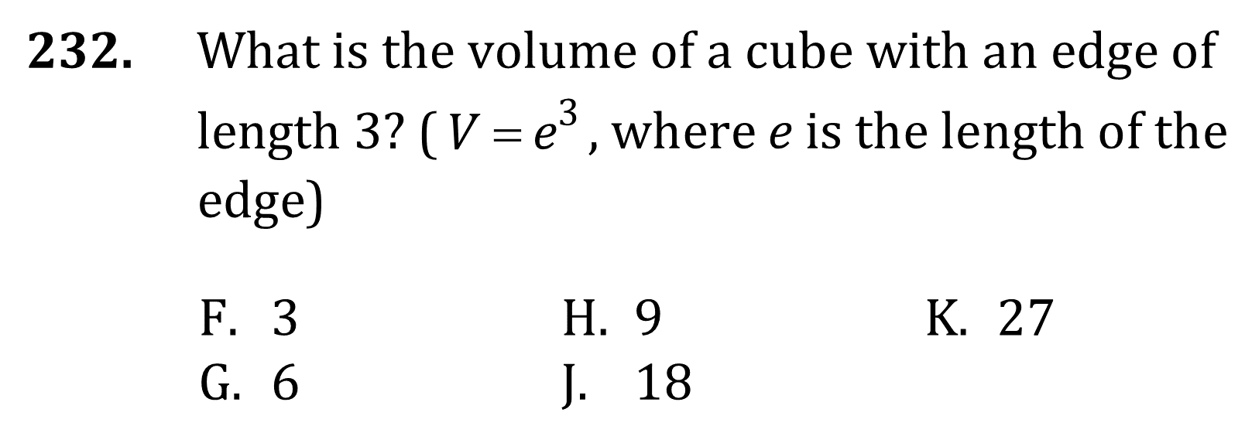
Area and Perimeter

Slide 3
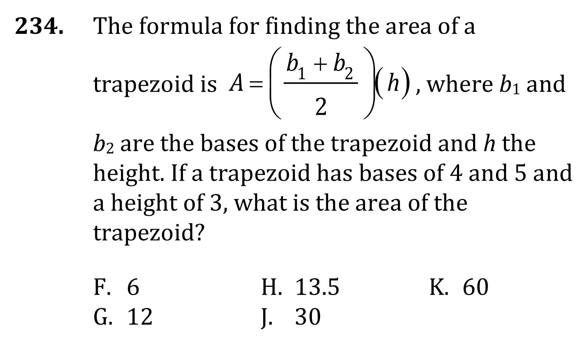
Area and Perimeter

Slide 4
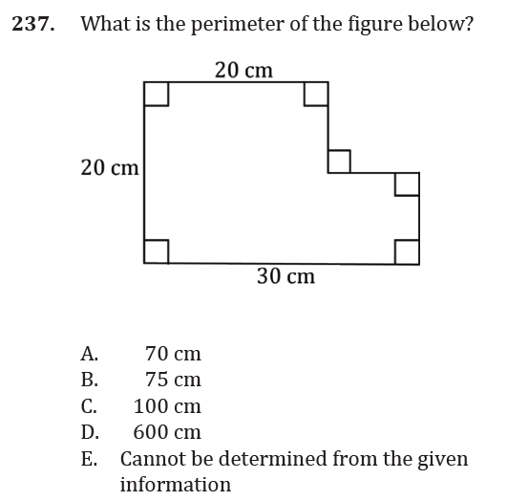
Area and Perimeter

Slide 5
Area and Perimeter

Slide 6
Area and Perimeter

Slide 7
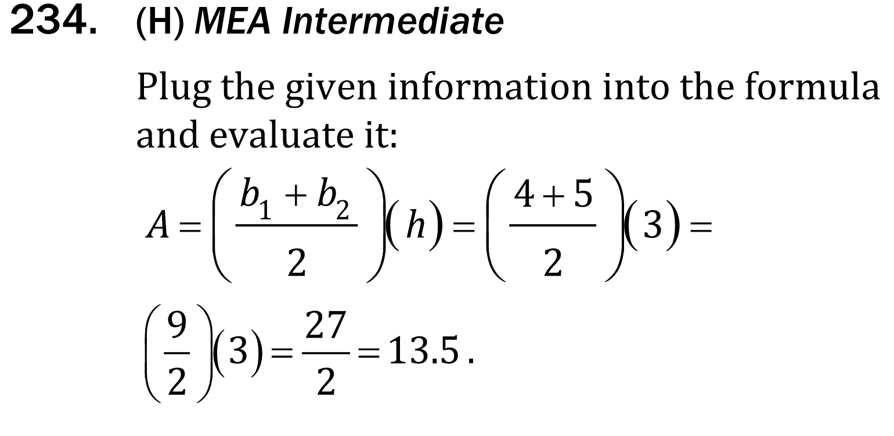
Area and Perimeter

Slide 8
Area and Perimeter

