Slide 1
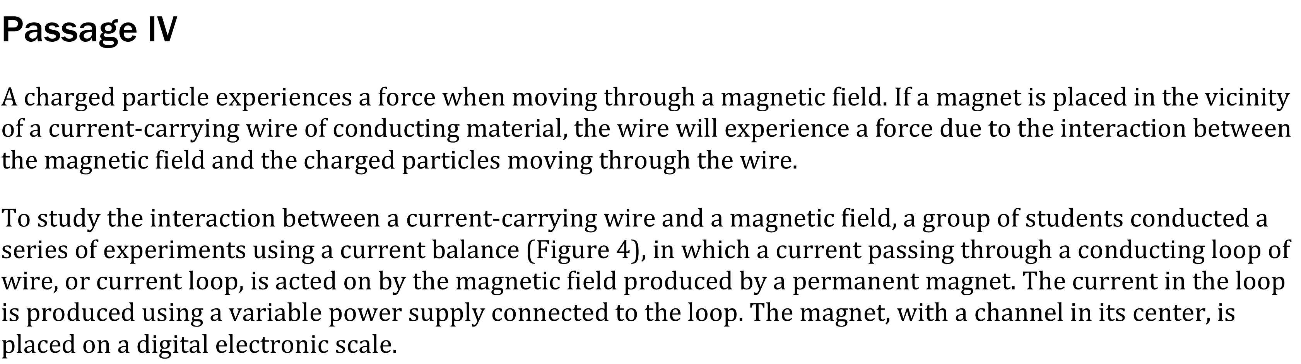
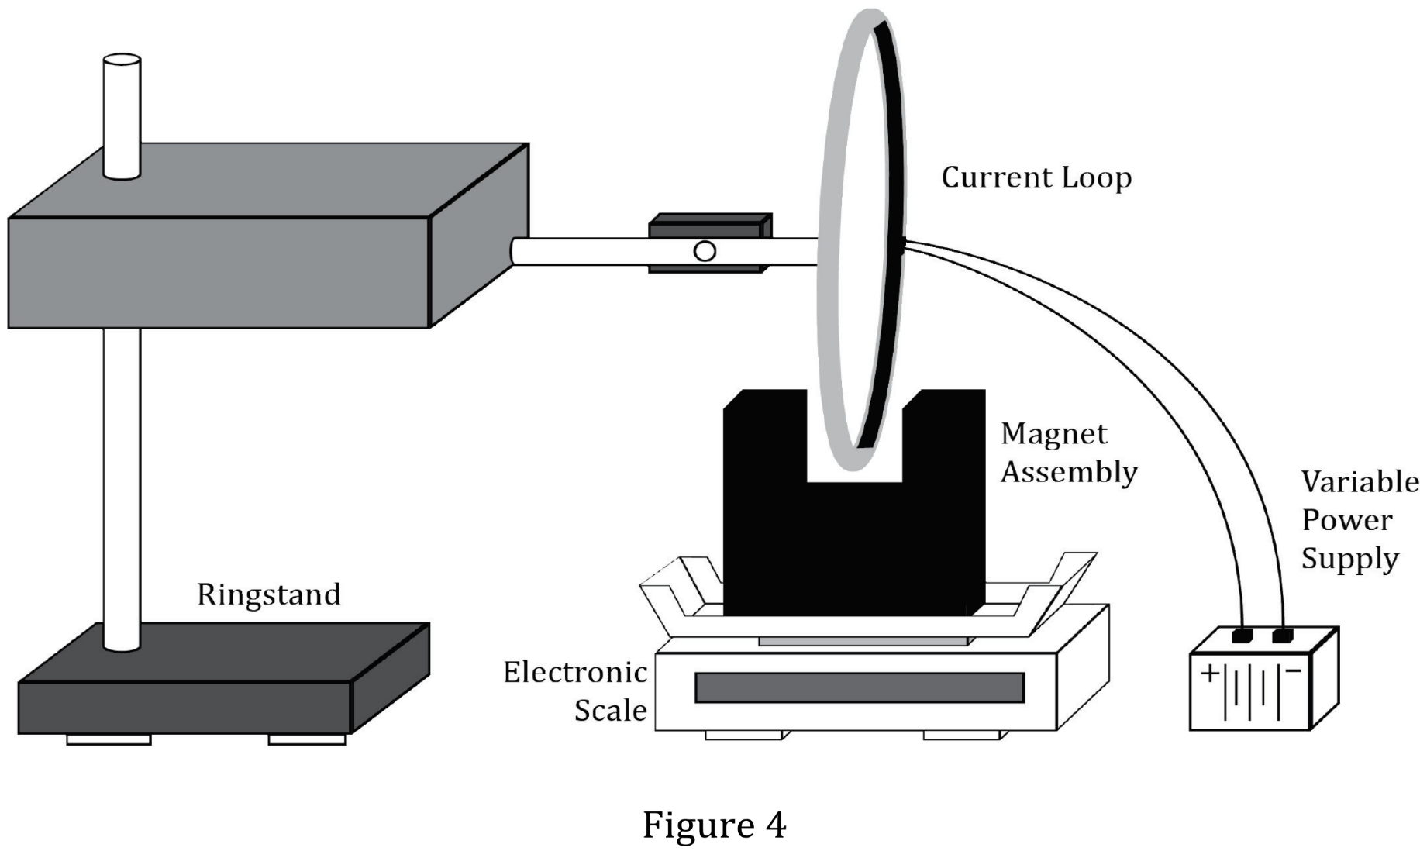

Notes:
Read and interpret data in more complex data presentations. Level: Advanced Skill Group: Interpretation of Data

Slide 2
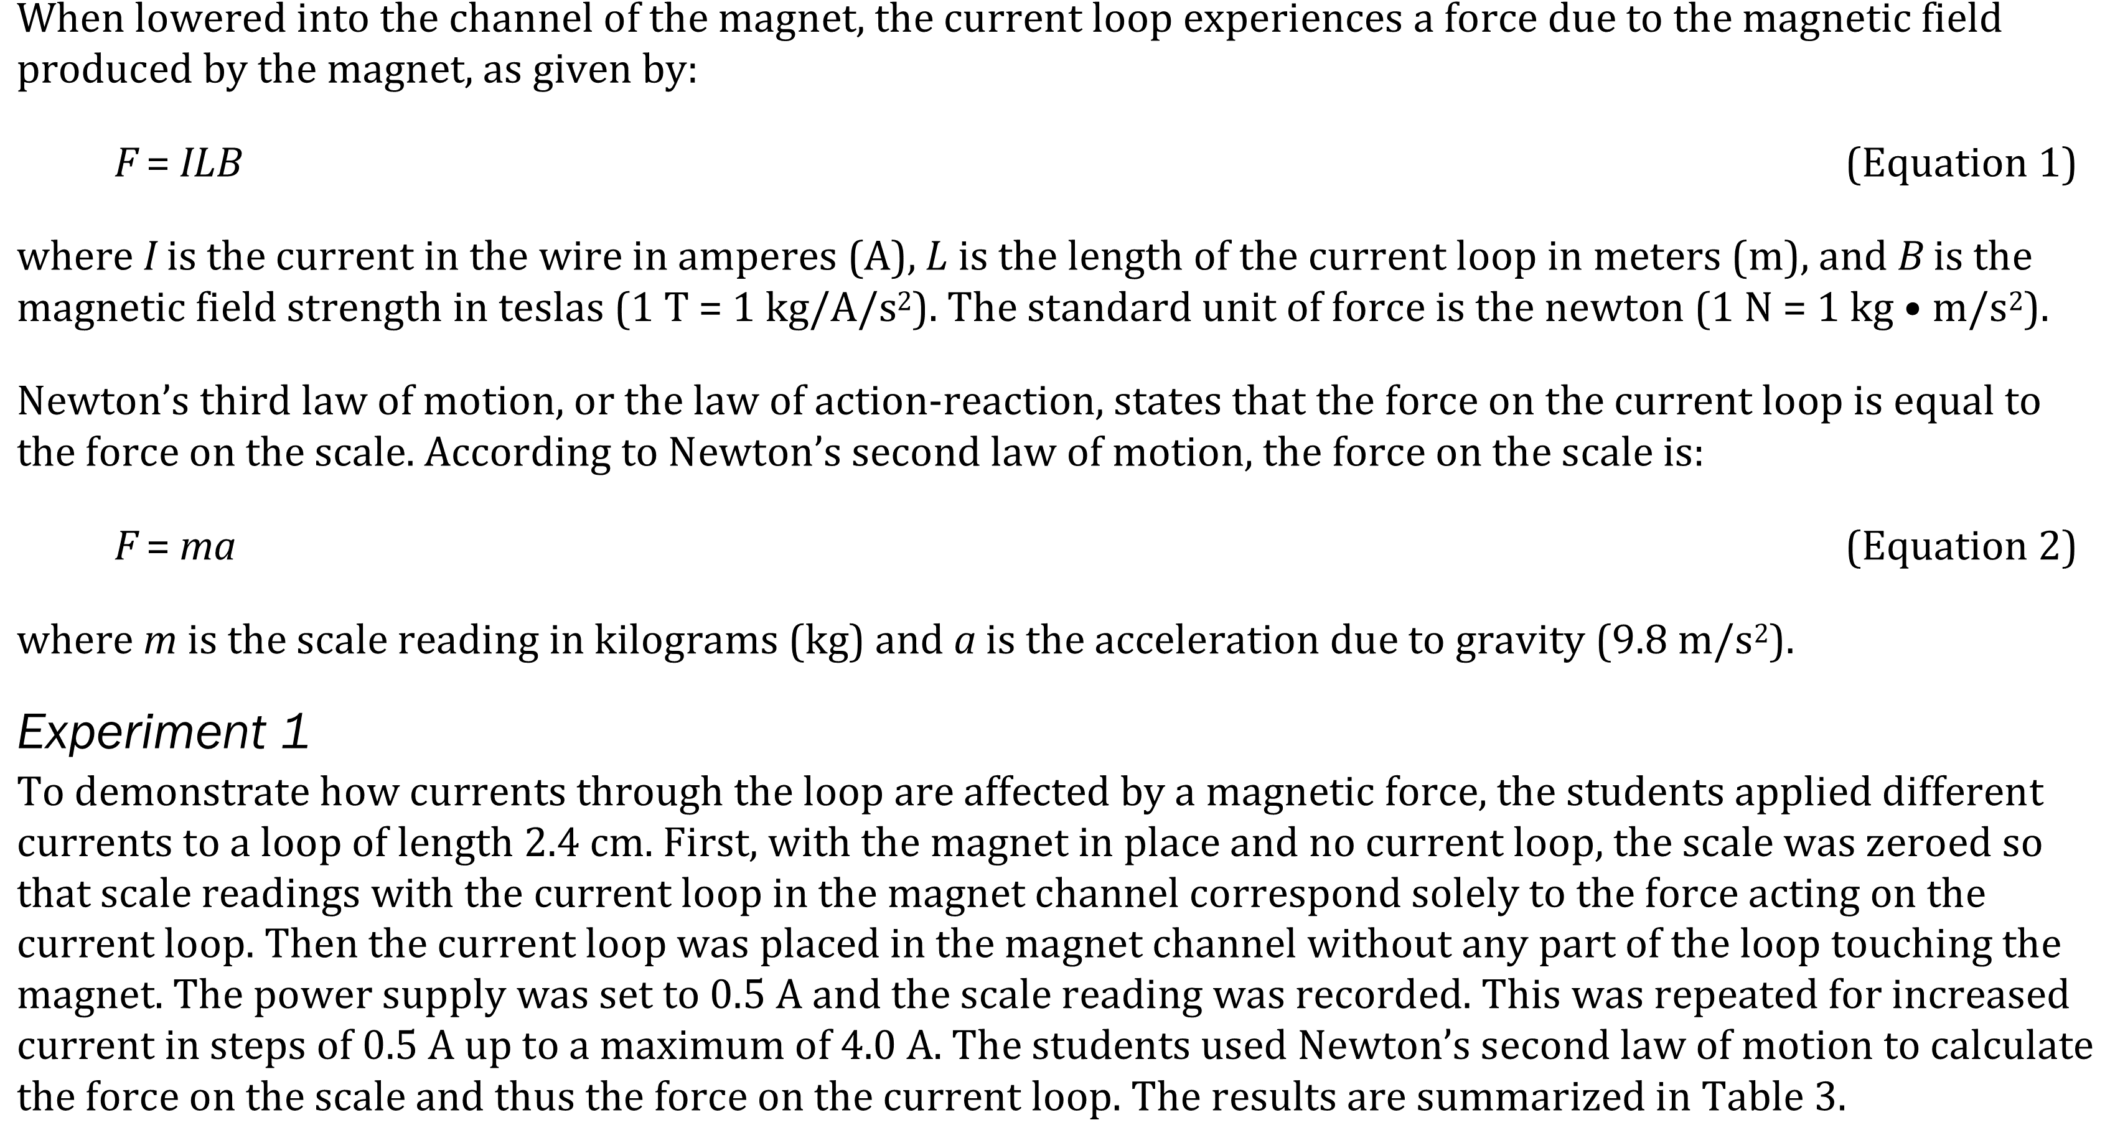
Notes:
Read and interpret data in more complex data presentations. Level: Advanced Skill Group: Interpretation of Data

Slide 3
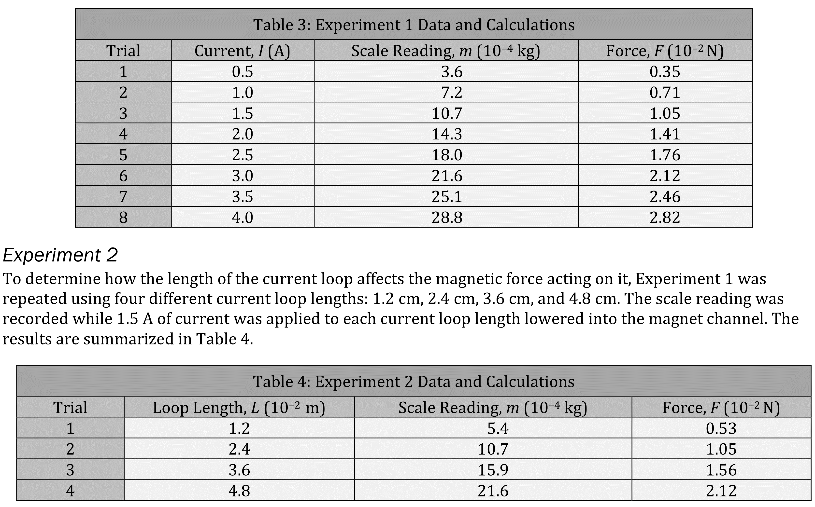
Notes:
Read and interpret data in more complex data presentations. Level: Advanced Skill Group: Interpretation of Data

Slide 4
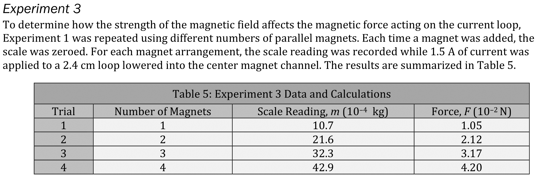
Notes:
Read and interpret data in more complex data presentations. Level: Advanced Skill Group: Interpretation of Data

Slide 5
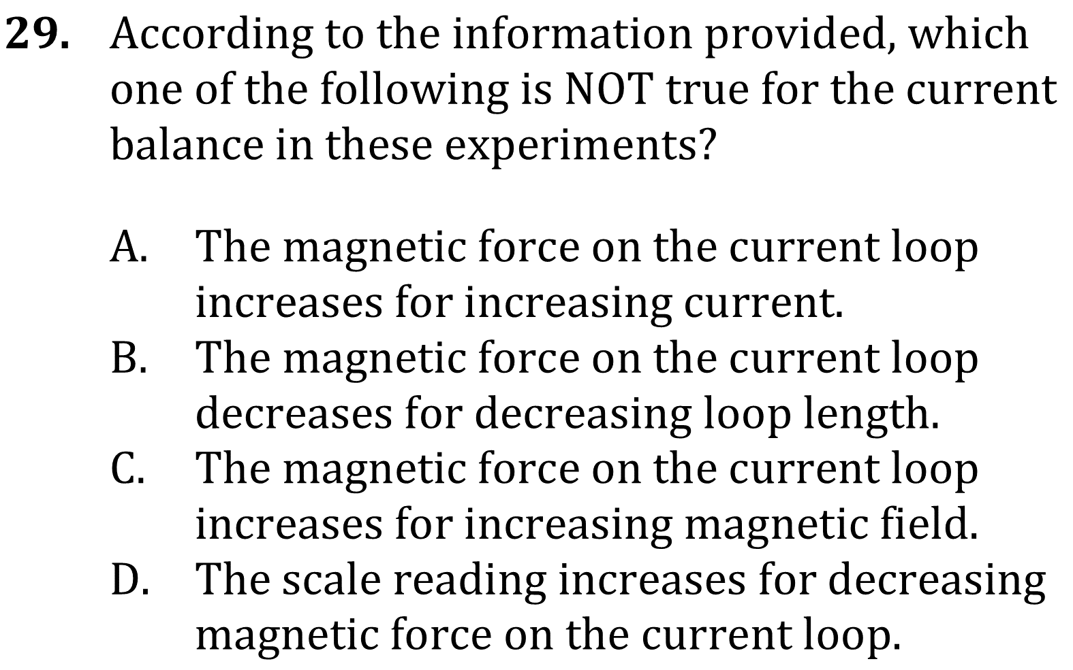
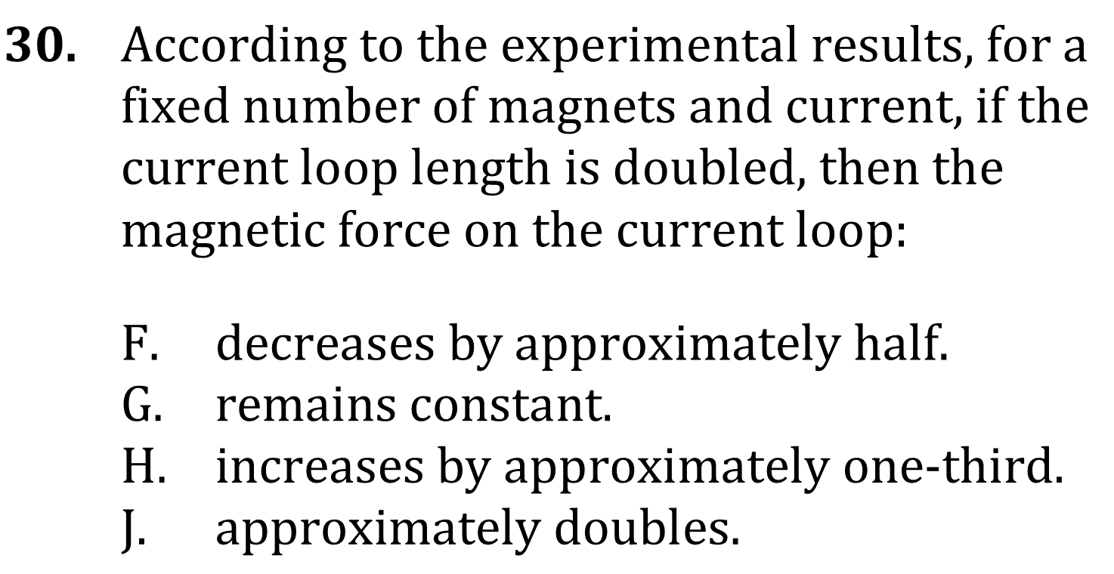
Notes:
Read and interpret data in more complex data presentations. Level: Advanced Skill Group: Interpretation of Data

Slide 6
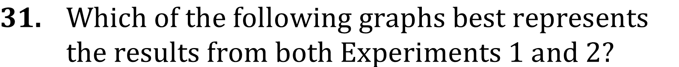
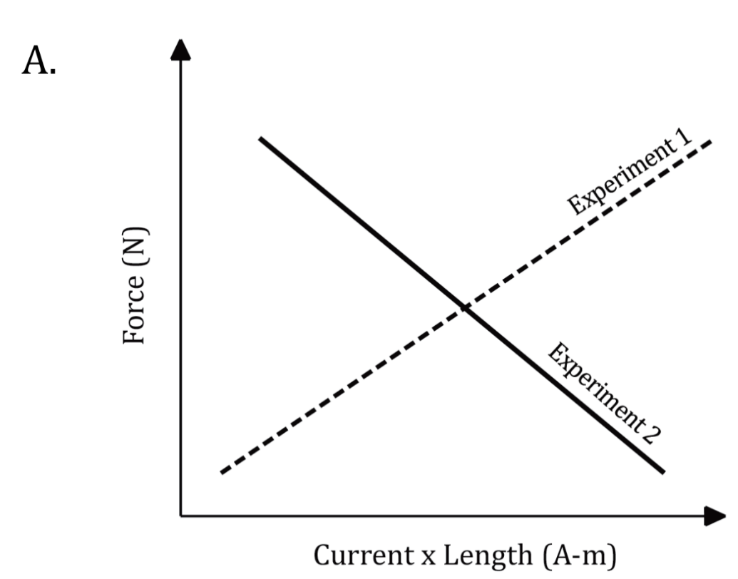
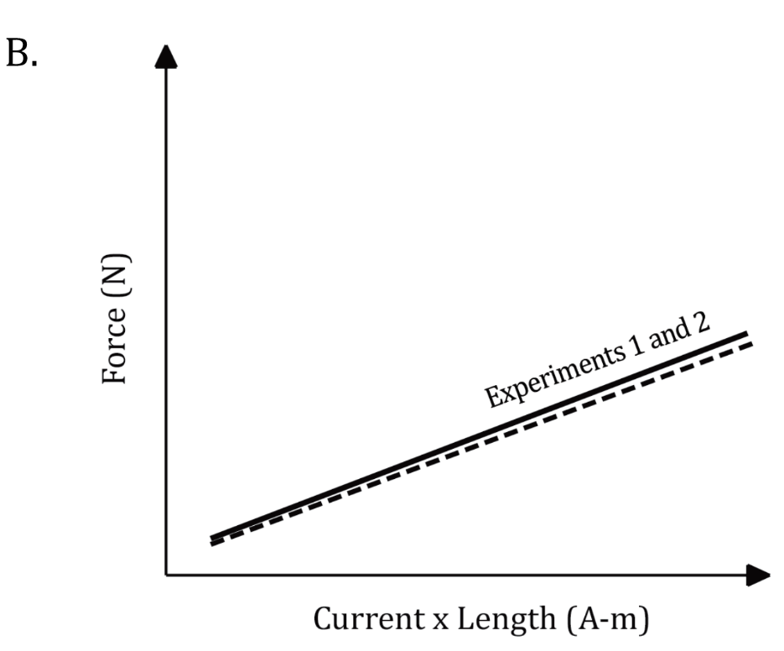
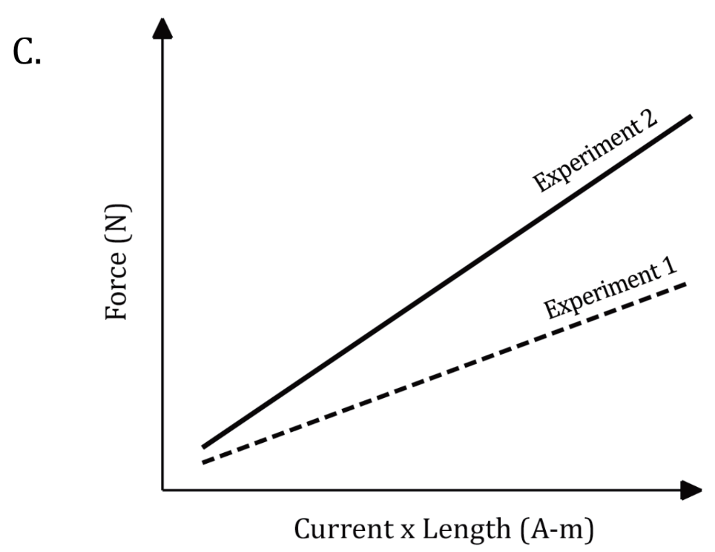
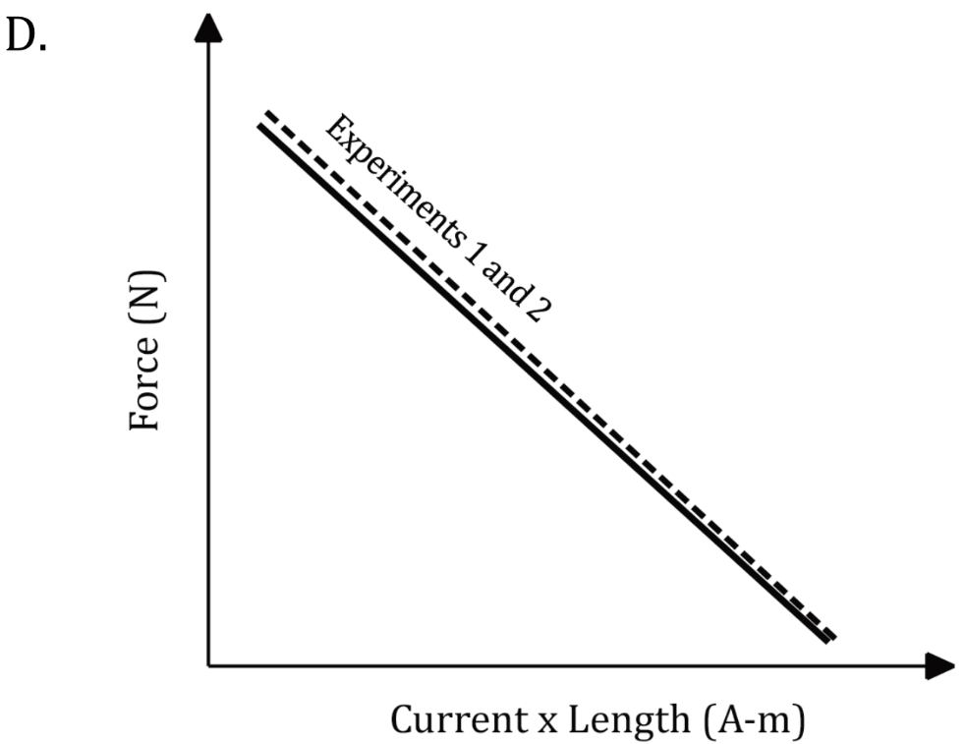
Notes:
Read and interpret data in more complex data presentations. Level: Advanced Skill Group: Interpretation of Data

Slide 7
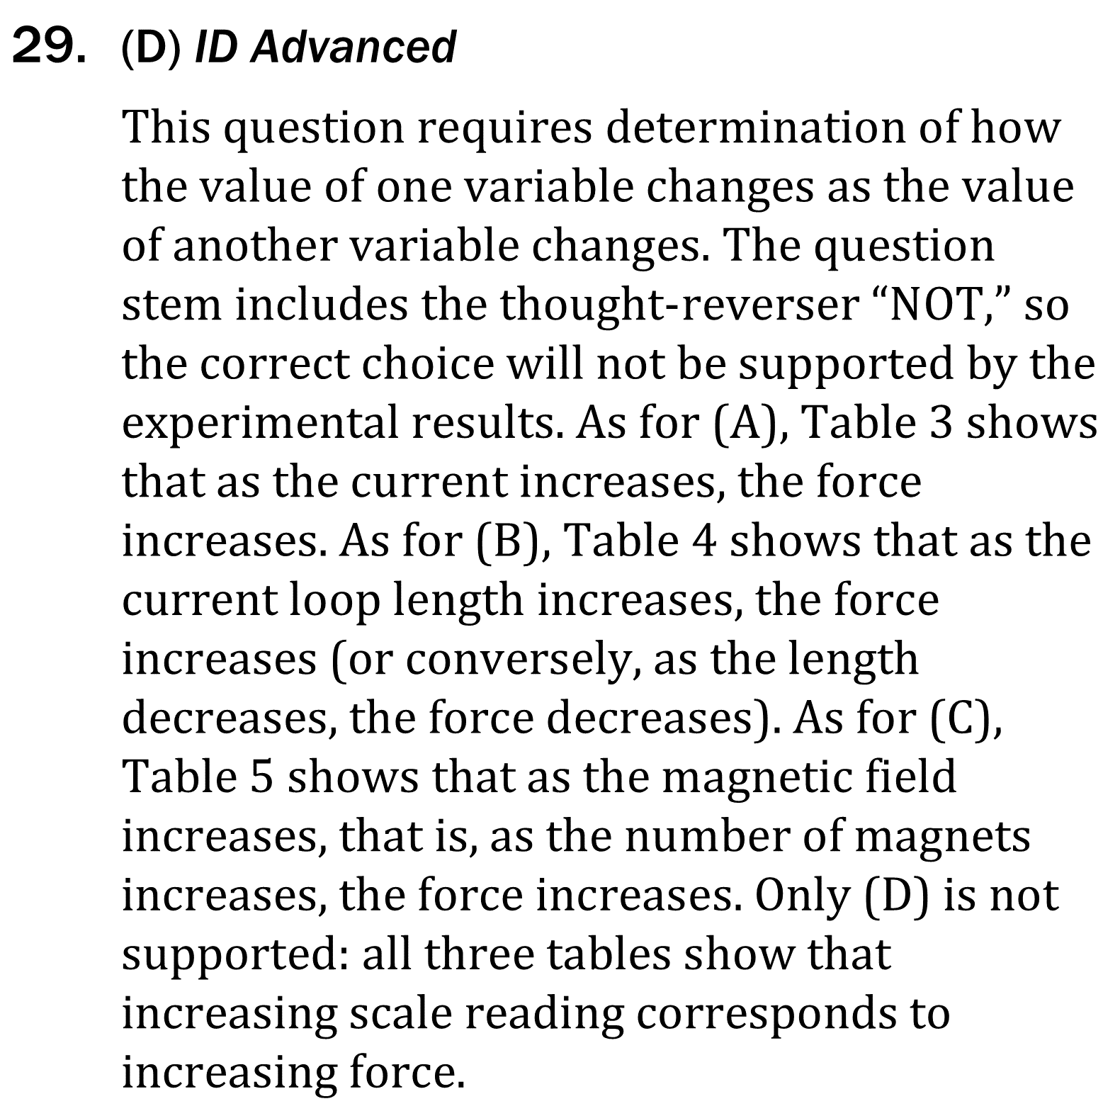
Notes:
Read and interpret data in more complex data presentations. Level: Advanced Skill Group: Interpretation of Data

Slide 8
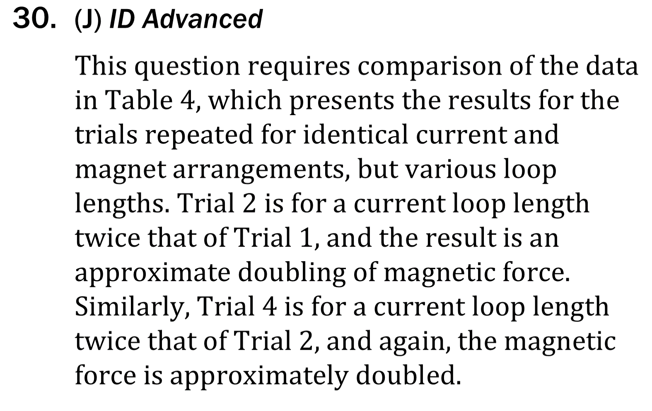
Notes:
Read and interpret data in more complex data presentations. Level: Advanced Skill Group: Interpretation of Data

Slide 9
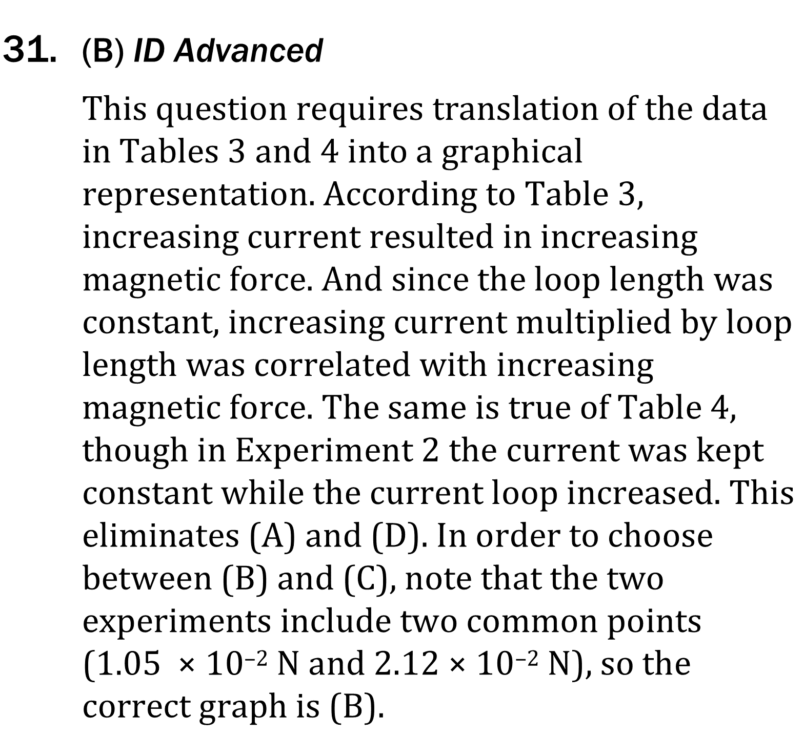




Notes:
Read and interpret data in more complex data presentations. Level: Advanced Skill Group: Interpretation of Data

