Slide 1
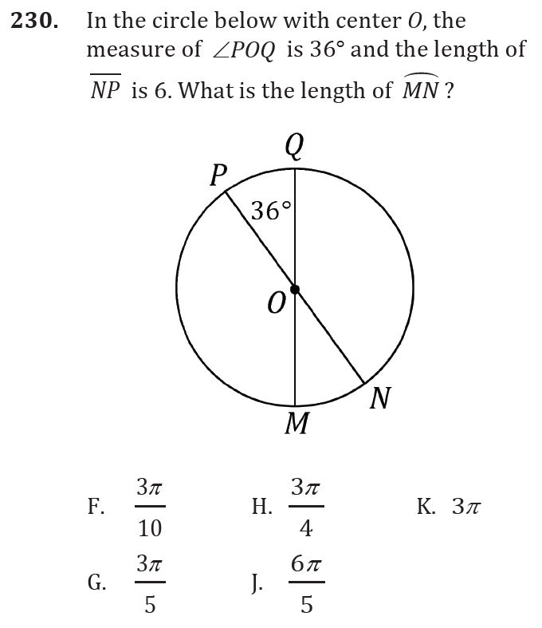
Circles and Multi-Step Problems

Slide 2
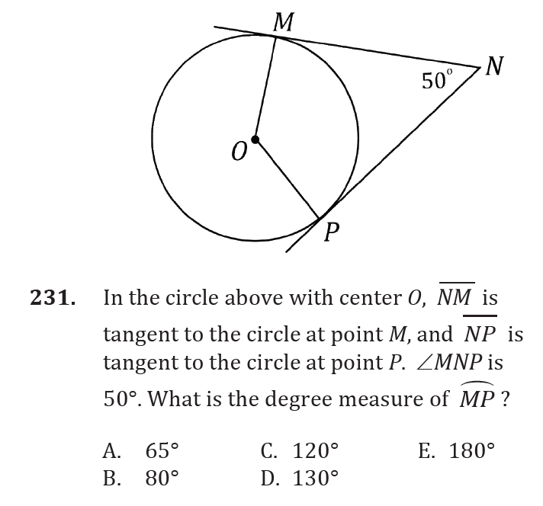
Circles and Multi-Step Problems

Slide 3
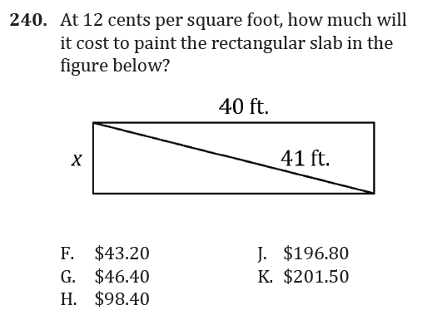
Circles and Multi-Step Problems

Slide 4
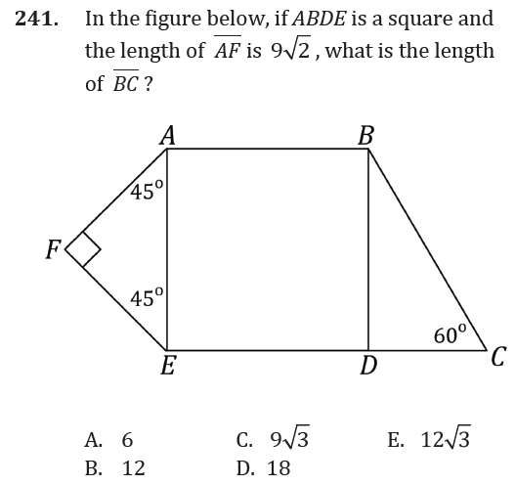
Circles and Multi-Step Problems

Slide 5
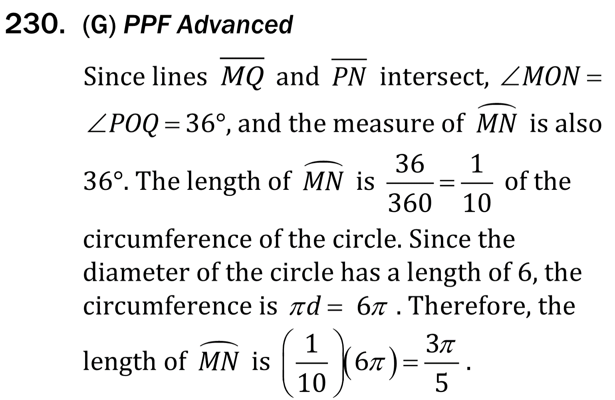
Circles and Multi-Step Problems

Slide 6
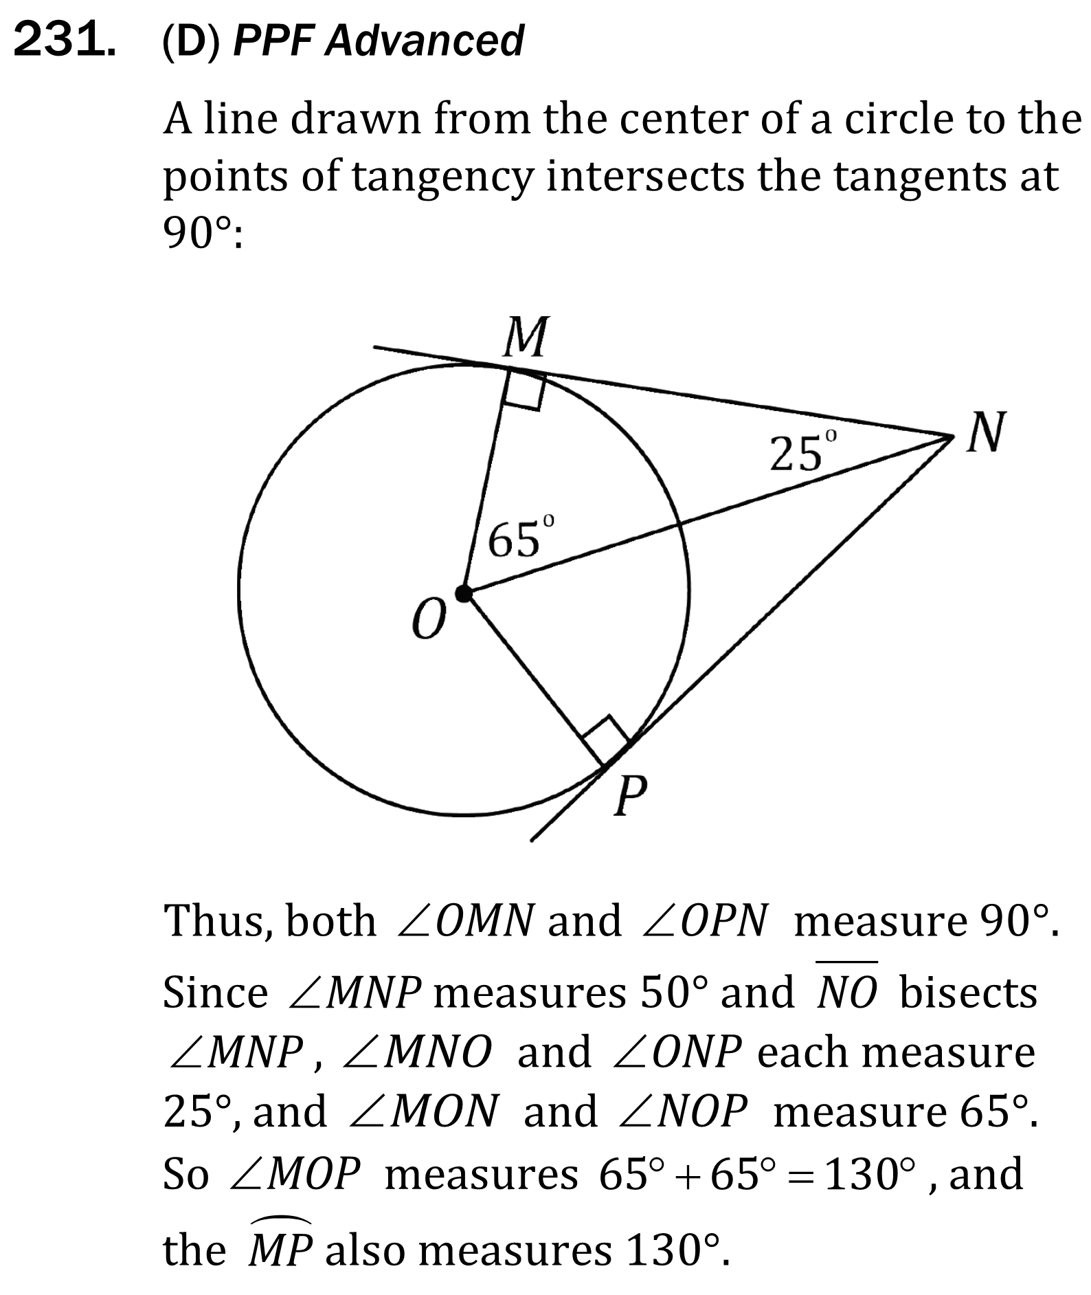
Circles and Multi-Step Problems

Slide 7
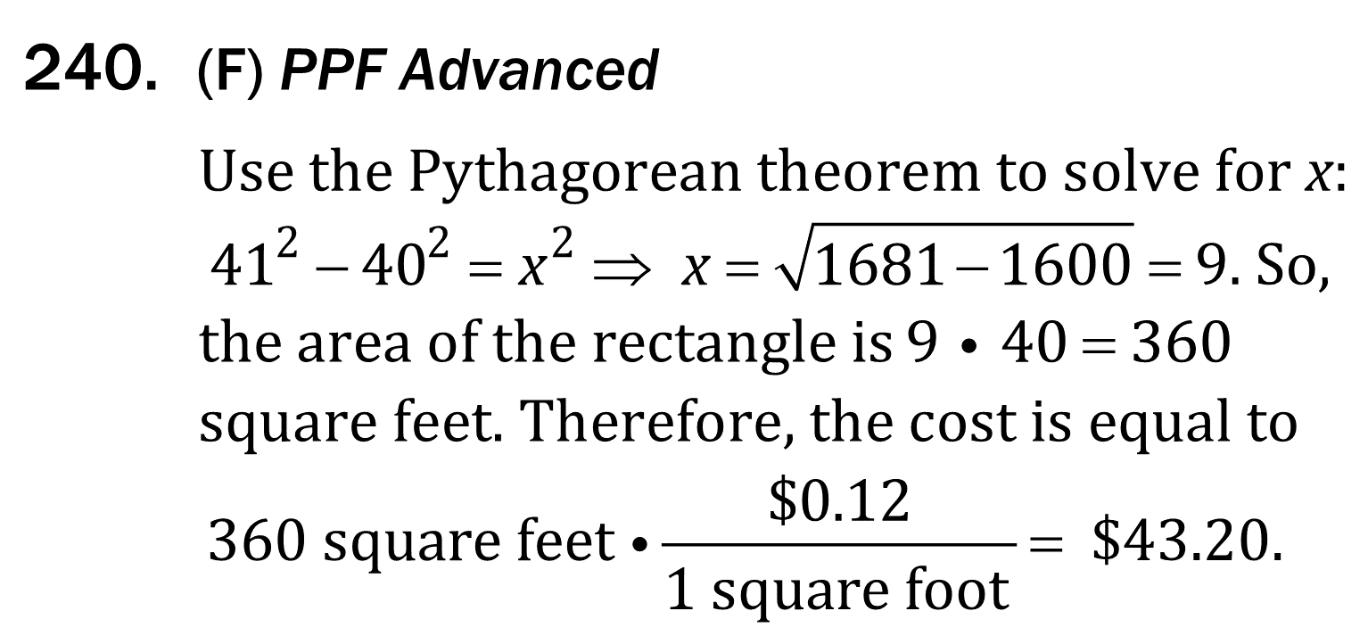
Circles and Multi-Step Problems

Slide 8
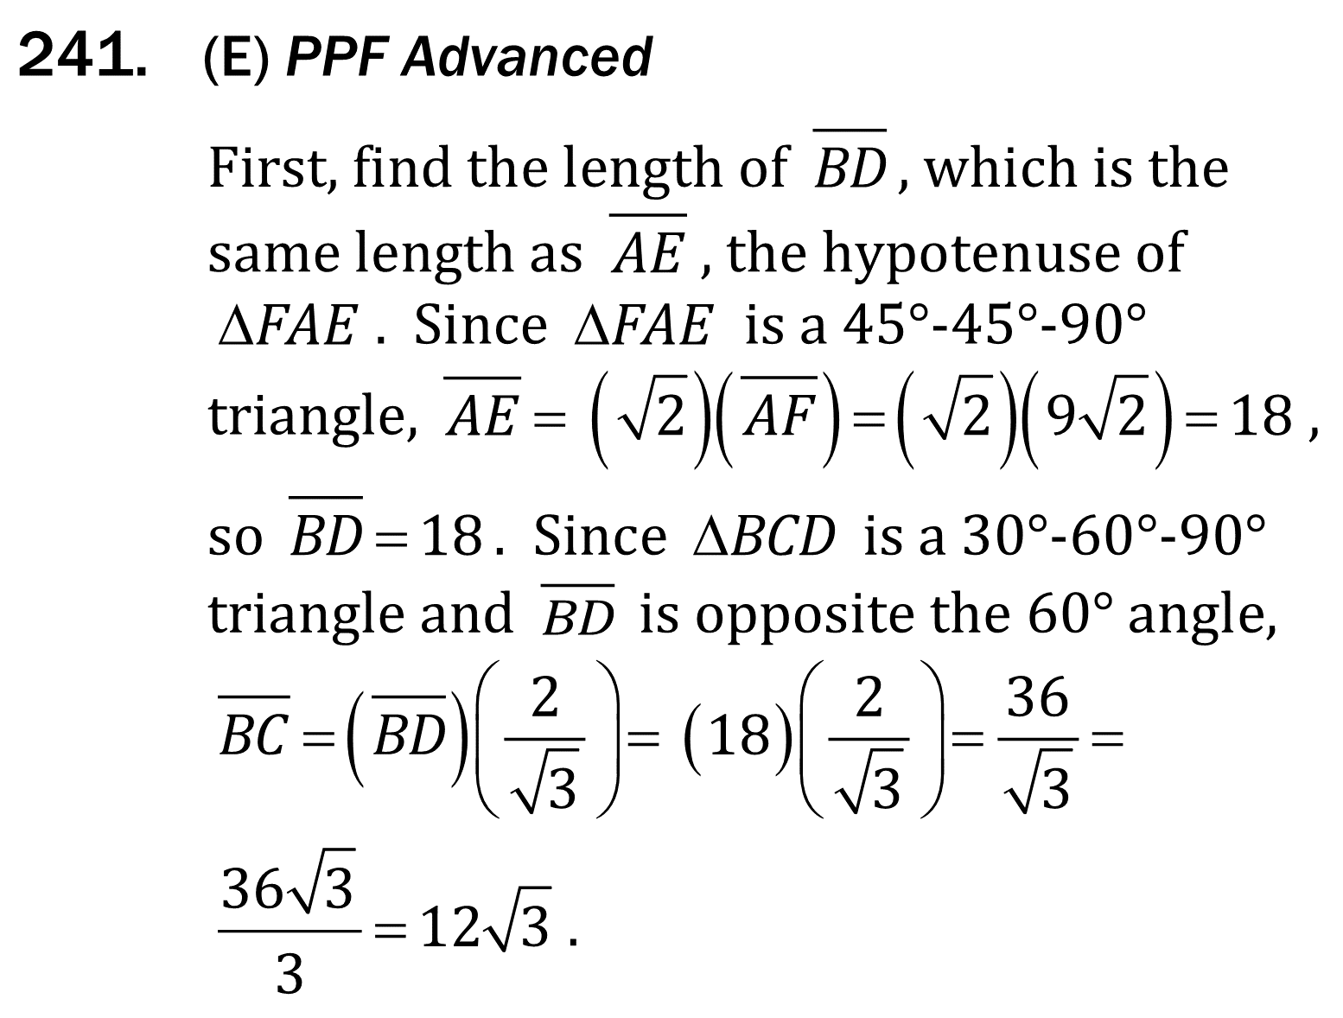
Circles and Multi-Step Problems

