Slide 1
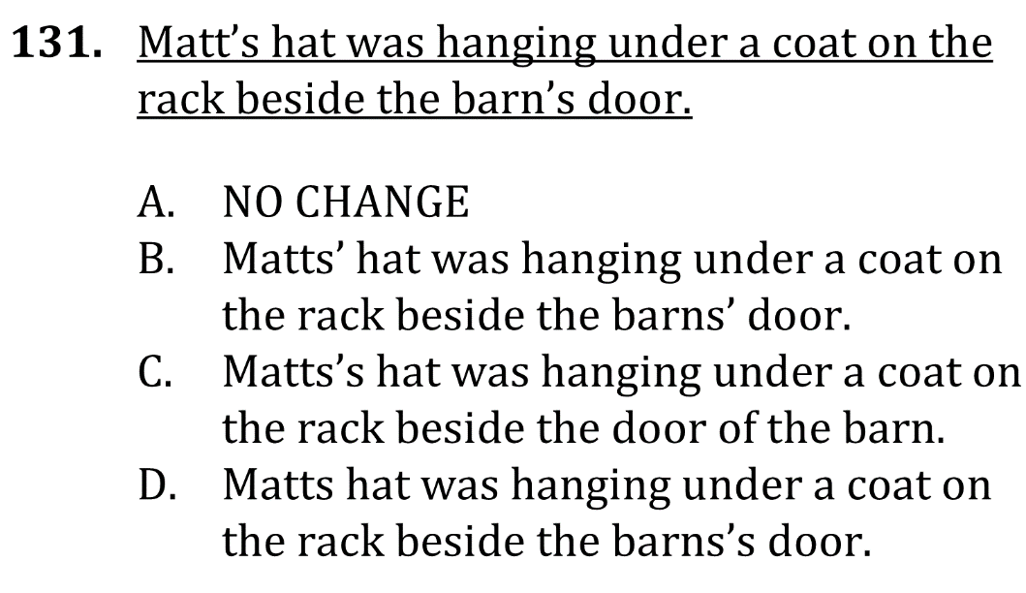
Correctly use apostrophes

Slide 2
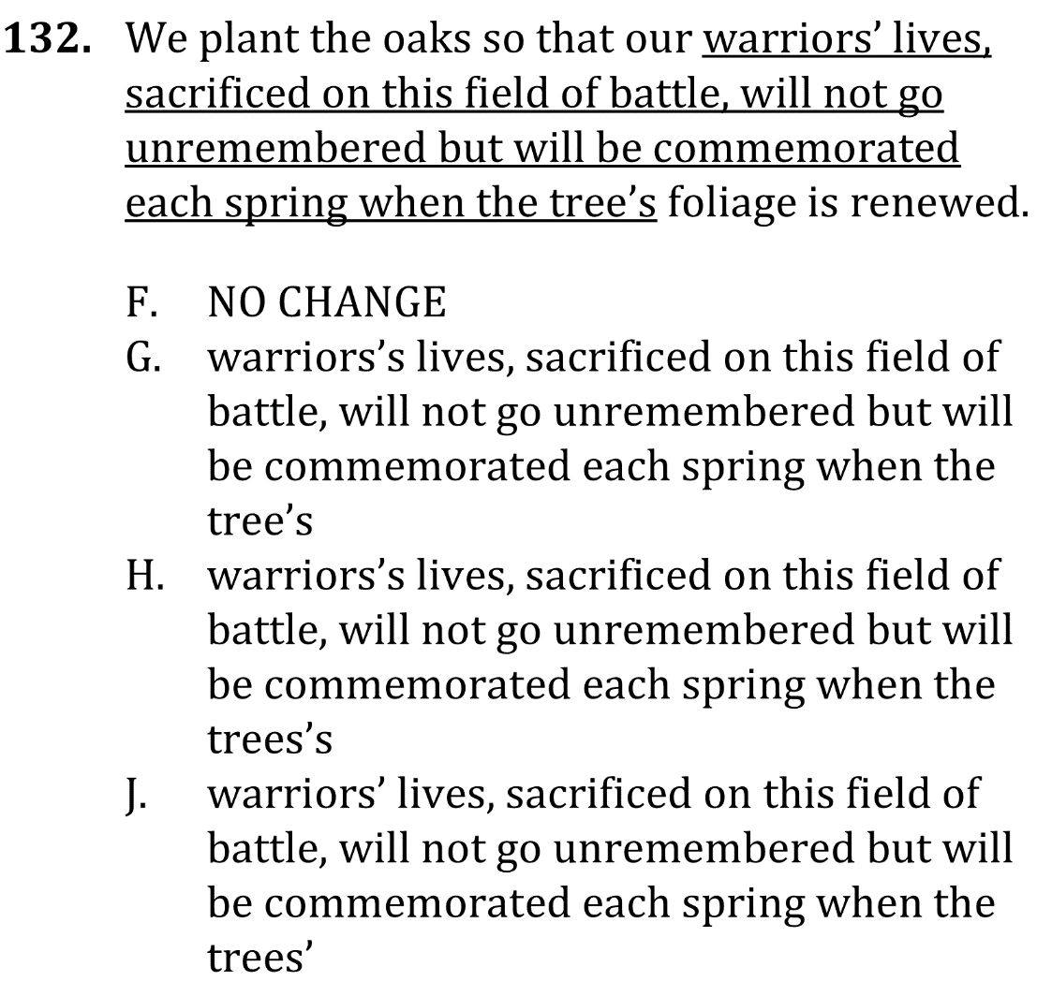
Correctly use apostrophes

Slide 3
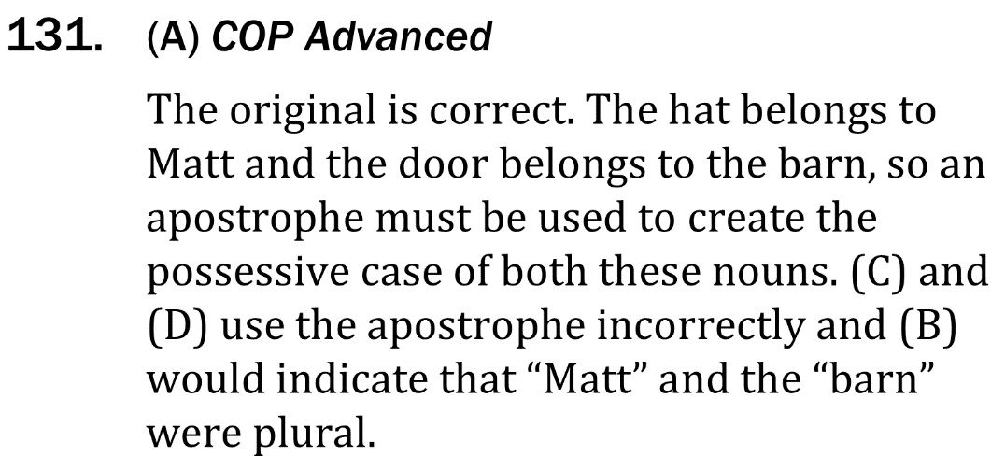
Correctly use apostrophes

Slide 4
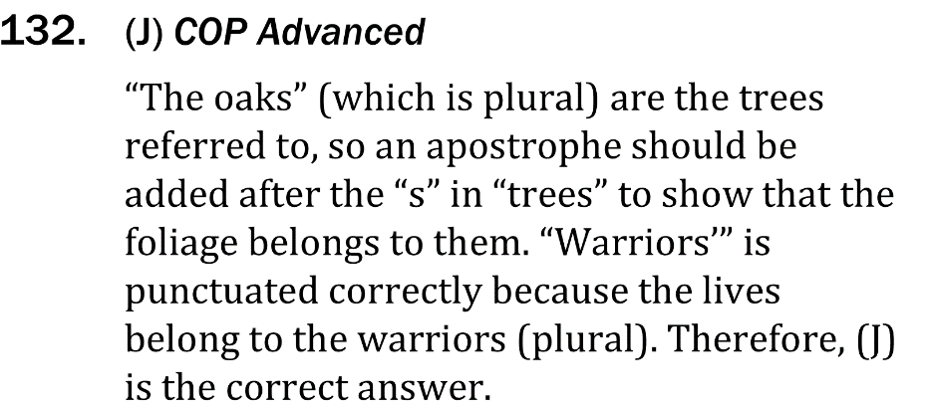
Correctly use apostrophes

