Slide 1
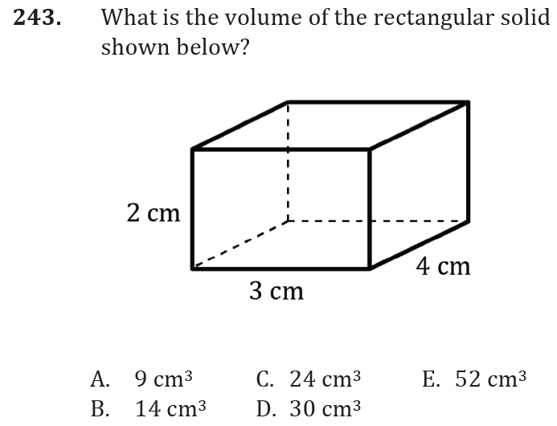
Perimeter, area, and volume

Slide 2
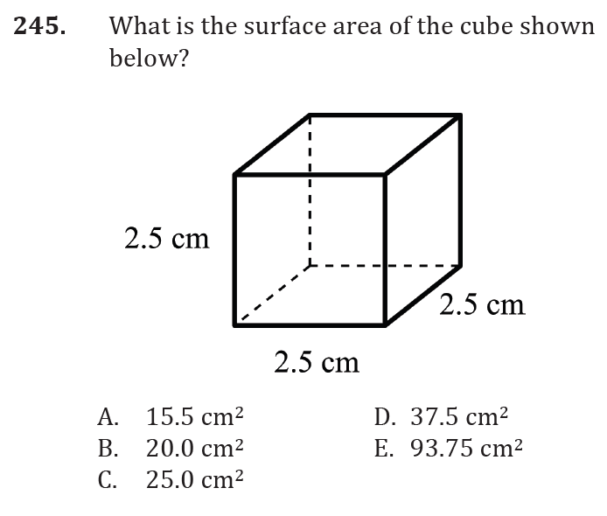
Perimeter, area, and volume

Slide 3
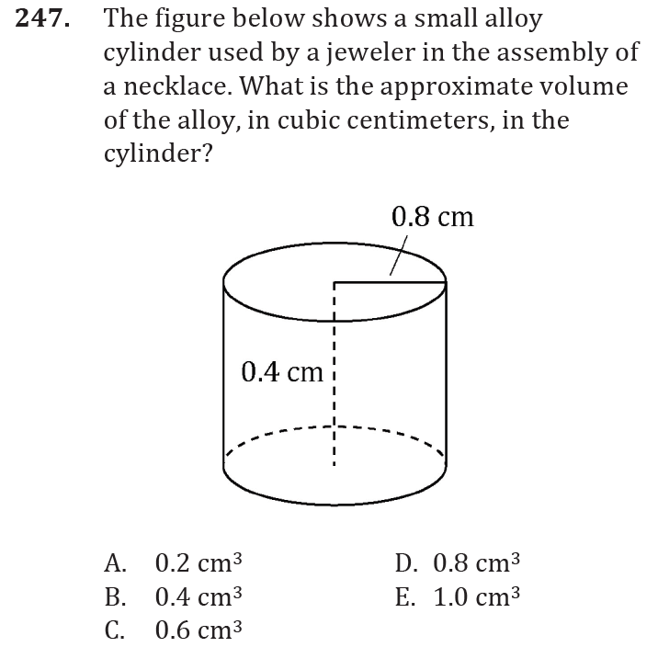
Perimeter, area, and volume

Slide 4
Perimeter, area, and volume

Slide 5
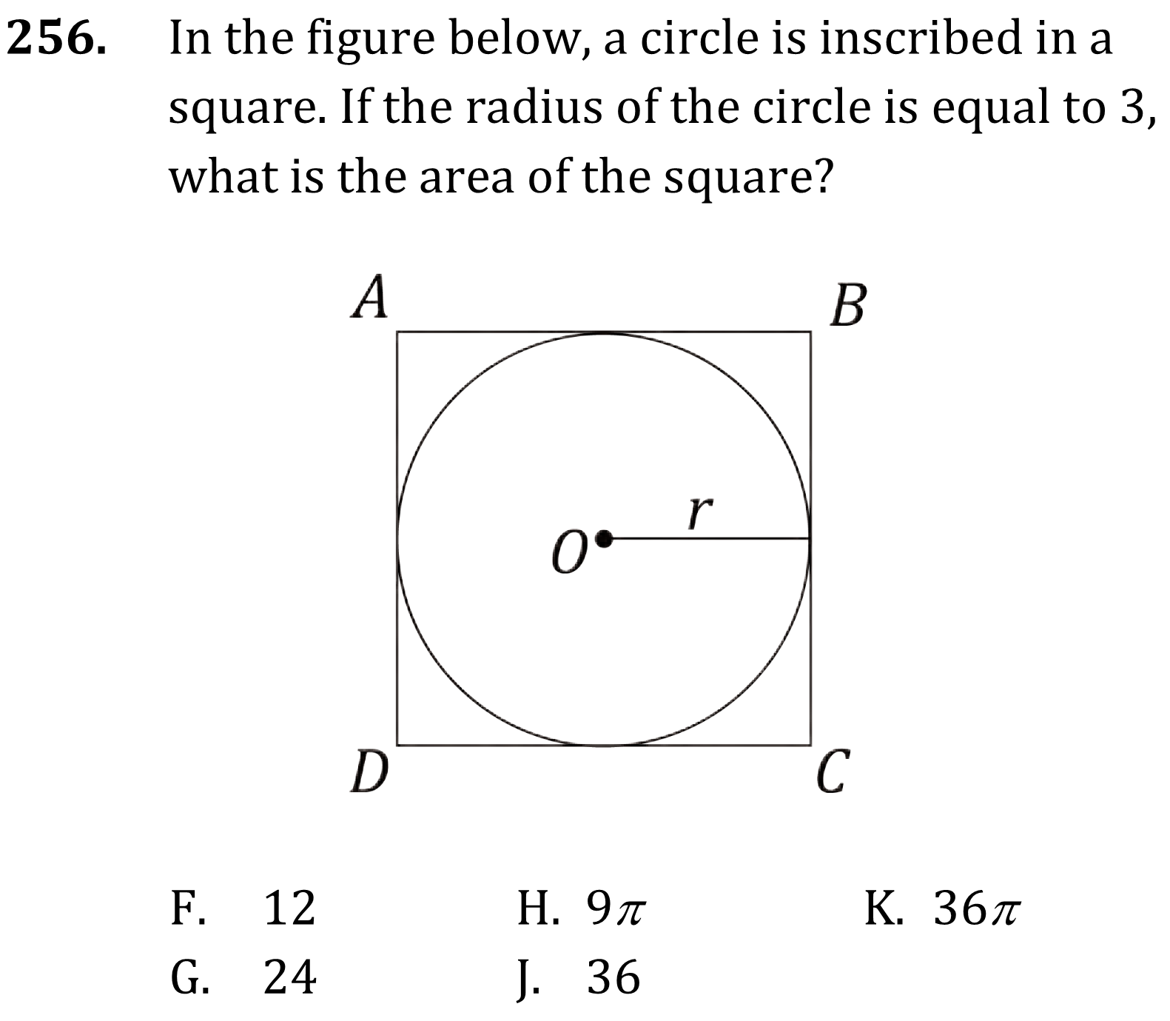
Perimeter, area, and volume

Slide 6
Perimeter, area, and volume

Slide 7
Perimeter, area, and volume

Slide 8
Perimeter, area, and volume

Slide 9
Perimeter, area, and volume

Slide 10
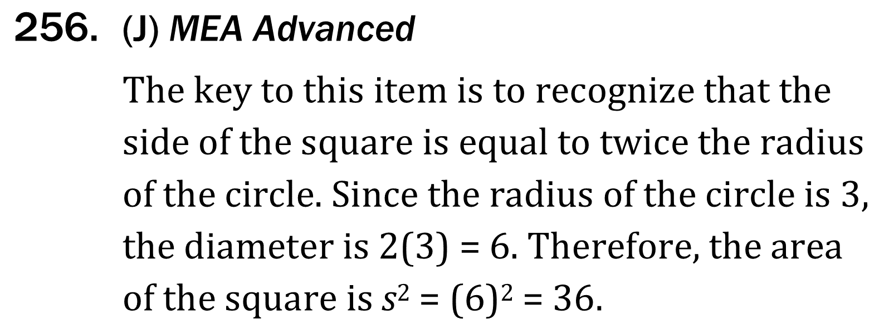
Perimeter, area, and volume

