Slide 1
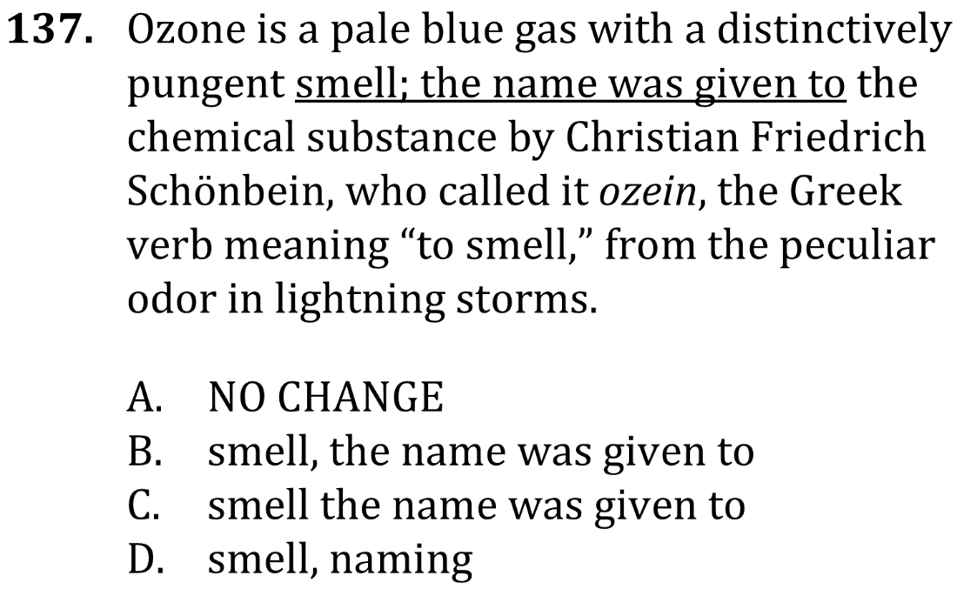
Correctly Use Semicolons

Slide 2
Correctly Use Semicolons

Slide 3
Correctly Use Semicolons

Slide 4
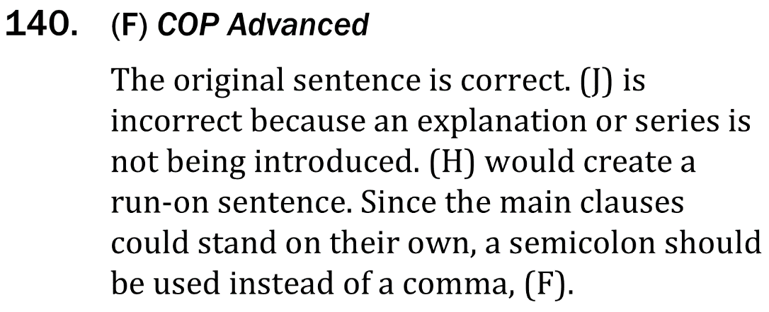
Correctly Use Semicolons

