Slide 1
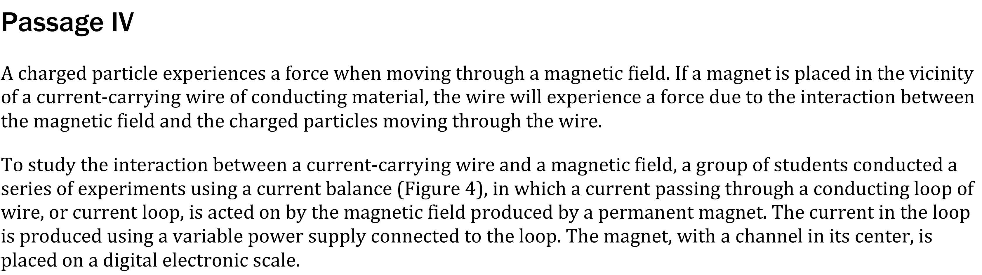
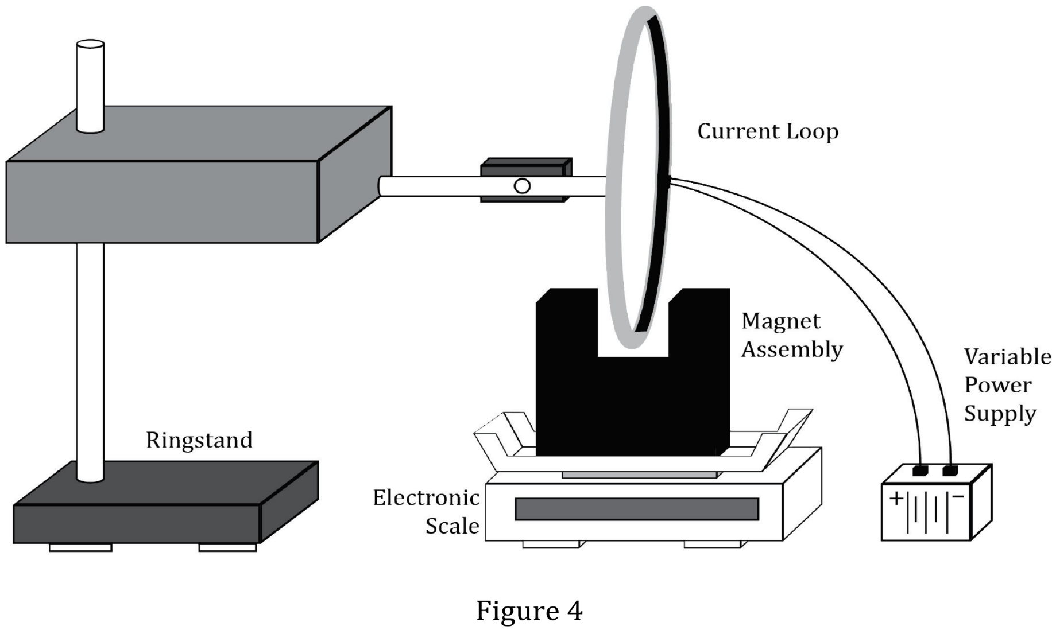

Notes:
Read and interpret data in more complex data presentations. Level: Advanced Skill Group: Interpretation of Data

Slide 2
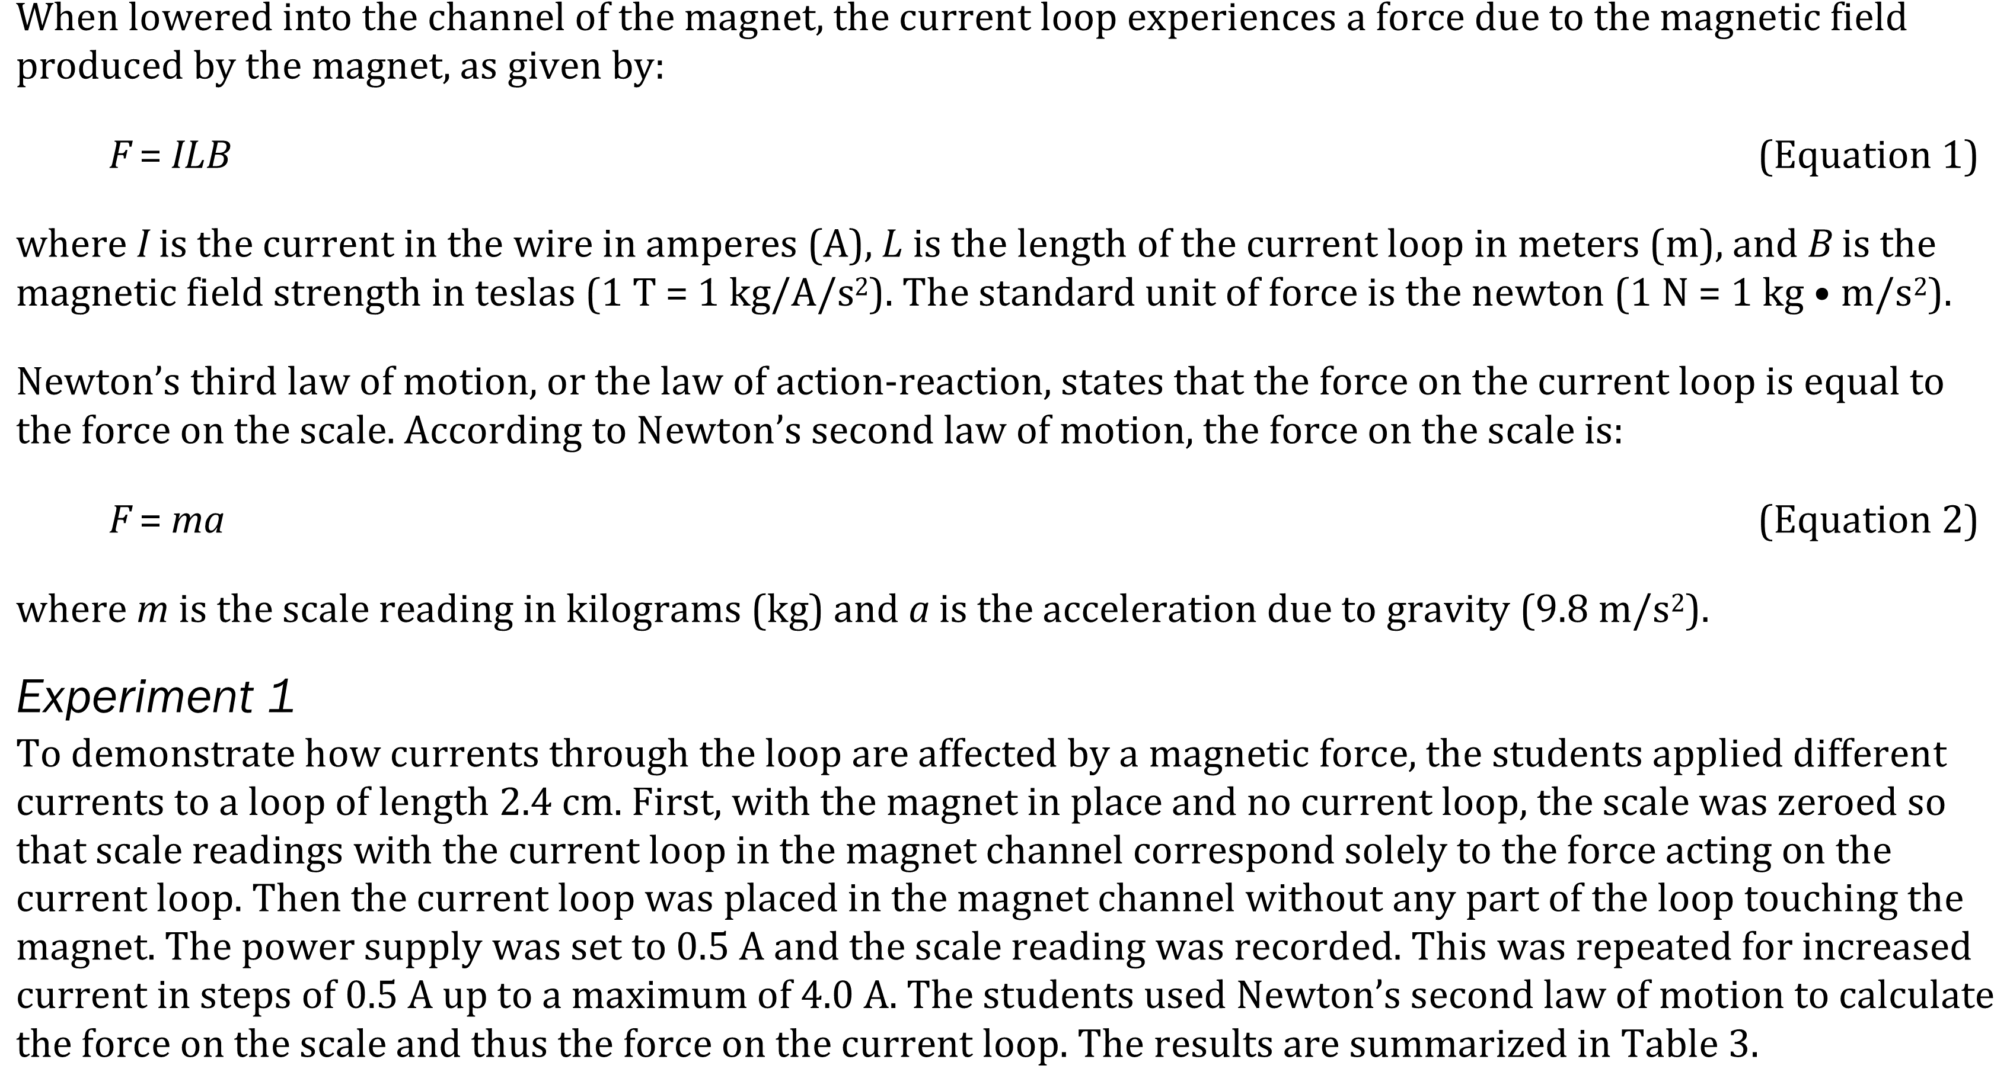
Notes:
Predict the results of an additional step in an experiment; Determine what would cause a specific result in an experiment; Determine the effect of new information on a model. Level: Advanced Skill Group: Evaluation of Models

Slide 3
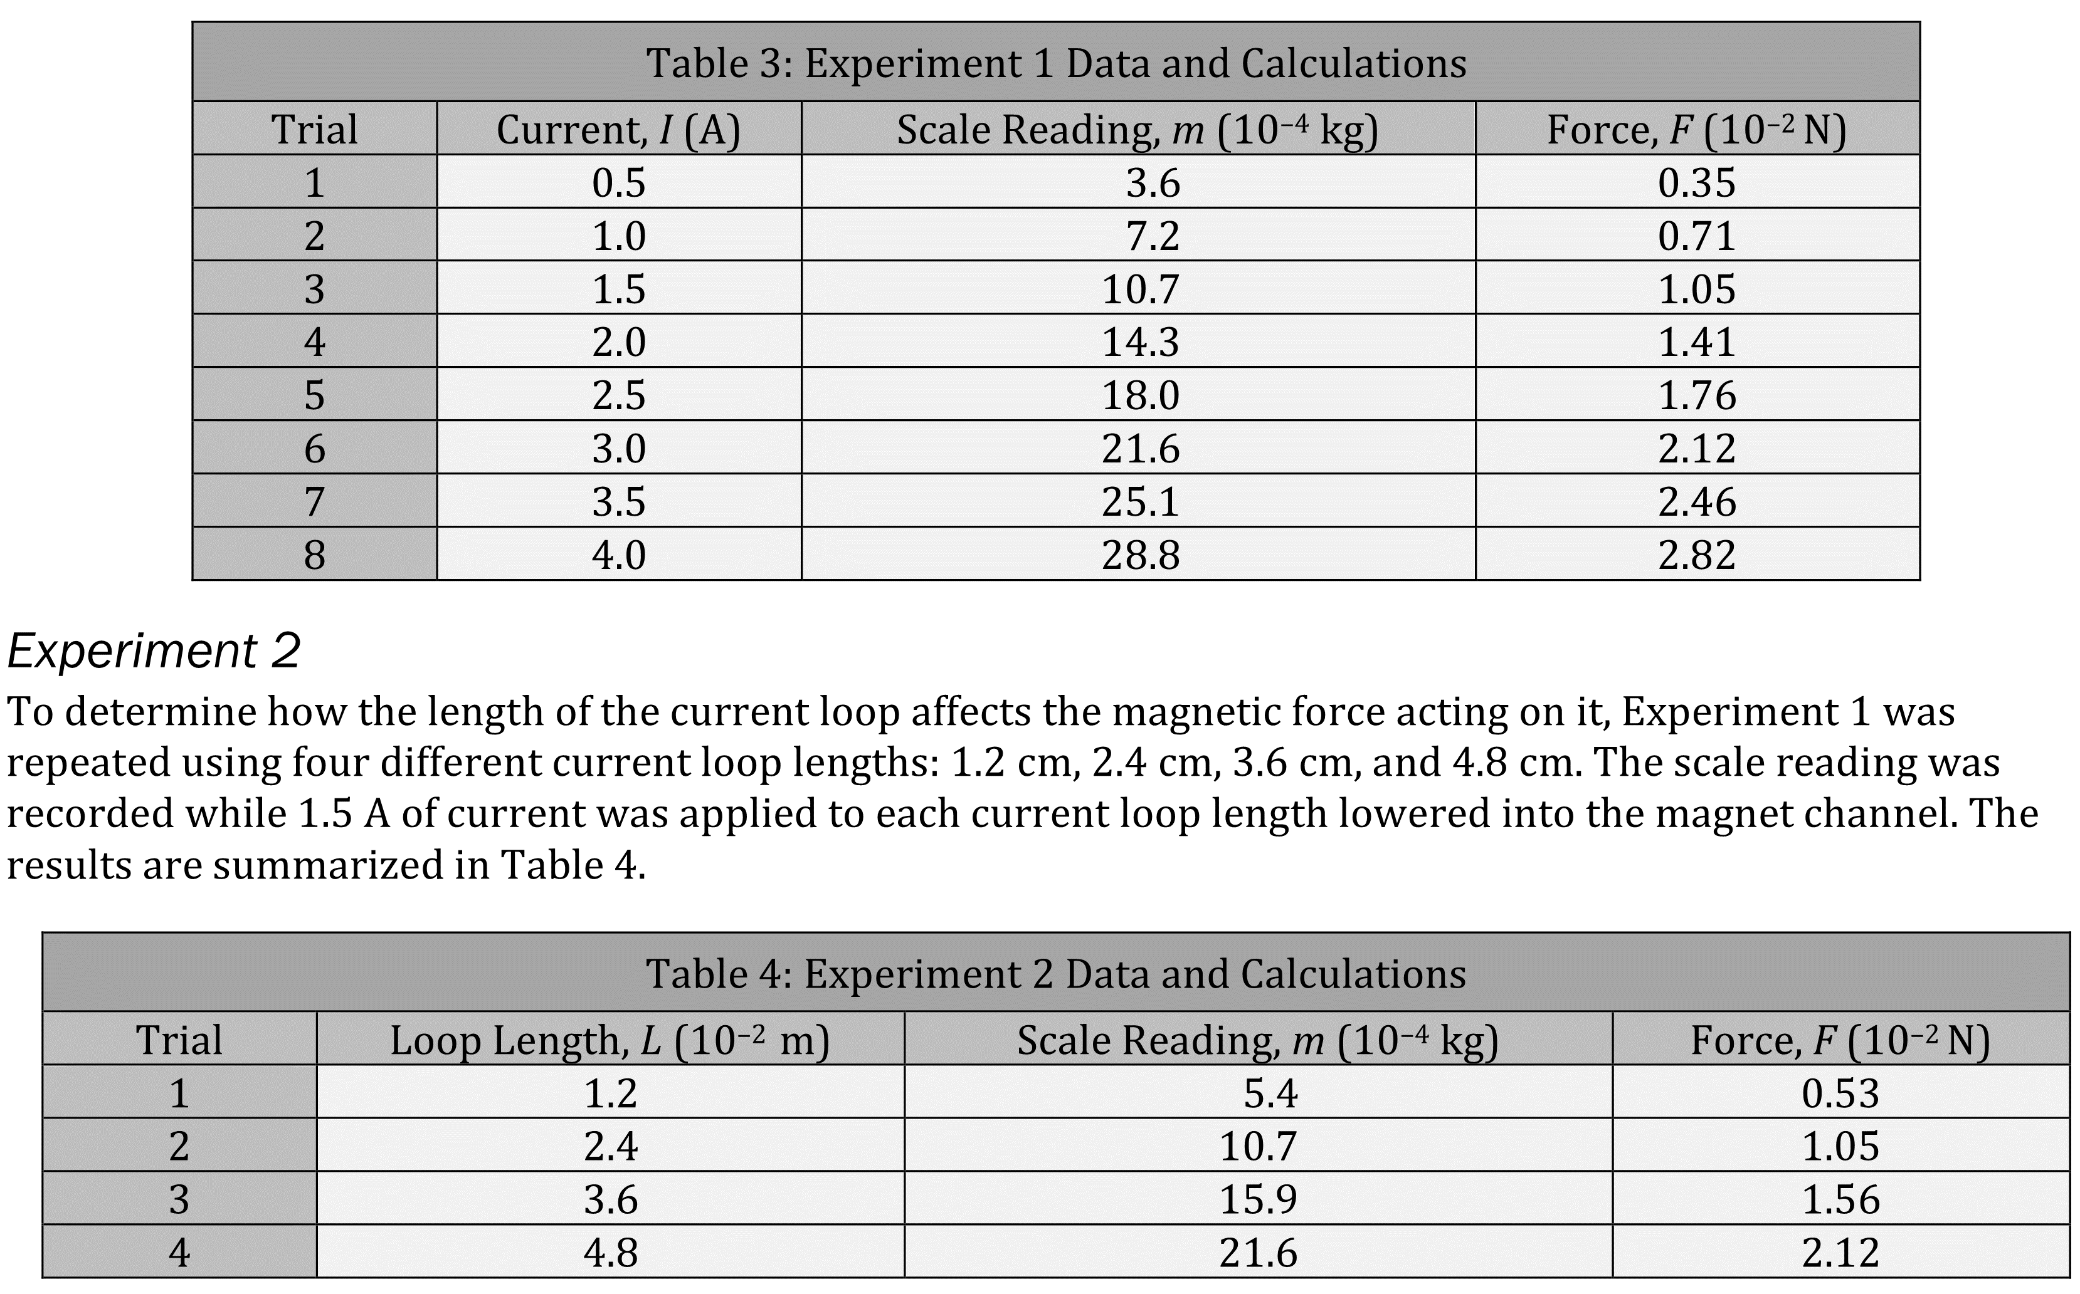
Notes:
Predict the results of an additional step in an experiment; Determine what would cause a specific result in an experiment; Determine the effect of new information on a model. Level: Advanced Skill Group: Evaluation of Models

Slide 4
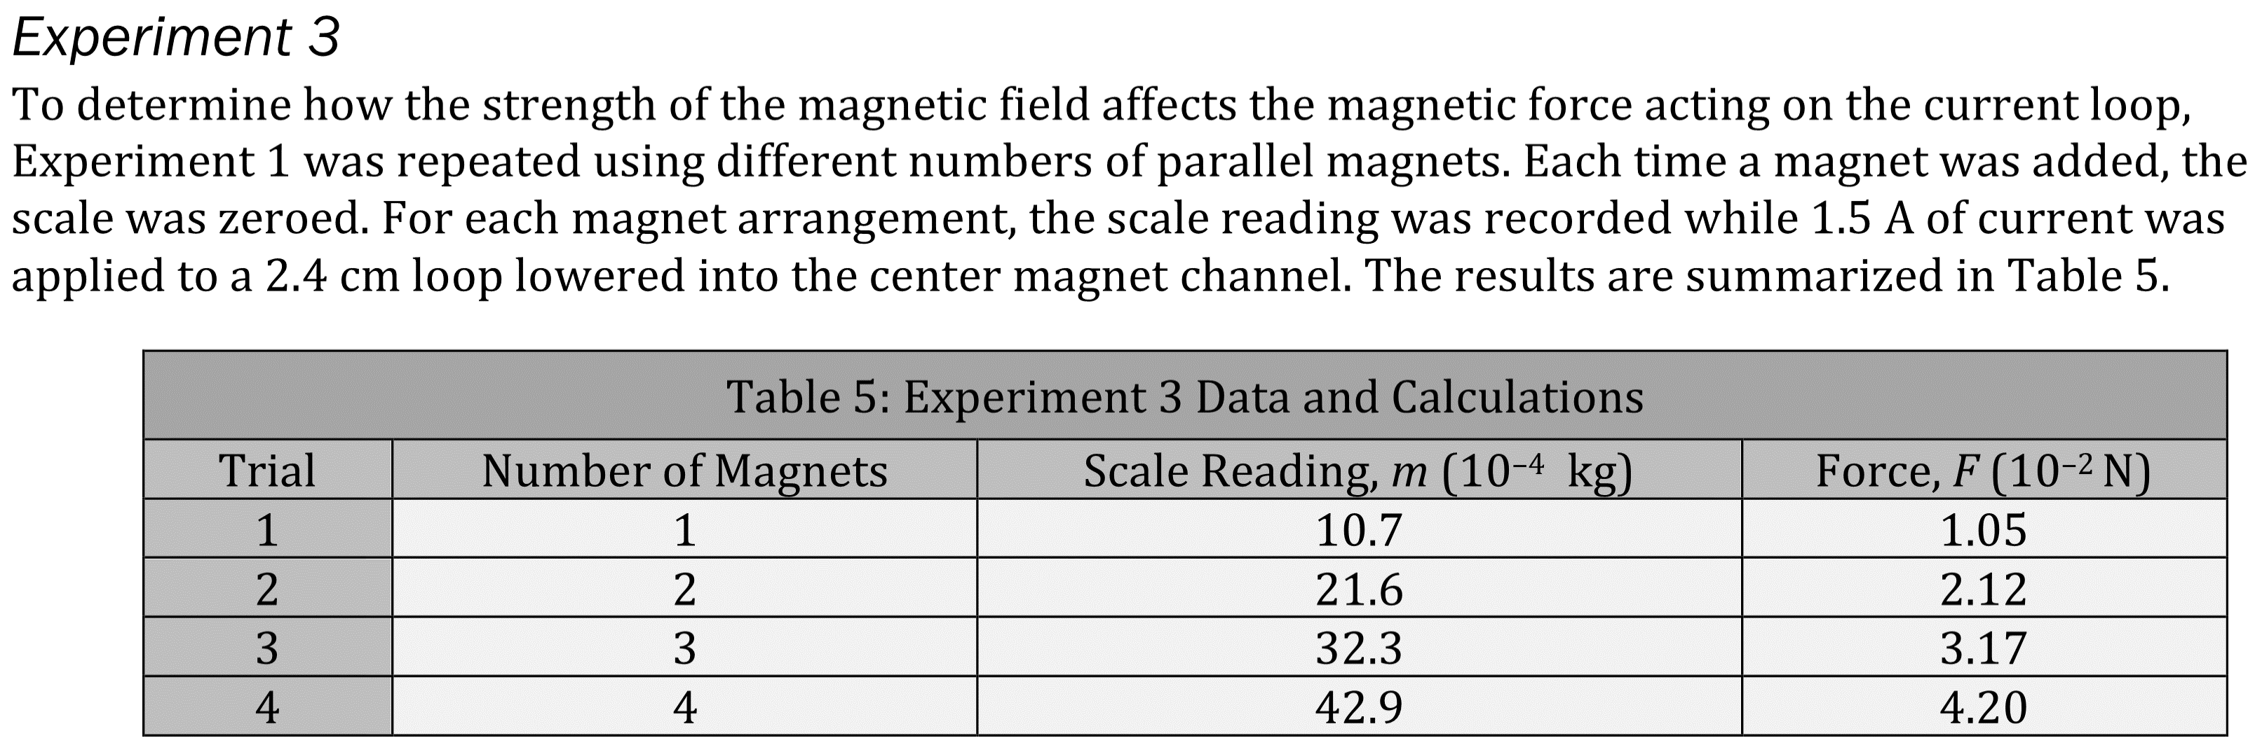
Notes:
Predict the results of an additional step in an experiment; Determine what would cause a specific result in an experiment; Determine the effect of new information on a model. Level: Advanced Skill Group: Evaluation of Models

Slide 5
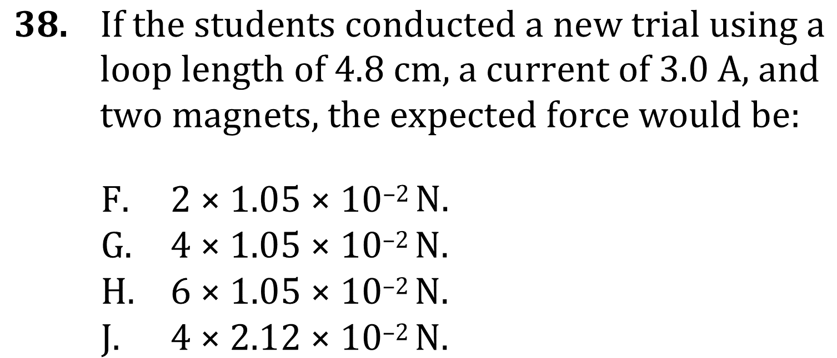
Notes:
Predict the results of an additional step in an experiment; Determine what would cause a specific result in an experiment; Determine the effect of new information on a model. Level: Advanced Skill Group: Evaluation of Models

Slide 6
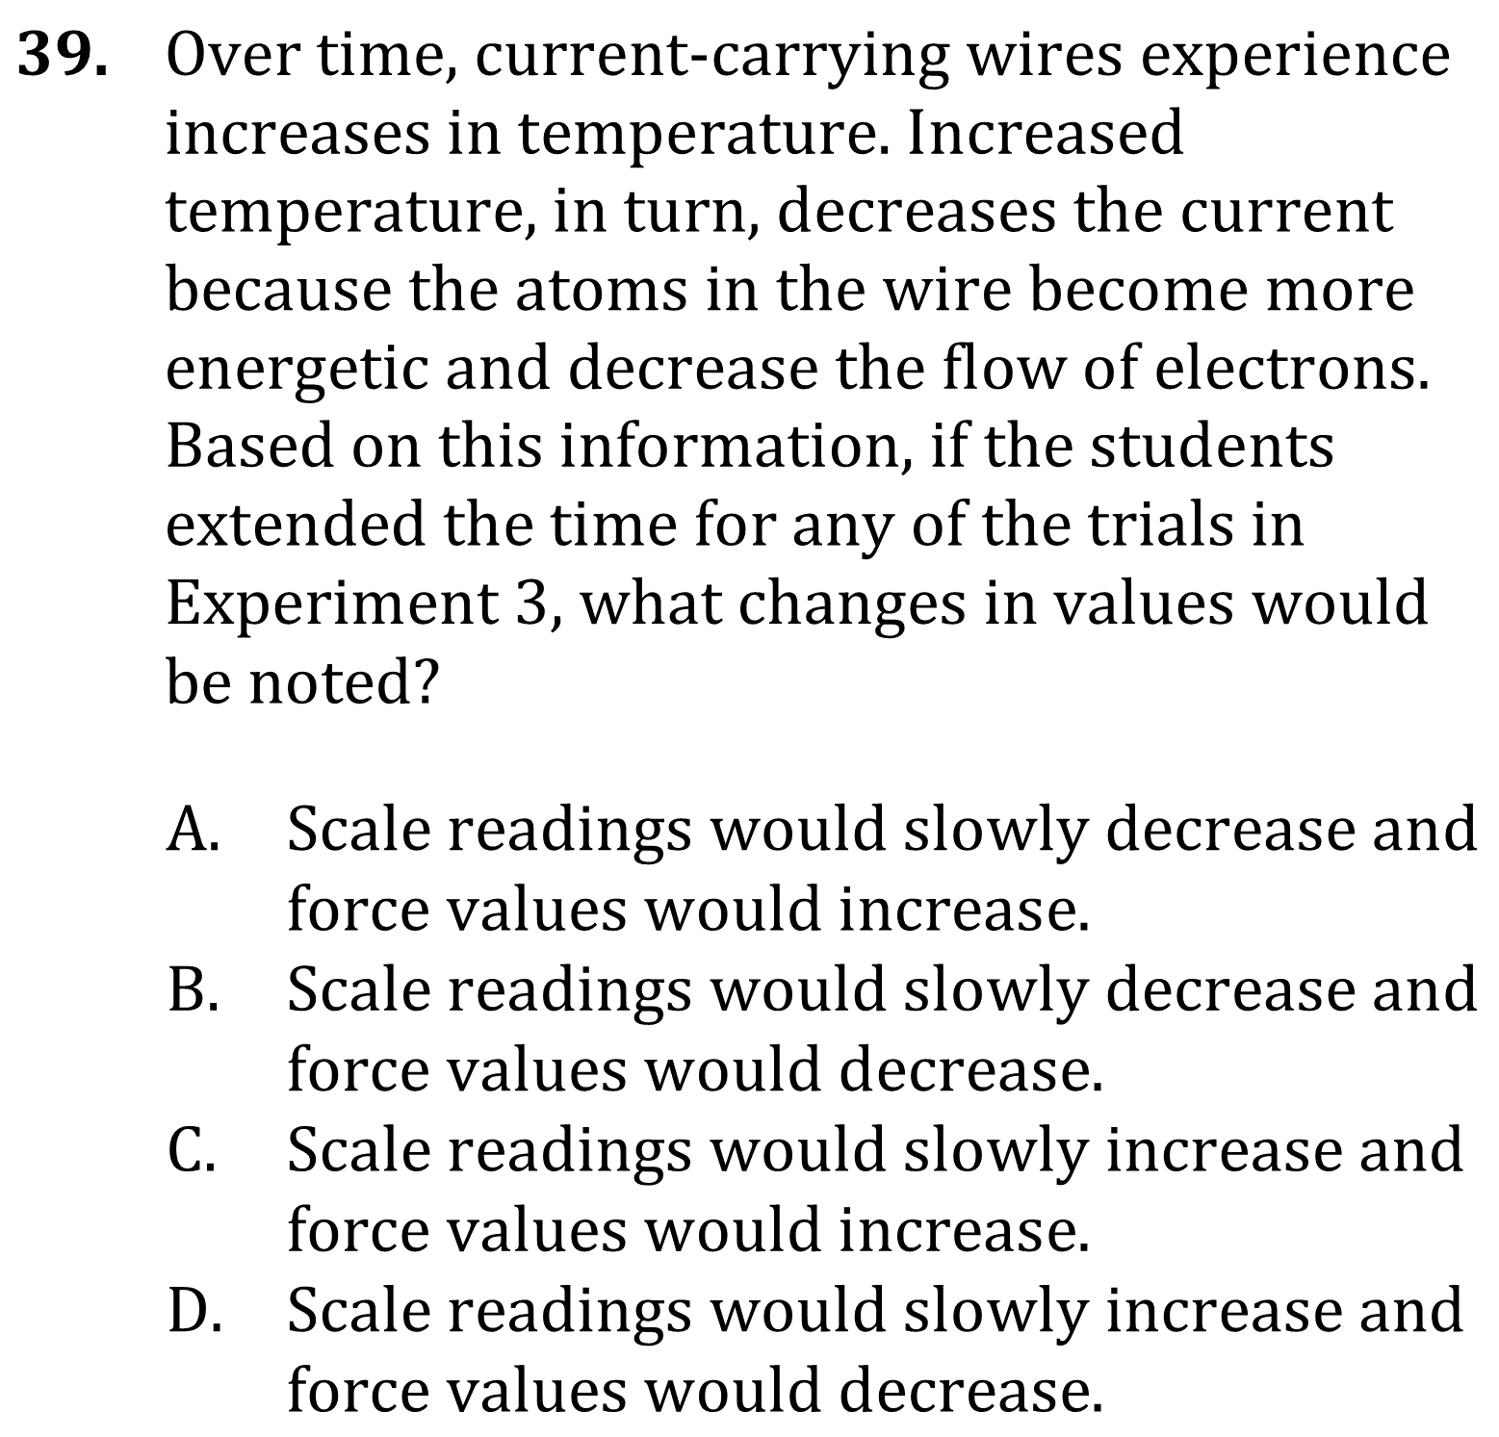
Notes:
Predict the results of an additional step in an experiment; Determine what would cause a specific result in an experiment; Determine the effect of new information on a model. Level: Advanced Skill Group: Evaluation of Models

Slide 7
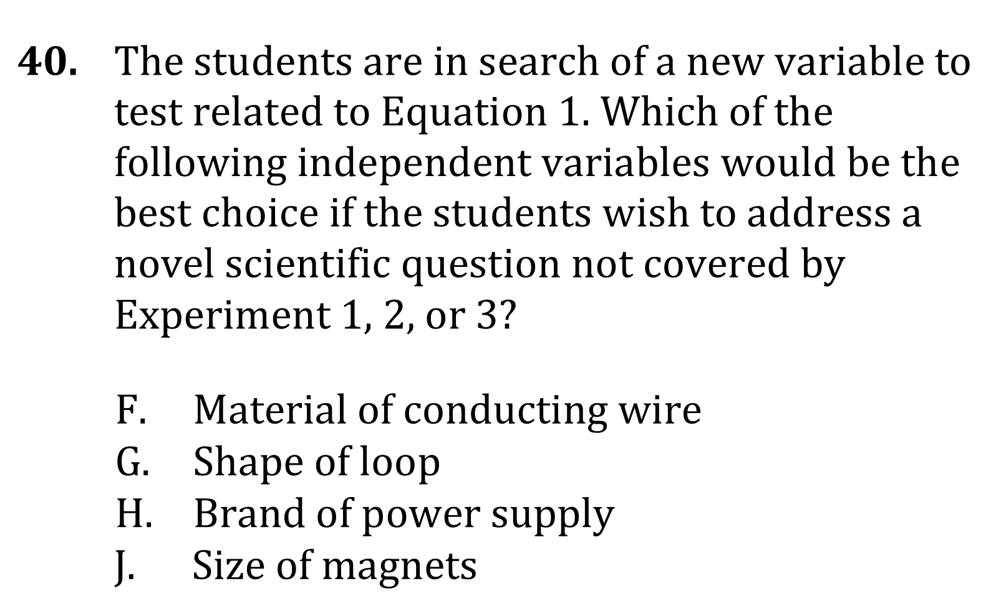
Notes:
Predict the results of an additional step in an experiment; Determine what would cause a specific result in an experiment; Determine the effect of new information on a model. Level: Advanced Skill Group: Evaluation of Models

Slide 8
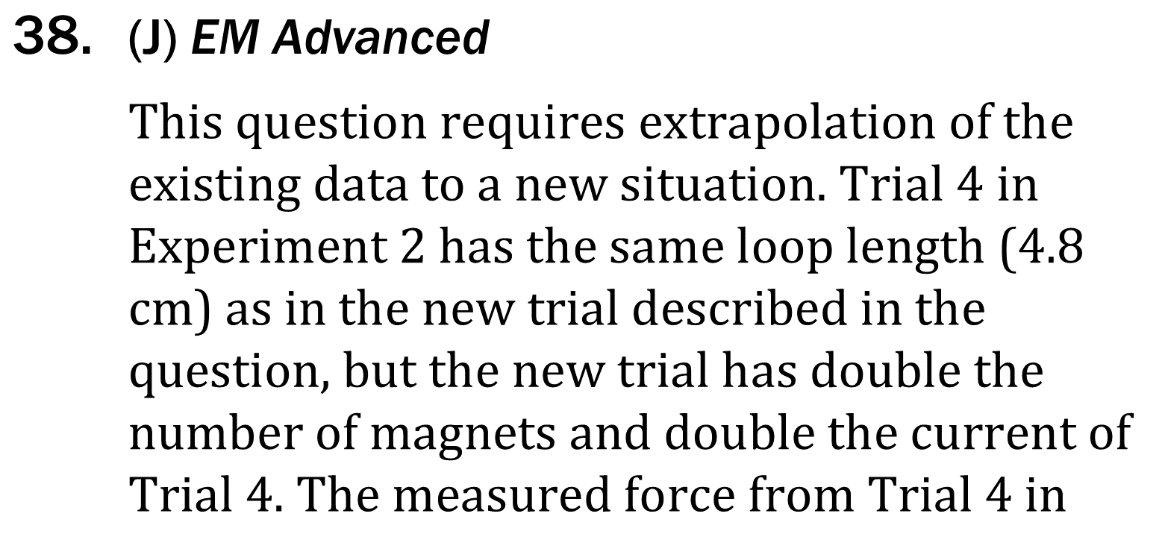
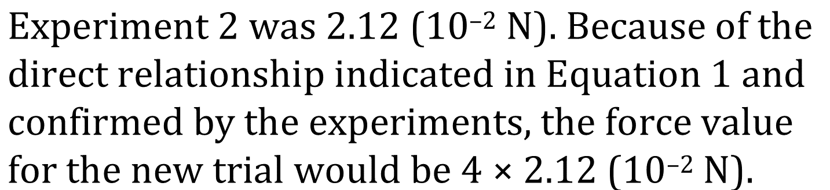
Notes:
Predict the results of an additional step in an experiment; Determine what would cause a specific result in an experiment; Determine the effect of new information on a model. Level: Advanced Skill Group: Evaluation of Models

Slide 9
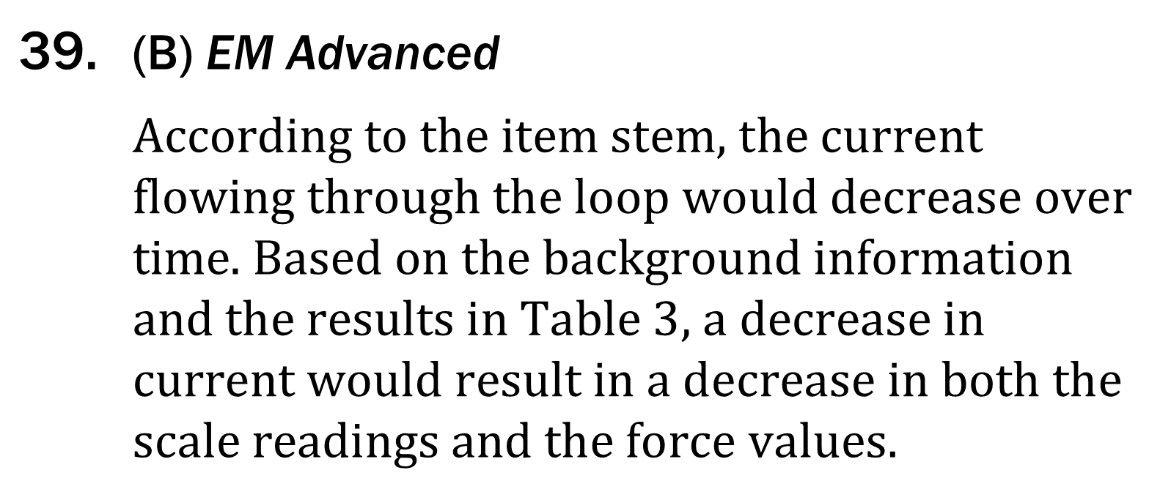
Notes:
Predict the results of an additional step in an experiment; Determine what would cause a specific result in an experiment; Determine the effect of new information on a model. Level: Advanced Skill Group: Evaluation of Models

Slide 10
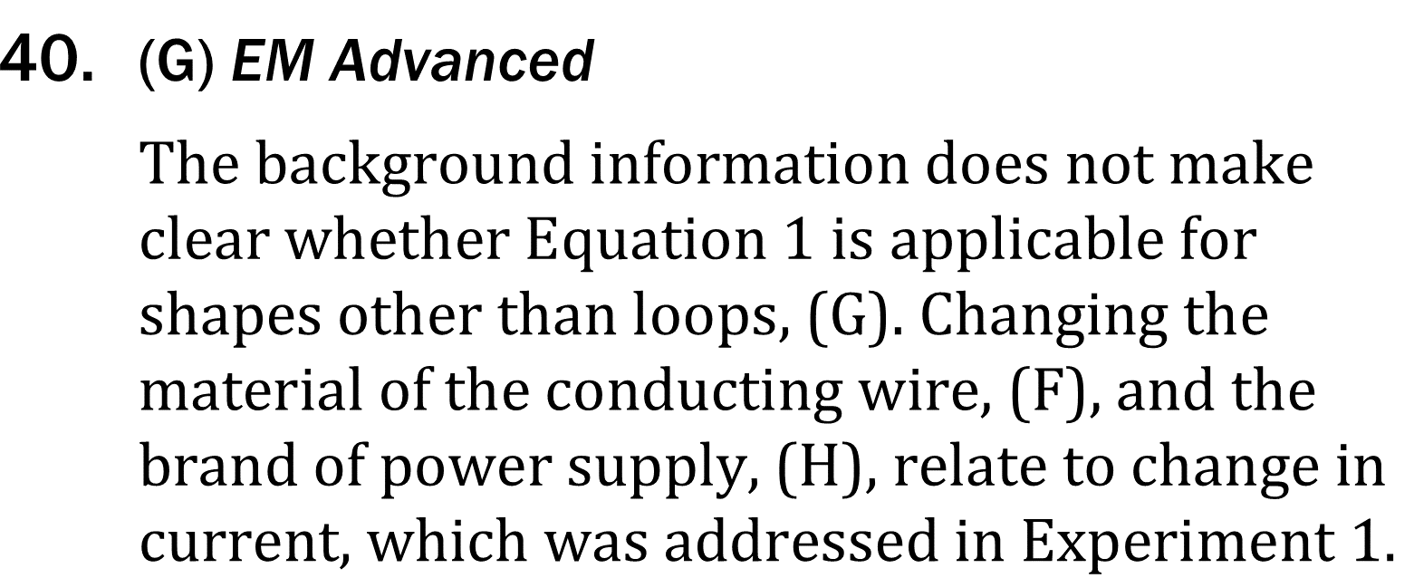
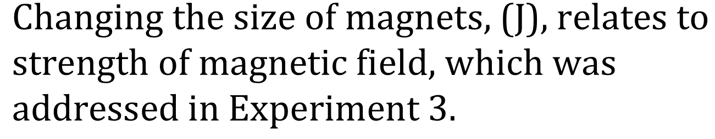
Notes:
Predict the results of an additional step in an experiment; Determine what would cause a specific result in an experiment; Determine the effect of new information on a model. Level: Advanced Skill Group: Evaluation of Models

