Slide 1
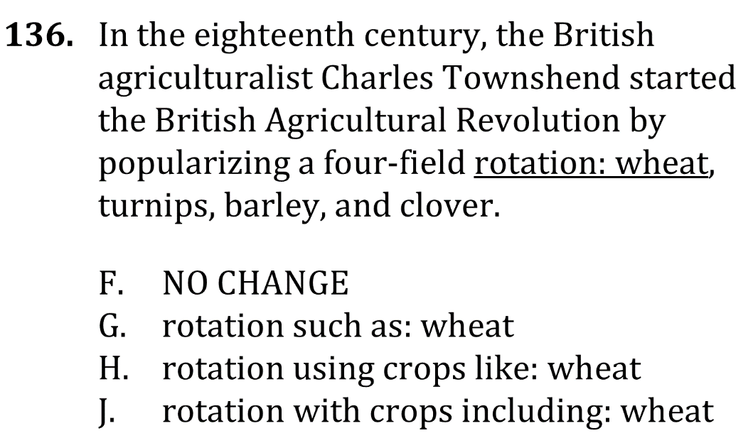
Correctly Use Colons

Slide 2
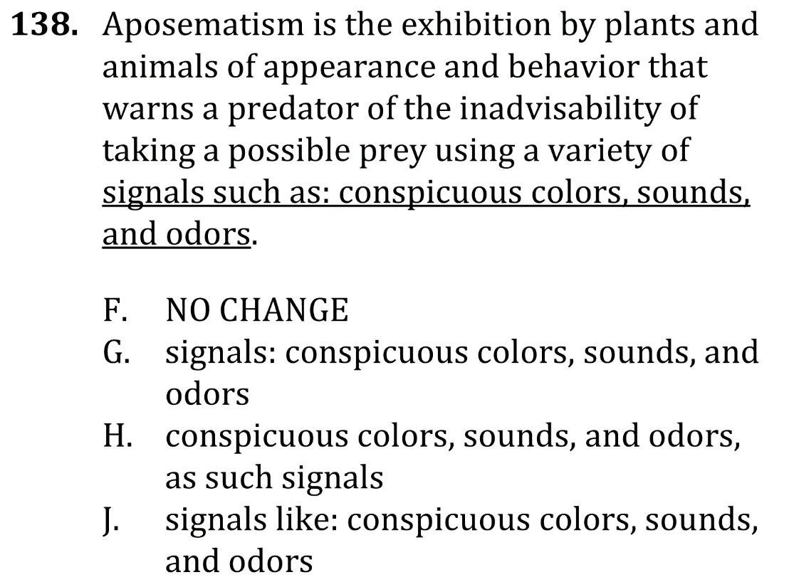
Correctly Use Colons

Slide 3
Correctly Use Colons

Slide 4
Correctly Use Colons

