Slide 1
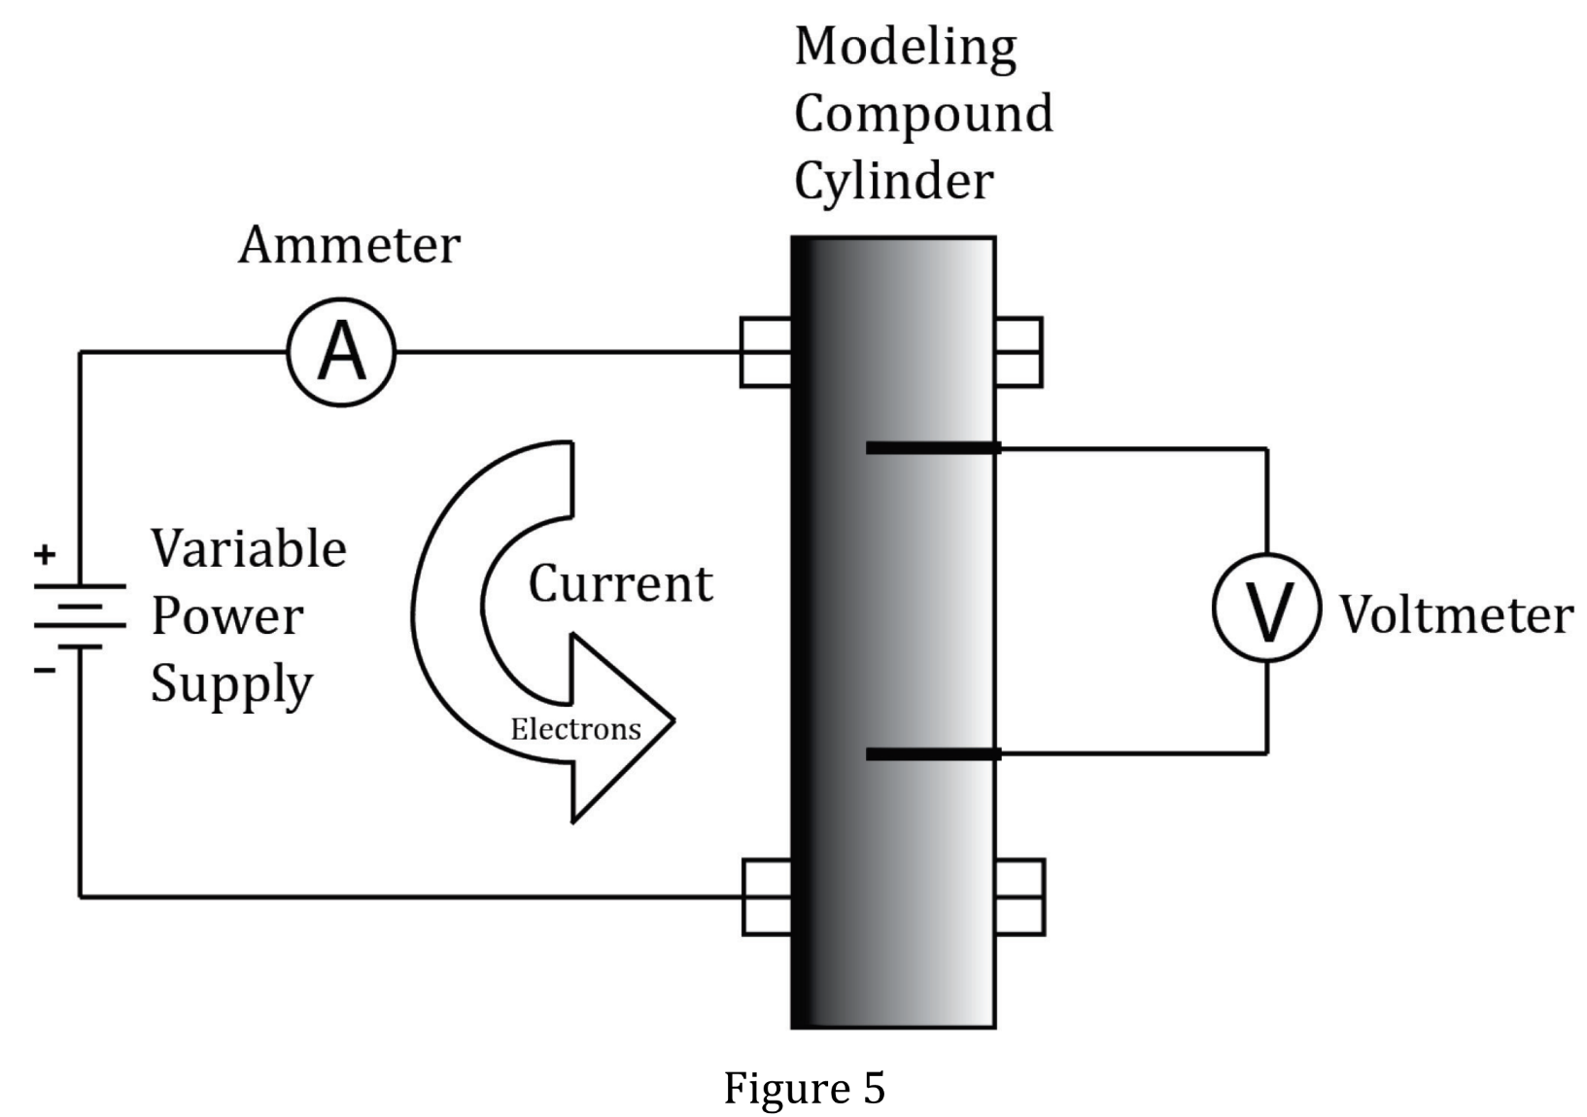
Notes:
Understand tools and methods in an experiment; Understand experimental design; Identify a control in an experiment. Level: Advanced Skill Group: Scientific

Slide 2
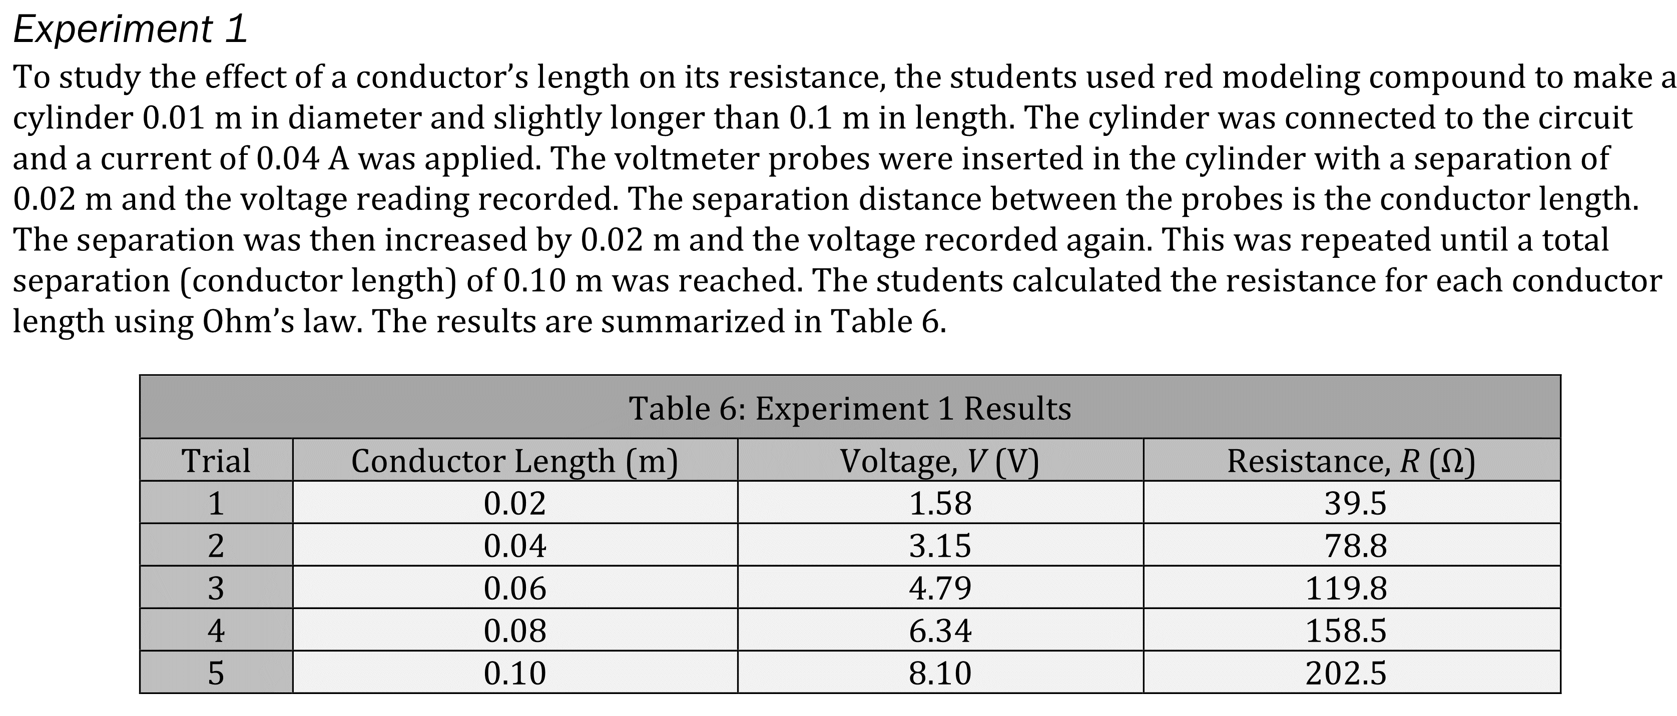
Notes:
Understand tools and methods in an experiment; Understand experimental design; Identify a control in an experiment. Level: Advanced Skill Group: Scientific

Slide 3
Notes:
Understand tools and methods in an experiment; Understand experimental design; Identify a control in an experiment. Level: Advanced Skill Group: Scientific

Slide 4
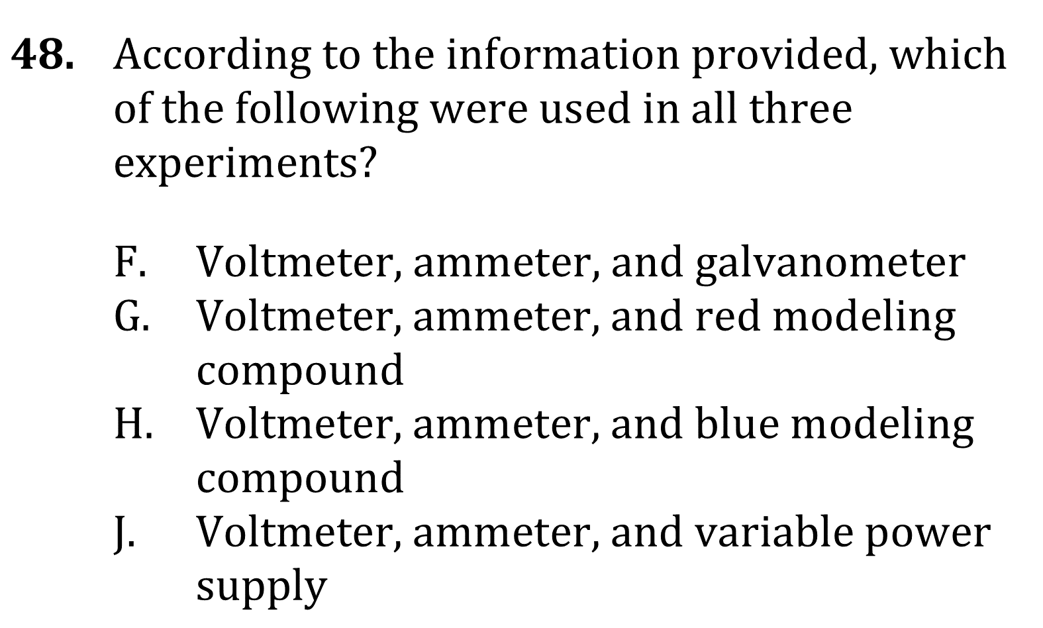
Notes:
Understand tools and methods in an experiment; Understand experimental design; Identify a control in an experiment. Level: Advanced Skill Group: Scientific

Slide 5
Notes:
Understand tools and methods in an experiment; Understand experimental design; Identify a control in an experiment. Level: Advanced Skill Group: Scientific

Slide 6
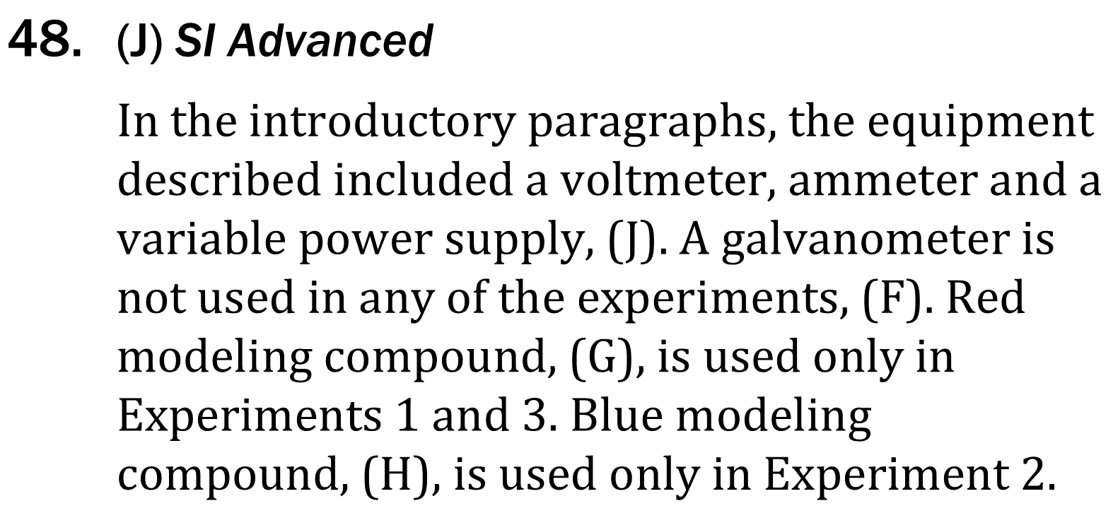
Notes:
Understand tools and methods in an experiment; Understand experimental design; Identify a control in an experiment. Level: Advanced Skill Group: Scientific

Slide 7
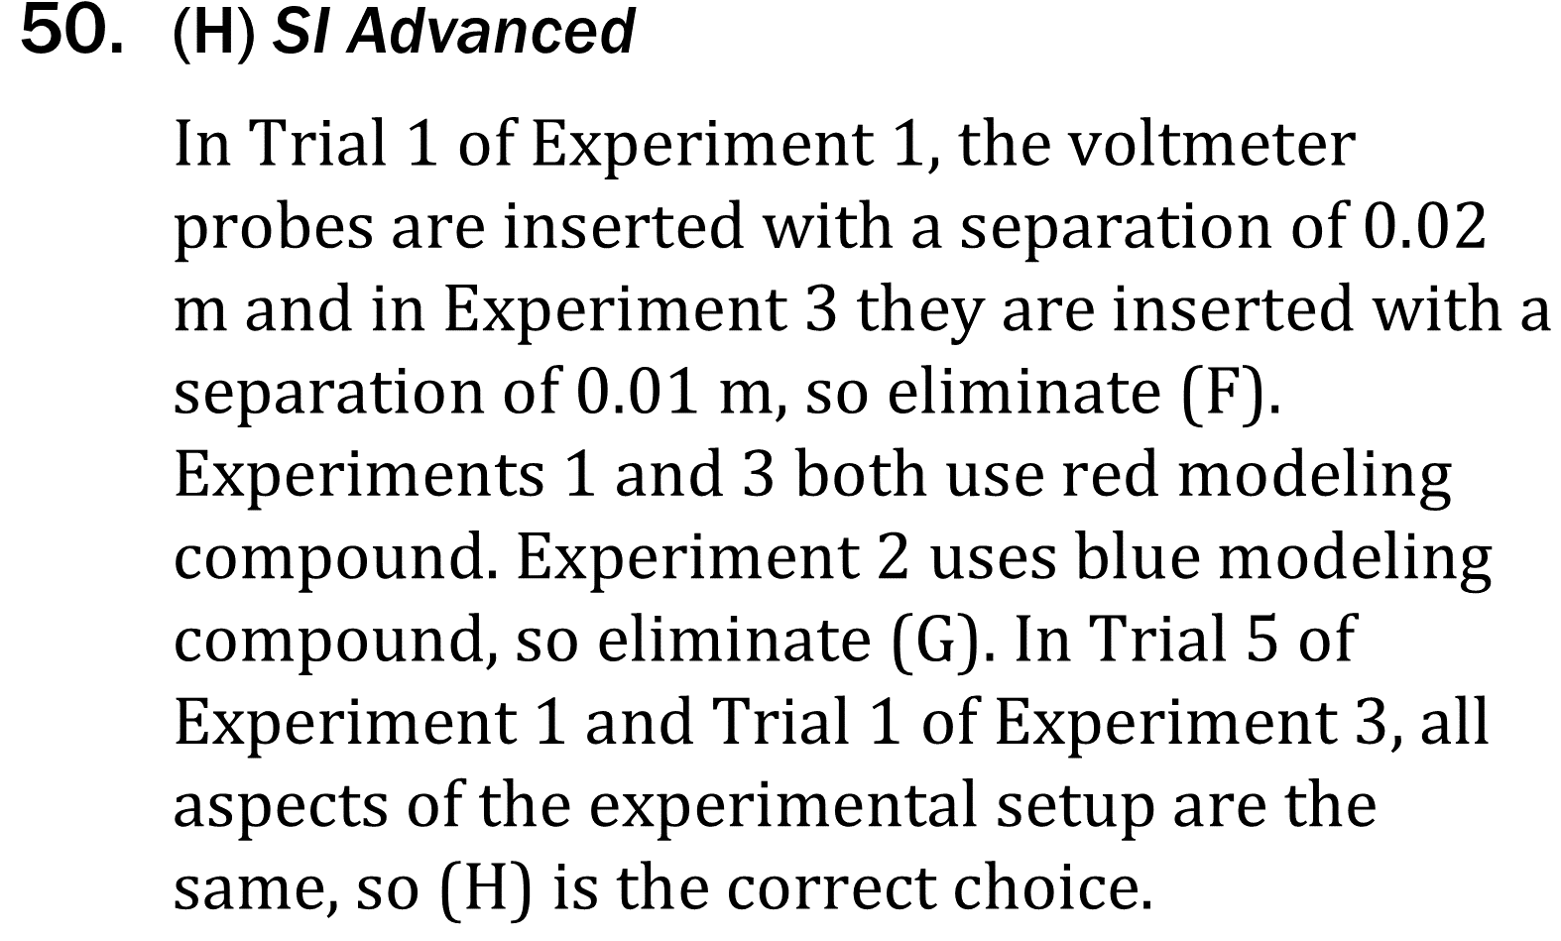
Notes:
Understand tools and methods in an experiment; Understand experimental design; Identify a control in an experiment. Level: Advanced Skill Group: Scientific

Slide 8
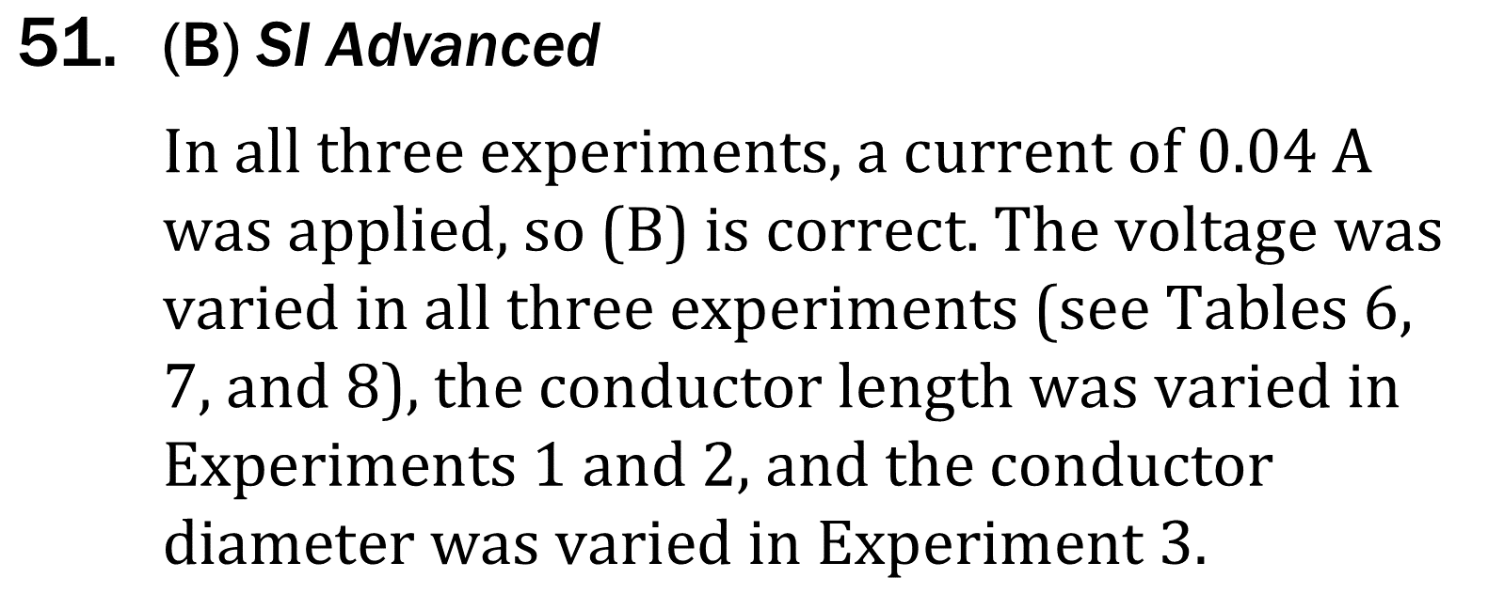
Notes:
Understand tools and methods in an experiment; Understand experimental design; Identify a control in an experiment. Level: Advanced Skill Group: Scientific

