Slide 1
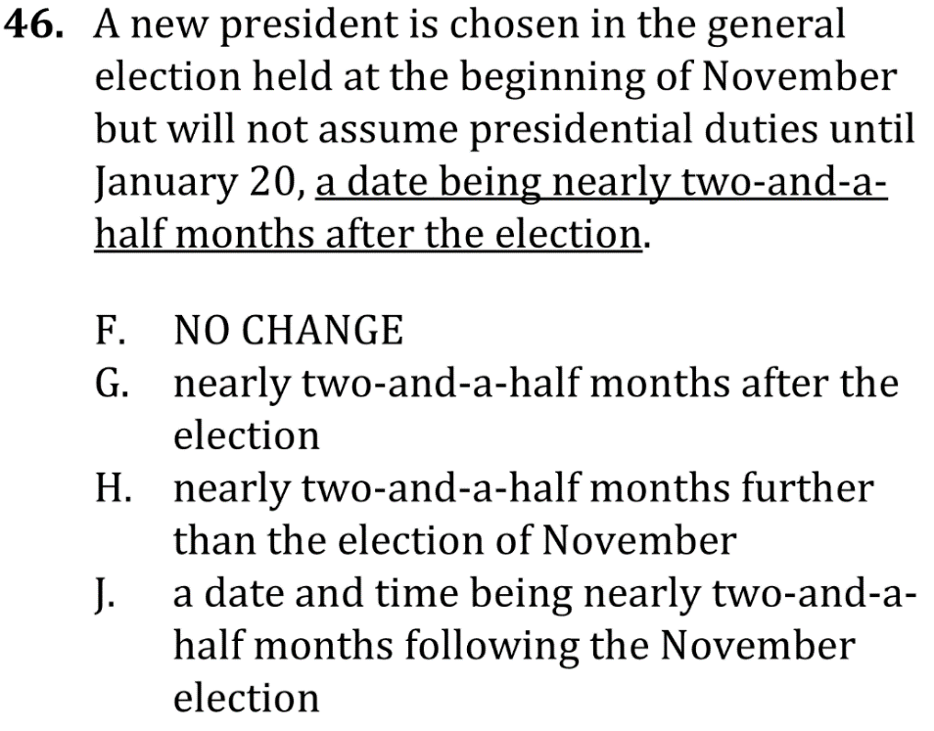
Correct awkward, wordy sentences

Slide 2
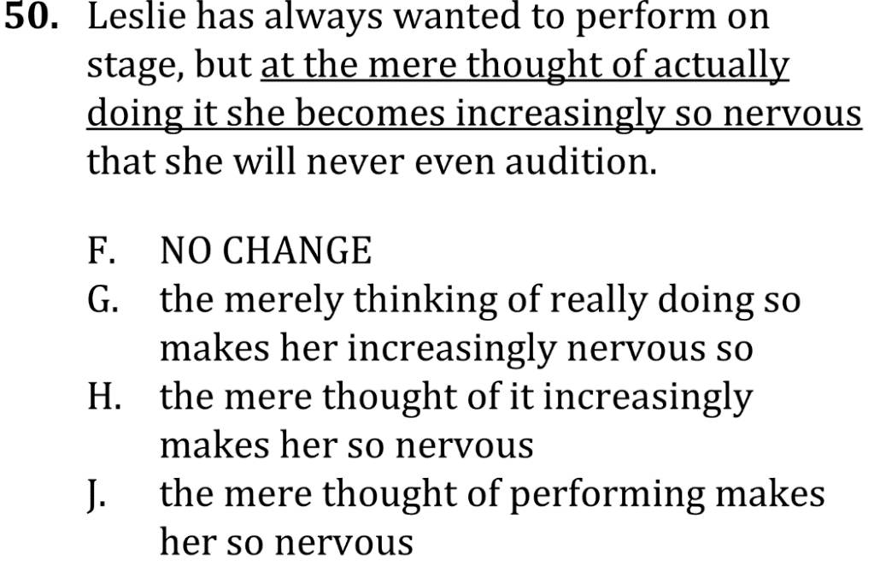
Correct awkward, wordy sentences

Slide 3
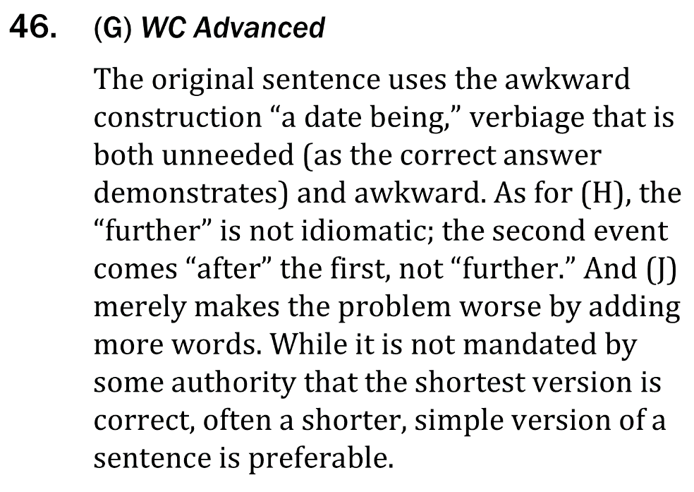
Correct awkward, wordy sentences

Slide 4
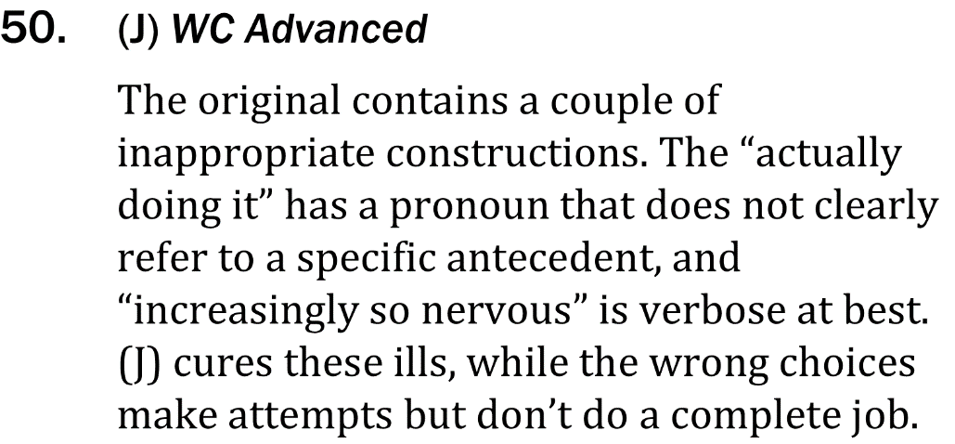
Correct awkward, wordy sentences

