Slide 1
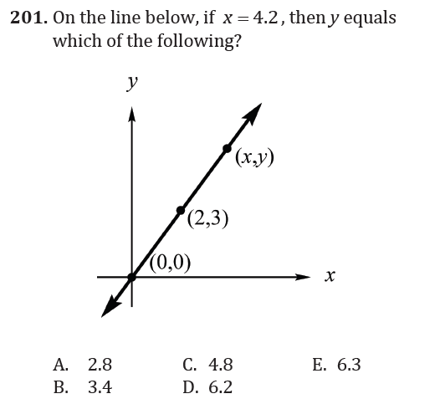

Graphing Geometric Figures and Transformations

Slide 2
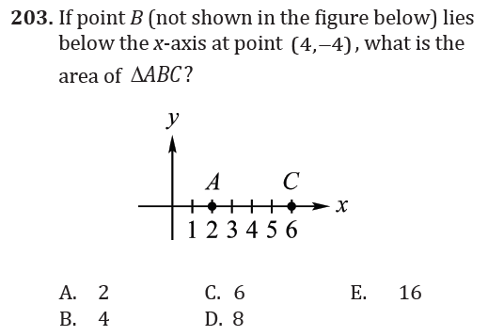
Graphing Geometric Figures and Transformations

Slide 3
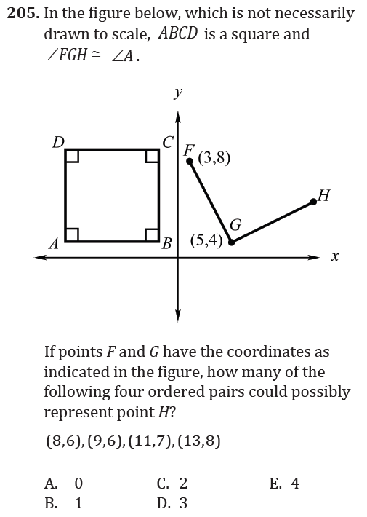
Graphing Geometric Figures and Transformations

Slide 4
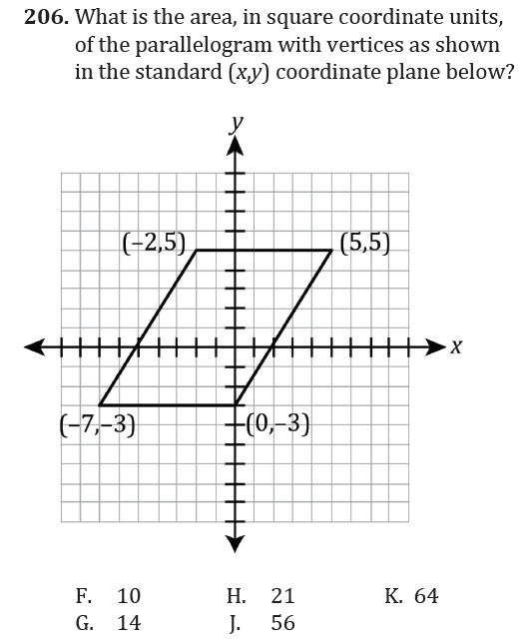
Graphing Geometric Figures and Transformations

Slide 5
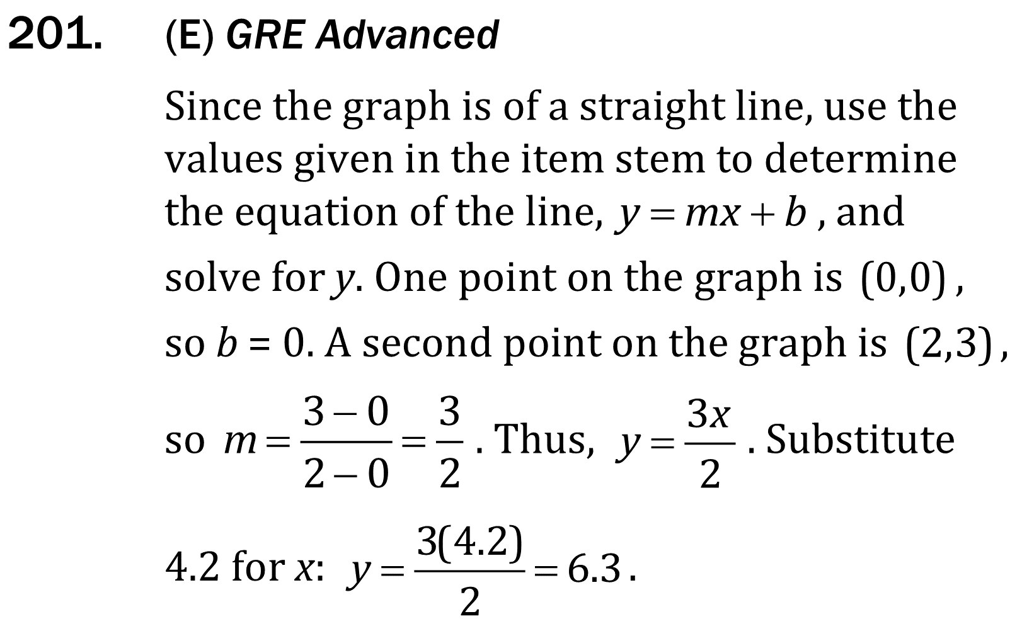
Graphing Geometric Figures and Transformations

Slide 6
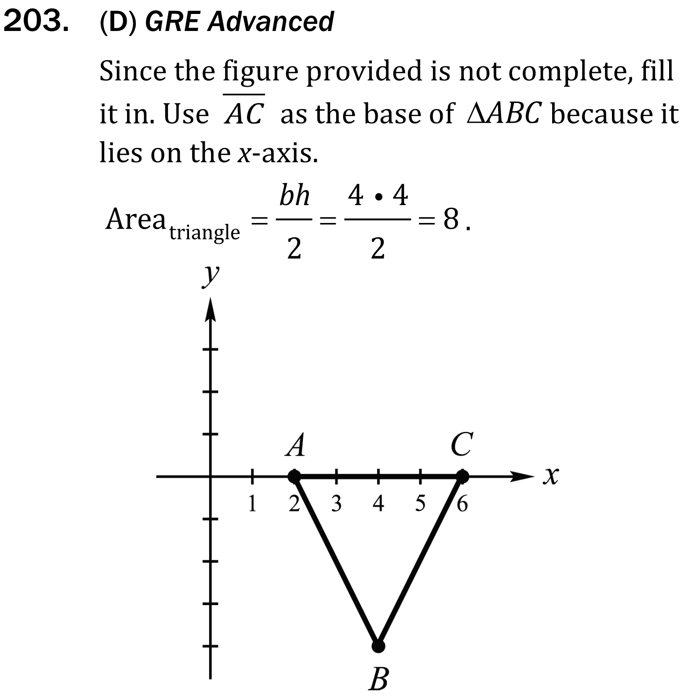
Graphing Geometric Figures and Transformations

Slide 7
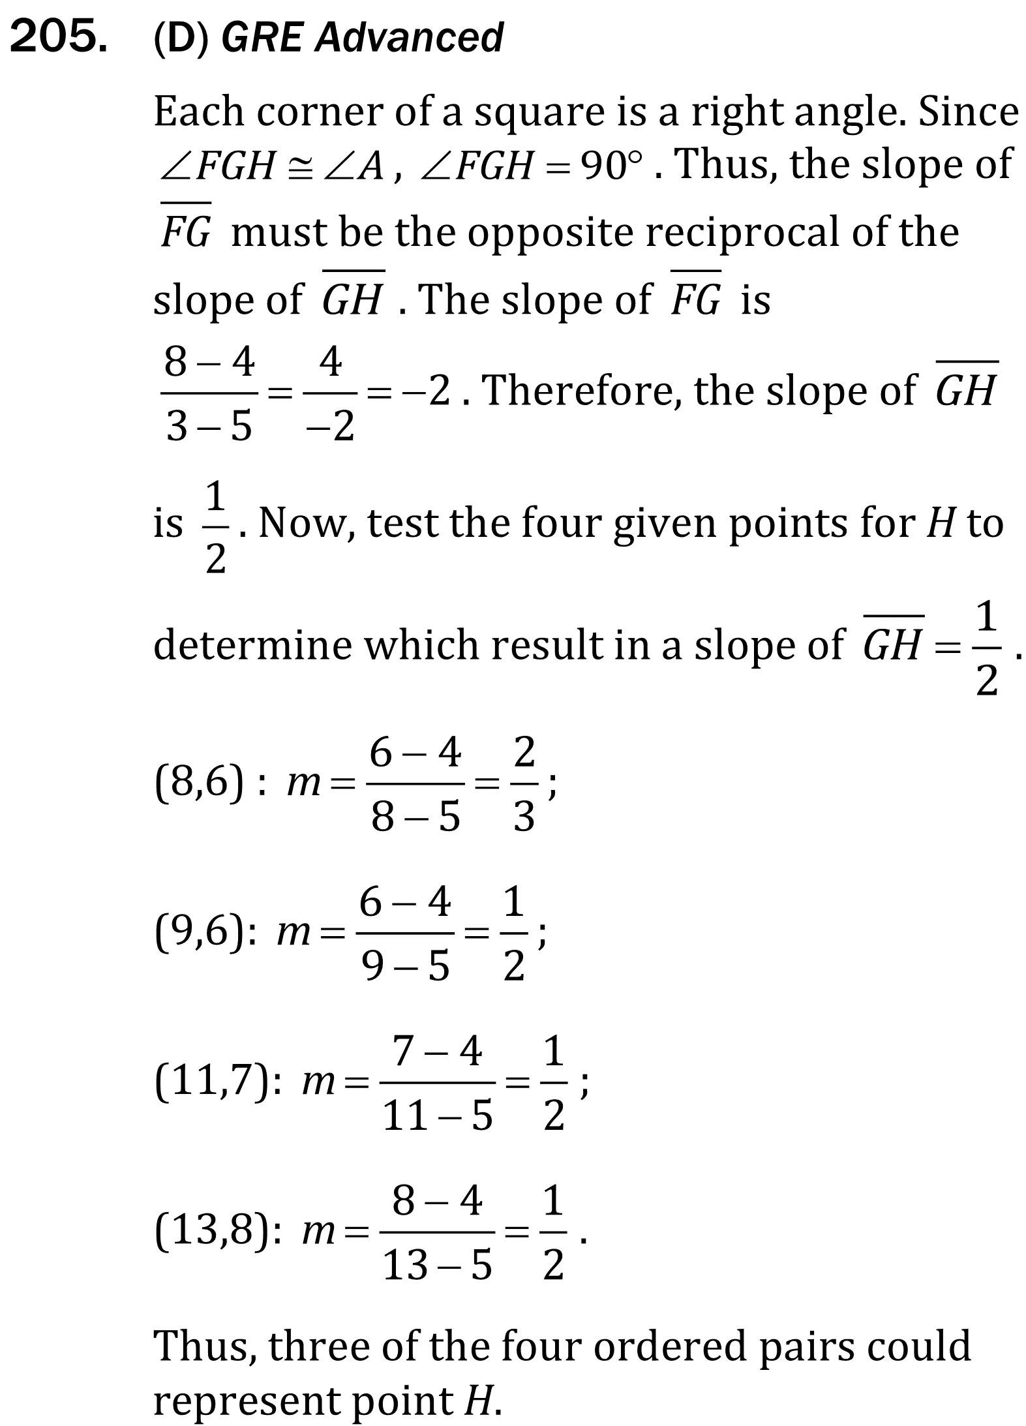
Graphing Geometric Figures and Transformations

Slide 8
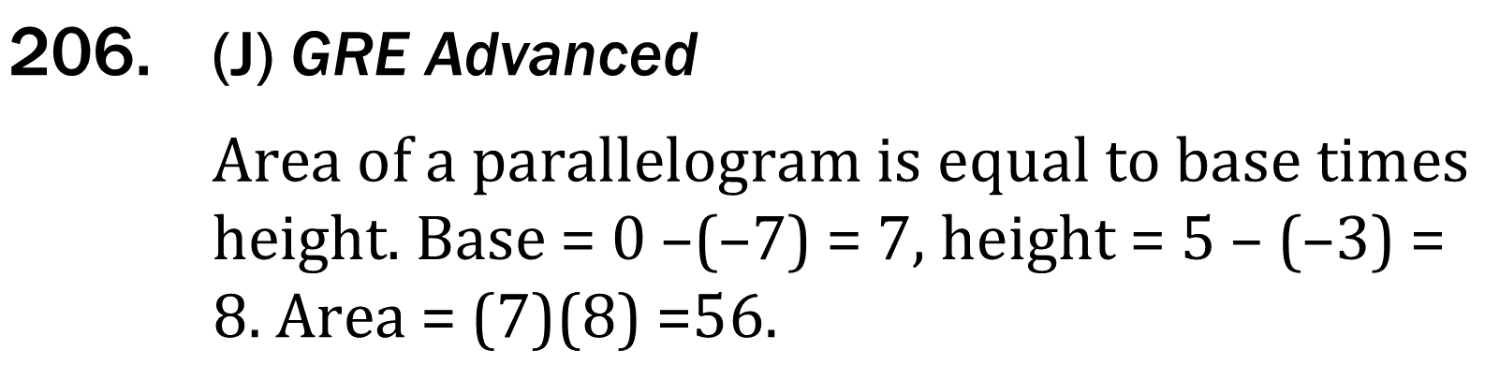
Graphing Geometric Figures and Transformations

