Slide 1
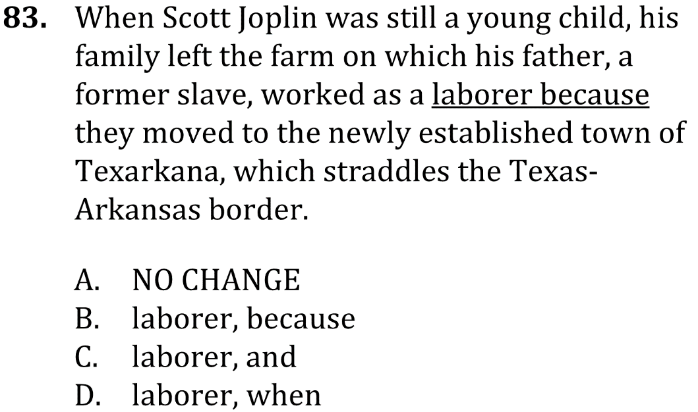

Use proper sentence structure

Slide 2
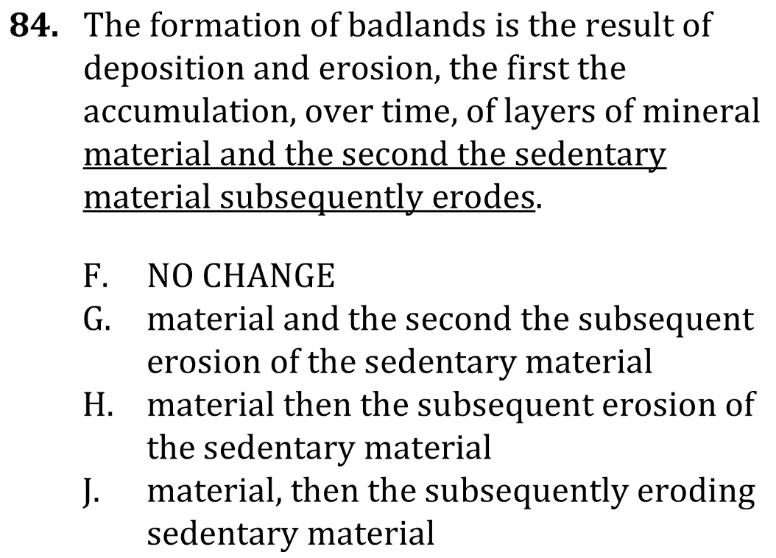
Use proper sentence structure

Slide 3

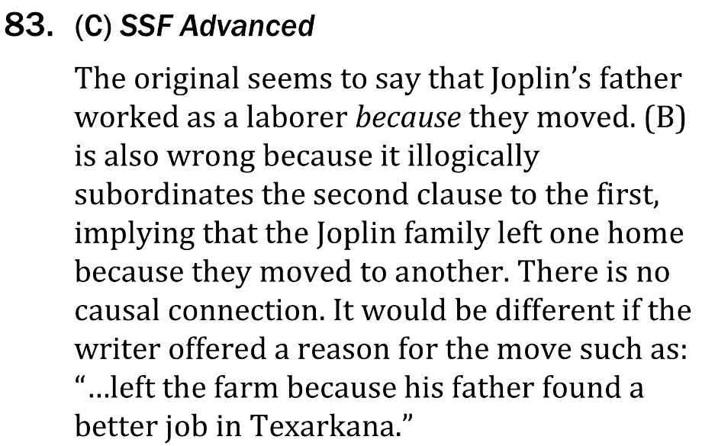
Use proper sentence structure

Slide 4

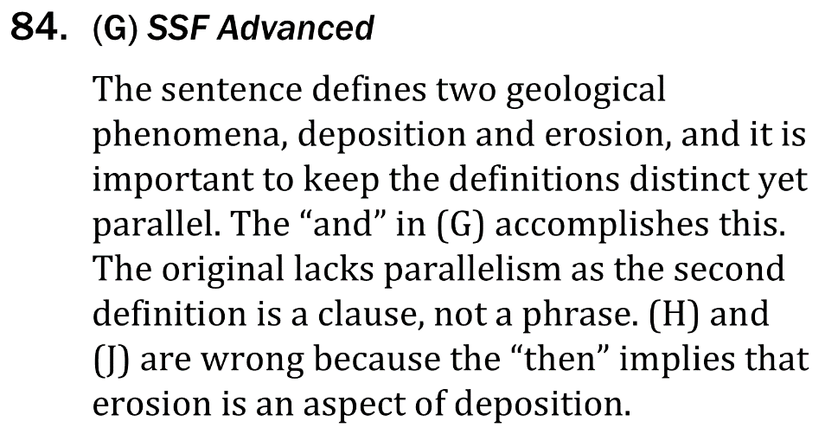
Use proper sentence structure

