Slide 1
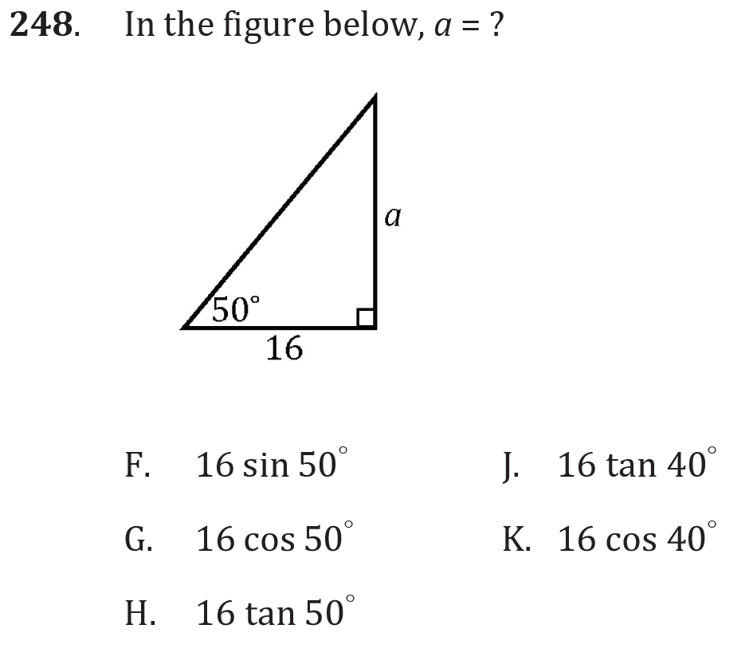
Sine, cosine, and tangent

Slide 2
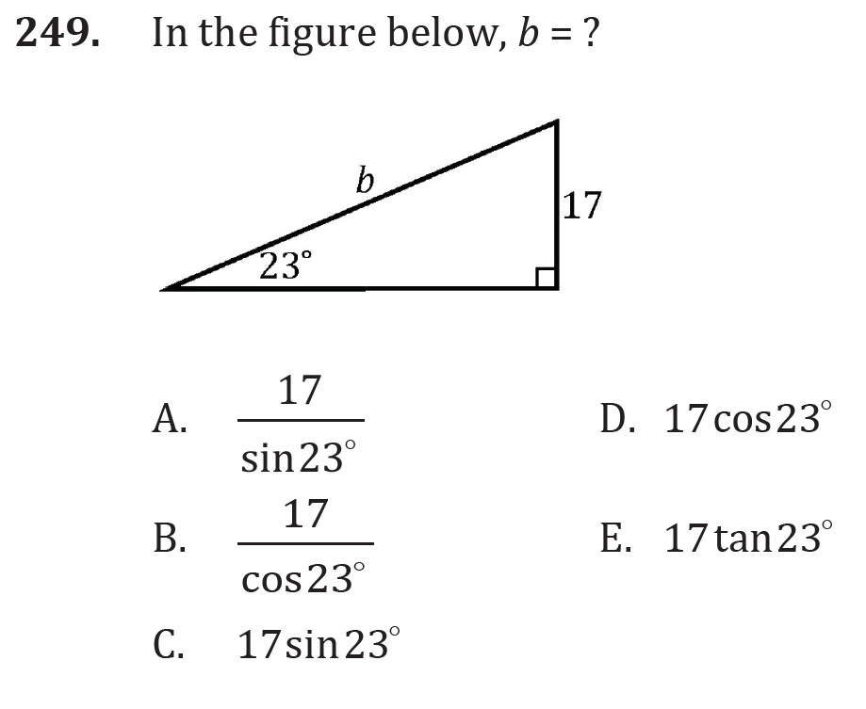
Sine, cosine, and tangent

Slide 3
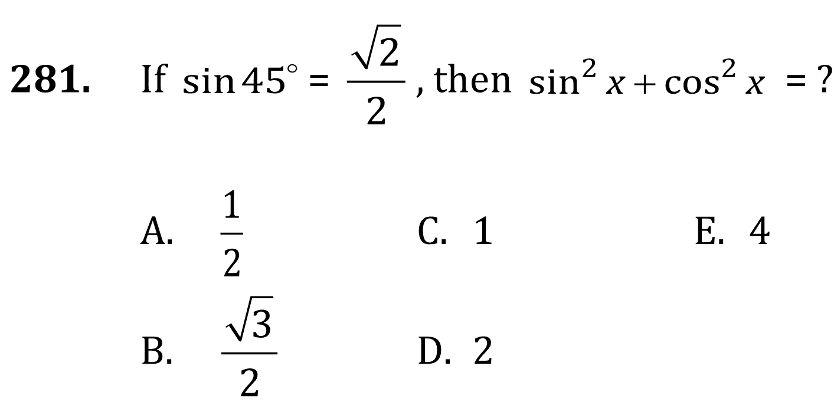
Sine, cosine, and tangent

Slide 4
Sine, cosine, and tangent

Slide 5
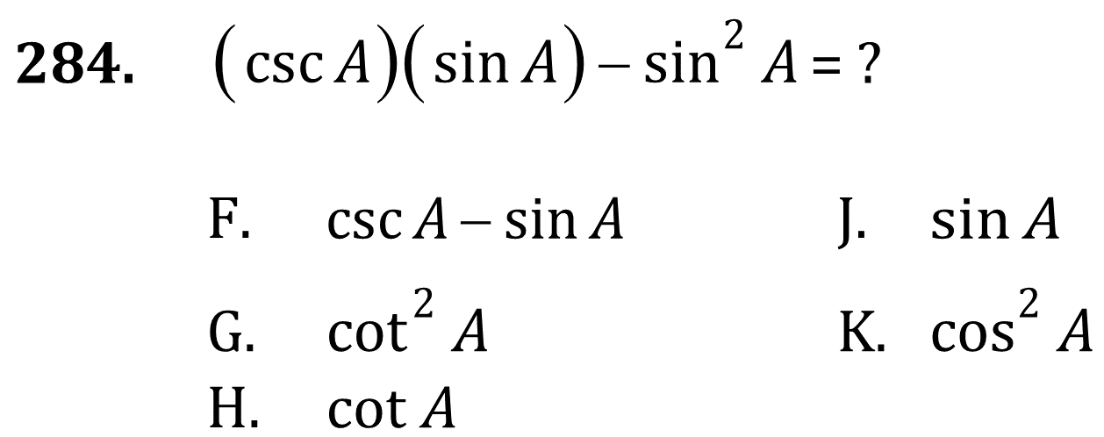
Sine, cosine, and tangent

Slide 6
Sine, cosine, and tangent

Slide 7
Sine, cosine, and tangent

Slide 8
Sine, cosine, and tangent

Slide 9
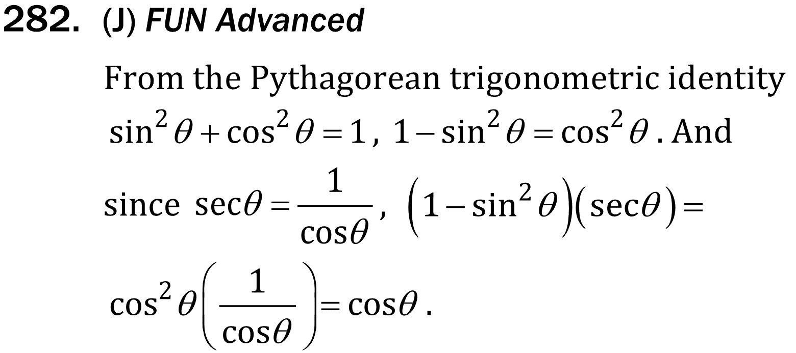
Sine, cosine, and tangent

Slide 10
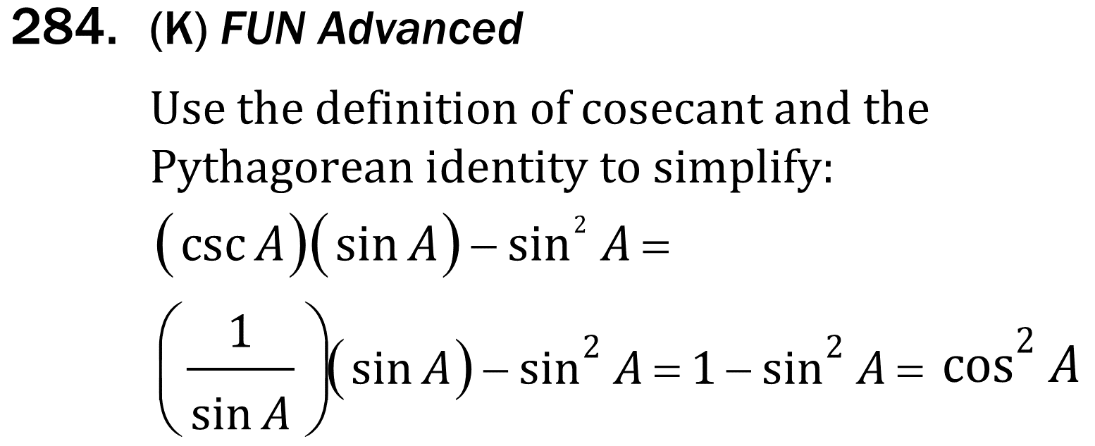
Sine, cosine, and tangent

