Slide 1
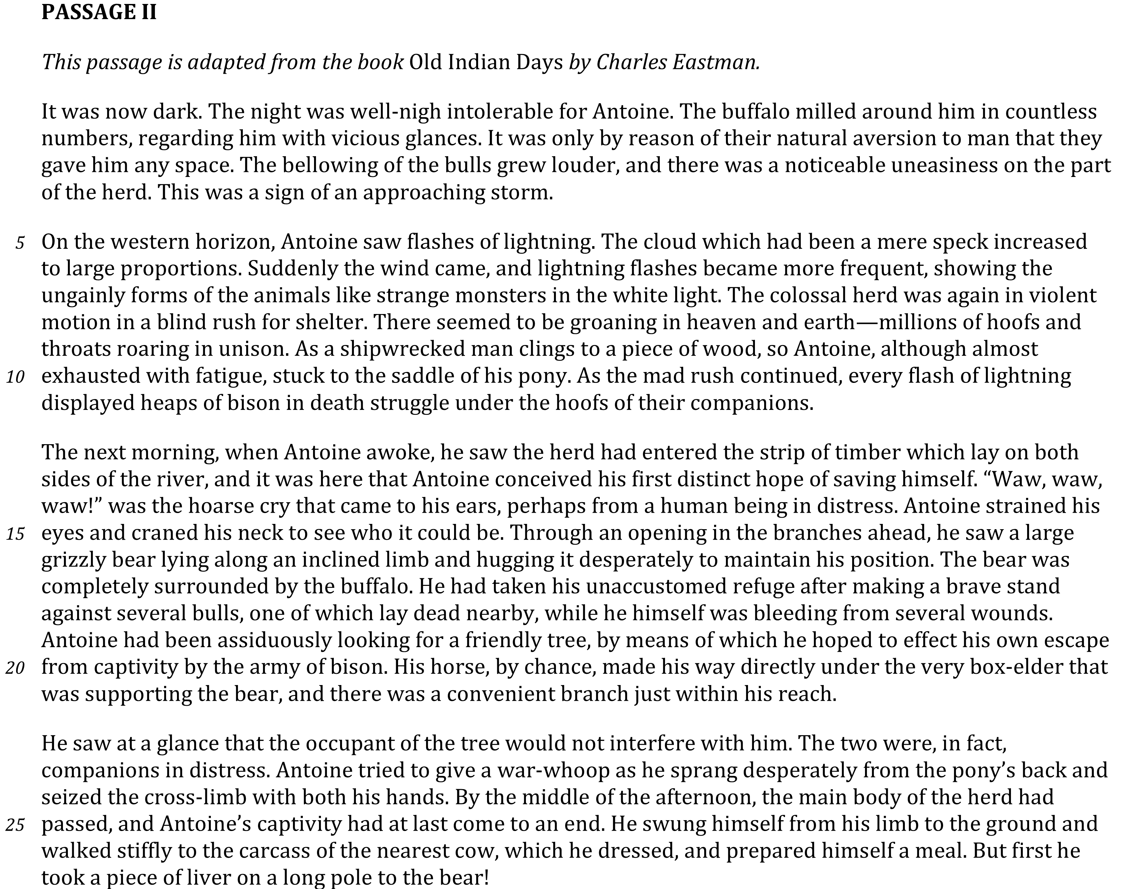

Slide 2
Draw Conclusions

Slide 3
