Slide 1
Story problems

Slide 2
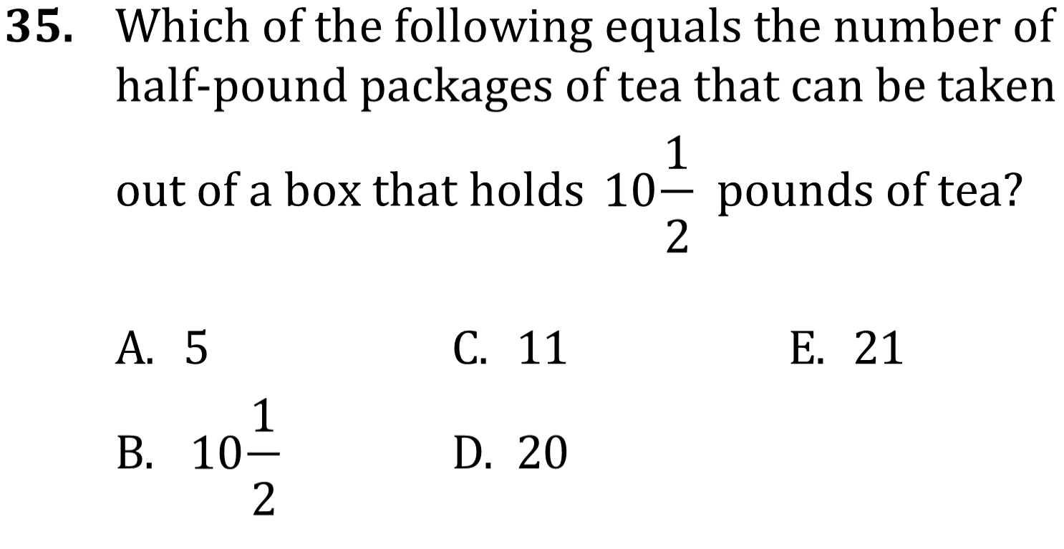
Story problems

Slide 3
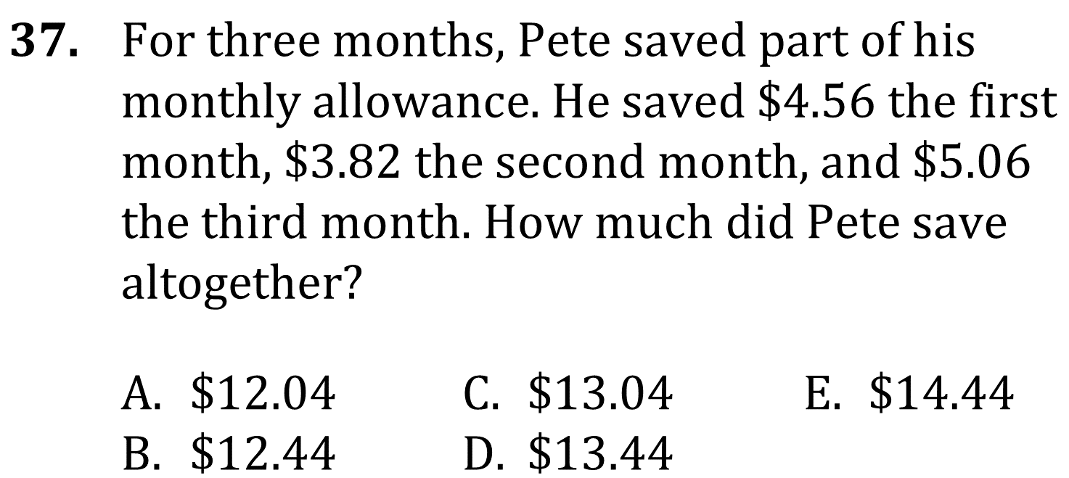
Story problems

Slide 4
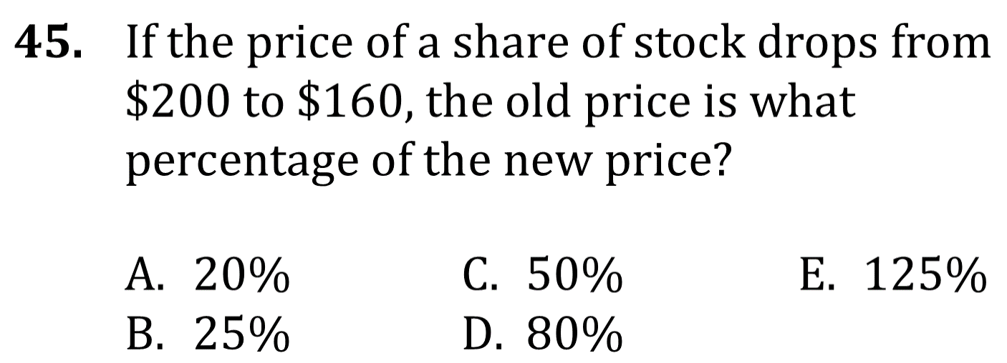
Story problems

Slide 5
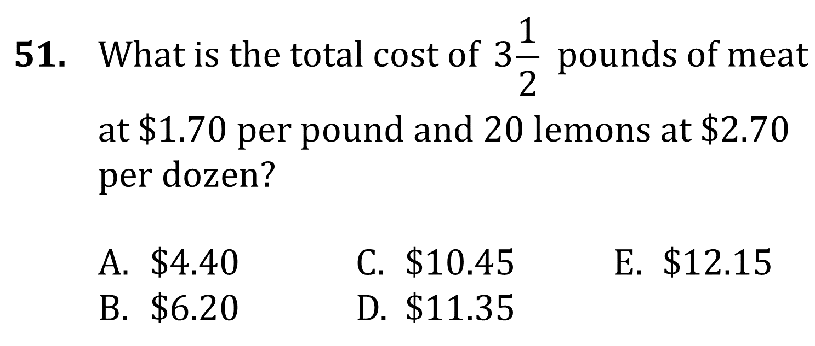
Story problems

Slide 6
Story problems

Slide 7
Story problems

Slide 8
Story problems

Slide 9
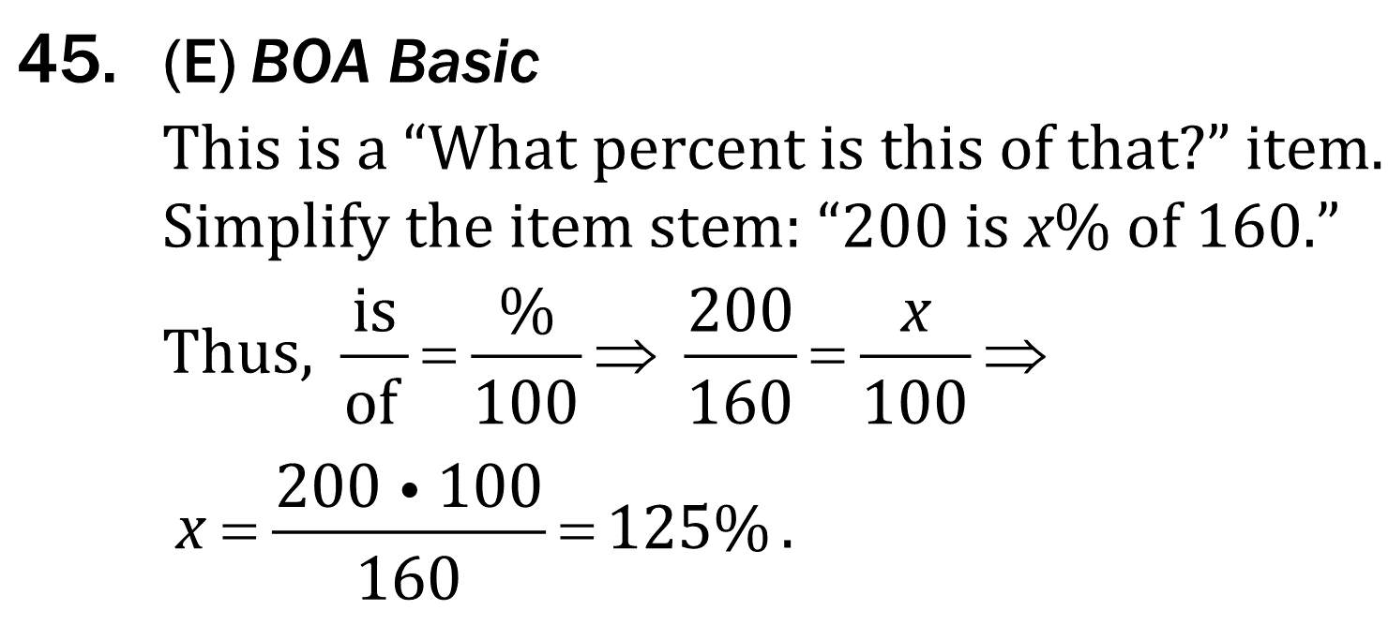
Story problems

Slide 10
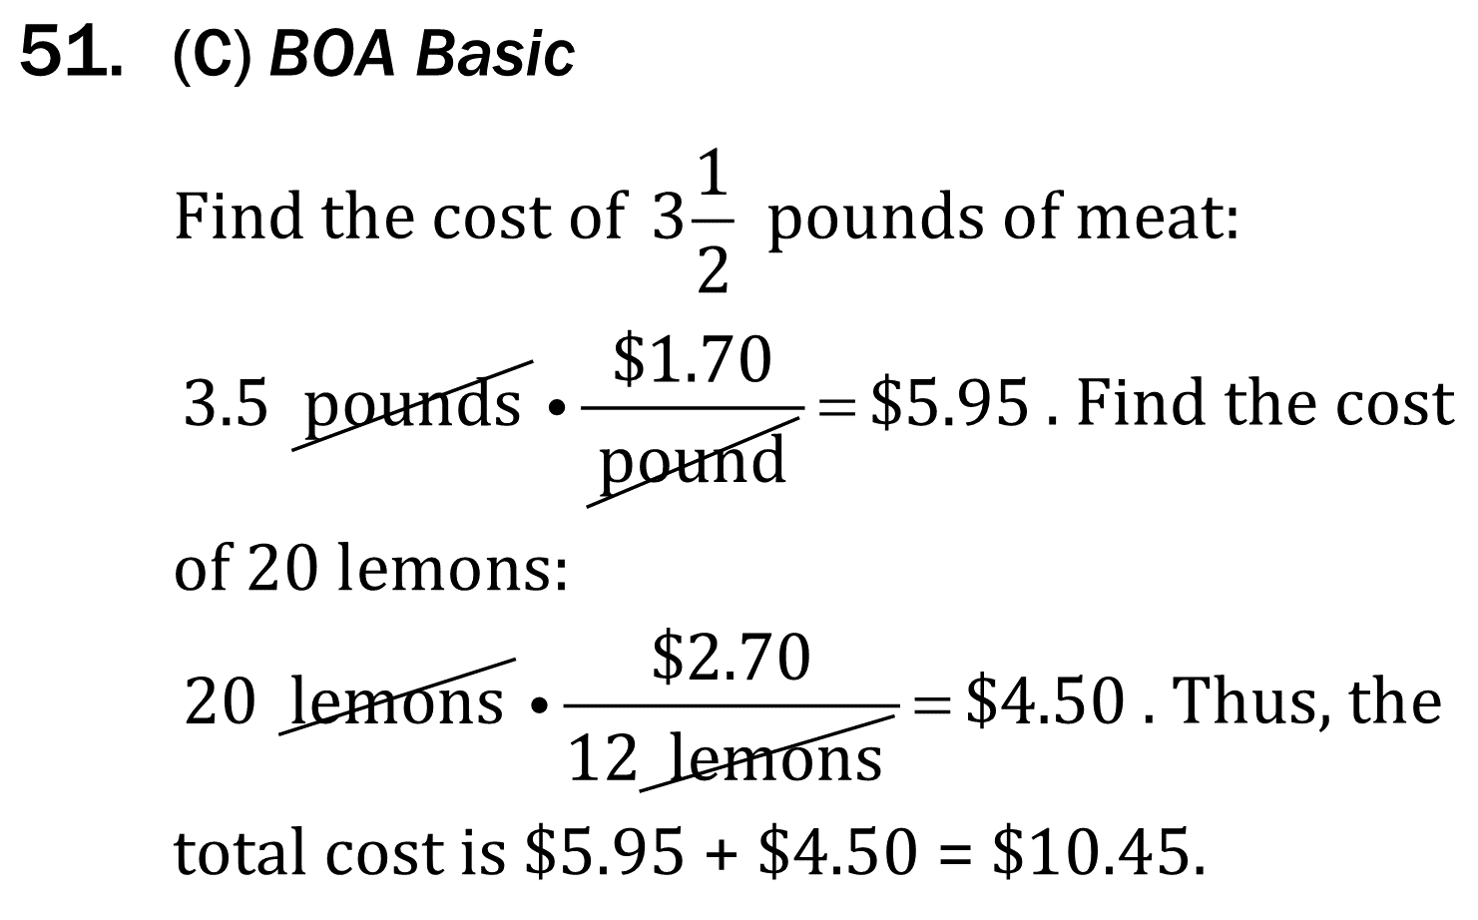
Story problems

