Slide 1
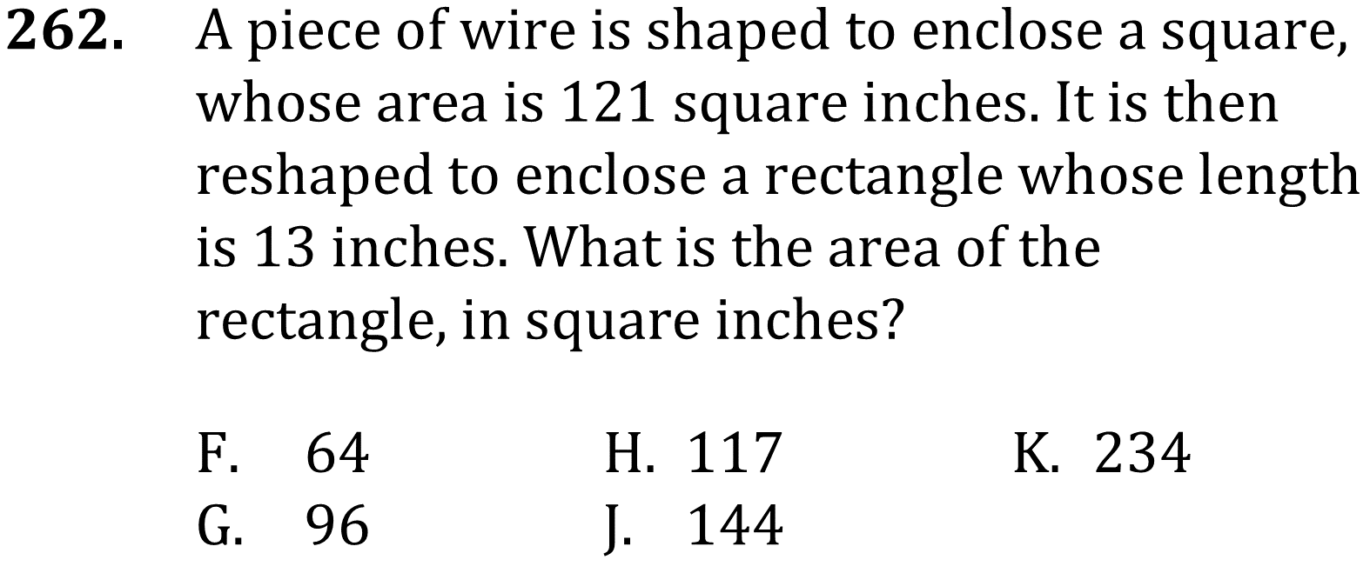

Scale factors

Slide 2

Scale factors

Slide 3
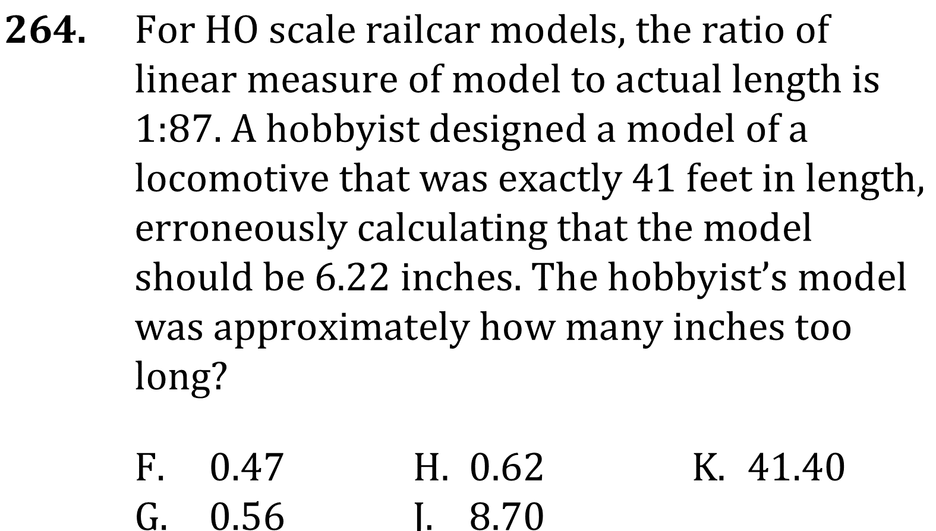
Scale factors

Slide 4
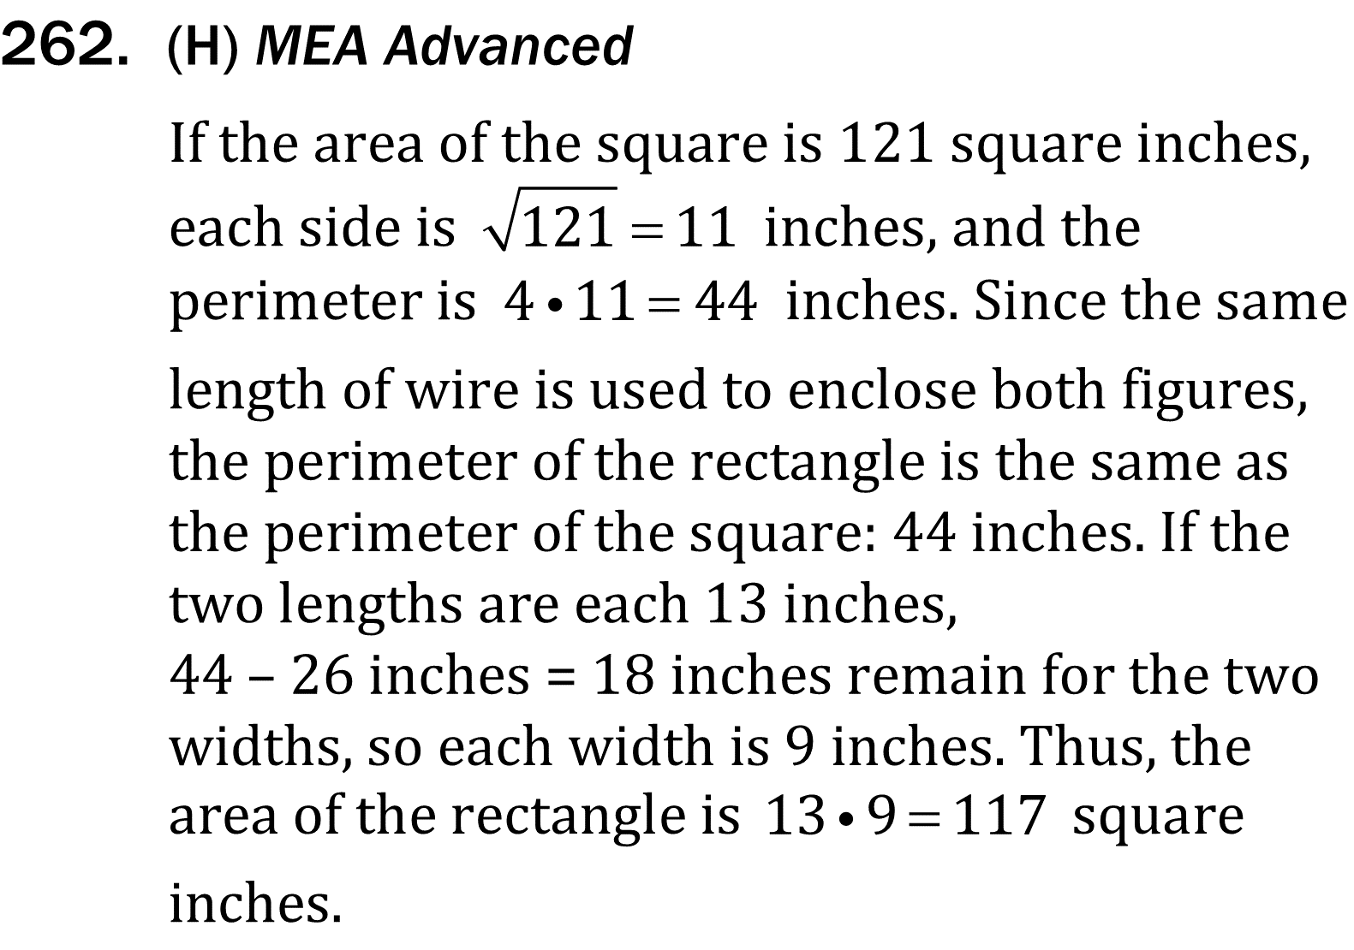
Scale factors

Slide 5
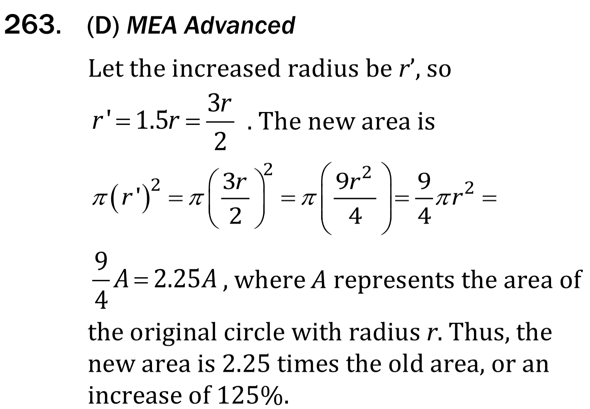
Scale factors

Slide 6

Scale factors

