Slide 1
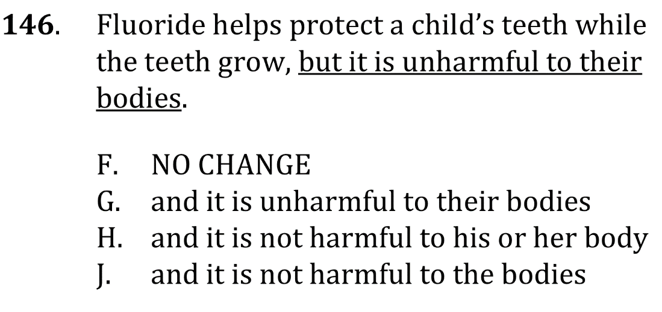
Pronoun-antecedent agreement

Slide 2
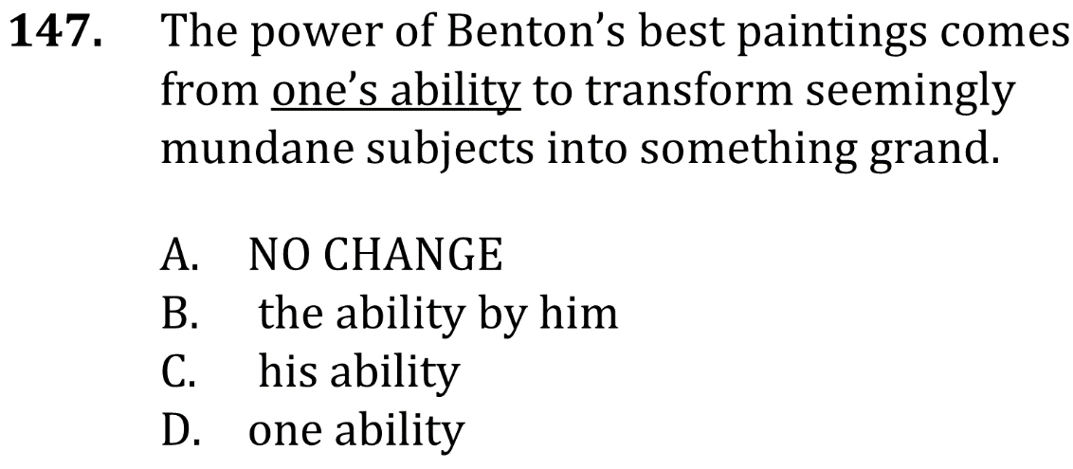
Pronoun-antecedent agreement

Slide 3
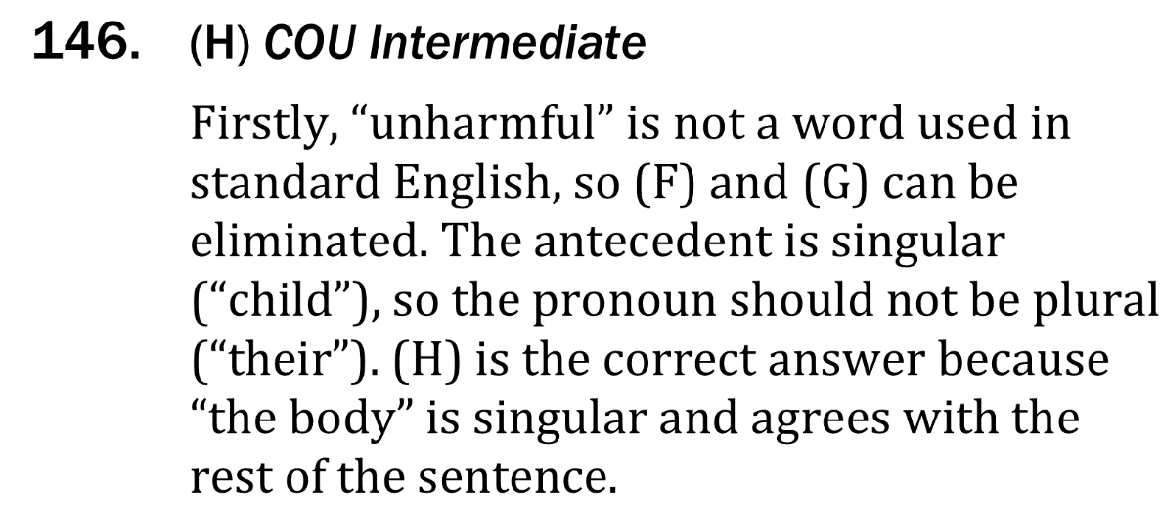
Pronoun-antecedent agreement

Slide 4
Pronoun-antecedent agreement

