Slide 1
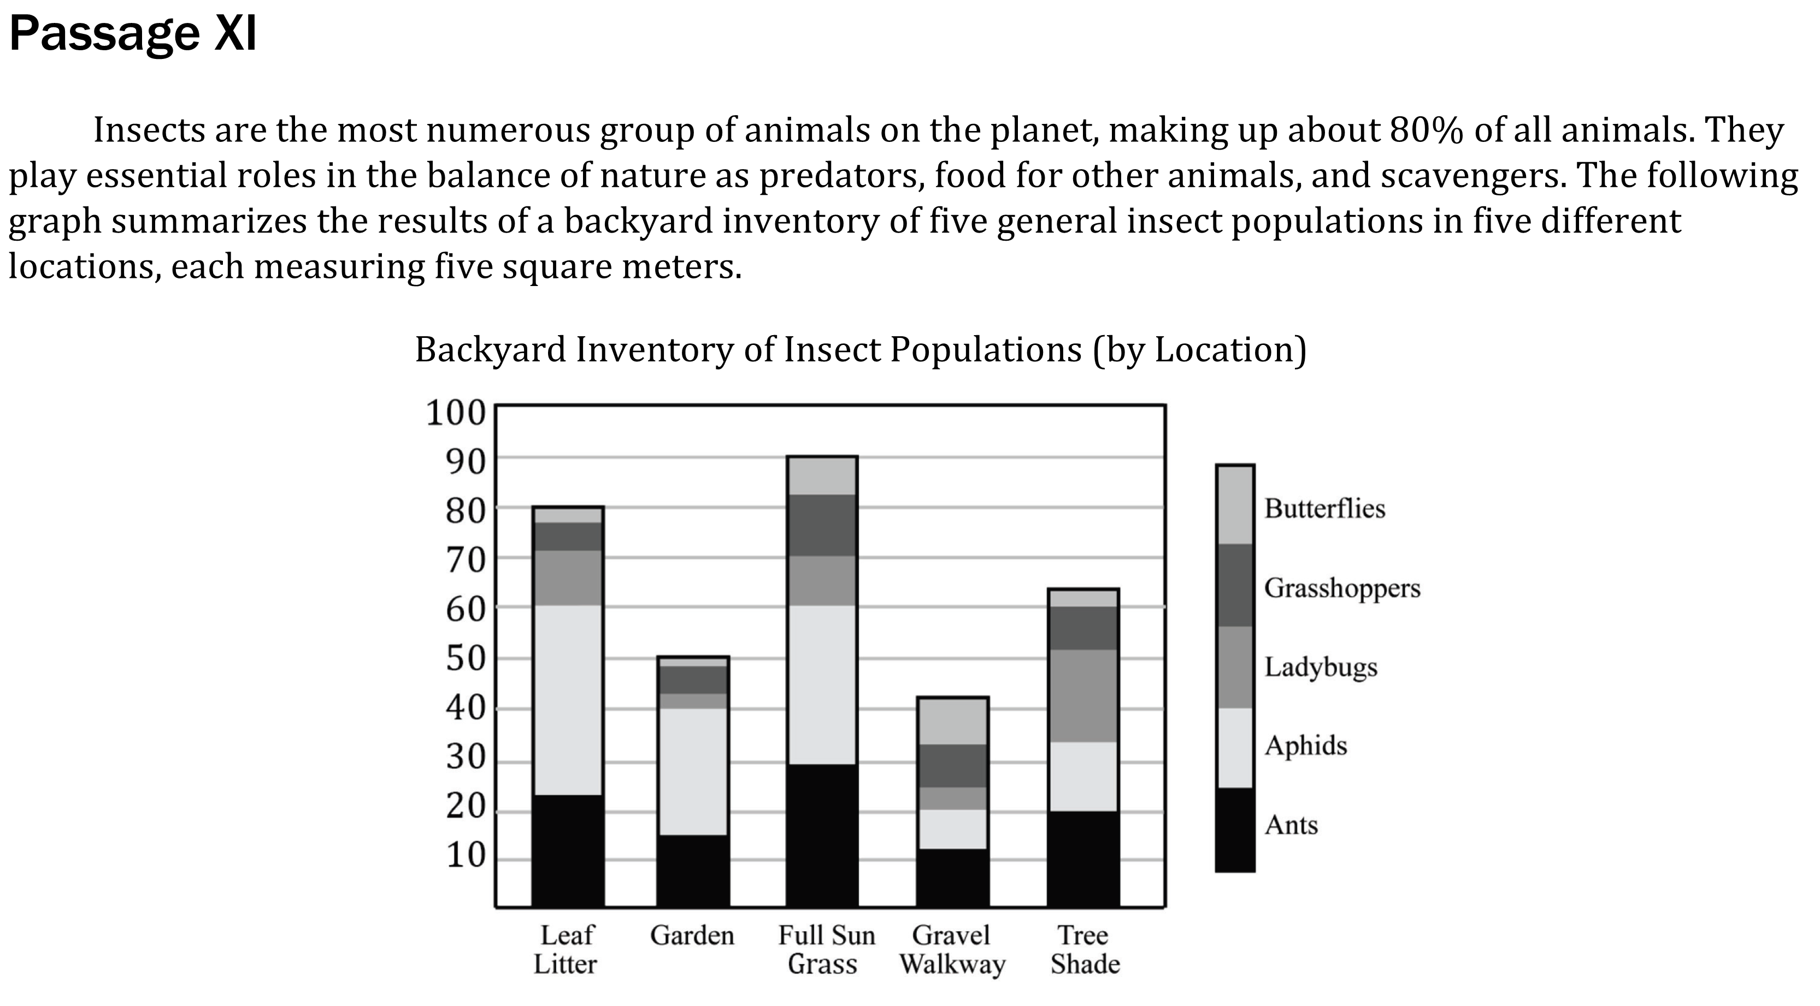
Notes:
Use a simple presentation of data to identify one two or more pieces of data either numerical of non-numerical; Find information in a body of scientific text; Determine direct and inverse relationships of variables in a data presentation. Level: Basic Skill Group: Interpretation of Data

Slide 2
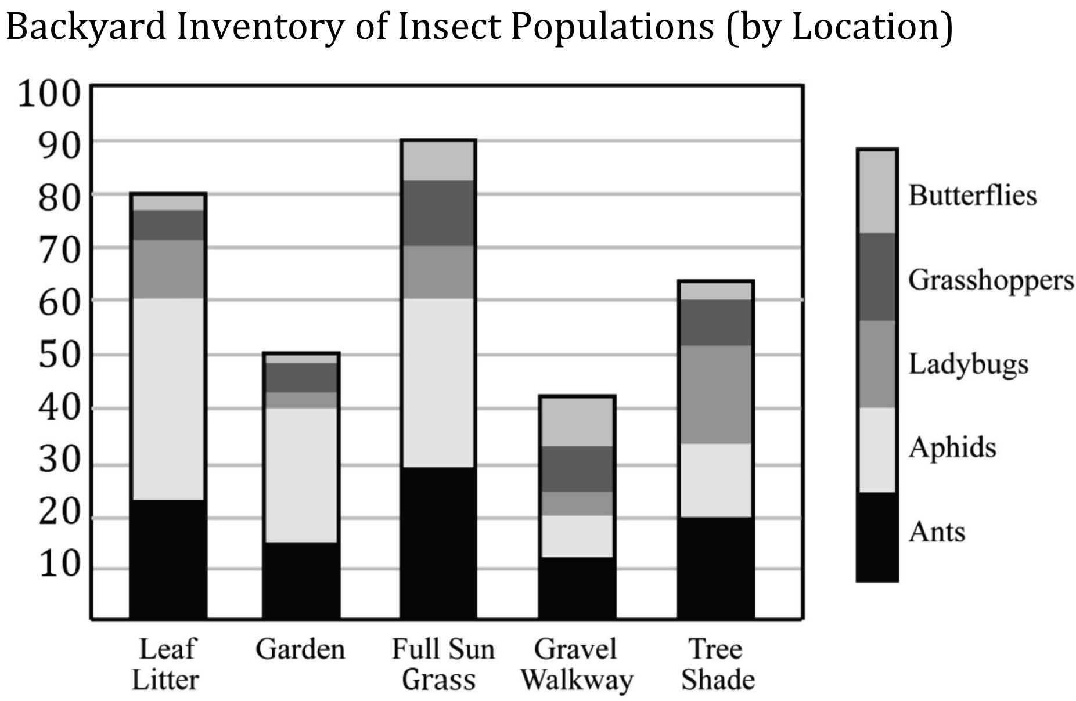
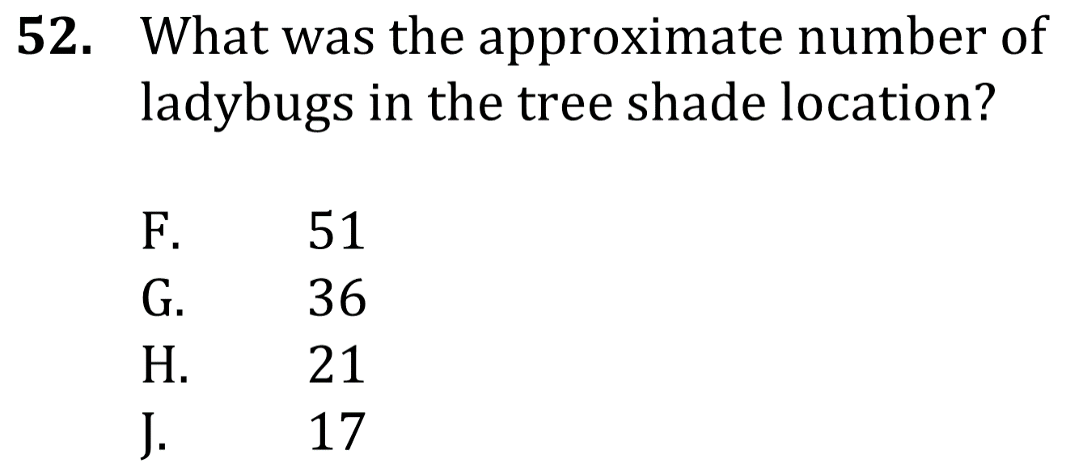
Notes:
Use a simple presentation of data to identify one two or more pieces of data either numerical of non-numerical; Find information in a body of scientific text; Determine direct and inverse relationships of variables in a data presentation. Level: Basic Skill Group: Interpretation of Data

Slide 3
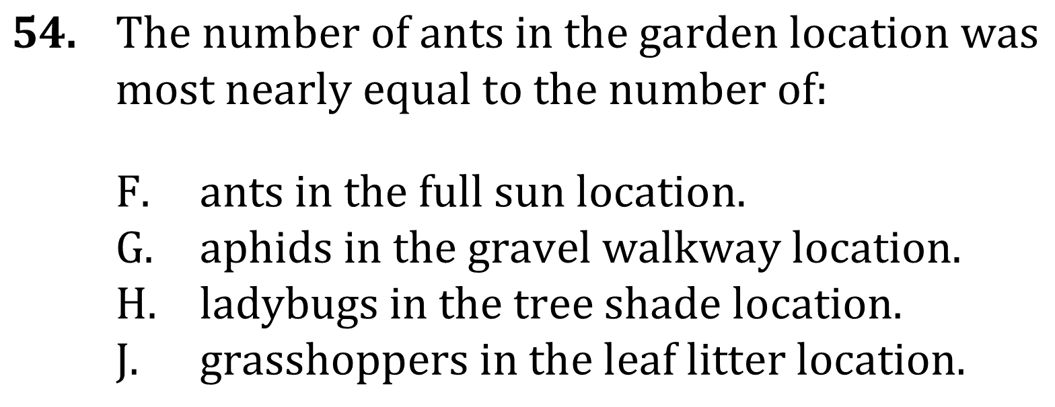

Slide 4
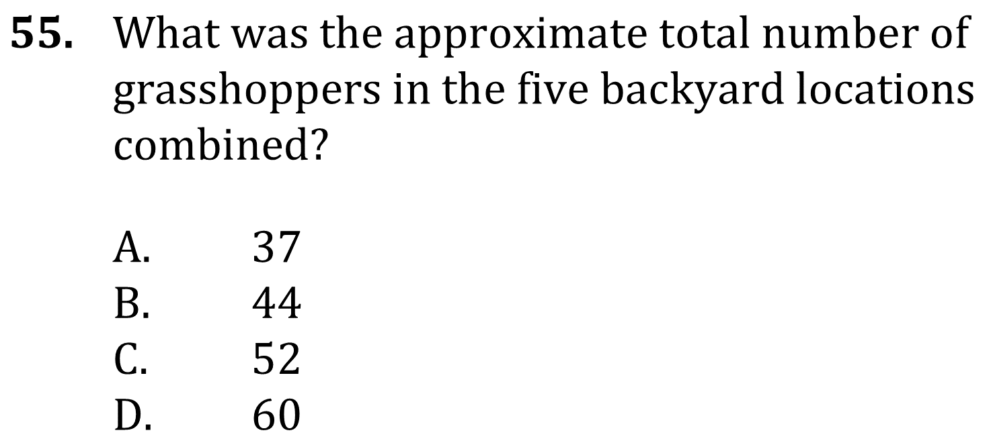
Notes:
Use a simple presentation of data to identify one two or more pieces of data either numerical of non-numerical; Find information in a body of scientific text; Determine direct and inverse relationships of variables in a data presentation. Level: Basic Skill Group: Interpretation of Data

Slide 5
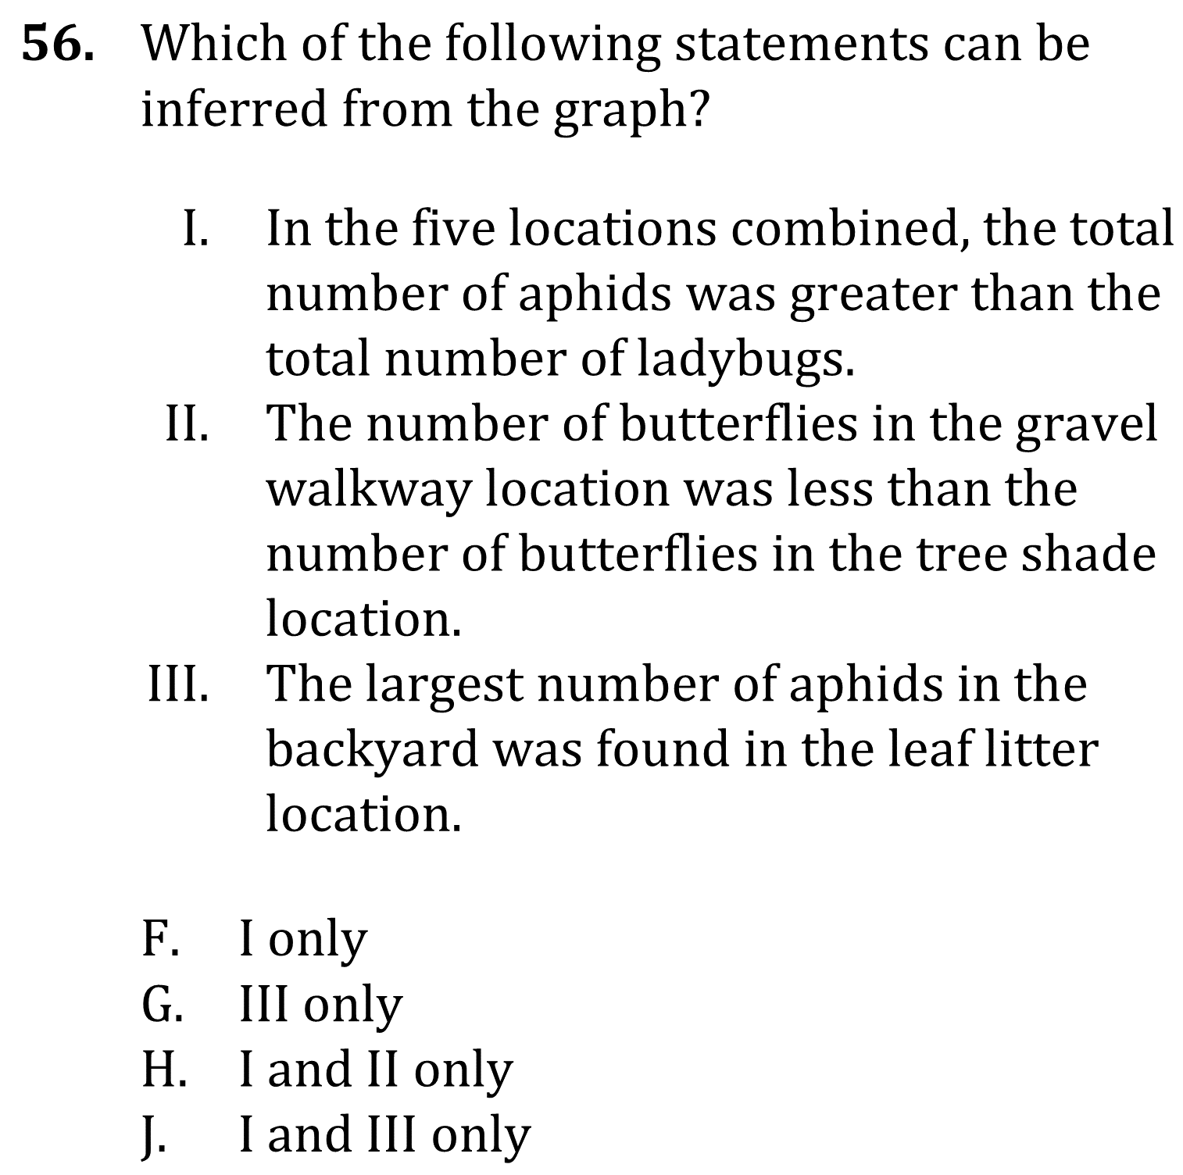
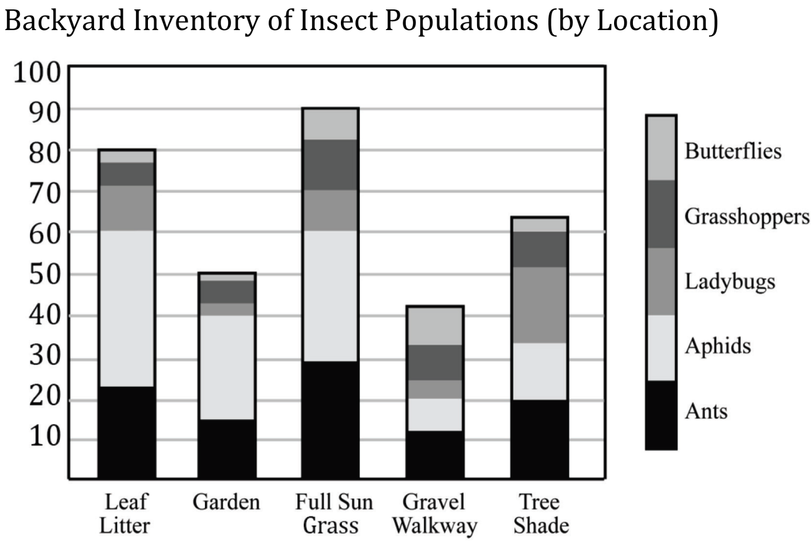
Notes:
Use a simple presentation of data to identify one two or more pieces of data either numerical of non-numerical; Find information in a body of scientific text; Determine direct and inverse relationships of variables in a data presentation. Level: Basic Skill Group: Interpretation of Data

Slide 6
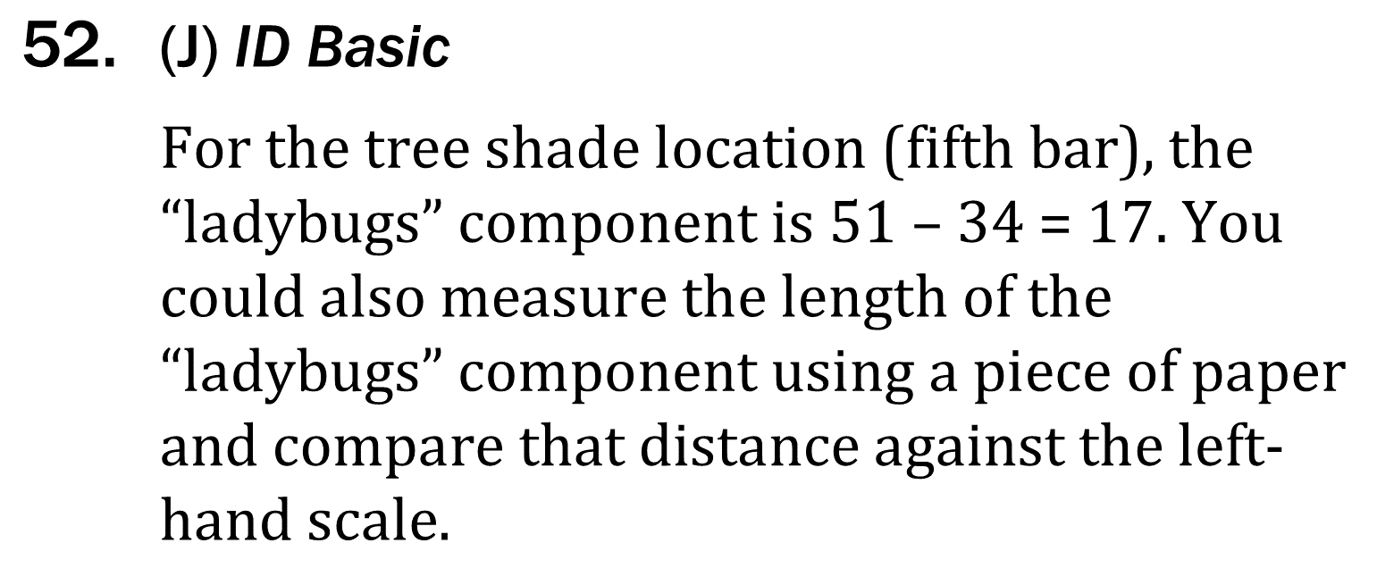
Notes:
Use a simple presentation of data to identify one two or more pieces of data either numerical of non-numerical; Find information in a body of scientific text; Determine direct and inverse relationships of variables in a data presentation. Level: Basic Skill Group: Interpretation of Data

Slide 7
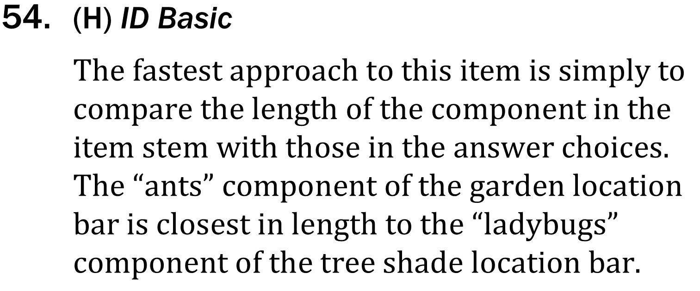
Notes:
Use a simple presentation of data to identify one two or more pieces of data either numerical of non-numerical; Find information in a body of scientific text; Determine direct and inverse relationships of variables in a data presentation. Level: Basic Skill Group: Interpretation of Data

Slide 8
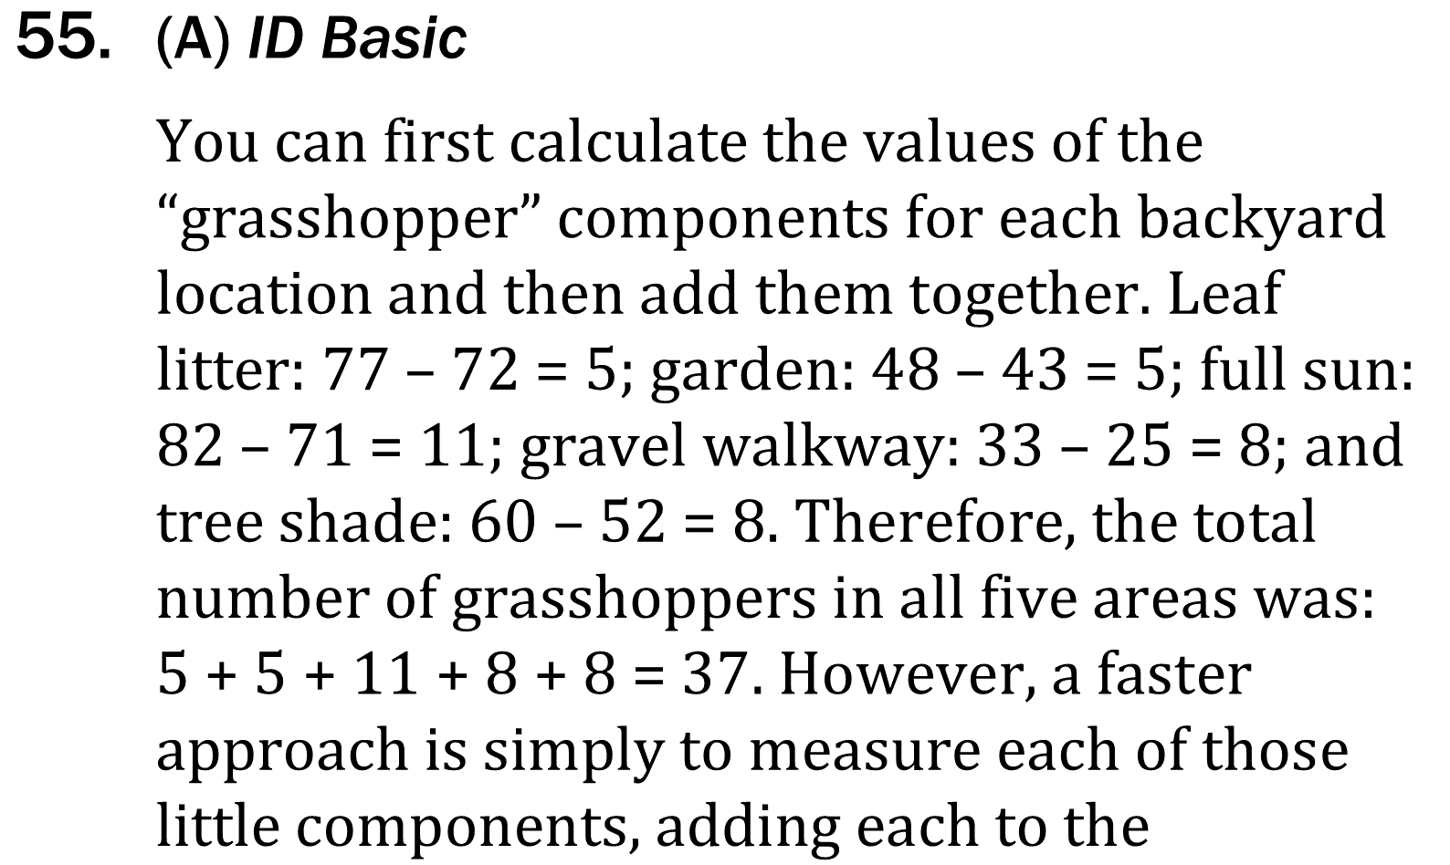
Notes:
Use a simple presentation of data to identify one two or more pieces of data either numerical of non-numerical; Find information in a body of scientific text; Determine direct and inverse relationships of variables in a data presentation. Level: Basic Skill Group: Interpretation of Data

Slide 9
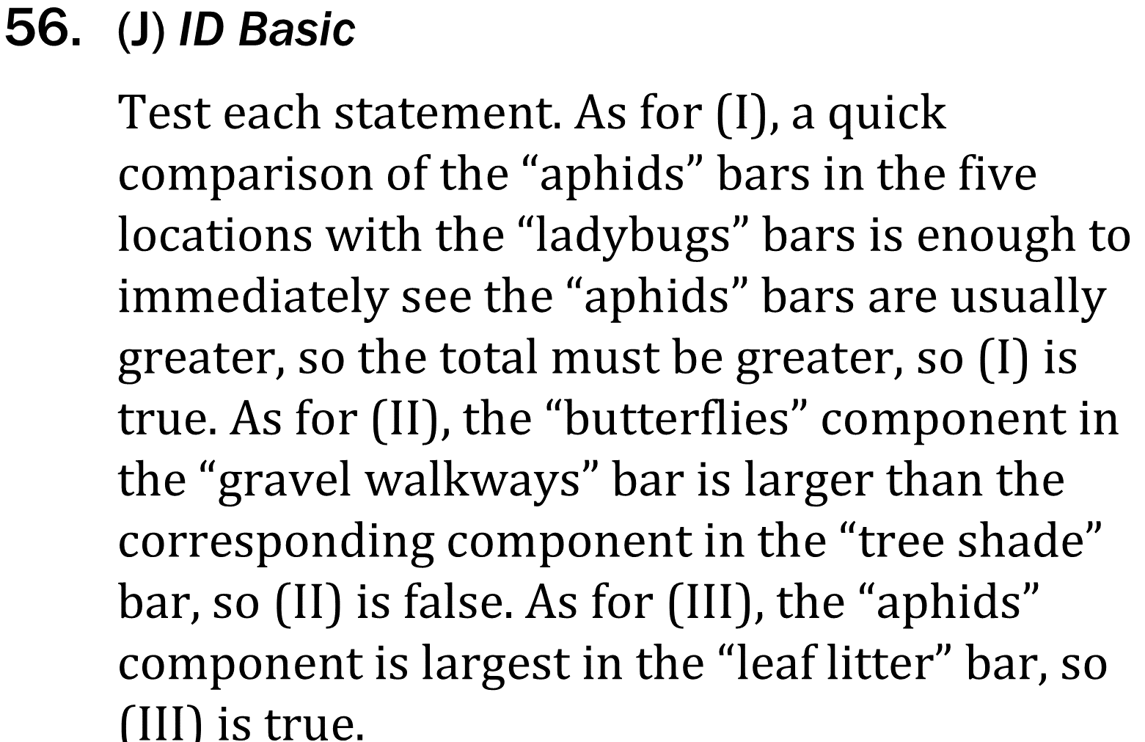
Notes:
Use a simple presentation of data to identify one two or more pieces of data either numerical of non-numerical; Find information in a body of scientific text; Determine direct and inverse relationships of variables in a data presentation. Level: Basic Skill Group: Interpretation of Data

