Slide 1
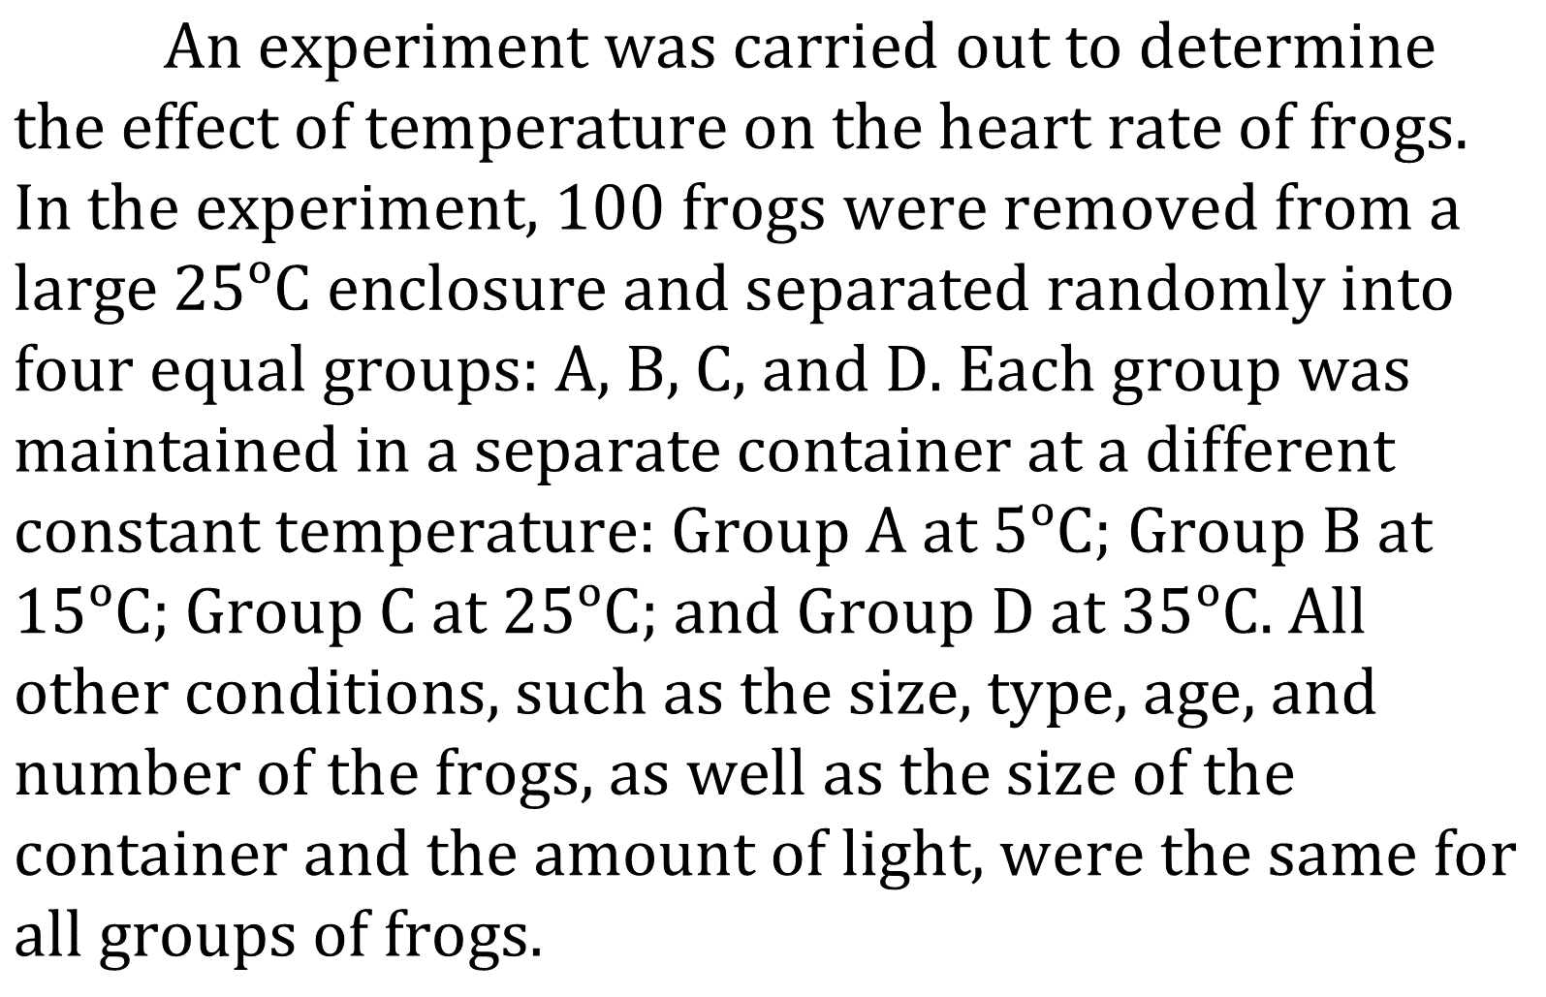
Notes:
Understand basic scientific terms; Understand experimental design; Identify a control in an experiment. Level: Intermediate Skill Group: Interpretation of Data

Slide 2
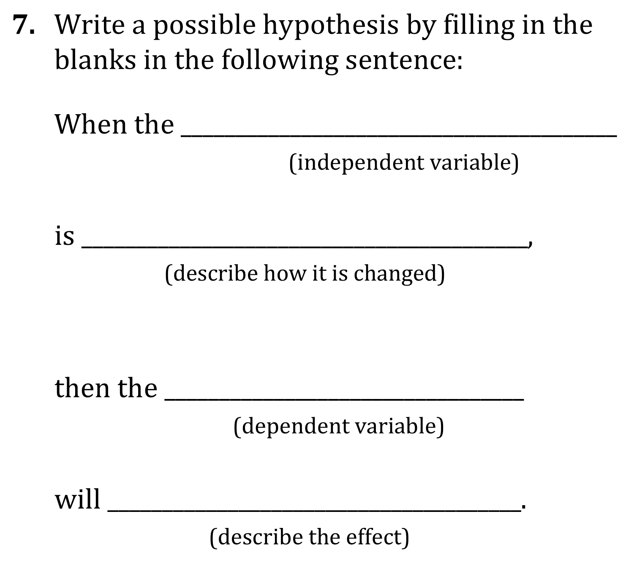
Notes:
Understand basic scientific terms; Understand experimental design; Identify a control in an experiment. Level: Intermediate Skill Group: Interpretation of Data

Slide 3
Notes:
Understand basic scientific terms; Understand experimental design; Identify a control in an experiment. Level: Intermediate Skill Group: Interpretation of Data

Slide 4
Notes:
Understand basic scientific terms; Understand experimental design; Identify a control in an experiment. Level: Intermediate Skill Group: Interpretation of Data

Slide 5
Notes:
Understand basic scientific terms; Understand experimental design; Identify a control in an experiment. Level: Intermediate Skill Group: Interpretation of Data

Slide 6
Notes:
Understand basic scientific terms; Understand experimental design; Identify a control in an experiment. Level: Intermediate Skill Group: Interpretation of Data

Slide 7
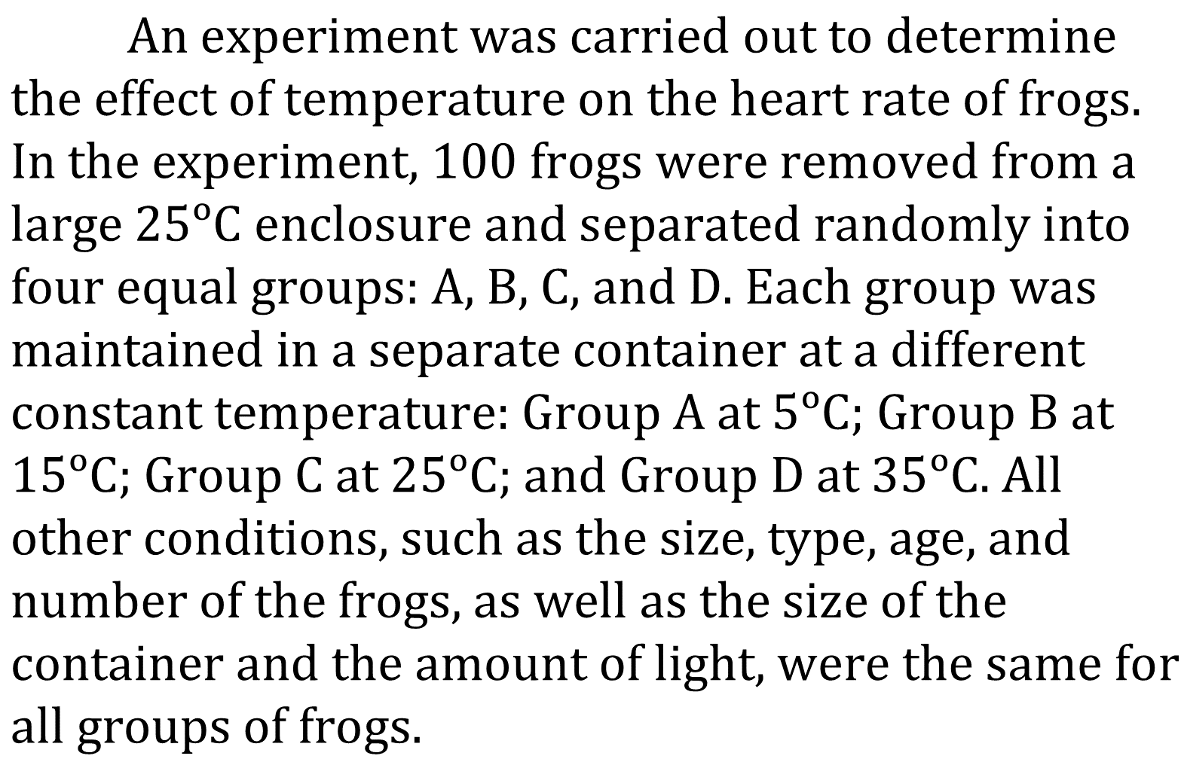
Notes:
Understand basic scientific terms; Understand experimental design; Identify a control in an experiment. Level: Intermediate Skill Group: Interpretation of Data

Slide 8
Notes:
Understand basic scientific terms; Understand experimental design; Identify a control in an experiment. Level: Intermediate Skill Group: Interpretation of Data

Slide 9
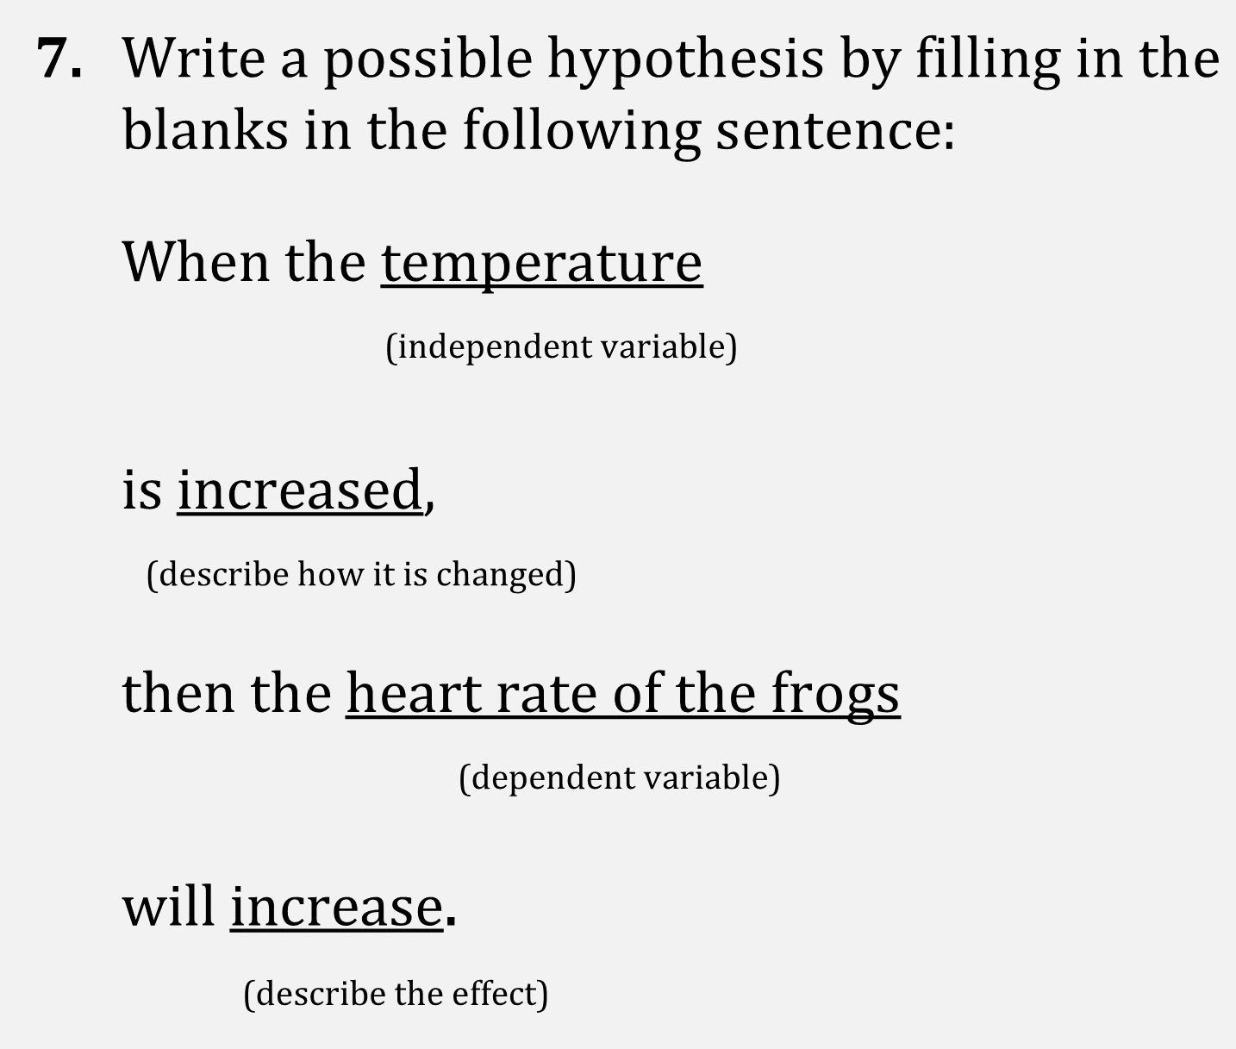
Notes:
Understand basic scientific terms; Understand experimental design; Identify a control in an experiment. Level: Intermediate Skill Group: Interpretation of Data

