Slide 1
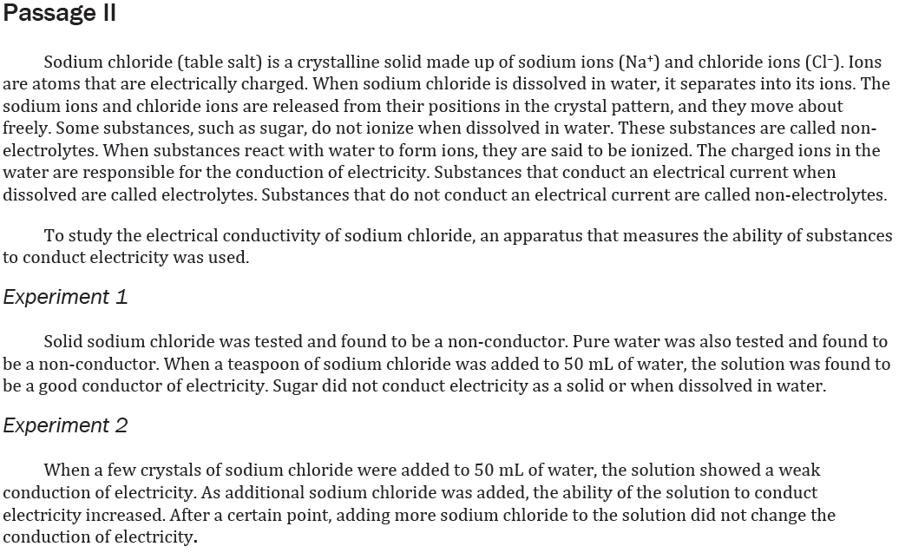

Notes:
Understand the relationship between variables in more complex data presentations

Slide 2
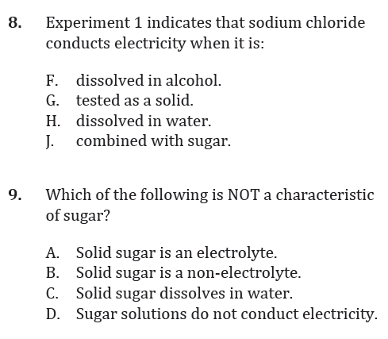
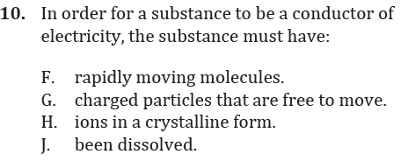
Notes:
Understand the relationship between variables in more complex data presentations

Slide 3
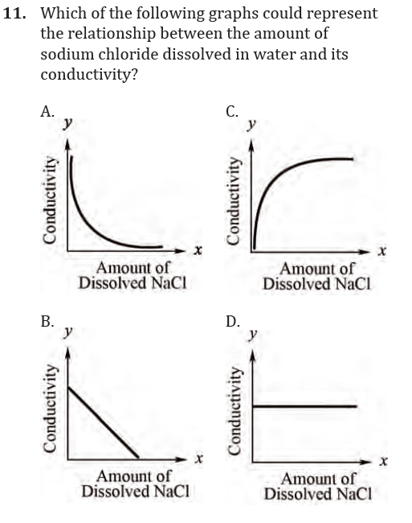
Notes:
Understand the relationship between variables in more complex data presentations

Slide 4
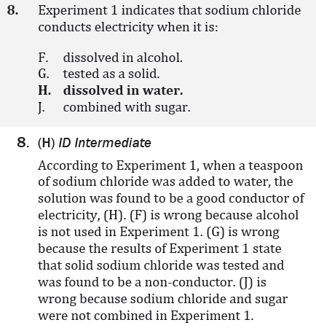
Notes:
Understand the relationship between variables in more complex data presentations

Slide 5
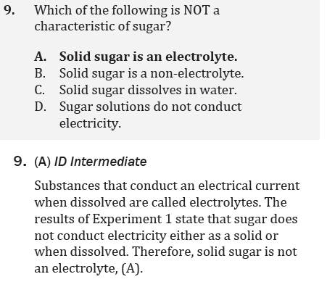
Notes:
Understand the relationship between variables in more complex data presentations

Slide 6
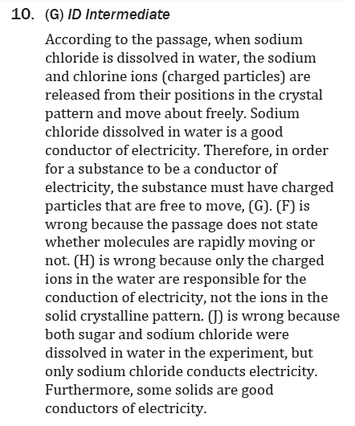
Notes:
Understand the relationship between variables in more complex data presentations

Slide 7
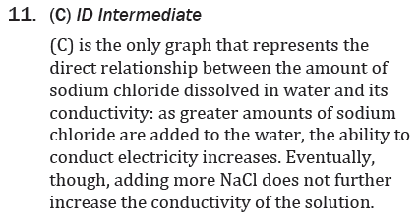
Notes:
Understand the relationship between variables in more complex data presentations

