Slide 1
Proportions and rates

Slide 2
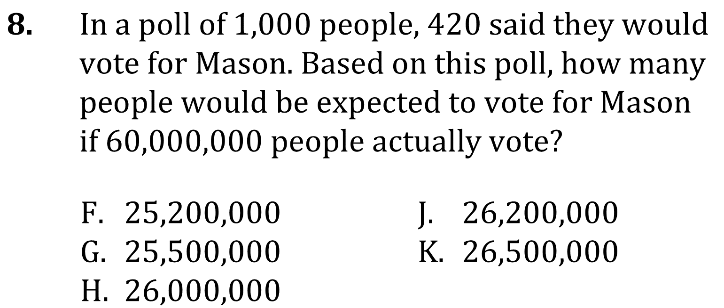
Proportions and rates

Slide 3
Proportions and rates

Slide 4
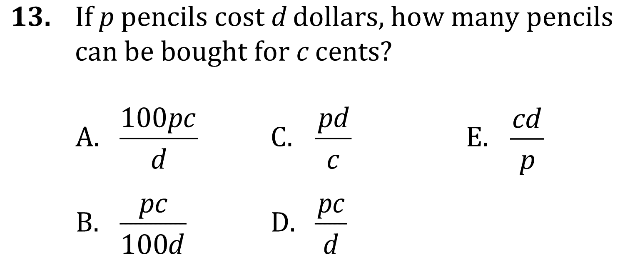
Proportions and rates

Slide 5
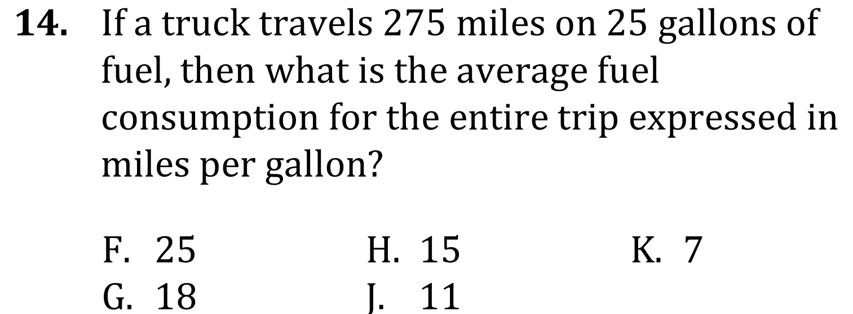
Proportions and rates

Slide 6
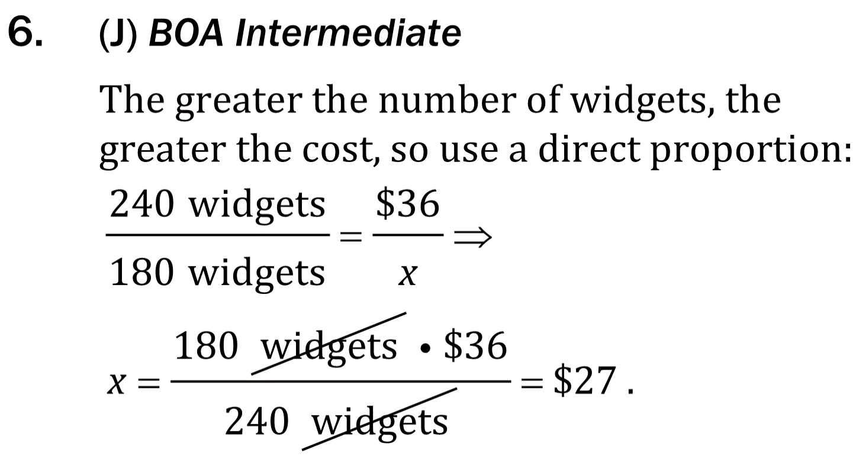
Proportions and rates

Slide 7
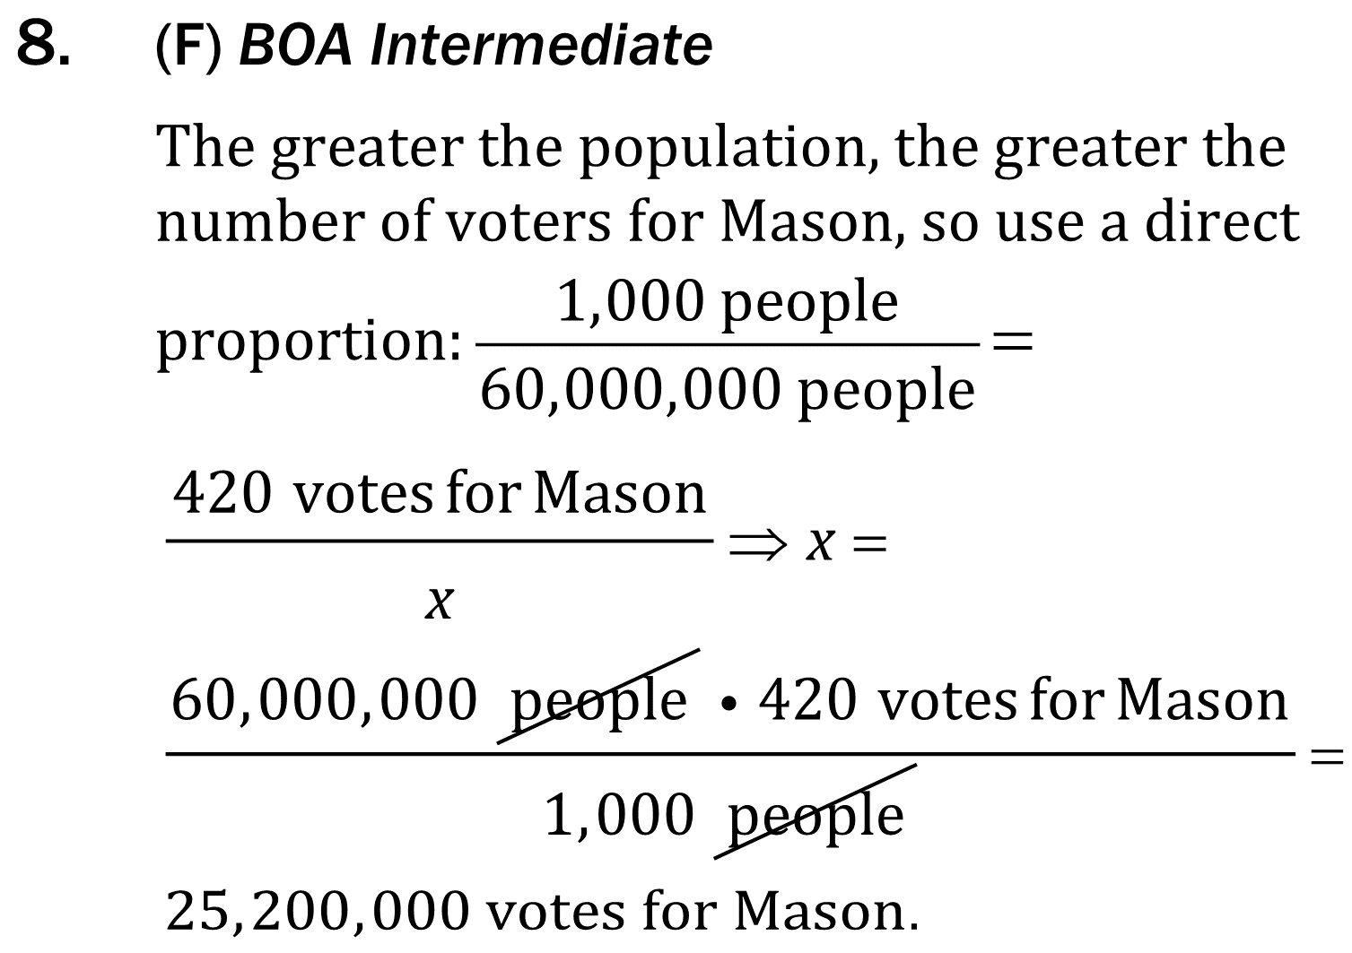
Proportions and rates

Slide 8
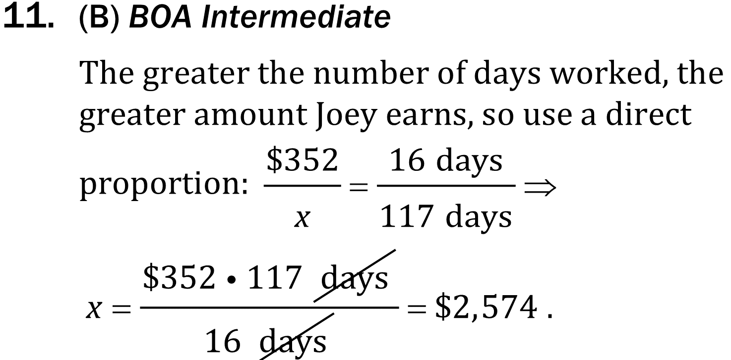
Proportions and rates

Slide 9
Proportions and rates

Slide 10
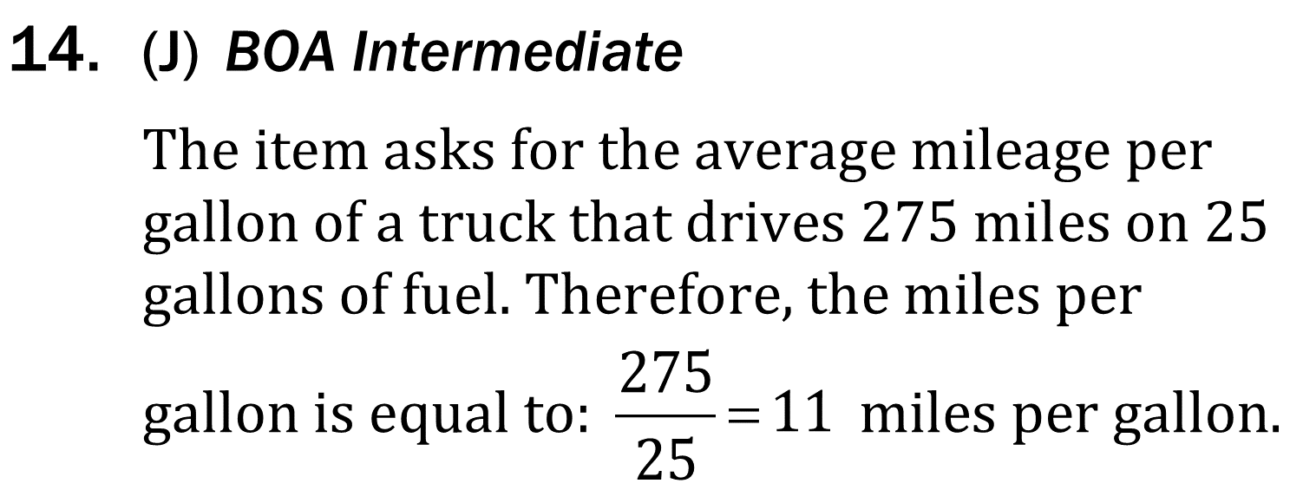
Proportions and rates

