Slide 1
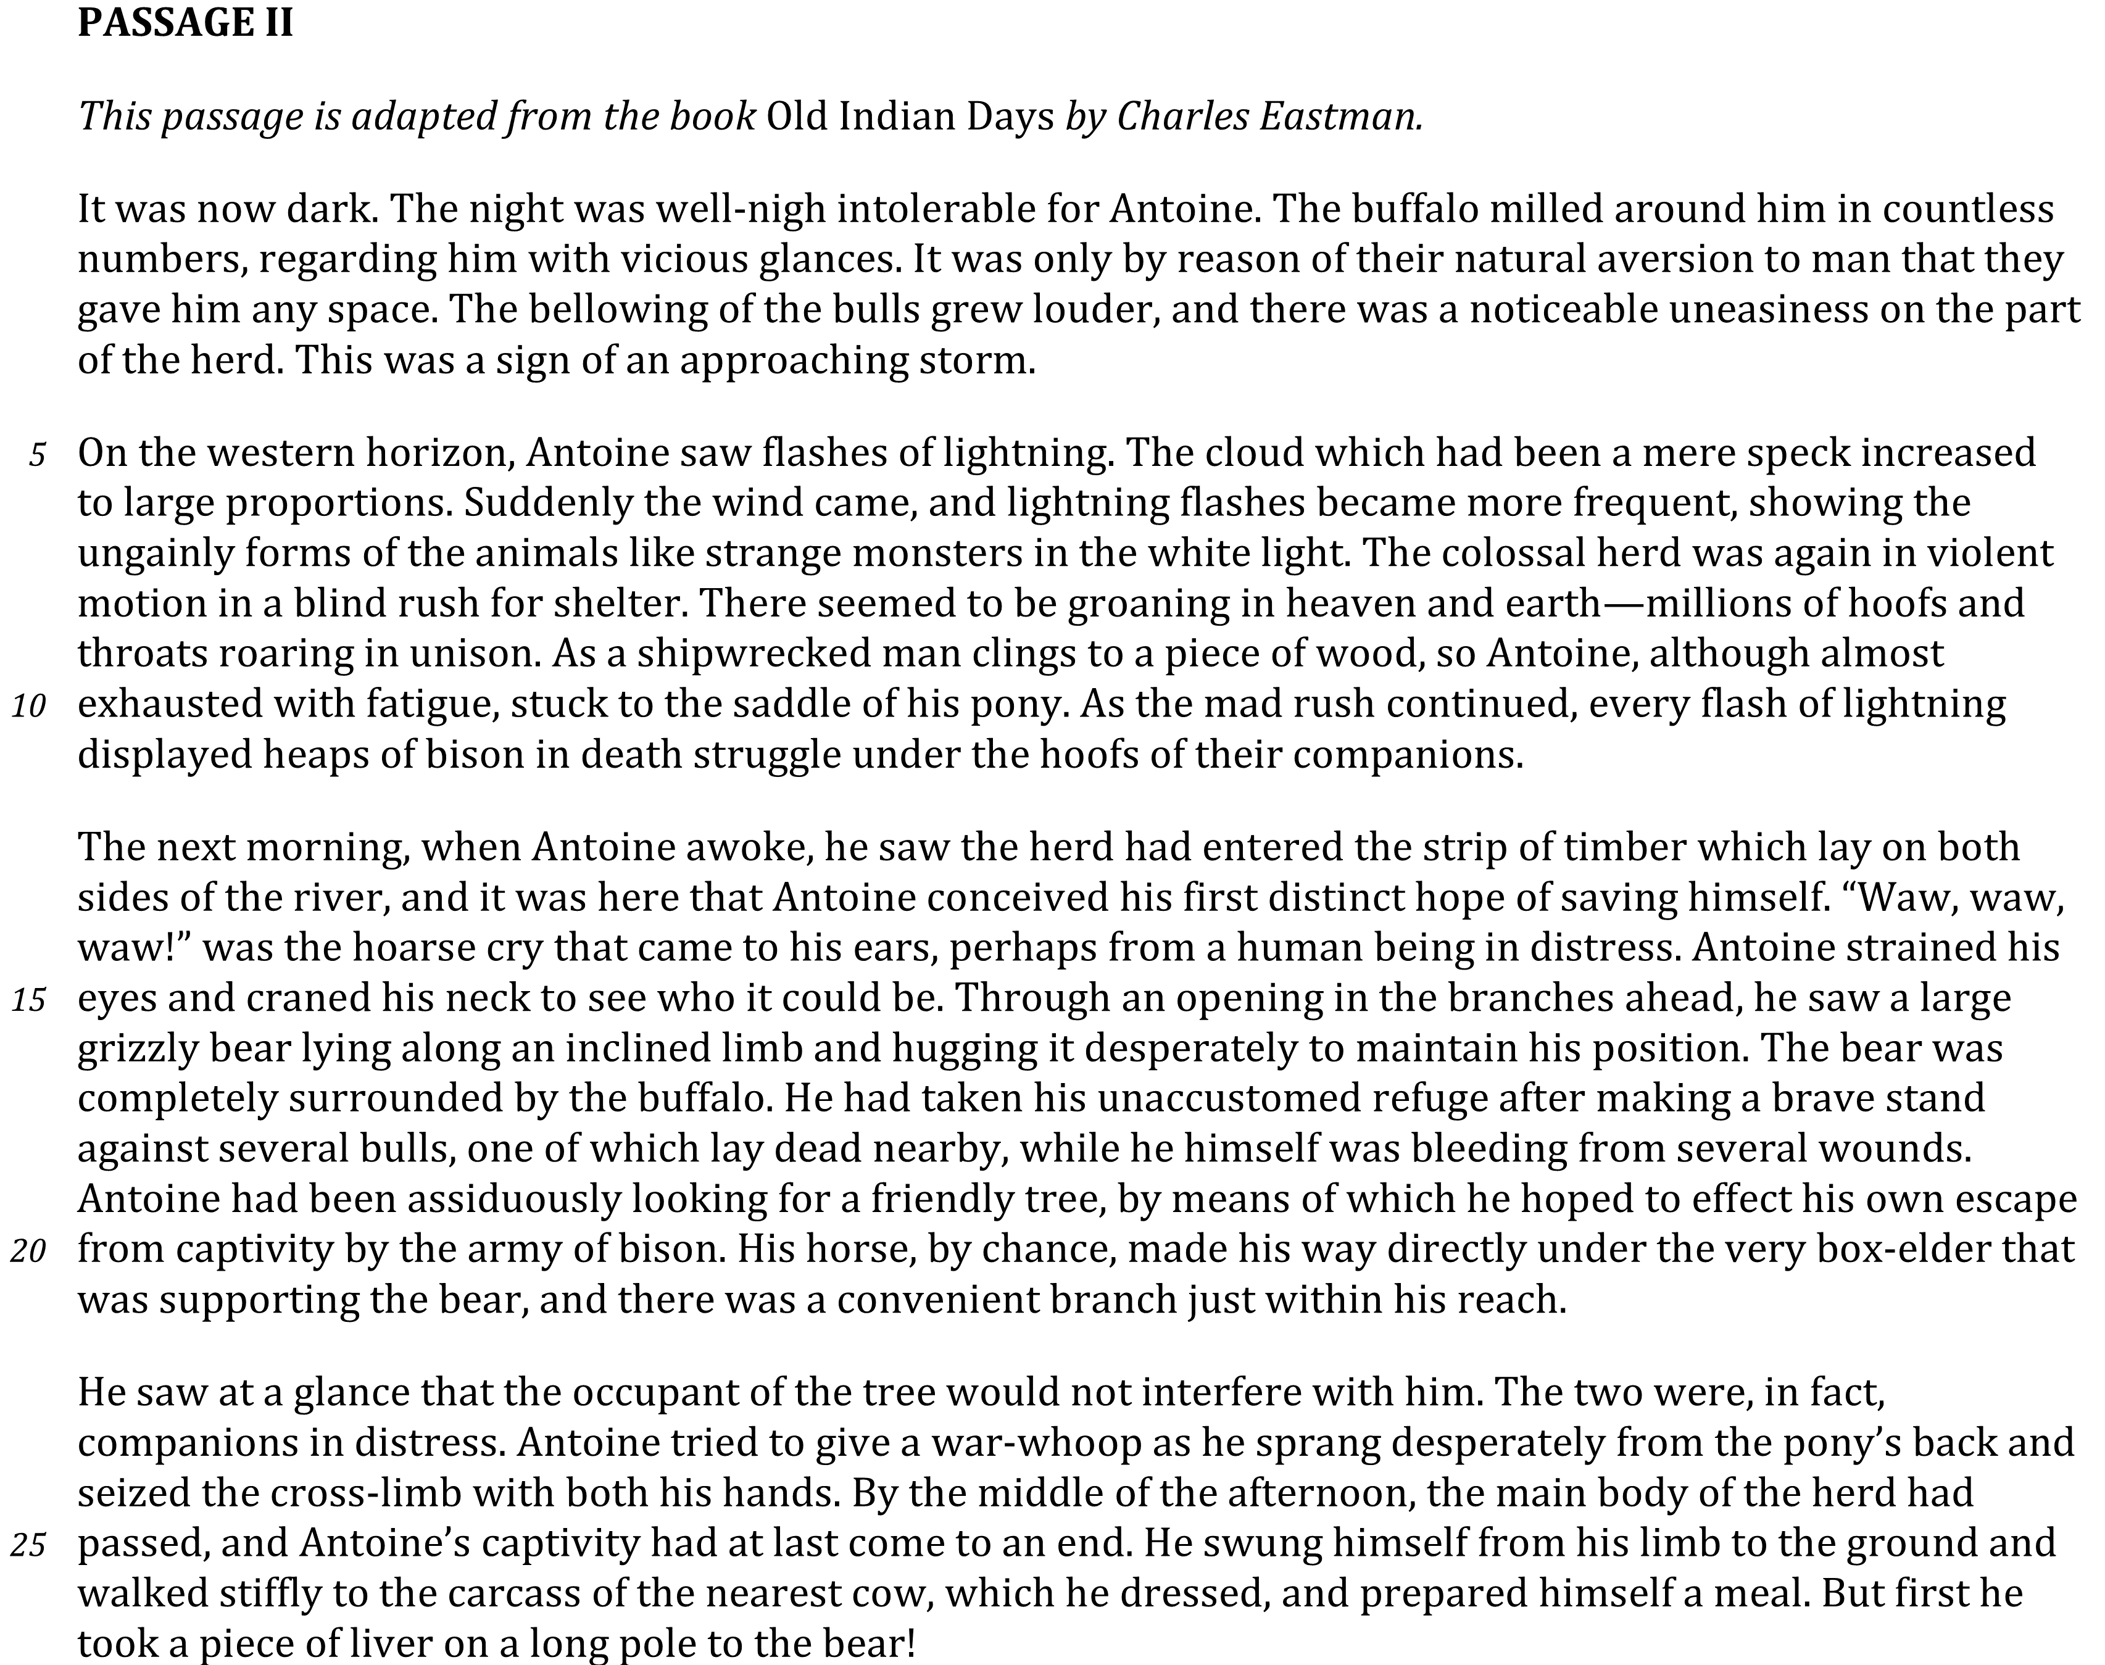


Slide 2
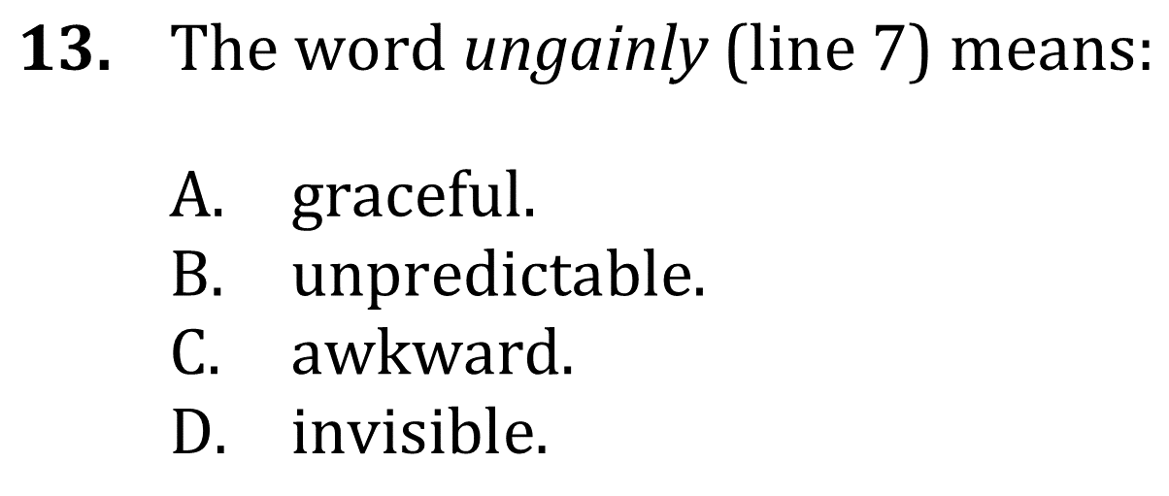
Use Context Clues

Slide 3


Use Context clues

