Slide 1
Victory for the GRE® Test PowerPoint Table of Contents
Verbal Reasoning: Completions
Verbal Reasoning: Reading
Quantitative Reasoning: Discrete Quantitative
Quantitative Reasoning: Numeric Entry
Quantitative Reasoning: Comparisons
Quantitative Reasoning: Data Interpretation
Analytical Writing

Slide 2
Verbal Reasoning: Completions Test Mechanics
21 • Verbal Reasoning: Completions
↖ Back to the Table of Contents
Notes:
Teacher’s Guide p. 49

Slide 3
Verbal Reasoning: Completions Anatomy Directions
22 • Verbal Reasoning: Completions
Notes:
Teacher’s Guide p. 53

Slide 4
Verbal Reasoning: Completions Anatomy Q1
22 • Verbal Reasoning: Completions
Notes:
Teacher’s Guide p. 53

Slide 5
Verbal Reasoning: Completions Anatomy Q2
22 • Verbal Reasoning: Completions
Notes:
Teacher’s Guide p. 53

Slide 6
Verbal Reasoning: Completions Anatomy Directions
22 • Verbal Reasoning: Completions
Notes:
Teacher’s Guide p. 53

Slide 7
Verbal Reasoning: Completions Anatomy Q3
22 • Verbal Reasoning: Completions
Notes:
Teacher’s Guide p. 53

Slide 8
Verbal Reasoning: Completions Anatomy Q4
23 • Verbal Reasoning: Completions
Notes:
Teacher’s Guide p. 54

Slide 9
Verbal Reasoning: Completions Anatomy Q5
23 • Verbal Reasoning: Completions
Notes:
Teacher’s Guide p. 54

Slide 10
Verbal Reasoning: Completions Anatomy Directions
23 • Verbal Reasoning: Completions
Notes:
Teacher’s Guide p. 54

Slide 11
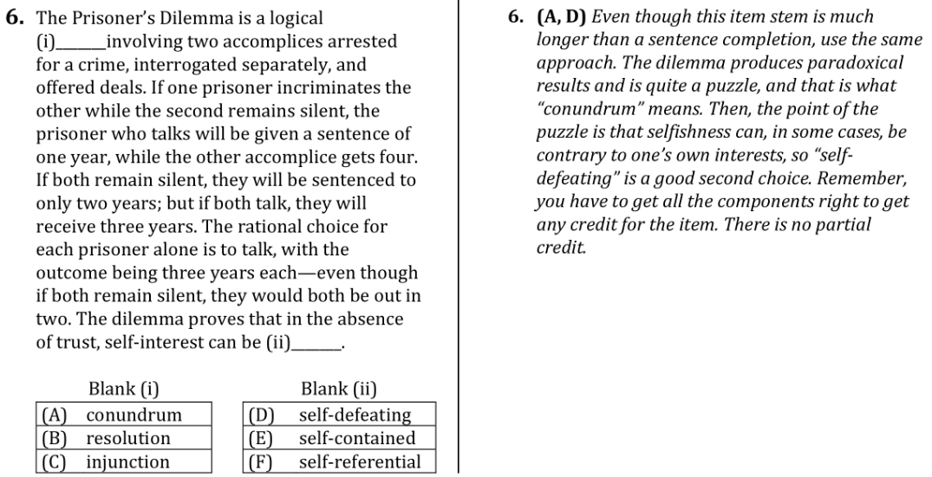
Verbal Reasoning: Completions Anatomy Q6
23 • Verbal Reasoning: Completions
Notes:
Teacher’s Guide p. 54

Slide 12
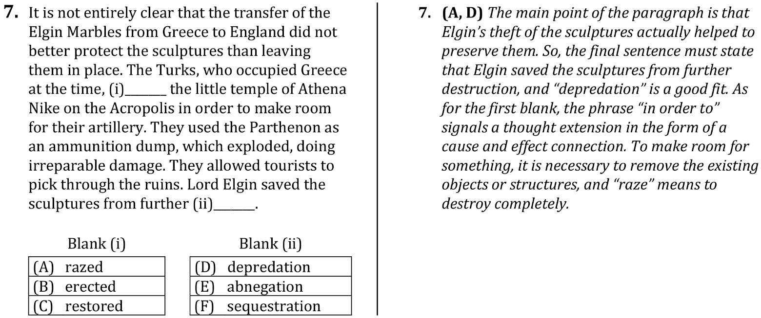
Verbal Reasoning: Completions Anatomy Q7
24 • Verbal Reasoning: Completions
Notes:
Teacher’s Guide p. 55

Slide 13
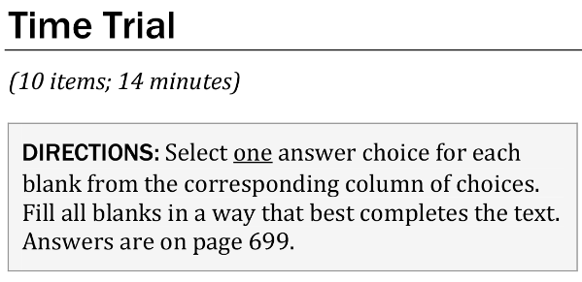
Verbal Reasoning: Completions Time Trial Directions
26 • Verbal Reasoning: Completions
Notes:
Teacher’s Guide p. 58

Slide 14
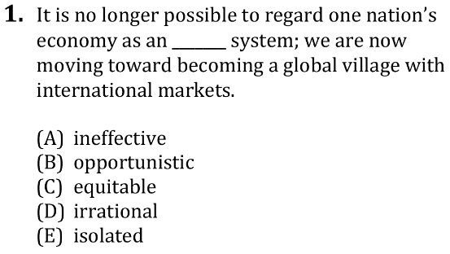
Verbal Reasoning: Completions Time Trial Q1
26 • Verbal Reasoning: Completions
Notes:
Teacher’s Guide p. 58

Slide 15
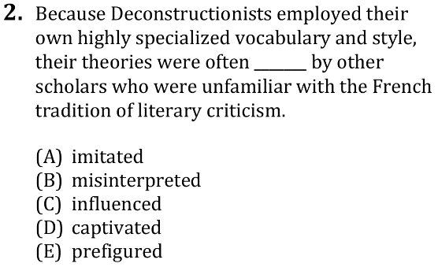
Verbal Reasoning: Completions Time Trial Q2
26 • Verbal Reasoning: Completions
Notes:
Teacher’s Guide p. 58

Slide 16
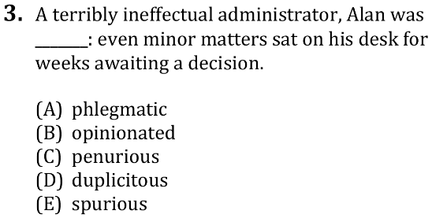
Verbal Reasoning: Completions Time Trial Q3
26 • Verbal Reasoning: Completions
Notes:
Teacher’s Guide p. 58

Slide 17
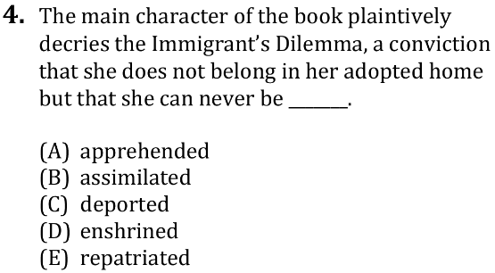
Verbal Reasoning: Completions Time Trial Q4
26 • Verbal Reasoning: Completions
Notes:
Teacher’s Guide p. 59

Slide 18
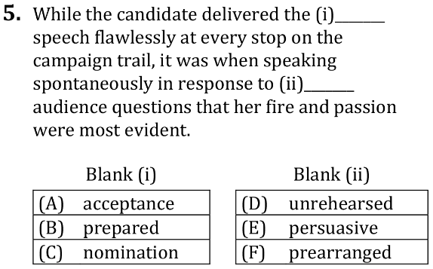
Verbal Reasoning: Completions Time Trial Q5
26 • Verbal Reasoning: Completions
Notes:
Teacher’s Guide p. 59

Slide 19
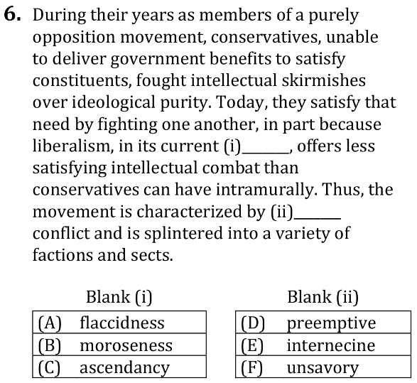
Verbal Reasoning: Completions Time Trial Q6
26 • Verbal Reasoning: Completions
Notes:
Teacher’s Guide p. 59

Slide 20
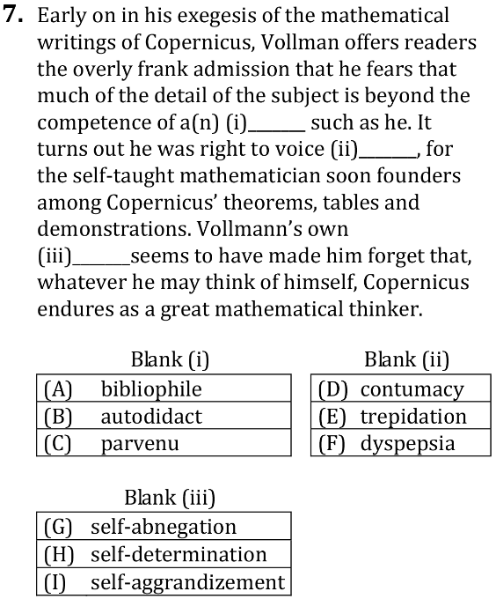
Verbal Reasoning: Completions Time Trial Q7
27 • Verbal Reasoning: Completions
Notes:
Teacher’s Guide p. 59

Slide 21
Verbal Reasoning: Completions Time Trial Directions
27 • Verbal Reasoning: Completions
Notes:
Teacher’s Guide p. 59

Slide 22
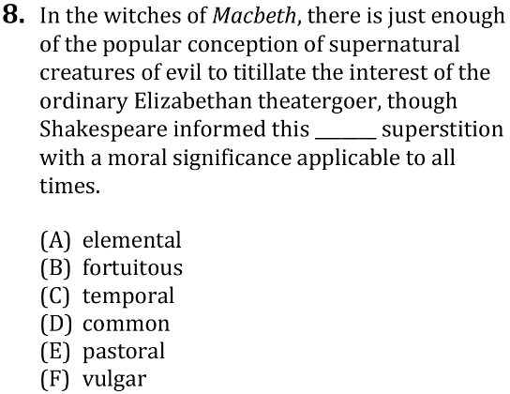
Verbal Reasoning: Completions Time Trial Q8
27 • Verbal Reasoning: Completions
Notes:
Teacher’s Guide p. 60

Slide 23
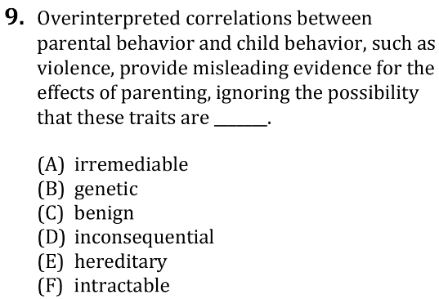
Verbal Reasoning: Completions Time Trial Q9
27 • Verbal Reasoning: Completions
Notes:
Teacher’s Guide p. 60

Slide 24
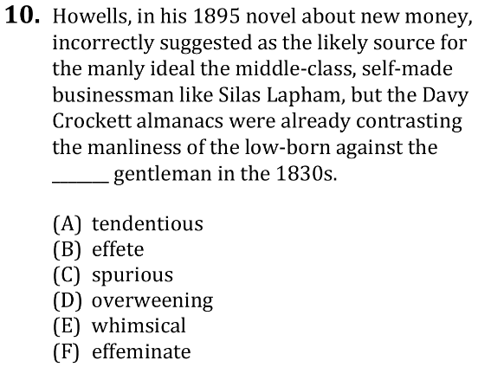
Verbal Reasoning: Completions Time Trial Q10
27 • Verbal Reasoning: Completions
Notes:
Teacher’s Guide p. 60

Slide 25
Verbal Reasoning: Completions Lesson Directions
33 • Verbal Reasoning: Completions
Notes:
Teacher’s Guide p. 68

Slide 26
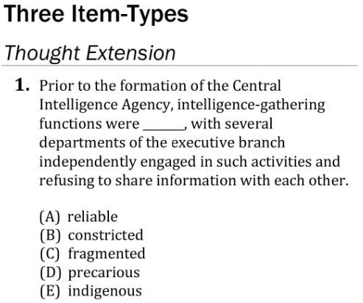
Verbal Reasoning: Completions Lesson Q1
33 • Verbal Reasoning: Completions
Notes:
Teacher’s Guide p. 68

Slide 27
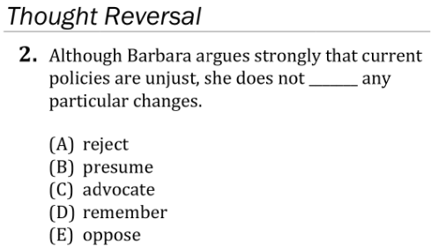
Verbal Reasoning: Completions Lesson Q2
33 • Verbal Reasoning: Completions
Notes:
Teacher’s Guide p. 69

Slide 28
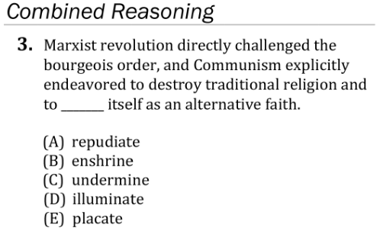
Verbal Reasoning: Completions Lesson Q3
33 • Verbal Reasoning: Completions
Notes:
Teacher’s Guide p. 69

Slide 29
Verbal Reasoning: Completions Lesson Q4
33 • Verbal Reasoning: Completions
Notes:
Teacher’s Guide p. 70

Slide 30
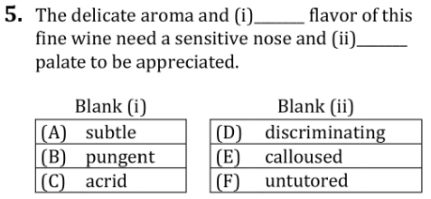
Verbal Reasoning: Completions Lesson Q5
33 • Verbal Reasoning: Completions
Notes:
Teacher’s Guide p. 70

Slide 31
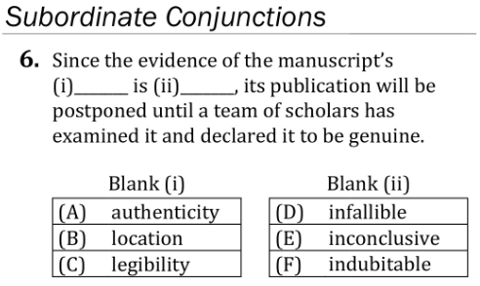
Verbal Reasoning: Completions Lesson Q6
34 • Verbal Reasoning: Completions
Notes:
Teacher’s Guide p. 71

Slide 32
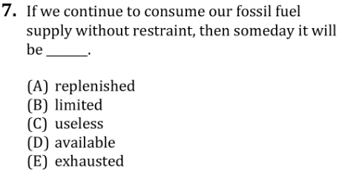
Verbal Reasoning: Completions Lesson Q7
34 • Verbal Reasoning: Completions
Notes:
Teacher’s Guide p. 71

Slide 33
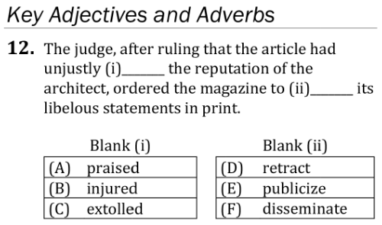
Verbal Reasoning: Completions Lesson Q12
34 • Verbal Reasoning: Completions
Notes:
Teacher’s Guide p. 72

Slide 34
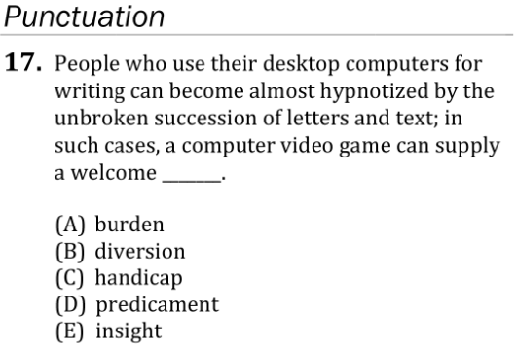
Verbal Reasoning: Completions Lesson Q17
35 • Verbal Reasoning: Completions
Notes:
Teacher’s Guide p. 74

Slide 35
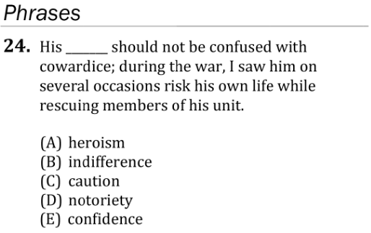
Verbal Reasoning: Completions Lesson Q24
36 • Verbal Reasoning: Completions
Notes:
Teacher’s Guide p. 76

Slide 36
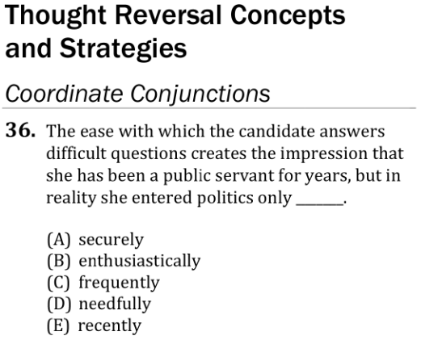
Verbal Reasoning: Completions Lesson Q36
37 • Verbal Reasoning: Completions
Notes:
Teacher’s Guide p. 79

Slide 37
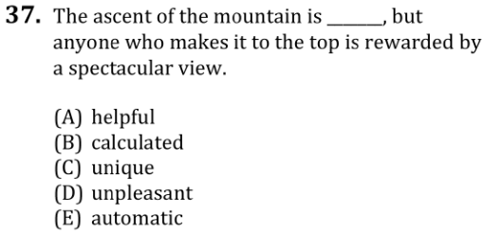
Verbal Reasoning: Completions Lesson Q37
37 • Verbal Reasoning: Completions
Notes:
Teacher’s Guide p. 79

Slide 38
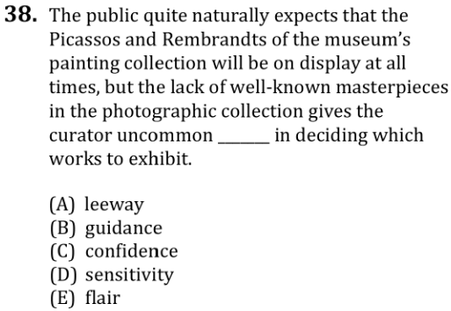
Verbal Reasoning: Completions Lesson Q38
37 • Verbal Reasoning: Completions
Notes:
Teacher’s Guide p. 79

Slide 39
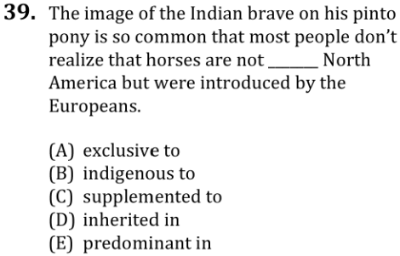
Verbal Reasoning: Completions Lesson Q39
37 • Verbal Reasoning: Completions
Notes:
Teacher’s Guide p. 80

Slide 40
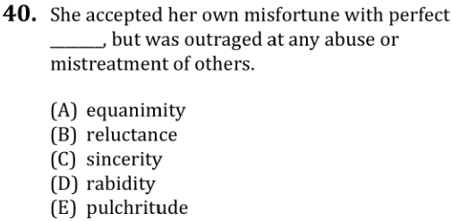
Verbal Reasoning: Completions Lesson Q40
37 • Verbal Reasoning: Completions
Notes:
Teacher’s Guide p. 80

Slide 41
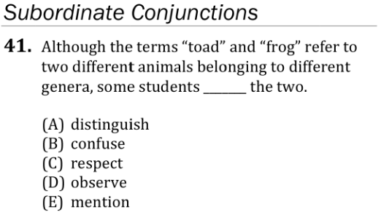
Verbal Reasoning: Completions Lesson Q41
37 • Verbal Reasoning: Completions
Notes:
Teacher’s Guide p. 80

Slide 42
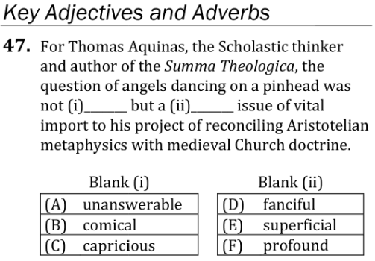
Verbal Reasoning: Completions Lesson Q47
38 • Verbal Reasoning: Completions
Notes:
Teacher’s Guide p. 82

Slide 43
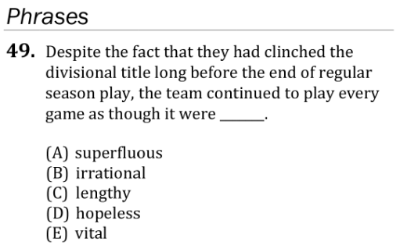
Verbal Reasoning: Completions Lesson Q49
38 • Verbal Reasoning: Completions
Notes:
Teacher’s Guide p. 83

Slide 44
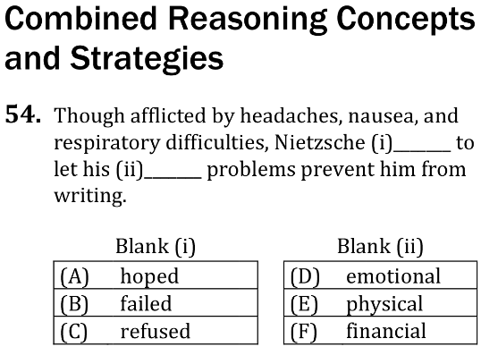
Verbal Reasoning: Completions Lesson Q54
39 • Verbal Reasoning: Completions
Notes:
Teacher’s Guide p. 84

Slide 45
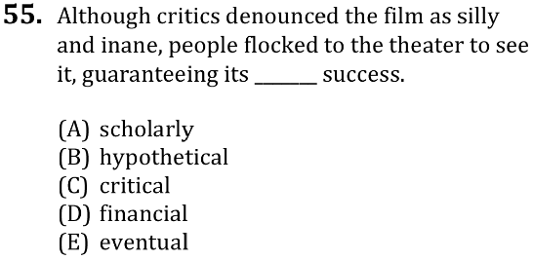
Verbal Reasoning: Completions Lesson Q55
39 • Verbal Reasoning: Completions
Notes:
Teacher’s Guide p. 84

Slide 46
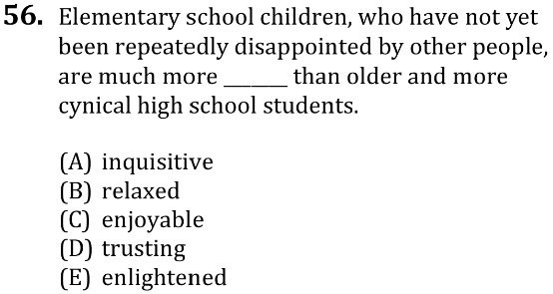
Verbal Reasoning: Completions Lesson Q56
39 • Verbal Reasoning: Completions
Notes:
Teacher’s Guide p. 85

Slide 47
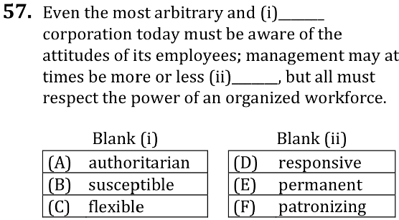
Verbal Reasoning: Completions Lesson Q57
39 • Verbal Reasoning: Completions
Notes:
Teacher’s Guide p. 85

Slide 48
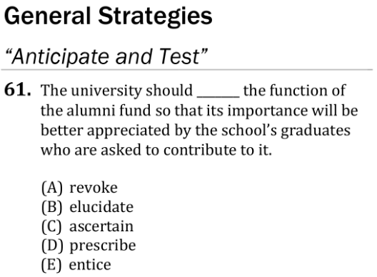
Verbal Reasoning: Completions Lesson Q61
40 • Verbal Reasoning: Completions
Notes:
Teacher’s Guide p. 87

Slide 49
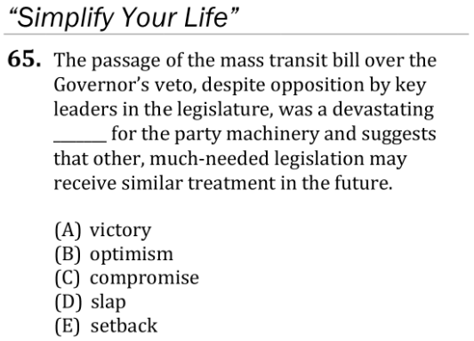
Verbal Reasoning: Completions Lesson Q65
40 • Verbal Reasoning: Completions
Notes:
Teacher’s Guide p. 88

Slide 50
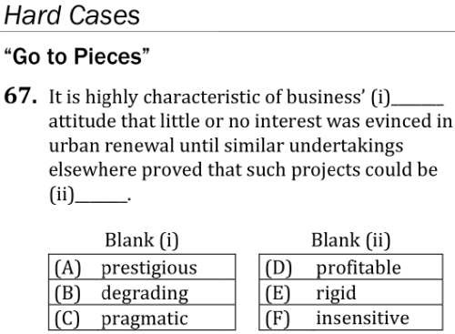
Verbal Reasoning: Completions Lesson Q67
41 • Verbal Reasoning: Completions
Notes:
Teacher’s Guide p. 89

Slide 51
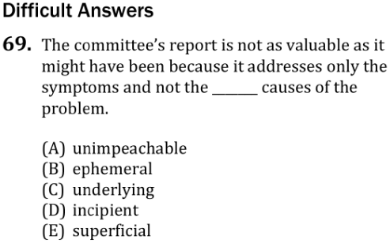
Verbal Reasoning: Completions Lesson Q69
41 • Verbal Reasoning: Completions
Notes:
Teacher’s Guide p. 90

Slide 52
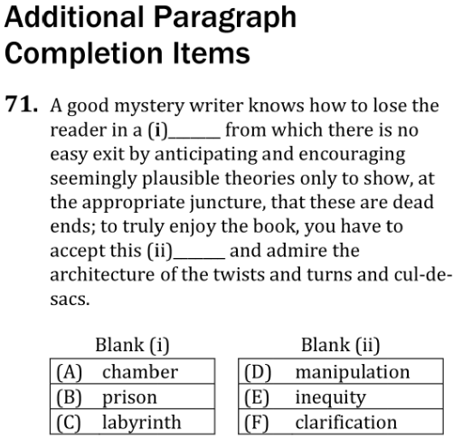
Verbal Reasoning: Completions Lesson Q71
41 • Verbal Reasoning: Completions
Notes:
Teacher’s Guide p. 91

Slide 53
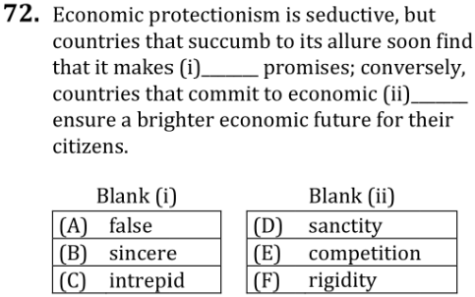
Verbal Reasoning: Completions Lesson Q72
41 • Verbal Reasoning: Completions
Notes:
Teacher’s Guide p. 91

Slide 54
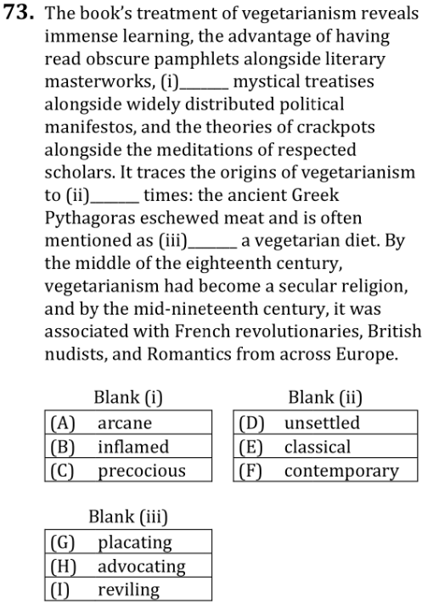
Verbal Reasoning: Completions Lesson Q73
42 • Verbal Reasoning: Completions
Notes:
Teacher’s Guide p. 92

Slide 55
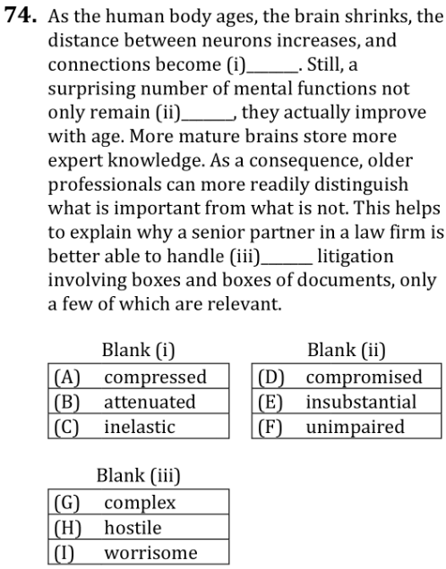
Verbal Reasoning: Completions Lesson Q74
42 • Verbal Reasoning: Completions
Notes:
Teacher’s Guide p. 93

Slide 56
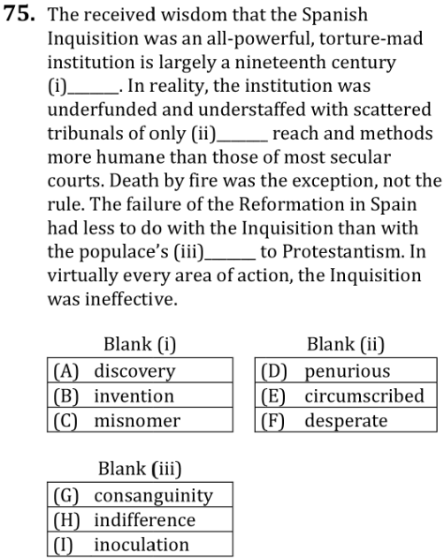
Verbal Reasoning: Completions Lesson Q75
42 • Verbal Reasoning: Completions
Notes:
Teacher’s Guide p. 93

Slide 57
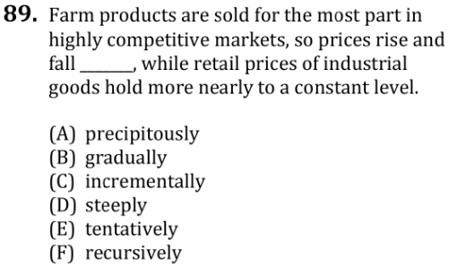
Verbal Reasoning: Completions Lesson Q89
45 • Verbal Reasoning: Completions
Notes:
Teacher’s Guide p. 98

Slide 58
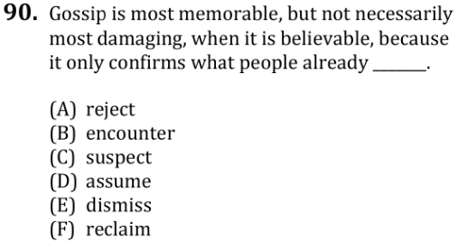
Verbal Reasoning: Completions Lesson Q90
45 • Verbal Reasoning: Completions
Notes:
Teacher’s Guide p. 98

Slide 59
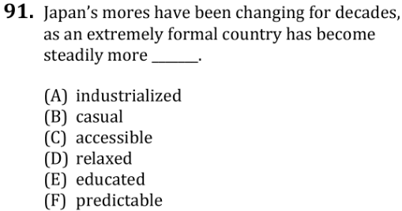
Verbal Reasoning: Completions Lesson Q91
45 • Verbal Reasoning: Completions
Notes:
Teacher’s Guide p. 99

Slide 60
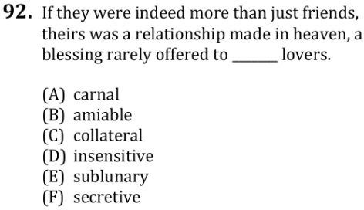
Verbal Reasoning: Completions Lesson Q92
45 • Verbal Reasoning: Completions
Notes:
Teacher’s Guide p. 99

Slide 61
Verbal Reasoning: Reading Test Mechanics
61 • Verbal Reasoning: Reading
↖ Back to the Table of Contents
Notes:
Teacher’s Guide p. 125

Slide 62
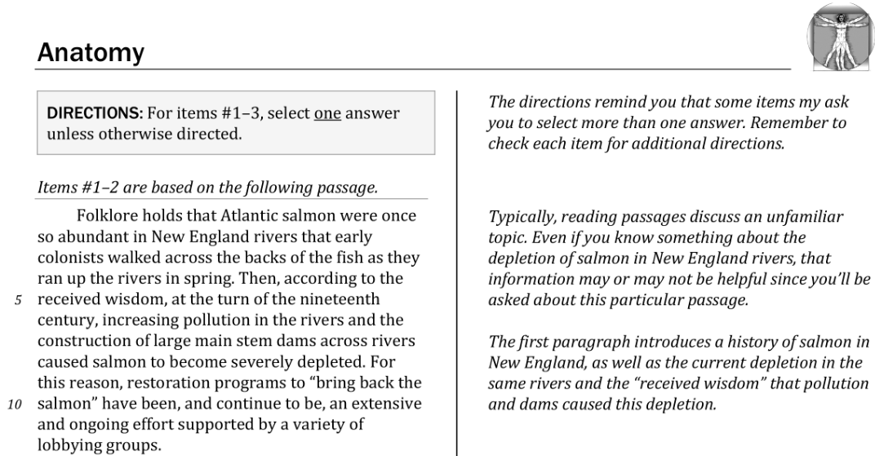
Verbal Reasoning: Reading Anatomy Passage
62 • Verbal Reasoning: Reading
Notes:
Teacher’s Guide p. 128

Slide 63
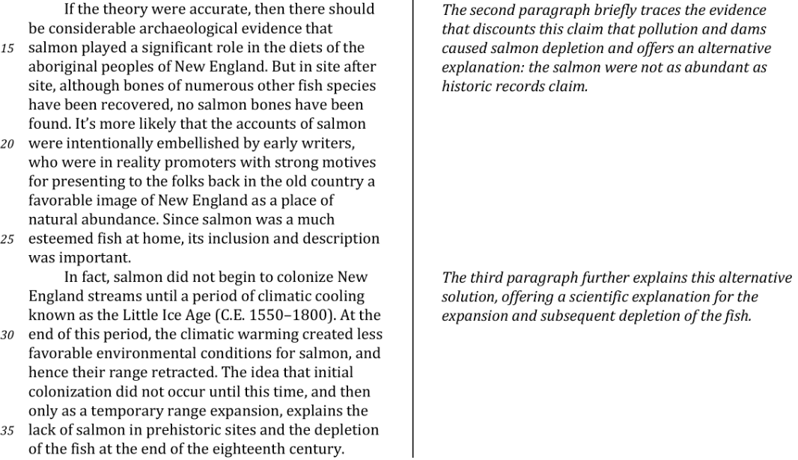
Verbal Reasoning: Reading Anatomy Passage
62 • Verbal Reasoning: Reading
Notes:
Teacher’s Guide p. 128

Slide 64
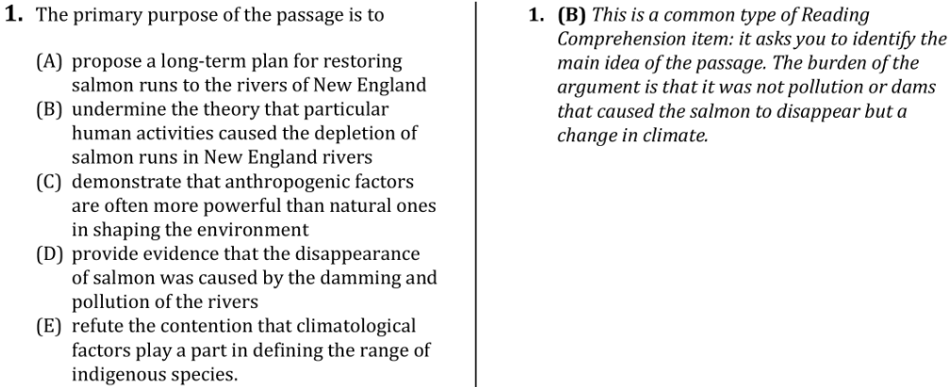
Verbal Reasoning: Reading Anatomy Q1
63 • Verbal Reasoning: Reading
Notes:
Teacher’s Guide p. 129

Slide 65
Verbal Reasoning: Reading Anatomy Q2
63 • Verbal Reasoning: Reading
Notes:
Teacher’s Guide p. 129

Slide 66
Verbal Reasoning: Reading Anatomy Passage
64 • Verbal Reasoning: Reading
Notes:
Teacher’s Guide p. 130

Slide 67
Verbal Reasoning: Reading Anatomy Q3
64 • Verbal Reasoning: Reading
Notes:
Teacher’s Guide p. 130

Slide 68
Verbal Reasoning: Reading Time Trial Directions
66 • Verbal Reasoning: Reading
Notes:
Teacher’s Guide p. 133

Slide 69
Verbal Reasoning: Reading Time Trial Passage
66 • Verbal Reasoning: Reading
Notes:
Teacher’s Guide p. 133

Slide 70
Verbal Reasoning: Reading Time Trial Passage
66 • Verbal Reasoning: Reading
Notes:
Teacher’s Guide p. 133

Slide 71
Verbal Reasoning: Reading Time Trial Passage
66 • Verbal Reasoning: Reading
Notes:
Teacher’s Guide p. 133

Slide 72
Verbal Reasoning: Reading Time Trial Q1
66 • Verbal Reasoning: Reading
Notes:
Teacher’s Guide p. 134

Slide 73
Verbal Reasoning: Reading Time Trial Q2
67 • Verbal Reasoning: Reading
Notes:
Teacher’s Guide p. 134

Slide 74
Verbal Reasoning: Reading Time Trial Q3
67 • Verbal Reasoning: Reading
Notes:
Teacher’s Guide p. 134

Slide 75
Verbal Reasoning: Reading Time Trial Passage
67 • Verbal Reasoning: Reading
Notes:
Teacher’s Guide p. 135

Slide 76
Verbal Reasoning: Reading Time Trial Q4
67 • Verbal Reasoning: Reading
Notes:
Teacher’s Guide p. 135

Slide 77
Verbal Reasoning: Reading Lesson Directions
73 • Verbal Reasoning: Reading
Notes:
Teacher’s Guide p. 143

Slide 78
Verbal Reasoning: Reading Lesson Passage
73 • Verbal Reasoning: Reading
Notes:
Teacher’s Guide p. 147

Slide 79
Verbal Reasoning: Reading Lesson Passage
73 • Verbal Reasoning: Reading
Notes:
Teacher’s Guide p. 147-148

Slide 80
Verbal Reasoning: Reading Lesson Q1
74 • Verbal Reasoning: Reading
Notes:
Teacher’s Guide p. 148

Slide 81
Verbal Reasoning: Reading Lesson Q2
74 • Verbal Reasoning: Reading
Notes:
Teacher’s Guide p. 148

Slide 82
Verbal Reasoning: Reading Lesson Q3
74 • Verbal Reasoning: Reading
Notes:
Teacher’s Guide p. 149

Slide 83
Verbal Reasoning: Reading Lesson Q4
74 • Verbal Reasoning: Reading
Notes:
Teacher’s Guide p. 149

Slide 84
Verbal Reasoning: Reading Lesson Q5
74 • Verbal Reasoning: Reading
Notes:
Teacher’s Guide p. 149

Slide 85
Verbal Reasoning: Reading Lesson Q6
74 • Verbal Reasoning: Reading
Notes:
Teacher’s Guide p. 150

Slide 86
Verbal Reasoning: Reading Lesson Q7
75 • Verbal Reasoning: Reading
Notes:
Teacher’s Guide p. 150

Slide 87
Verbal Reasoning: Reading Lesson Q8
75 • Verbal Reasoning: Reading
Notes:
Teacher’s Guide p. 151

Slide 88
Verbal Reasoning: Reading Lesson Q9
75 • Verbal Reasoning: Reading
Notes:
Teacher’s Guide p. 151

Slide 89
Verbal Reasoning: Reading Lesson Q10
75 • Verbal Reasoning: Reading
Notes:
Teacher’s Guide p. 151

Slide 90
Verbal Reasoning: Reading Lesson Q11
75 • Verbal Reasoning: Reading
Notes:
Teacher’s Guide p. 152

Slide 91
Verbal Reasoning: Reading Lesson Q12
75 • Verbal Reasoning: Reading
Notes:
Teacher’s Guide p. 152

Slide 92
Verbal Reasoning: Reading Lesson Q13
75 • Verbal Reasoning: Reading
Notes:
Teacher’s Guide p. 152

Slide 93
Verbal Reasoning: Reading Lesson Q14
75 • Verbal Reasoning: Reading
Notes:
Teacher’s Guide p. 152

Slide 94
Verbal Reasoning: Reading Lesson Passage
76 • Verbal Reasoning: Reading
Notes:
Teacher’s Guide p. 153

Slide 95
Verbal Reasoning: Reading Lesson Passage
76 • Verbal Reasoning: Reading
Notes:
Teacher’s Guide p. 153

Slide 96
Verbal Reasoning: Reading Lesson Q15
76 • Verbal Reasoning: Reading
Notes:
Teacher’s Guide p. 154

Slide 97
Verbal Reasoning: Reading Lesson Q16
76 • Verbal Reasoning: Reading
Notes:
Teacher’s Guide p. 154

Slide 98
Verbal Reasoning: Reading Lesson Q17
77 • Verbal Reasoning: Reading
Notes:
Teacher’s Guide p. 154

Slide 99
Verbal Reasoning: Reading Lesson Q18
77 • Verbal Reasoning: Reading
Notes:
Teacher’s Guide p. 155

Slide 100
Verbal Reasoning: Reading Lesson Q19
77 • Verbal Reasoning: Reading
Notes:
Teacher’s Guide p. 155

Slide 101
Verbal Reasoning: Reading Lesson Q20
77 • Verbal Reasoning: Reading
Notes:
Teacher’s Guide p. 156

Slide 102
Verbal Reasoning: Reading Lesson Q21
77 • Verbal Reasoning: Reading
Notes:
Teacher’s Guide p. 156

Slide 103
Verbal Reasoning: Reading Lesson Q22
77 • Verbal Reasoning: Reading
Notes:
Teacher’s Guide p. 156

Slide 104
Verbal Reasoning: Reading Lesson Q23
78 • Verbal Reasoning: Reading
Notes:
Teacher’s Guide p. 157

Slide 105
Verbal Reasoning: Reading Lesson Q24
78 • Verbal Reasoning: Reading
Notes:
Teacher’s Guide p. 157

Slide 106
Verbal Reasoning: Reading Lesson Q25
78 • Verbal Reasoning: Reading
Notes:
Teacher’s Guide p. 158

Slide 107
Verbal Reasoning: Reading Lesson Q26
78 • Verbal Reasoning: Reading
Notes:
Teacher’s Guide p. 158

Slide 108
Verbal Reasoning: Reading Lesson Passage
78 • Verbal Reasoning: Reading
Notes:
Teacher’s Guide p. 159

Slide 109
Verbal Reasoning: Reading Lesson Passage
78-79 • Verbal Reasoning: Reading
Notes:
Teacher’s Guide p. 159

Slide 110
Verbal Reasoning: Reading Lesson Q27
79 • Verbal Reasoning: Reading
Notes:
Teacher’s Guide p. 160

Slide 111
Verbal Reasoning: Reading Lesson Q28
79 • Verbal Reasoning: Reading
Notes:
Teacher’s Guide p. 160

Slide 112
Verbal Reasoning: Reading Lesson Q29
79 • Verbal Reasoning: Reading
Notes:
Teacher’s Guide p. 160

Slide 113
Verbal Reasoning: Reading Lesson Q30
79 • Verbal Reasoning: Reading
Notes:
Teacher’s Guide p. 161

Slide 114
Verbal Reasoning: Reading Lesson Q31
80 • Verbal Reasoning: Reading
Notes:
Teacher’s Guide p. 161

Slide 115
Verbal Reasoning: Reading Lesson Q32
80 • Verbal Reasoning: Reading
Notes:
Teacher’s Guide p. 162

Slide 116
Verbal Reasoning: Reading Lesson Q33
80 • Verbal Reasoning: Reading
Notes:
Teacher’s Guide p. 162

Slide 117
Verbal Reasoning: Reading Lesson Q34
80 • Verbal Reasoning: Reading
Notes:
Teacher’s Guide p. 162

Slide 118
Verbal Reasoning: Reading Lesson Passage
80 • Verbal Reasoning: Reading
Notes:
Teacher’s Guide p. 163

Slide 119
Verbal Reasoning: Reading Lesson Passage
80-81 • Verbal Reasoning: Reading
Notes:
Teacher’s Guide p. 163

Slide 120
Verbal Reasoning: Reading Lesson Q35
81 • Verbal Reasoning: Reading
Notes:
Teacher’s Guide p. 164

Slide 121
Verbal Reasoning: Reading Lesson Q36
81 • Verbal Reasoning: Reading
Notes:
Teacher’s Guide p. 164

Slide 122
Verbal Reasoning: Reading Lesson Q37
81 • Verbal Reasoning: Reading
Notes:
Teacher’s Guide p. 164

Slide 123
Verbal Reasoning: Reading Lesson Q38
81 • Verbal Reasoning: Reading
Notes:
Teacher’s Guide p. 165

Slide 124
Verbal Reasoning: Reading Lesson Q39
81 • Verbal Reasoning: Reading
Notes:
Teacher’s Guide p. 165

Slide 125
Verbal Reasoning: Reading Lesson Q40
82 • Verbal Reasoning: Reading
Notes:
Teacher’s Guide p. 166

Slide 126
Verbal Reasoning: Reading Lesson Q41
82 • Verbal Reasoning: Reading
Notes:
Teacher’s Guide p. 166

Slide 127
Verbal Reasoning: Reading Lesson Q42
82 • Verbal Reasoning: Reading
Notes:
Teacher’s Guide p. 166

Slide 128
Verbal Reasoning: Reading Lesson Q43
82 • Verbal Reasoning: Reading
Notes:
Teacher’s Guide p. 167

Slide 129
Verbal Reasoning: Reading Lesson Passage
82 • Verbal Reasoning: Reading
Notes:
Teacher’s Guide p. 167

Slide 130
Verbal Reasoning: Reading Lesson Passage
82-83 • Verbal Reasoning: Reading
Notes:
Teacher’s Guide p. 167

Slide 131
Verbal Reasoning: Reading Lesson Passage
83 • Verbal Reasoning: Reading
Notes:
Teacher’s Guide p. 168

Slide 132
Verbal Reasoning: Reading Lesson Q44
83 • Verbal Reasoning: Reading
Notes:
Teacher’s Guide p. 168

Slide 133
Verbal Reasoning: Reading Lesson Q45
83 • Verbal Reasoning: Reading
Notes:
Teacher’s Guide p. 168

Slide 134
Verbal Reasoning: Reading Lesson Q46
83 • Verbal Reasoning: Reading
Notes:
Teacher’s Guide p. 169

Slide 135
Verbal Reasoning: Reading Lesson Q47
83 • Verbal Reasoning: Reading
Notes:
Teacher’s Guide p. 169

Slide 136
Verbal Reasoning: Reading Lesson Q48
83 • Verbal Reasoning: Reading
Notes:
Teacher’s Guide p. 169

Slide 137
Verbal Reasoning: Reading Lesson Q49
84 • Verbal Reasoning: Reading
Notes:
Teacher’s Guide p. 170

Slide 138
Verbal Reasoning: Reading Lesson Q50
84 • Verbal Reasoning: Reading
Notes:
Teacher’s Guide p. 170

Slide 139
Verbal Reasoning: Reading Lesson Passage
84 • Verbal Reasoning: Reading
Notes:
Teacher’s Guide p. 170-171

Slide 140
Verbal Reasoning: Reading Lesson Passage
84-85 • Verbal Reasoning: Reading
Notes:
Teacher’s Guide p. 171

Slide 141
Verbal Reasoning: Reading Lesson Q51
85 • Verbal Reasoning: Reading
Notes:
Teacher’s Guide p. 171

Slide 142
Verbal Reasoning: Reading Lesson Q52
85 • Verbal Reasoning: Reading
Notes:
Teacher’s Guide p. 171

Slide 143
Verbal Reasoning: Reading Lesson Q53
85 • Verbal Reasoning: Reading
Notes:
Teacher’s Guide p. 172

Slide 144
Verbal Reasoning: Reading Lesson Q54
85 • Verbal Reasoning: Reading
Notes:
Teacher’s Guide p. 172

Slide 145
Verbal Reasoning: Reading Lesson Q55
85 • Verbal Reasoning: Reading
Notes:
Teacher’s Guide p. 172

Slide 146
Verbal Reasoning: Reading Lesson Q56
85 • Verbal Reasoning: Reading
Notes:
Teacher’s Guide p. 173

Slide 147
Verbal Reasoning: Reading Lesson Q57
85 • Verbal Reasoning: Reading
Notes:
Teacher’s Guide p. 173

Slide 148
Verbal Reasoning: Reading Lesson Passage
86 • Verbal Reasoning: Reading
Notes:
Teacher’s Guide p. 173-174

Slide 149
Verbal Reasoning: Reading Lesson Passage
86 • Verbal Reasoning: Reading
Notes:
Teacher’s Guide p. 174

Slide 150
Verbal Reasoning: Reading Lesson Q58
86 • Verbal Reasoning: Reading
86 • Verbal Reasoning: Reading
Notes:
Teacher’s Guide p. 174

Slide 151
Verbal Reasoning: Reading Lesson Q59
86 • Verbal Reasoning: Reading
Notes:
Teacher’s Guide p. 174

Slide 152
Verbal Reasoning: Reading Lesson Q60
87 • Verbal Reasoning: Reading
Notes:
Teacher’s Guide p. 175

Slide 153
Verbal Reasoning: Reading Lesson Q61
87 • Verbal Reasoning: Reading
Notes:
Teacher’s Guide p. 175

Slide 154
Verbal Reasoning: Reading Lesson Q62
87 • Verbal Reasoning: Reading
Notes:
Teacher’s Guide p. 175

Slide 155
Verbal Reasoning: Reading Lesson Q63
87 • Verbal Reasoning: Reading
Notes:
Teacher’s Guide p. 176

Slide 156
Verbal Reasoning: Reading Lesson Q64
87 • Verbal Reasoning: Reading
Notes:
Teacher’s Guide p. 176

Slide 157
Verbal Reasoning: Reading Lesson Q153
114 • Verbal Reasoning: Reading
Notes:
Teacher’s Guide p. 221

Slide 158
Verbal Reasoning: Reading Lesson Q154
115 • Verbal Reasoning: Reading
Notes:
Teacher’s Guide p. 224

Slide 159
Verbal Reasoning: Reading Lesson Q163
118 • Verbal Reasoning: Reading
Notes:
Teacher’s Guide p. 230

Slide 160
Verbal Reasoning: Reading Lesson Q164
119 • Verbal Reasoning: Reading
Notes:
Teacher’s Guide p. 231

Slide 161
Verbal Reasoning: Reading Lesson Q165
119 • Verbal Reasoning: Reading
Notes:
Teacher’s Guide p. 231

Slide 162
Verbal Reasoning: Reading Lesson Q166
119 • Verbal Reasoning: Reading
Notes:
Teacher’s Guide p. 232

Slide 163
Verbal Reasoning: Reading Lesson Q172
122 • Verbal Reasoning: Reading
Notes:
Teacher’s Guide p. 236

Slide 164
Verbal Reasoning: Reading Lesson Q173
123 • Verbal Reasoning: Reading
Notes:
Teacher’s Guide p. 236

Slide 165
Verbal Reasoning: Reading Lesson Q174
123 • Verbal Reasoning: Reading
Notes:
Teacher’s Guide p. 237

Slide 166
Verbal Reasoning: Reading Lesson Q175
124 • Verbal Reasoning: Reading
Notes:
Teacher’s Guide p. 238

Slide 167
Verbal Reasoning: Reading Lesson Q182
126 • Verbal Reasoning: Reading
Notes:
Teacher’s Guide p. 242

Slide 168
Verbal Reasoning: Reading Lesson Q183
127 • Verbal Reasoning: Reading
Notes:
Teacher’s Guide p. 242

Slide 169
Verbal Reasoning: Reading Lesson Q184
127 • Verbal Reasoning: Reading
Notes:
Teacher’s Guide p. 242

Slide 170
Verbal Reasoning: Reading Lesson Q187
129 • Verbal Reasoning: Reading
Notes:
Teacher’s Guide p. 244

Slide 171
Verbal Reasoning: Reading Lesson Q188
129 • Verbal Reasoning: Reading
Notes:
Teacher’s Guide p. 244

Slide 172
Verbal Reasoning: Reading Lesson Q189
129 • Verbal Reasoning: Reading
Notes:
Teacher’s Guide p. 245

Slide 173
Verbal Reasoning: Reading Lesson Q190
129 • Verbal Reasoning: Reading
Notes:
Teacher’s Guide p. 245

Slide 174
Verbal Reasoning: Reading Lesson Q191
130 • Verbal Reasoning: Reading
Notes:
Teacher’s Guide p. 246

Slide 175
Verbal Reasoning: Reading Lesson Q194
131 • Verbal Reasoning: Reading
Notes:
Teacher’s Guide p. 248

Slide 176
Verbal Reasoning: Reading Lesson Q197
132 • Verbal Reasoning: Reading
Notes:
Teacher’s Guide p. 250

Slide 177
Quantitative Reasoning: Discrete Quantitative Test Mechanics
155 • Quantitative Reasoning: Discrete Quantitative
↖ Back to the Table of Contents
Notes:
Teacher’s Guide p. 273

Slide 178
Quantitative Reasoning: Discrete Quantitative Test Mechanics
155 • Quantitative Reasoning: Discrete Quantitative
Notes:
Teacher’s Guide p. 277

Slide 179
Quantitative Reasoning: Discrete Quantitative Test Mechanics
155 • Quantitative Reasoning: Discrete Quantitative
Notes:
Teacher’s Guide p. 277

Slide 180
Quantitative Reasoning: Discrete Quantitative Time Trial Directions
160 • Quantitative Reasoning: Discrete Quantitative
Notes:
Teacher’s Guide p. 283

Slide 181
Quantitative Reasoning: Discrete Quantitative Time Trial Q1
160 • Quantitative Reasoning: Discrete Quantitative
Notes:
Teacher’s Guide p. 283

Slide 182
Quantitative Reasoning: Discrete Quantitative Time Trial Q2
160 • Quantitative Reasoning: Discrete Quantitative
Notes:
Teacher’s Guide p. 283

Slide 183
Quantitative Reasoning: Discrete Quantitative Time Trial Q3
160 • Quantitative Reasoning: Discrete Quantitative
Notes:
Teacher’s Guide p. 284

Slide 184
Quantitative Reasoning: Discrete Quantitative Time Trial Q4
160 • Quantitative Reasoning: Discrete Quantitative
Notes:
Teacher’s Guide p. 284

Slide 185
Quantitative Reasoning: Discrete Quantitative Time Trial Q5
160 • Quantitative Reasoning: Discrete Quantitative
Notes:
Teacher’s Guide p. 284

Slide 186
Quantitative Reasoning: Discrete Quantitative Lesson Directions
165 • Quantitative Reasoning: Discrete Quantitative
Notes:
Teacher’s Guide p. 296

Slide 187
Quantitative Reasoning: Discrete Quantitative Lesson Q1
165 • Quantitative Reasoning: Discrete Quantitative
Notes:
Teacher’s Guide p. 297

Slide 188
Quantitative Reasoning: Discrete Quantitative Lesson Q2
165 • Quantitative Reasoning: Discrete Quantitative
Notes:
Teacher’s Guide p. 297

Slide 189
Quantitative Reasoning: Discrete Quantitative Lesson Q3
165 • Quantitative Reasoning: Discrete Quantitative
Notes:
Teacher’s Guide p. 297

Slide 190
Quantitative Reasoning: Discrete Quantitative Lesson Q4
165 • Quantitative Reasoning: Discrete Quantitative
Notes:
Teacher’s Guide p. 297

Slide 191
Quantitative Reasoning: Discrete Quantitative Lesson Q5
166 • Quantitative Reasoning: Discrete Quantitative
Notes:
Teacher’s Guide p. 298

Slide 192
Quantitative Reasoning: Discrete Quantitative Lesson Q6
166 • Quantitative Reasoning: Discrete Quantitative
Notes:
Teacher’s Guide p. 298

Slide 193
Quantitative Reasoning: Discrete Quantitative Lesson Q7
166 • Quantitative Reasoning: Discrete Quantitative
Notes:
Teacher’s Guide p. 298

Slide 194
Quantitative Reasoning: Discrete Quantitative Lesson Q8
166 • Quantitative Reasoning: Discrete Quantitative
Notes:
Teacher’s Guide p. 299

Slide 195
Quantitative Reasoning: Discrete Quantitative Lesson Q9
166 • Quantitative Reasoning: Discrete Quantitative
Notes:
Teacher’s Guide p. 299

Slide 196
Quantitative Reasoning: Discrete Quantitative Lesson Q10
166 • Quantitative Reasoning: Discrete Quantitative
Notes:
Teacher’s Guide p. 300

Slide 197
Quantitative Reasoning: Discrete Quantitative Lesson Q14
167 • Quantitative Reasoning: Discrete Quantitative
Notes:
Teacher’s Guide p. 302

Slide 198
Quantitative Reasoning: Discrete Quantitative Lesson Q17
168 • Quantitative Reasoning: Discrete Quantitative
Notes:
Teacher’s Guide p. 303

Slide 199
Quantitative Reasoning: Discrete Quantitative Lesson Q20
168 • Quantitative Reasoning: Discrete Quantitative
Notes:
Teacher’s Guide p. 305

Slide 200
Quantitative Reasoning: Discrete Quantitative Lesson Q25
169 • Quantitative Reasoning: Discrete Quantitative
Notes:
Teacher’s Guide p. 306

Slide 201
Quantitative Reasoning: Discrete Quantitative Lesson Q26
169 • Quantitative Reasoning: Discrete Quantitative
Notes:
Teacher’s Guide p. 306

Slide 202
Quantitative Reasoning: Discrete Quantitative Lesson Q31
170 • Quantitative Reasoning: Discrete Quantitative
Notes:
Teacher’s Guide p. 308

Slide 203
Quantitative Reasoning: Discrete Quantitative Lesson Q35
170 • Quantitative Reasoning: Discrete Quantitative
Notes:
Teacher’s Guide p. 311

Slide 204
Quantitative Reasoning: Discrete Quantitative Lesson Q37
171 • Quantitative Reasoning: Discrete Quantitative
Notes:
Teacher’s Guide p. 312

Slide 205
Quantitative Reasoning: Discrete Quantitative Lesson Q38
171 • Quantitative Reasoning: Discrete Quantitative
Notes:
Teacher’s Guide p. 312

Slide 206
Quantitative Reasoning: Discrete Quantitative Lesson Q40
171 • Quantitative Reasoning: Discrete Quantitative
Notes:
Teacher’s Guide p. 313

Slide 207
Quantitative Reasoning: Discrete Quantitative Lesson Q41
171 • Quantitative Reasoning: Discrete Quantitative
Notes:
Teacher’s Guide p. 314

Slide 208
Quantitative Reasoning: Discrete Quantitative Lesson Q42
171 • Quantitative Reasoning: Discrete Quantitative
Notes:
Teacher’s Guide p. 314

Slide 209
Quantitative Reasoning: Discrete Quantitative Lesson Q43
171 • Quantitative Reasoning: Discrete Quantitative
Notes:
Teacher’s Guide p. 315

Slide 210
Quantitative Reasoning: Discrete Quantitative Lesson Q49
172 • Quantitative Reasoning: Discrete Quantitative
Notes:
Teacher’s Guide p. 318

Slide 211
Quantitative Reasoning: Discrete Quantitative Lesson Q51
173 • Quantitative Reasoning: Discrete Quantitative
Notes:
Teacher’s Guide p. 319

Slide 212
Quantitative Reasoning: Discrete Quantitative Lesson Q54
173 • Quantitative Reasoning: Discrete Quantitative
Notes:
Teacher’s Guide p. 320

Slide 213
Quantitative Reasoning: Discrete Quantitative Lesson Q56
173 • Quantitative Reasoning: Discrete Quantitative
Notes:
Teacher’s Guide p. 322

Slide 214
Quantitative Reasoning: Discrete Quantitative Lesson Q59
174 • Quantitative Reasoning: Discrete Quantitative
Notes:
Teacher’s Guide p. 323

Slide 215
Quantitative Reasoning: Discrete Quantitative Lesson Q61
174 • Quantitative Reasoning: Discrete Quantitative
Notes:
Teacher’s Guide p. 324

Slide 216
Quantitative Reasoning: Discrete Quantitative Lesson Q65
175 • Quantitative Reasoning: Discrete Quantitative
Notes:
Teacher’s Guide p. 325

Slide 217
Quantitative Reasoning: Discrete Quantitative Lesson Q72
175 • Quantitative Reasoning: Discrete Quantitative
Notes:
Teacher’s Guide p. 328

Slide 218
Quantitative Reasoning: Discrete Quantitative Lesson Q74
176 • Quantitative Reasoning: Discrete Quantitative
Notes:
Teacher’s Guide p. 329

Slide 219
Quantitative Reasoning: Discrete Quantitative Lesson Q78
176 • Quantitative Reasoning: Discrete Quantitative
Notes:
Teacher’s Guide p. 331

Slide 220
Quantitative Reasoning: Discrete Quantitative Lesson Q82
177 • Quantitative Reasoning: Discrete Quantitative
Notes:
Teacher’s Guide p. 332

Slide 221
Quantitative Reasoning: Discrete Quantitative Lesson Q84
177 • Quantitative Reasoning: Discrete Quantitative
Notes:
Teacher’s Guide p. 333

Slide 222
Quantitative Reasoning: Discrete Quantitative Lesson Q86
177 • Quantitative Reasoning: Discrete Quantitative
Notes:
Teacher’s Guide p. 334

Slide 223
Quantitative Reasoning: Discrete Quantitative Lesson Q87
177 • Quantitative Reasoning: Discrete Quantitative
Notes:
Teacher’s Guide p. 334

Slide 224
Quantitative Reasoning: Discrete Quantitative Lesson Q88
177 • Quantitative Reasoning: Discrete Quantitative
Notes:
Teacher’s Guide p. 335

Slide 225
Quantitative Reasoning: Discrete Quantitative Lesson Q89
178 • Quantitative Reasoning: Discrete Quantitative
Notes:
Teacher’s Guide p. 336

Slide 226
Quantitative Reasoning: Discrete Quantitative Lesson Q91
178 • Quantitative Reasoning: Discrete Quantitative
Notes:
Teacher’s Guide p. 338

Slide 227
Quantitative Reasoning: Discrete Quantitative Lesson Q97
180 • Quantitative Reasoning: Discrete Quantitative
Notes:
Teacher’s Guide p. 344

Slide 228
Quantitative Reasoning: Discrete Quantitative Lesson Q101
181 • Quantitative Reasoning: Discrete Quantitative
Notes:
Teacher’s Guide p. 346

Slide 229
Quantitative Reasoning: Discrete Quantitative Lesson Q105
181 • Quantitative Reasoning: Discrete Quantitative
Notes:
Teacher’s Guide p. 348

Slide 230
Quantitative Reasoning: Discrete Quantitative Lesson Q108
182 • Quantitative Reasoning: Discrete Quantitative
Notes:
Teacher’s Guide p. 349

Slide 231
Quantitative Reasoning: Discrete Quantitative Lesson Q109
182 • Quantitative Reasoning: Discrete Quantitative
Notes:
Teacher’s Guide p. 350

Slide 232
Quantitative Reasoning: Discrete Quantitative Lesson Q119
184 • Quantitative Reasoning: Discrete Quantitative
Notes:
Teacher’s Guide p. 355

Slide 233
Quantitative Reasoning: Discrete Quantitative Lesson Q127
186 • Quantitative Reasoning: Discrete Quantitative
Notes:
Teacher’s Guide p. 359

Slide 234
Quantitative Reasoning: Discrete Quantitative Lesson Q131
187 • Quantitative Reasoning: Discrete Quantitative
Notes:
Teacher’s Guide p. 362

Slide 235
Quantitative Reasoning: Discrete Quantitative Lesson Q133
188 • Quantitative Reasoning: Discrete Quantitative
Notes:
Teacher’s Guide p. 364

Slide 236
Quantitative Reasoning: Discrete Quantitative Lesson Q137
188 • Quantitative Reasoning: Discrete Quantitative
Notes:
Teacher’s Guide p. 366

Slide 237
Quantitative Reasoning: Discrete Quantitative Lesson Q138
189 • Quantitative Reasoning: Discrete Quantitative
Notes:
Teacher’s Guide p. 366

Slide 238
Quantitative Reasoning: Discrete Quantitative Lesson Q139
189 • Quantitative Reasoning: Discrete Quantitative
Notes:
Teacher’s Guide p. 367

Slide 239
Quantitative Reasoning: Discrete Quantitative Lesson Q140
189 • Quantitative Reasoning: Discrete Quantitative
Notes:
Teacher’s Guide p. 367

Slide 240
Quantitative Reasoning: Discrete Quantitative Lesson Q141
189 • Quantitative Reasoning: Discrete Quantitative
Notes:
Teacher’s Guide p. 368

Slide 241
Quantitative Reasoning: Discrete Quantitative Lesson Q142
189 • Quantitative Reasoning: Discrete Quantitative
Notes:
Teacher’s Guide p. 369

Slide 242
Quantitative Reasoning: Discrete Quantitative Lesson Q143
189 • Quantitative Reasoning: Discrete Quantitative
Notes:
Teacher’s Guide p. 370

Slide 243
Quantitative Reasoning: Discrete Quantitative Lesson Q144
190 • Quantitative Reasoning: Discrete Quantitative
Notes:
Teacher’s Guide p. 370

Slide 244
Quantitative Reasoning: Discrete Quantitative Lesson Q147
190 • Quantitative Reasoning: Discrete Quantitative
Notes:
Teacher’s Guide p. 371

Slide 245
Quantitative Reasoning: Discrete Quantitative Lesson Q148
190 • Quantitative Reasoning: Discrete Quantitative
Notes:
Teacher’s Guide p. 372

Slide 246
Quantitative Reasoning: Discrete Quantitative Lesson Q149
191 • Quantitative Reasoning: Discrete Quantitative
Notes:
Teacher’s Guide p. 372

Slide 247
Quantitative Reasoning: Discrete Quantitative Lesson Q150
191 • Quantitative Reasoning: Discrete Quantitative
Notes:
Teacher’s Guide p. 372

Slide 248
Quantitative Reasoning: Numeric Entry Test Mechanics
203 • Quantitative Reasoning: Numeric Entry
↖ Back to the Table of Contents
Notes:
Teacher’s Guide p. 387

Slide 249
Quantitative Reasoning: Numeric Entry Anatomy Directions
204 • Quantitative Reasoning: Numeric Entry
Notes:
Teacher’s Guide p. 389

Slide 250
Quantitative Reasoning: Numeric Entry Anatomy Q1
204 • Quantitative Reasoning: Numeric Entry
Notes:
Teacher’s Guide p. 389

Slide 251
Quantitative Reasoning: Numeric Entry Anatomy Q2
204 • Quantitative Reasoning: Numeric Entry
Notes:
Teacher’s Guide p. 389

Slide 252
Quantitative Reasoning: Numeric Entry Anatomy Q3
204 • Quantitative Reasoning: Numeric Entry
Notes:
Teacher’s Guide p. 389

Slide 253
Quantitative Reasoning: Numeric Entry Anatomy Q4
205 • Quantitative Reasoning: Numeric Entry
Notes:
Teacher’s Guide p. 390

Slide 254
Quantitative Reasoning: Numeric Entry Time Trial Directions
207 • Quantitative Reasoning: Numeric Entry
Notes:
Teacher’s Guide p. 392

Slide 255
Quantitative Reasoning: Numeric Entry Time Trial Q1
207 • Quantitative Reasoning: Numeric Entry
Notes:
Teacher’s Guide p. 392

Slide 256
Quantitative Reasoning: Numeric Entry Time Trial Q2
207 • Quantitative Reasoning: Numeric Entry
Notes:
Teacher’s Guide p. 393

Slide 257
Quantitative Reasoning: Numeric Entry Time Trial Q3
207 • Quantitative Reasoning: Numeric Entry
Notes:
Teacher’s Guide p. 393

Slide 258
Quantitative Reasoning: Numeric Entry Time Trial Q4
207 • Quantitative Reasoning: Numeric Entry
Notes:
Teacher’s Guide p. 393

Slide 259
Quantitative Reasoning: Numeric Entry Time Trial Q5
207 • Quantitative Reasoning: Numeric Entry
Notes:
Teacher’s Guide p. 393

Slide 260
Quantitative Reasoning: Numeric Entry Lesson Directions
209 • Quantitative Reasoning: Numeric Entry
Notes:
Teacher’s Guide p. 397-398

Slide 261
Quantitative Reasoning: Numeric Entry Lesson Q1
210 • Quantitative Reasoning: Numeric Entry
Notes:
Teacher’s Guide p. 398

Slide 262
Quantitative Reasoning: Numeric Entry Lesson Q3
210 • Quantitative Reasoning: Numeric Entry
Notes:
Teacher’s Guide p. 399

Slide 263
Quantitative Reasoning: Numeric Entry Lesson Q4
210 • Quantitative Reasoning: Numeric Entry
Notes:
Teacher’s Guide p. 399

Slide 264
Quantitative Reasoning: Numeric Entry Lesson Q5
210 • Quantitative Reasoning: Numeric Entry
Notes:
Teacher’s Guide p. 399

Slide 265
Quantitative Reasoning: Numeric Entry Lesson Q6
210 • Quantitative Reasoning: Numeric Entry
Notes:
Teacher’s Guide p. 400

Slide 266
Quantitative Reasoning: Numeric Entry Lesson Q20
211 • Quantitative Reasoning: Numeric Entry
Notes:
Teacher’s Guide p. 403

Slide 267
Quantitative Reasoning: Numeric Entry Lesson Q21
211 • Quantitative Reasoning: Numeric Entry
Notes:
Teacher’s Guide p. 403

Slide 268
Quantitative Reasoning: Numeric Entry Lesson Q22
212 • Quantitative Reasoning: Numeric Entry
Notes:
Teacher’s Guide p. 403

Slide 269
Quantitative Reasoning: Numeric Entry Lesson Q23
212 • Quantitative Reasoning: Numeric Entry
Notes:
Teacher’s Guide p. 403

Slide 270
Quantitative Reasoning: Numeric Entry Lesson Q24
212 • Quantitative Reasoning: Numeric Entry
Notes:
Teacher’s Guide p. 404

Slide 271
Quantitative Reasoning: Numeric Entry Lesson Q25
212 • Quantitative Reasoning: Numeric Entry
Notes:
Teacher’s Guide p. 404

Slide 272
Quantitative Reasoning: Numeric Entry Lesson Q26
212 • Quantitative Reasoning: Numeric Entry
Notes:
Teacher’s Guide p. 404

Slide 273
Quantitative Reasoning: Numeric Entry Lesson Q27
212 • Quantitative Reasoning: Numeric Entry
Notes:
Teacher’s Guide p. 405

Slide 274
Quantitative Reasoning: Numeric Entry Lesson Q28
213 • Quantitative Reasoning: Numeric Entry
Notes:
Teacher’s Guide p. 405

Slide 275
Quantitative Reasoning: Numeric Entry Lesson Q29
213 • Quantitative Reasoning: Numeric Entry
Notes:
Teacher’s Guide p. 405

Slide 276
Quantitative Reasoning: Numeric Entry Lesson Q30
213 • Quantitative Reasoning: Numeric Entry
Notes:
Teacher’s Guide p. 405

Slide 277
Quantitative Reasoning: Numeric Entry Lesson Q31
213 • Quantitative Reasoning: Numeric Entry
Notes:
Teacher’s Guide p. 405

Slide 278
Quantitative Reasoning: Numeric Entry Lesson Q32
213 • Quantitative Reasoning: Numeric Entry
Notes:
Teacher’s Guide p. 406

Slide 279
Quantitative Reasoning: Numeric Entry Lesson Q33
213 • Quantitative Reasoning: Numeric Entry
Notes:
Teacher’s Guide p. 406

Slide 280
Quantitative Reasoning: Numeric Entry Lesson Q34
213 • Quantitative Reasoning: Numeric Entry
Notes:
Teacher’s Guide p. 406

Slide 281
Quantitative Reasoning: Numeric Entry Lesson Q35
213 • Quantitative Reasoning: Numeric Entry
Notes:
Teacher’s Guide p. 407

Slide 282
Quantitative Reasoning: Numeric Entry Lesson Q36
214 • Quantitative Reasoning: Numeric Entry
Notes:
Teacher’s Guide p. 407

Slide 283
Quantitative Reasoning: Numeric Entry Lesson Q37
214 • Quantitative Reasoning: Numeric Entry
Notes:
Teacher’s Guide p. 407

Slide 284
Quantitative Reasoning: Numeric Entry Lesson Q38
214 • Quantitative Reasoning: Numeric Entry
Notes:
Teacher’s Guide p. 408

Slide 285
Quantitative Reasoning: Numeric Entry Lesson Q39
214 • Quantitative Reasoning: Numeric Entry
Notes:
Teacher’s Guide p. 408

Slide 286
Quantitative Reasoning: Numeric Entry Lesson Q40
214 • Quantitative Reasoning: Numeric Entry
Notes:
Teacher’s Guide p. 408

Slide 287
Quantitative Reasoning: Numeric Entry Lesson Q41
214 • Quantitative Reasoning: Numeric Entry
Notes:
Teacher’s Guide p. 409

Slide 288
Quantitative Reasoning: Numeric Entry Lesson Q42
214 • Quantitative Reasoning: Numeric Entry
Notes:
Teacher’s Guide p. 409

Slide 289
Quantitative Reasoning: Numeric Entry Lesson Q43
215 • Quantitative Reasoning: Numeric Entry
Notes:
Teacher’s Guide p. 409

Slide 290
Quantitative Reasoning: Numeric Entry Lesson Q44
215 • Quantitative Reasoning: Numeric Entry
Notes:
Teacher’s Guide p. 410

Slide 291
Quantitative Reasoning: Numeric Entry Lesson Q45
215 • Quantitative Reasoning: Numeric Entry
Notes:
Teacher’s Guide p. 410

Slide 292
Quantitative Reasoning: Comparisons Test Mechanics
227 • Quantitative Reasoning: Comparisons
↖ Back to the Table of Contents
Notes:
Teacher’s Guide p. 423

Slide 293
Quantitative Reasoning: Comparisons Anatomy Directions
228 • Quantitative Reasoning: Comparisons
Notes:
Teacher’s Guide p. 424

Slide 294
Quantitative Reasoning: Comparisons Anatomy Q1
228 • Quantitative Reasoning: Comparisons
Notes:
Teacher’s Guide p. 424

Slide 295
Quantitative Reasoning: Comparisons Anatomy Q2
228 • Quantitative Reasoning: Comparisons
Notes:
Teacher’s Guide p. 424

Slide 296
Quantitative Reasoning: Comparisons Anatomy Q3
229 • Quantitative Reasoning: Comparisons
Notes:
Teacher’s Guide p. 425

Slide 297
Quantitative Reasoning: Comparisons Anatomy Q4
229 • Quantitative Reasoning: Comparisons
Notes:
Teacher’s Guide p. 426

Slide 298
Quantitative Reasoning: Comparisons Anatomy Q5
229 • Quantitative Reasoning: Comparisons
Notes:
Teacher’s Guide p. 426

Slide 299
Quantitative Reasoning: Comparisons Time Trial Directions
231 • Quantitative Reasoning: Comparisons
Notes:
Teacher’s Guide p. 428

Slide 300
Quantitative Reasoning: Comparisons Time Trial Q1
231 • Quantitative Reasoning: Comparisons
Notes:
Teacher’s Guide p. 428

Slide 301
Quantitative Reasoning: Comparisons Time Trial Q2
231 • Quantitative Reasoning: Comparisons
Notes:
Teacher’s Guide p. 428

Slide 302
Quantitative Reasoning: Comparisons Time Trial Q3
231 • Quantitative Reasoning: Comparisons
Notes:
Teacher’s Guide p. 428

Slide 303
Quantitative Reasoning: Comparisons Time Trial Q4
231 • Quantitative Reasoning: Comparisons
Notes:
Teacher’s Guide p. 428

Slide 304
Quantitative Reasoning: Comparisons Time Trial Q5
231 • Quantitative Reasoning: Comparisons
Notes:
Teacher’s Guide p. 429

Slide 305
Quantitative Reasoning: Comparisons Time Trial Q6
231 • Quantitative Reasoning: Comparisons
Notes:
Teacher’s Guide p. 429

Slide 306
Quantitative Reasoning: Comparisons Time Trial Q7
231 • Quantitative Reasoning: Comparisons
Notes:
Teacher’s Guide p. 429

Slide 307
Quantitative Reasoning: Comparisons Time Trial Q8
231 • Quantitative Reasoning: Comparisons
Notes:
Teacher’s Guide p. 429-430

Slide 308
Quantitative Reasoning: Comparisons Time Trial Q9
231 • Quantitative Reasoning: Comparisons
Notes:
Teacher’s Guide p. 430

Slide 309
Quantitative Reasoning: Comparisons Time Trial Q10
231 • Quantitative Reasoning: Comparisons
Notes:
Teacher’s Guide p. 430

Slide 310
Quantitative Reasoning: Comparisons Lesson Directions
235 • Quantitative Reasoning: Comparisons
Notes:
Teacher’s Guide p. 437-438

Slide 311
Quantitative Reasoning: Comparisons Lesson Q3
235 • Quantitative Reasoning: Comparisons
Notes:
Teacher’s Guide p. 438

Slide 312
Quantitative Reasoning: Comparisons Lesson Q7
235 • Quantitative Reasoning: Comparisons
Notes:
Teacher’s Guide p. 439

Slide 313
Quantitative Reasoning: Comparisons Lesson Q9
236 • Quantitative Reasoning: Comparisons
Notes:
Teacher’s Guide p. 440

Slide 314
Quantitative Reasoning: Comparisons Lesson Q11
236 • Quantitative Reasoning: Comparisons
Notes:
Teacher’s Guide p. 440

Slide 315
Quantitative Reasoning: Comparisons Lesson Q15
236 • Quantitative Reasoning: Comparisons
Notes:
Teacher’s Guide p. 441

Slide 316
Quantitative Reasoning: Comparisons Lesson Q16
236 • Quantitative Reasoning: Comparisons
Notes:
Teacher’s Guide p. 441

Slide 317
Quantitative Reasoning: Comparisons Lesson Q23
237 • Quantitative Reasoning: Comparisons
Notes:
Teacher’s Guide p. 443

Slide 318
Quantitative Reasoning: Comparisons Lesson Q24
237 • Quantitative Reasoning: Comparisons
Notes:
Teacher’s Guide p. 443

Slide 319
Quantitative Reasoning: Comparisons Lesson Q25
237 • Quantitative Reasoning: Comparisons
Notes:
Teacher’s Guide p. 444

Slide 320
Quantitative Reasoning: Comparisons Lesson Q52
239 • Quantitative Reasoning: Comparisons
Notes:
Teacher’s Guide p. 449

Slide 321
Quantitative Reasoning: Comparisons Lesson Q59
240 • Quantitative Reasoning: Comparisons
Notes:
Teacher’s Guide p. 450

Slide 322
Quantitative Reasoning: Comparisons Lesson Q69
241 • Quantitative Reasoning: Comparisons
Notes:
Teacher’s Guide p. 453

Slide 323
Quantitative Reasoning: Comparisons Lesson Q70
241 • Quantitative Reasoning: Comparisons
Notes:
Teacher’s Guide p. 453

Slide 324
Quantitative Reasoning: Comparisons Lesson Q71
241 • Quantitative Reasoning: Comparisons
Notes:
Teacher’s Guide p. 453

Slide 325
Quantitative Reasoning: Comparisons Lesson Q89
242 • Quantitative Reasoning: Comparisons
Notes:
Teacher’s Guide p. 457

Slide 326
Quantitative Reasoning: Comparisons Lesson Q90
242 • Quantitative Reasoning: Comparisons
Notes:
Teacher’s Guide p. 457

Slide 327
Quantitative Reasoning: Comparisons Lesson Q100
243 • Quantitative Reasoning: Comparisons
Notes:
Teacher’s Guide p. 460

Slide 328
Quantitative Reasoning: Comparisons Lesson Q118
246 • Quantitative Reasoning: Comparisons
Notes:
Teacher’s Guide p. 466

Slide 329
Quantitative Reasoning: Comparisons Lesson Q119
246 • Quantitative Reasoning: Comparisons
Notes:
Teacher’s Guide p. 466

Slide 330
Quantitative Reasoning: Comparisons Lesson Q120
246 • Quantitative Reasoning: Comparisons
Notes:
Teacher’s Guide p. 466

Slide 331
Quantitative Reasoning: Comparisons Lesson Q121
246 • Quantitative Reasoning: Comparisons
Notes:
Teacher’s Guide p. 466

Slide 332
Quantitative Reasoning: Comparisons Lesson Q124
247 • Quantitative Reasoning: Comparisons
Notes:
Teacher’s Guide p. 467

Slide 333
Quantitative Reasoning: Comparisons Lesson Q127
247 • Quantitative Reasoning: Comparisons
Notes:
Teacher’s Guide p. 468

Slide 334
Quantitative Reasoning: Comparisons Lesson Q132
248 • Quantitative Reasoning: Comparisons
Notes:
Teacher’s Guide p. 470

Slide 335
Quantitative Reasoning: Comparisons Lesson Q133
248 • Quantitative Reasoning: Comparisons
Notes:
Teacher’s Guide p. 471

Slide 336
Quantitative Reasoning: Comparisons Lesson Q134
248 • Quantitative Reasoning: Comparisons
Notes:
Teacher’s Guide p. 471

Slide 337
Quantitative Reasoning: Comparisons Lesson Q135
248 • Quantitative Reasoning: Comparisons
Notes:
Teacher’s Guide p. 472

Slide 338
Quantitative Reasoning: Comparisons Lesson Q139
249 • Quantitative Reasoning: Comparisons
Notes:
Teacher’s Guide p. 473

Slide 339
Quantitative Reasoning: Comparisons Lesson Q146
250 • Quantitative Reasoning: Comparisons
Notes:
Teacher’s Guide p. 475

Slide 340
Quantitative Reasoning: Comparisons Lesson Q148
250 • Quantitative Reasoning: Comparisons
Notes:
Teacher’s Guide p. 476

Slide 341
Quantitative Reasoning: Comparisons Lesson Q149
250 • Quantitative Reasoning: Comparisons
Notes:
Teacher’s Guide p. 476

Slide 342
Quantitative Reasoning: Comparisons Lesson Q150
250 • Quantitative Reasoning: Comparisons
Notes:
Teacher’s Guide p. 477

Slide 343
Quantitative Reasoning: Data Interpretation Test Mechanics
261 • Quantitative Reasoning: Data Interpretation
↖ Back to the Table of Contents
Notes:
Teacher’s Guide p. 493

Slide 344
Quantitative Reasoning: Data Interpretation Anatomy Directions
262 • Quantitative Reasoning: Data Interpretation
Notes:
Teacher’s Guide p. 494

Slide 345
Quantitative Reasoning: Data Interpretation Anatomy Q1
262 • Quantitative Reasoning: Data Interpretation
Notes:
Teacher’s Guide p. 494

Slide 346
Quantitative Reasoning: Data Interpretation Anatomy Q2
262 • Quantitative Reasoning: Data Interpretation
Notes:
Teacher’s Guide p. 494

Slide 347
Quantitative Reasoning: Data Interpretation Anatomy Q3
262 • Quantitative Reasoning: Data Interpretation
Notes:
Teacher’s Guide p. 494

Slide 348
Quantitative Reasoning: Data Interpretation Time Trial Directions
264 • Quantitative Reasoning: Data Interpretation
Notes:
Teacher’s Guide p. 496

Slide 349
Quantitative Reasoning: Data Interpretation Time Trial Q1
264 • Quantitative Reasoning: Data Interpretation
Notes:
Teacher’s Guide p. 496

Slide 350
Quantitative Reasoning: Data Interpretation Time Trial Q2
264 • Quantitative Reasoning: Data Interpretation
Notes:
Teacher’s Guide p. 496

Slide 351
Quantitative Reasoning: Data Interpretation Time Trial Q3
264 • Quantitative Reasoning: Data Interpretation
Notes:
Teacher’s Guide p. 497

Slide 352
Quantitative Reasoning: Data Interpretation Time Trial Q4
265 • Quantitative Reasoning: Data Interpretation
Notes:
Teacher’s Guide p. 497

Slide 353
Quantitative Reasoning: Data Interpretation Time Trial Q5
265 • Quantitative Reasoning: Data Interpretation
Notes:
Teacher’s Guide p. 497

Slide 354
Quantitative Reasoning: Data Interpretation Lesson Directions
271 • Quantitative Reasoning: Data Interpretation
Notes:
Teacher’s Guide p. 503

Slide 355
Quantitative Reasoning: Data Interpretation Lesson Item Q1-Q4
271 • Quantitative Reasoning: Data Interpretation
Notes:
Teacher’s Guide p. 505

Slide 356
Quantitative Reasoning: Data Interpretation Lesson Q1
271 • Quantitative Reasoning: Data Interpretation
Notes:
Teacher’s Guide p. 505

Slide 357
Quantitative Reasoning: Data Interpretation Lesson Q2
271 • Quantitative Reasoning: Data Interpretation
Notes:
Teacher’s Guide p. 506

Slide 358
Quantitative Reasoning: Data Interpretation Lesson Q3
271 • Quantitative Reasoning: Data Interpretation
Notes:
Teacher’s Guide p. 506

Slide 359
Quantitative Reasoning: Data Interpretation Lesson Q4
271 • Quantitative Reasoning: Data Interpretation
Notes:
Teacher’s Guide p. 506

Slide 360
Quantitative Reasoning: Data Interpretation Lesson Item Q5-Q9
272 • Quantitative Reasoning: Data Interpretation
Notes:
Teacher’s Guide p. 507

Slide 361
Quantitative Reasoning: Data Interpretation Lesson Q8
272 • Quantitative Reasoning: Data Interpretation
Notes:
Teacher’s Guide p. 508

Slide 362
Quantitative Reasoning: Data Interpretation Lesson Q9
273 • Quantitative Reasoning: Data Interpretation
Notes:
Teacher’s Guide p. 509

Slide 363
Quantitative Reasoning: Data Interpretation Lesson Q10
273 • Quantitative Reasoning: Data Interpretation
Notes:
Teacher’s Guide p. 509

Slide 364
Quantitative Reasoning: Data Interpretation Lesson Item Q22-Q24
276 • Quantitative Reasoning: Data Interpretation
Notes:
Teacher’s Guide p. 514

Slide 365
Quantitative Reasoning: Data Interpretation Lesson Q22
276 • Quantitative Reasoning: Data Interpretation
Notes:
Teacher’s Guide p. 514

Slide 366
Quantitative Reasoning: Data Interpretation Lesson Q23
276 • Quantitative Reasoning: Data Interpretation
Notes:
Teacher’s Guide p. 514

Slide 367
Quantitative Reasoning: Data Interpretation Lesson Q24
276 • Quantitative Reasoning: Data Interpretation
Notes:
Teacher’s Guide p. 514

Slide 368
Quantitative Reasoning: Data Interpretation Lesson Item Q36-Q38
280 • Quantitative Reasoning: Data Interpretation
Notes:
Teacher’s Guide p. 520

Slide 369
Quantitative Reasoning: Data Interpretation Lesson Q36
280 • Quantitative Reasoning: Data Interpretation
Notes:
Teacher’s Guide p. 520

Slide 370
Quantitative Reasoning: Data Interpretation Lesson Q37
280 • Quantitative Reasoning: Data Interpretation
Notes:
Teacher’s Guide p. 520

Slide 371
Quantitative Reasoning: Data Interpretation Lesson Q38
280 • Quantitative Reasoning: Data Interpretation
Notes:
Teacher’s Guide p. 521

Slide 372
Quantitative Reasoning: Data Interpretation Lesson Item Q39-Q43
281 • Quantitative Reasoning: Data Interpretation
Notes:
Teacher’s Guide p. 521

Slide 373
Quantitative Reasoning: Data Interpretation Lesson Q39
281 • Quantitative Reasoning: Data Interpretation
Notes:
Teacher’s Guide p. 522

Slide 374
Quantitative Reasoning: Data Interpretation Lesson Q40
281 • Quantitative Reasoning: Data Interpretation
Notes:
Teacher’s Guide p. 522

Slide 375
Quantitative Reasoning: Data Interpretation Lesson Q41
281 • Quantitative Reasoning: Data Interpretation
Notes:
Teacher’s Guide p. 522

Slide 376
Quantitative Reasoning: Data Interpretation Lesson Q42
281 • Quantitative Reasoning: Data Interpretation
Notes:
Teacher’s Guide p. 522

Slide 377
Quantitative Reasoning: Data Interpretation Lesson Q43
281 • Quantitative Reasoning: Data Interpretation
Notes:
Teacher’s Guide p. 523

Slide 378
Quantitative Reasoning: Data Interpretation Lesson Item Q60-Q62
286 • Quantitative Reasoning: Data Interpretation
Notes:
Teacher’s Guide p. 531

Slide 379
Quantitative Reasoning: Data Interpretation Lesson Q60
286 • Quantitative Reasoning: Data Interpretation
Notes:
Teacher’s Guide p. 531

Slide 380
Quantitative Reasoning: Data Interpretation Lesson Q61
286 • Quantitative Reasoning: Data Interpretation
Notes:
Teacher’s Guide p. 531

Slide 381
Quantitative Reasoning: Data Interpretation Lesson Q62
286 • Quantitative Reasoning: Data Interpretation
Notes:
Teacher’s Guide p. 532

Slide 382
Quantitative Reasoning: Data Interpretation Lesson Item Q63-Q64
287 • Quantitative Reasoning: Data Interpretation
Notes:
Teacher’s Guide p. 532-533

Slide 383
Quantitative Reasoning: Data Interpretation Lesson Q63
287 • Quantitative Reasoning: Data Interpretation
Notes:
Teacher’s Guide p. 533

Slide 384
Quantitative Reasoning: Data Interpretation Lesson Q64
287 • Quantitative Reasoning: Data Interpretation
Notes:
Teacher’s Guide p. 533

Slide 385
Quantitative Reasoning: Data Interpretation Lesson Item Q65-Q66
288 • Quantitative Reasoning: Data Interpretation
Notes:
Teacher’s Guide p. 534

Slide 386
Quantitative Reasoning: Data Interpretation Lesson Q65
288 • Quantitative Reasoning: Data Interpretation
Notes:
Teacher’s Guide p. 534

Slide 387
Quantitative Reasoning: Data Interpretation Lesson Item Q70-Q72
290 • Quantitative Reasoning: Data Interpretation
Notes:
Teacher’s Guide p. 537

Slide 388
Quantitative Reasoning: Data Interpretation Lesson Q70
290 • Quantitative Reasoning: Data Interpretation
Notes:
Teacher’s Guide p. 538

Slide 389
Quantitative Reasoning: Data Interpretation Lesson Q71
290 • Quantitative Reasoning: Data Interpretation
Notes:
Teacher’s Guide p. 538

Slide 390
Quantitative Reasoning: Data Interpretation Lesson Q72
290 • Quantitative Reasoning: Data Interpretation
Notes:
Teacher’s Guide p. 538

Slide 391
Quantitative Reasoning: Data Interpretation Lesson Q73
291 • Quantitative Reasoning: Data Interpretation
Notes:
Teacher’s Guide p. 539

Slide 392
Analytical Writing Test Mechanics
301 • Analytical Writing
↖ Back to the Table of Contents

Slide 393
Analytical Writing Anatomy
302 • Analytical Writing
Notes:
Teacher’s Guide p. 552

Slide 394
Analytical Writing Anatomy
302 • Analytical Writing
Notes:
Teacher’s Guide p. 552

Slide 395
Analytical Writing Anatomy
302 • Analytical Writing
Notes:
Teacher’s Guide p. 552-553

Slide 396
Analytical Writing Anatomy
303 • Analytical Writing
Notes:
Teacher’s Guide p. 553

Slide 397
Analytical Writing Anatomy
303 • Analytical Writing
Notes:
Teacher’s Guide p. 553

Slide 398
Analytical Writing Anatomy
303 • Analytical Writing
Notes:
Teacher’s Guide p. 554

Slide 399
Analytical Writing Anatomy
304 • Analytical Writing
Notes:
Teacher’s Guide p. 554

Slide 400
Analytical Writing Lesson Directions
309 • Analytical Writing
Notes:
Teacher’s Guide p. 565

Slide 401
Analytical Writing Lesson Q1
309 • Analytical Writing
Notes:
Teacher’s Guide p. 565

Slide 402
Analytical Writing Lesson Q2
309 • Analytical Writing
Notes:
Teacher’s Guide p. 565

Slide 403
Analytical Writing Lesson Q3
309 • Analytical Writing
Notes:
Teacher’s Guide p. 566

Slide 404
Analytical Writing Lesson Q4
309 • Analytical Writing
Notes:
Teacher’s Guide p. 566

Slide 405
Analytical Writing Lesson Q5
309 • Analytical Writing
Notes:
Teacher’s Guide p. 566

Slide 406
Analytical Writing Lesson Q6
309 • Analytical Writing
Notes:
Teacher’s Guide p. 566

Slide 407
Analytical Writing Lesson Q7
309 • Analytical Writing
Notes:
Teacher’s Guide p. 566

Slide 408
Analytical Writing Lesson Q8
309 • Analytical Writing
Notes:
Teacher’s Guide p. 567

Slide 409
Analytical Writing Lesson Q9
309 • Analytical Writing
Notes:
Teacher’s Guide p. 567

Slide 410
Analytical Writing Lesson Q10
309 • Analytical Writing
Notes:
Teacher’s Guide p. 567

Slide 411
Analytical Writing Lesson Q11
310 • Analytical Writing
Notes:
Teacher’s Guide p. 567

Slide 412
Analytical Writing Lesson Q12
310 • Analytical Writing
Notes:
Teacher’s Guide p. 567

Slide 413
Analytical Writing Lesson Q13
310 • Analytical Writing
Notes:
Teacher’s Guide p. 568

Slide 414
Analytical Writing Lesson Q14
310 • Analytical Writing
Notes:
Teacher’s Guide p. 568

Slide 415
Analytical Writing Lesson Q15
310 • Analytical Writing
Notes:
Teacher’s Guide p. 568

Slide 416
Analytical Writing Lesson Q16
310 • Analytical Writing
Notes:
Teacher’s Guide p. 568

Slide 417
Analytical Writing Lesson Q17
310 • Analytical Writing
Notes:
Teacher’s Guide p. 569

Slide 418
Analytical Writing Lesson Q18
310 • Analytical Writing
Notes:
Teacher’s Guide p. 569

Slide 419
Analytical Writing Lesson Q19
310 • Analytical Writing
Notes:
Teacher’s Guide p. 569

Slide 420
Analytical Writing Lesson Q20
310 • Analytical Writing
Notes:
Teacher’s Guide p. 569

Slide 421
Analytical Writing Lesson Q36
312 • Analytical Writing
Notes:
Teacher’s Guide p. 574

Slide 422
Analytical Writing Concepts
313 • Analytical Writing
Notes:
Teacher’s Guide p. 574

Slide 423
Analytical Writing Concepts
313 • Analytical Writing
Notes:
Teacher’s Guide p. 575

Slide 424
Analytical Writing Strategies Q37
315 • Analytical Writing
Notes:
Teacher’s Guide p. 585

Slide 425
Analytical Writing Strategies Q38
315 • Analytical Writing
Notes:
Teacher’s Guide p. 585

Slide 426
Analytical Writing Strategies Q39
315 • Analytical Writing
Notes:
Teacher’s Guide p. 585

Slide 427
Analytical Writing Strategies Q40
315 • Analytical Writing
Notes:
Teacher’s Guide p. 586

Slide 428
Analytical Writing Strategies Q41
316 • Analytical Writing
Notes:
Teacher’s Guide p. 586

Slide 429
Analytical Writing Strategies Q42
316 • Analytical Writing
Notes:
Teacher’s Guide p. 586

Slide 430
Analytical Writing Strategies Q43
316 • Analytical Writing
Notes:
Teacher’s Guide p. 586

Slide 431
Analytical Writing Strategies Q44
316 • Analytical Writing
Notes:
Teacher’s Guide p. 587

Slide 432
Analytical Writing Strategies Q45
316 • Analytical Writing
Notes:
Teacher’s Guide p. 587

Slide 433
Analytical Writing Strategies Q46
316 • Analytical Writing
Notes:
Teacher’s Guide p. 587

